Slide 1
AI Teacher
Charmain, Jae, Sabi, Kieren, Hong

Slide 2
Process
Get together and decide on the idea
Decide on the questions
Break the program into methods to avoid conflicts on Github
Work out who is going to do what?
Write the program

Slide 3
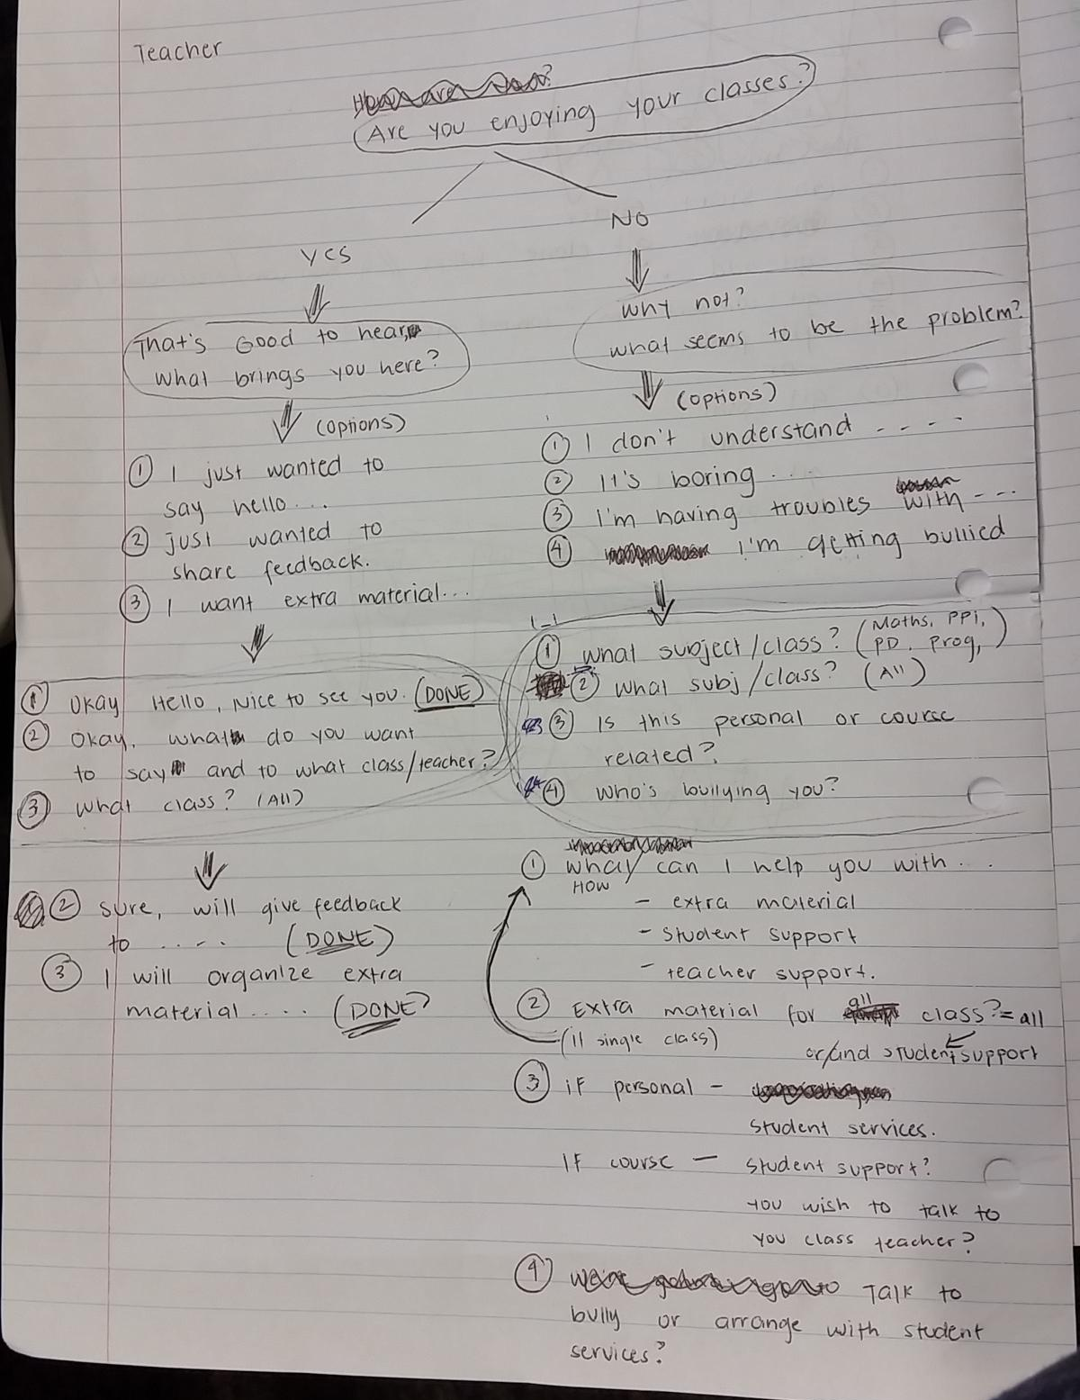
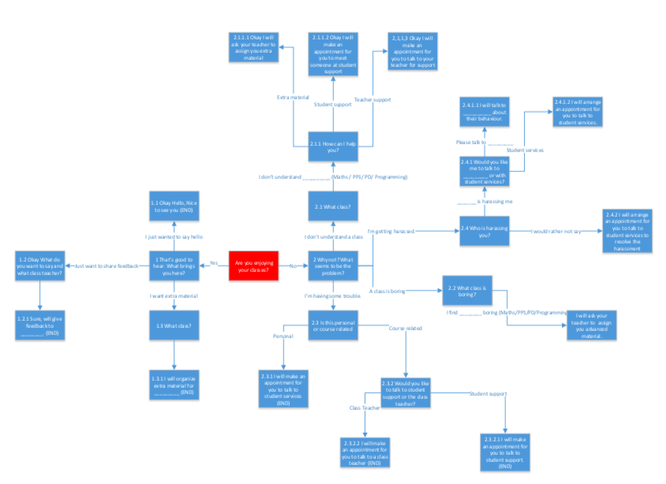
Planning

Slide 4
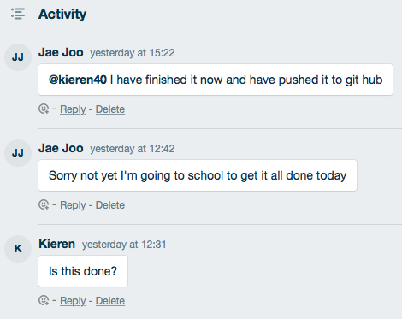
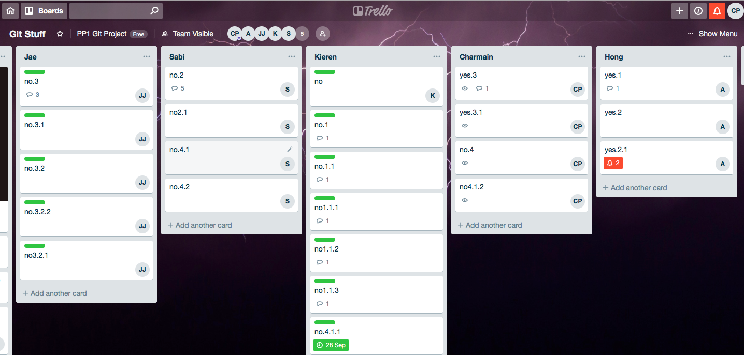
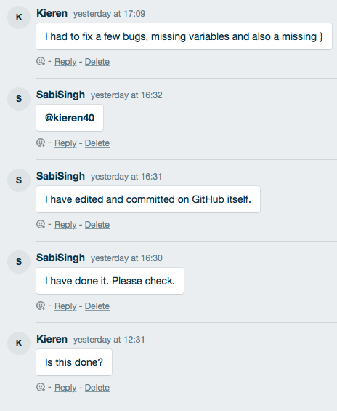
Communication & Collaboration Tools

Slide 5
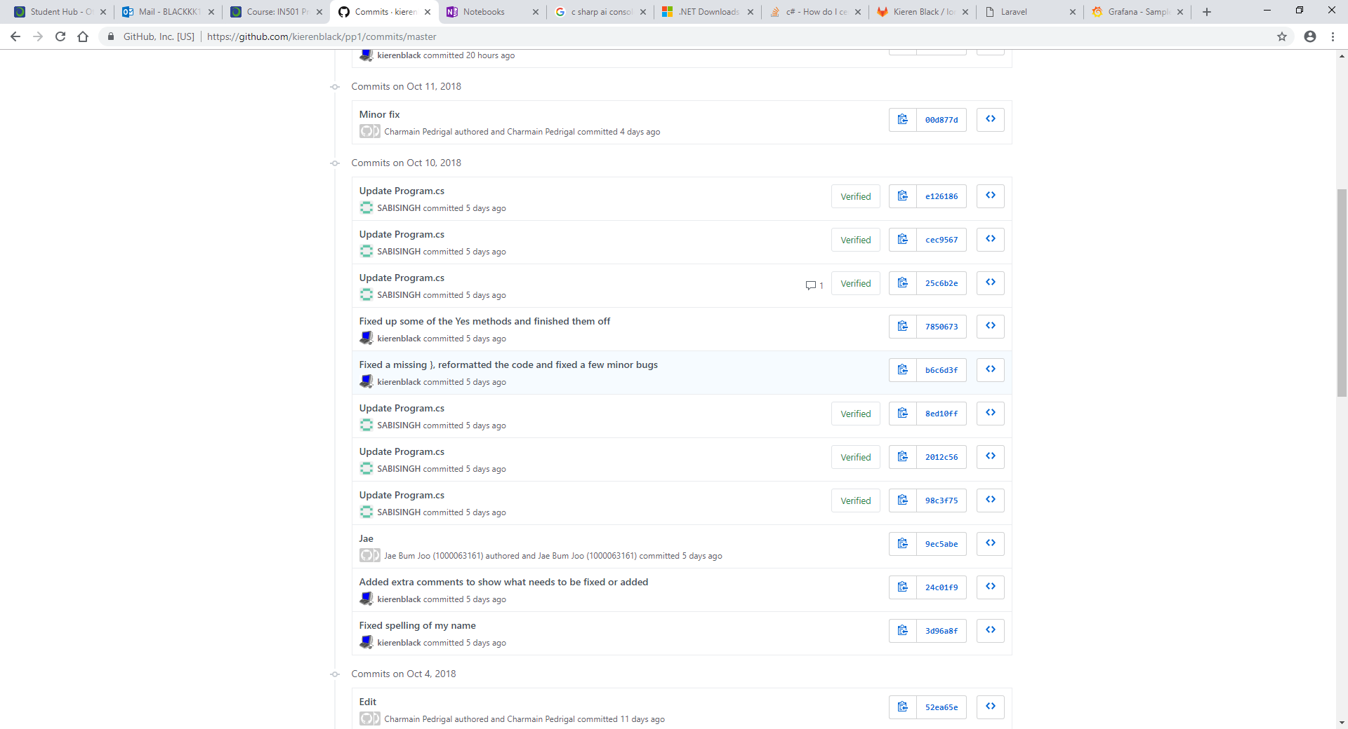
Programming

Slide 6
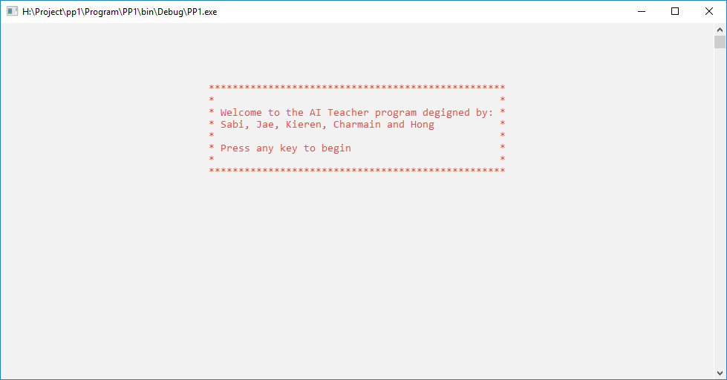
The program

Slide 7
What we could’ve improved
Time management
Meet together at the assigned time
Better communication within the team

