Slide 1

NLBSE'24 GitHub Issue Classification
Seminar 2 · AI for Software Engineering (AI4SE)
Pham Tuan Kiet · 20252751M
Nguyen Trung Hieu · 20261059M
Le Ngoc Anh · 20252275M
Nguyen Hoang Nam · 20261081M
Bui Tien Dung · 20261204M

Slide 2
Outline
I. Introduction
Problem and project objectives
II. Dataset
NLBSE'24 data and its challenges
III. Methodology
Model families, background, evaluation protocols, pipeline
IV. Experiments & Results
Baseline, lightweight models, RoBERTa, SetFit, comparison
V. Conclusion
Key findings, limitations, future work

Slide 3
Outline
I. Introduction
Problem and project objectives
II. Dataset
NLBSE'24 data and its challenges
III. Methodology
Model families, background, evaluation protocols, pipeline
IV. Experiments & Results
Baseline, lightweight models, RoBERTa, SetFit, comparison
V. Conclusion
Key findings, limitations, future work

Slide 4
Problem: GitHub Issue Classification
Maintainers need to classify issues before prioritizing and assigning them
Manual labeling is time-consuming and can be inconsistent
Issues contain a mix of text, code, stack traces, URLs, and versions
Each repository has its own terminology and templates
bug · incorrect behavior or defect
Issue
title + body
Classifier
→
→
feature · feature request
question · question or help request

Slide 5
Project Objectives
1. Model Comparison
From TF-IDF to dense encoders (RoBERTa, SetFit)
2. Multiple Evaluation Protocols
Repo-specific CV, Pooled CV, LOO, Official Test
3. Performance and Cost
Consider fitting time, inference time, and implementation complexity
Primary Metric: Macro-F1
Computed per repository and then averaged across 5 repositories; predictions are not pooled across repositories

Slide 6
Outline
I. Introduction
Problem and project objectives
II. Dataset
NLBSE'24 data and its challenges
III. Methodology
Model families, background, evaluation protocols, pipeline
IV. Experiments & Results
Baseline, lightweight models, RoBERTa, SetFit, comparison
V. Conclusion
Key findings, limitations, future work

Slide 7
Dataset NLBSE'24
1,500
training issues
Property | Value
Train / Test | 1,500 / 1,500 issue
Repositories | bitcoin, react, vscode, opencv, tensorflow
Labels | bug; feature; question
Class balance | 100 samples per label, per repository, per split
Input | title and body
1,500
official test issues
5 × 3 × 100
repositories × labels × samples per split

Slide 8
Dataset Challenges
Repository-specific language
Different templates and terminology
Hard to transfer to unseen repositories
Duplicate leakage
3 shared normalized keys between train and test
1 pair has conflicting labels
CV keeps identical texts in the same fold
Technical content
Code, paths, and version strings are retained
Because they may carry predictive signals
Label overlap
Questions can resemble both bugs and features
Feature requests may be phrased as questions
Highly skewed text length
Train median: 150 words; P95: 536 words
Train maximum: 21,595 words → truncation is required
Missing data
2 test bodies are missing → replaced with empty strings
Train has no missing bodies

Slide 9
Outline
I. Introduction
Problem and project objectives
II. Dataset
NLBSE'24 data and its challenges
III. Methodology
Model families, background, evaluation protocols, pipeline
IV. Experiments & Results
Baseline, lightweight models, RoBERTa, SetFit, comparison
V. Conclusion
Key findings, limitations, future work

Slide 10
Three Model Families
Sparse / Lightweight
TF-IDF + Logistic Regression (baseline)
LinearSVC: word, word + char
Complement NB, Hashed SGD
fastText
Evaluated under CV, LOO, and Official Test
RoBERTa
RoBERTa-base, max 160 tokens
Full fine-tuning
LoRA: low-rank adapters (r = 48)
Repo-specific CV and pooled CV
SetFit
Sentence encoder: MPNet, MiniLM
Few-shot k = 8 / 16 / 32
Contrastive iterations: 5–80
Data-size and iteration ablations
The same data and evaluation pipeline is used for all model families

Slide 11
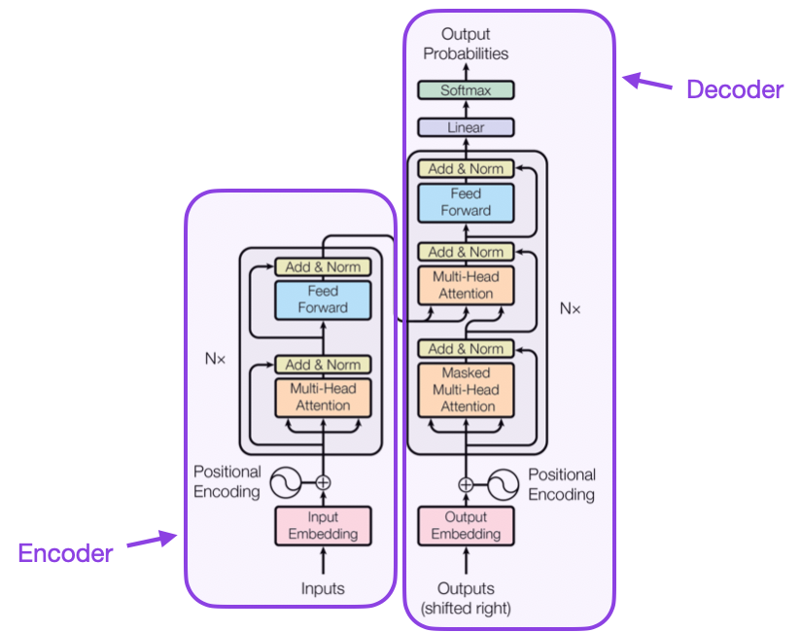
Background: Transformer and RoBERTa
Transformer encoder
Self-attention and multi-head attention
Positional information for token order
Feed-forward + residual + normalization
RoBERTa
Optimized BERT pretraining: removes Next Sentence Prediction
Dynamic masking and more pretraining data
Add a classification head and fine-tune on issue data
Fig. 2.1. Transformer architecture (Vaswani et al.)

Slide 12
LoRA and SetFit
LoRA: learn only low-rank updates
SetFit: two stages
x
W₀ (frozen)
Labeled issues
h
+
↓
B · A (trainable)
1. Contrastive fine-tune sentence encoder
↓
h = W₀x + BAx, with rank r ≪ matrix dimension
Configuration: rank 48, alpha 96, dropout 0.1
Reduces trainable parameters and memory usage
2. Embedding → classification head
↓
bug / feature / question

Slide 13
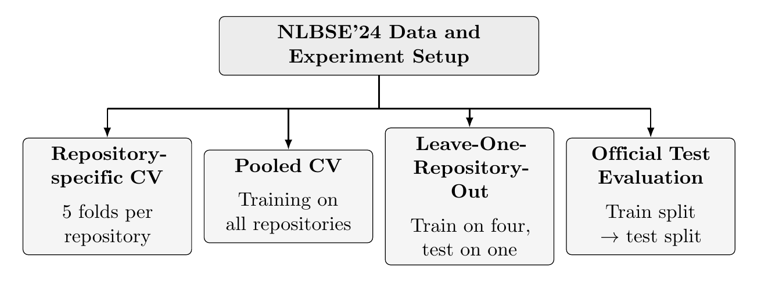
Four Evaluation Protocols
Repo-specific CV
5 folds per repository; duplicates stay in the same fold
Pooled CV
Train on the pooled training folds of all 5 repositories; held-out folds are used only for evaluation
LOO
Train on 1,200 official-train issues from 4 repositories; test on 300 issues from the held-out repository
Official Test
5 separate classifiers, each with 300 training / 300 test issues

Slide 14
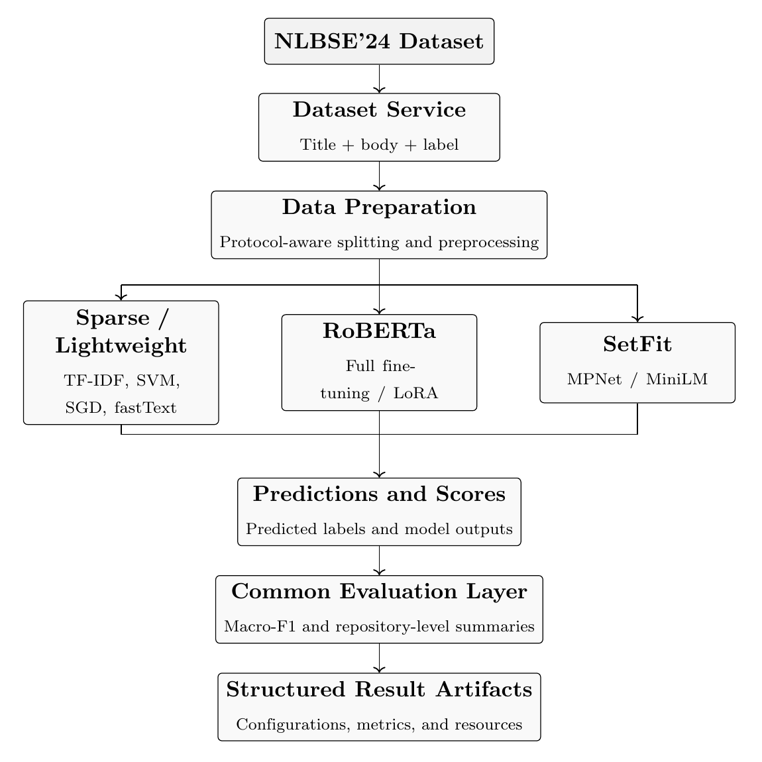
System Pipeline and Contributions
 | Member | Contribution
P1 | Pham Tuan Kiet | Leader, data, splits, LR
P2 | Nguyen Trung Hieu | Sparse models, fastText
P3 | Le Ngoc Anh | RoBERTa full / LoRA
P4 | Nguyen Hoang Nam | SetFit MPNet / MiniLM
P5 | Bui Tien Dung | Evaluation, ensemble, demo
The vectorizer is fitted only on the training partition to avoid leakage
Interchangeable storage: in-memory, CSV, JSON

Slide 15
Outline
I. Introduction
Problem and project objectives
II. Dataset
NLBSE'24 data and its challenges
III. Methodology
Model families, background, evaluation protocols, pipeline
IV. Experiments & Results
Baseline, lightweight models, RoBERTa, SetFit, comparison
V. Conclusion
Key findings, limitations, future work

Slide 16
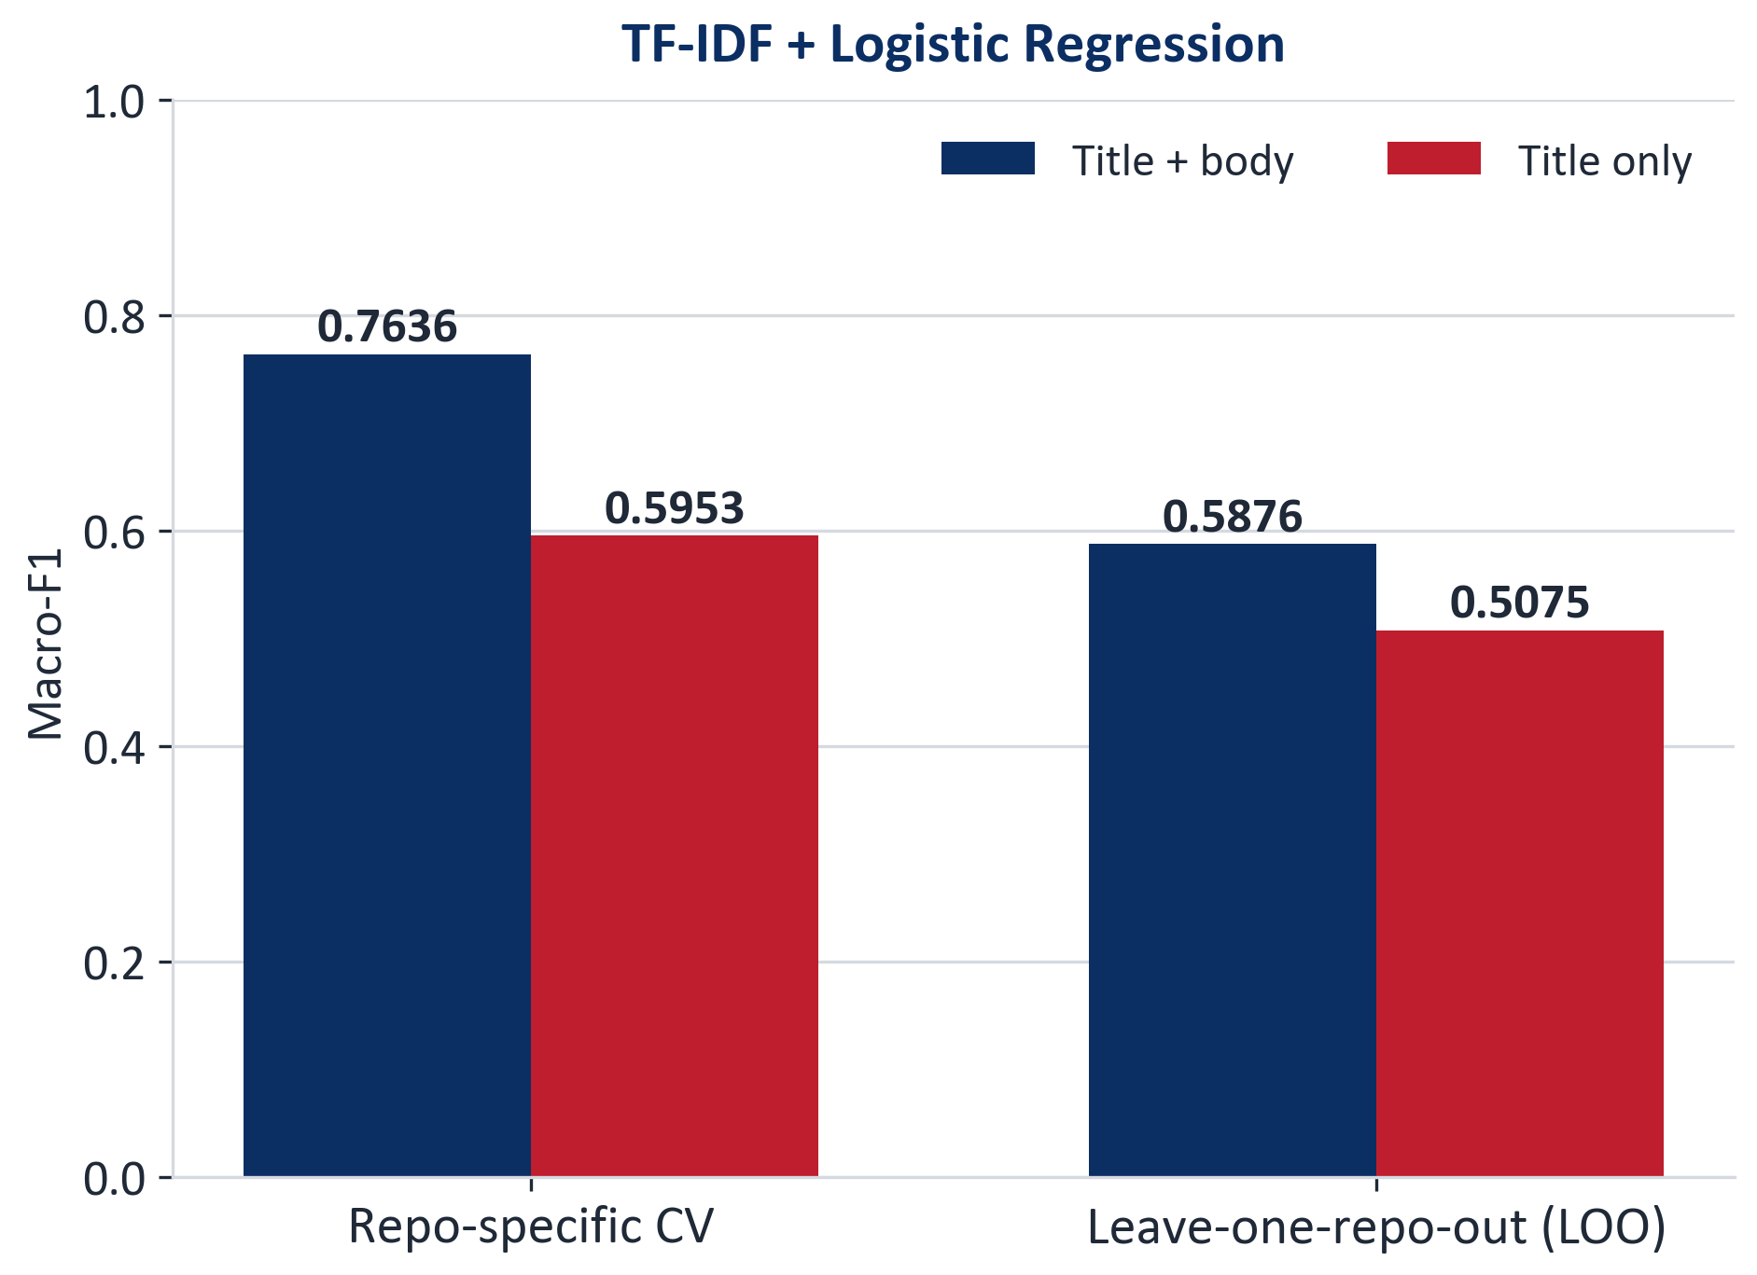
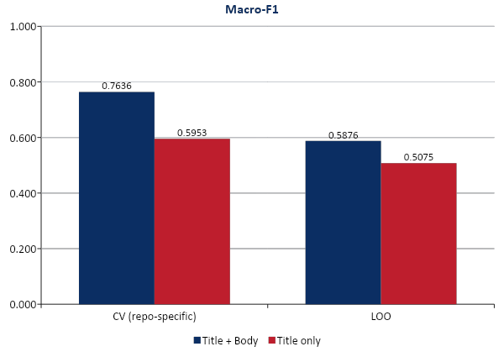
Baseline: TF-IDF + Logistic Regression
+0.0801
Title + body vs title only (LOO), paired bootstrap 95% CI [0.0484, 0.1120]
0.7636 → 0.5876
CV → LOO: unseen repositories are much harder (training data also changes)
Word 1–2 gram, min_df 2, 50,000 features, C = 4
Title-only is an ablation that removes the body
CI uses fixed predictions: excludes training variability and new-repository uncertainty

Slide 17
Lightweight Models
Model | CV | LOO | Official
Word LinearSVC | 0.7541 | 0.5898 | 0.7498
Word + Char LinearSVC | 0.7533 | 0.6003 | 0.7591
Hashed SGD | 0.7030 | 0.6152 | 0.7322
Supervised fastText | 0.7089 | 0.5384 | 0.6896
Complement NB | 0.7054 | 0.4904 | 0.7108
Word+Char beats Word-only on LOO and Official, but needs ~8.5× the fitting time and ~11.5× the inference time
Hashed SGD has the highest LOO score (0.6152) despite a CV score of only 0.7030
Model ranking changes across protocols; each score must be reported with its protocol

Slide 18
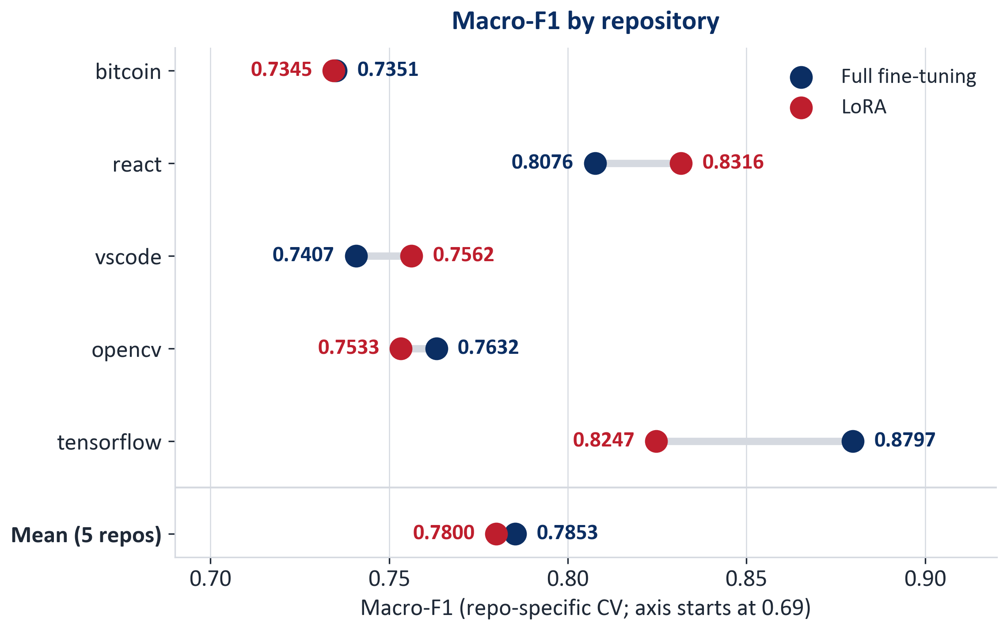
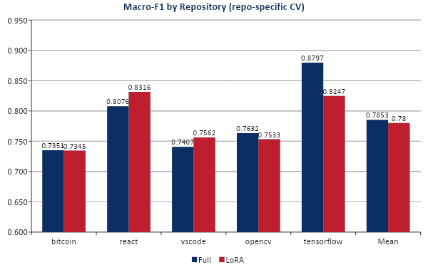
RoBERTa: Full fine-tuning vs LoRA
Repo-specific CV mean: Full 0.7853, LoRA 0.7800 (LoRA − Full = −0.0052)
LoRA − Full by repository: React +0.0240, VS Code +0.0155, TensorFlow −0.0550
Pooled CV (reported separately): Full 0.7924, LoRA 0.7994
The two training recipes differ, so the difference cannot be attributed solely to the adapter mechanism

Slide 19
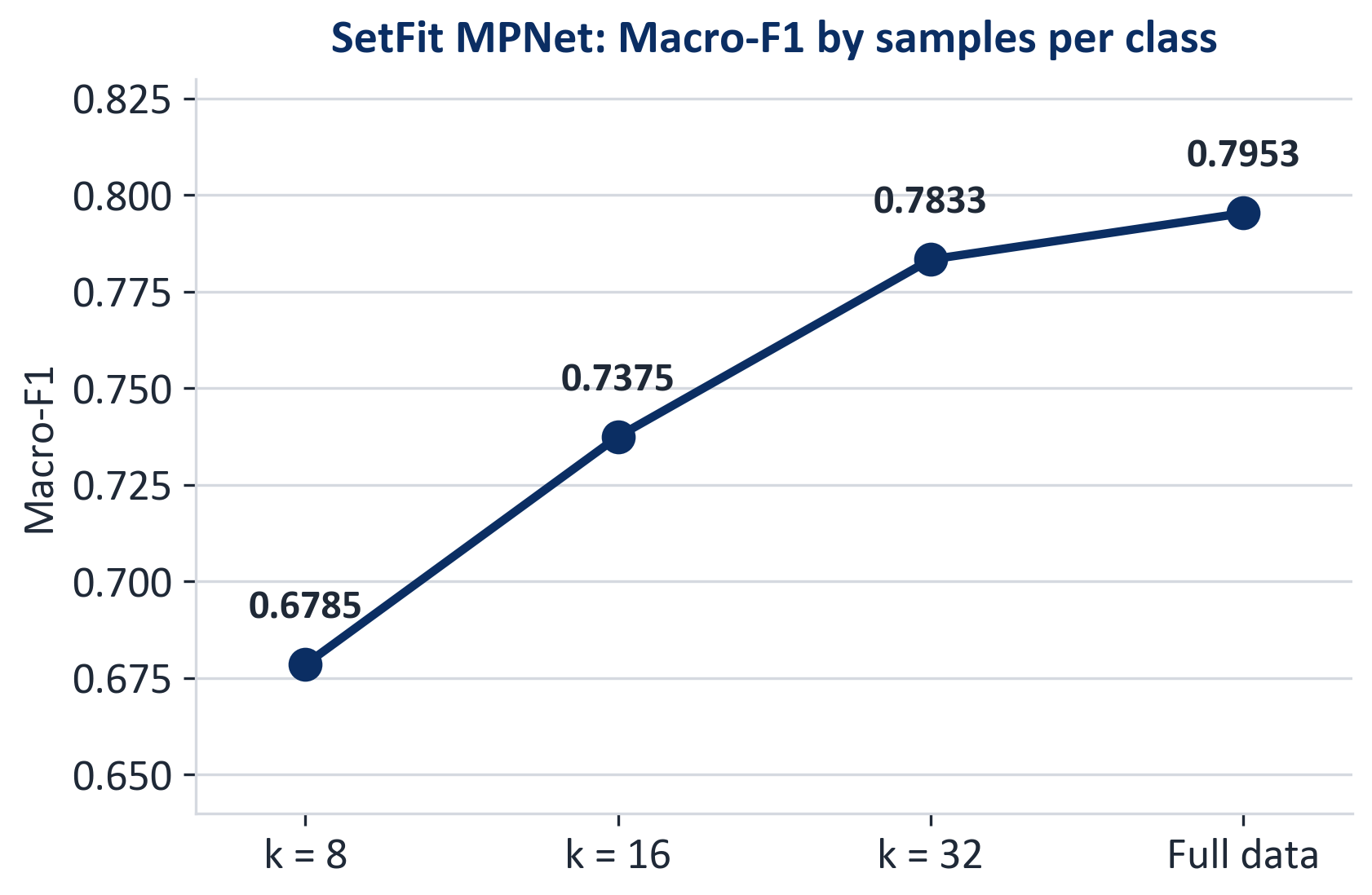
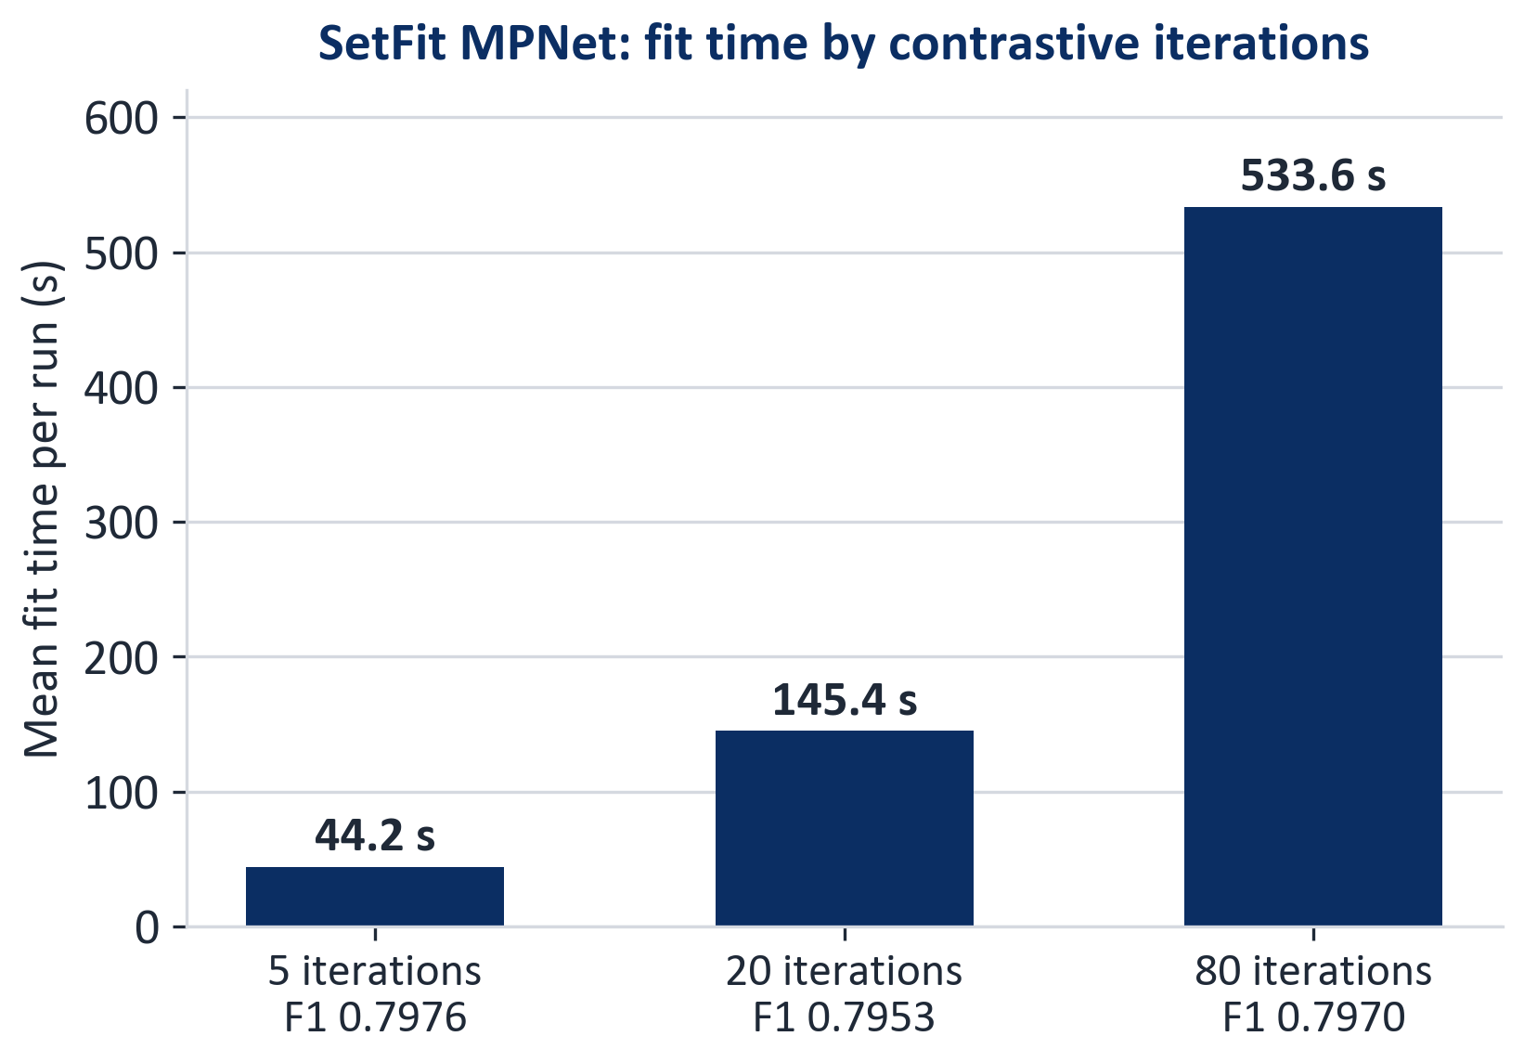
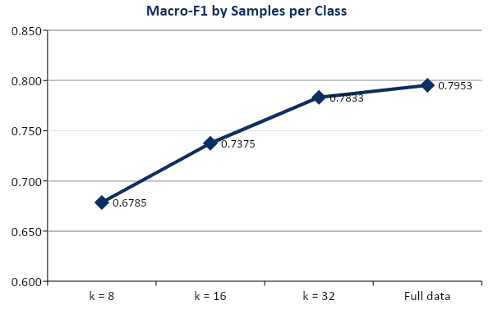
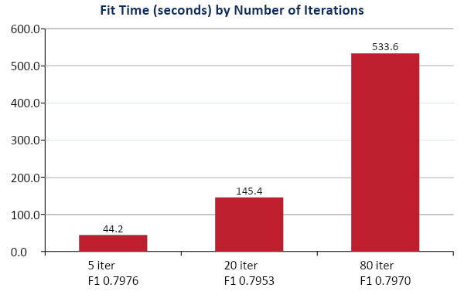
SetFit: Data Size and Contrastive Iterations
MPNet reaches 0.7953 vs MiniLM 0.7881, but MiniLM fits faster: 55.1 s vs 145.4 s (mean per run)
Fewer labeled samples clearly reduce performance; 5 iterations are nearly as good as 80 (0.7976 vs 0.7970) at ~12× lower fit time

Slide 20
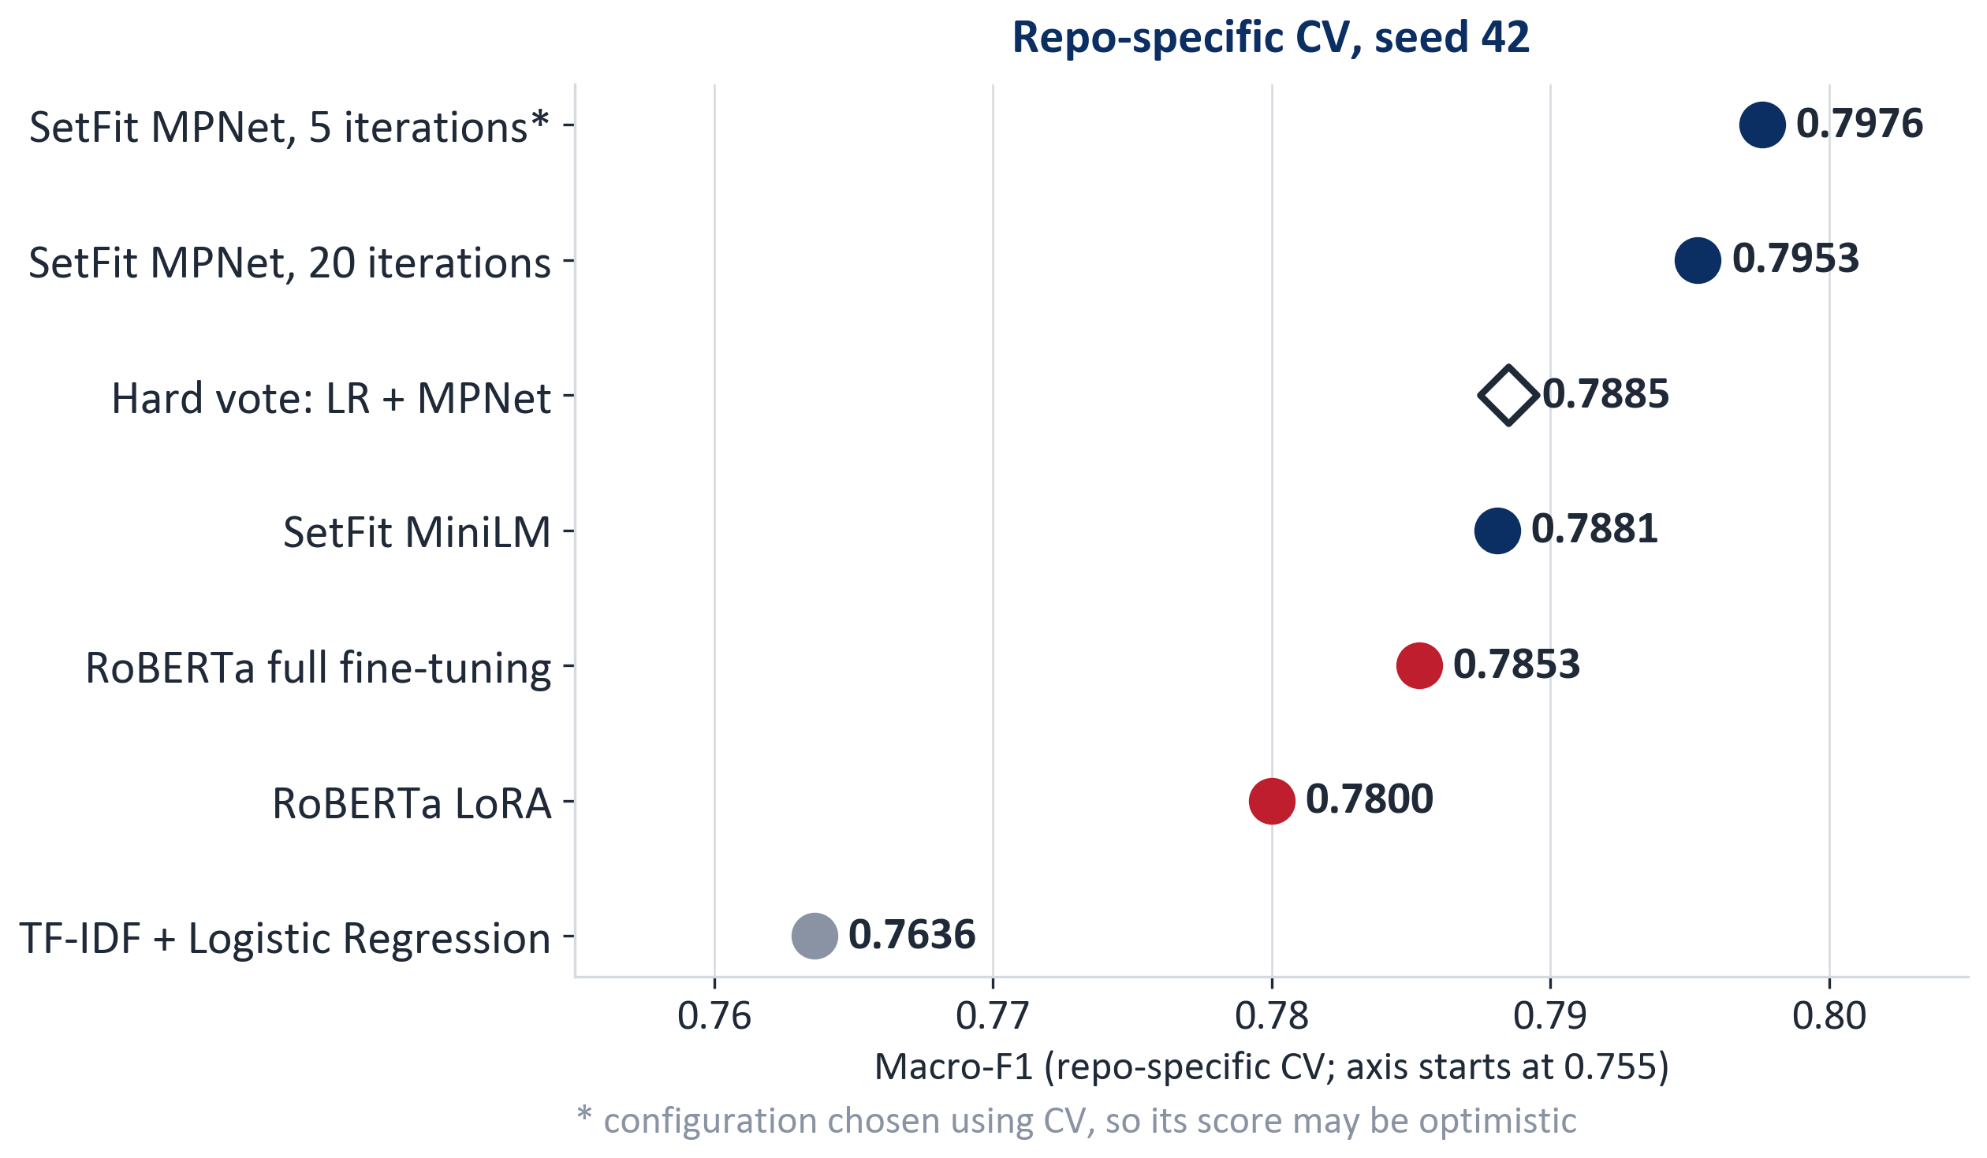
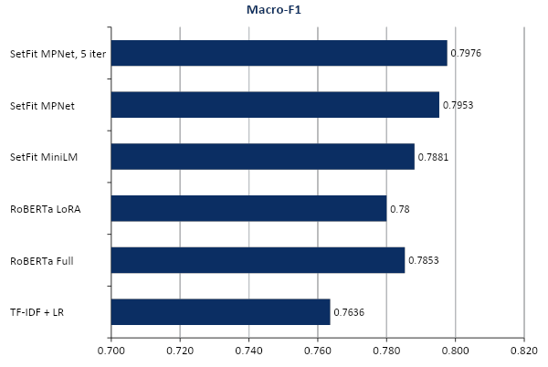
Overall Comparison (repo-specific CV)
+0.0317
MPNet − LR, paired bootstrap 95% CI [0.0085, 0.0557]
0.7885
Hard vote of LR + MPNet is below MPNet alone (0.7953)
CIs condition on fixed predictions: no training variability, no new-repository uncertainty
Pooled CV is reported separately: LoRA 0.7994, Full 0.7924
Do not rank results across different protocols

Slide 21
Outline
I. Introduction
Problem and project objectives
II. Dataset
NLBSE'24 data and its challenges
III. Methodology
Model families, background, evaluation protocols, pipeline
IV. Experiments & Results
Baseline, lightweight models, RoBERTa, SetFit, comparison
V. Conclusion
Key findings, limitations, future work

Slide 22
Conclusion
Key Findings
The body is more informative than the title; transfer to unseen repositories is difficult (LR: 0.7636 CV → 0.5876 LOO)
Dense models achieve the strongest CV results (SetFit MPNet 0.7953 vs LR 0.7636), but the gains are moderate; sparse models remain suitable when simplicity and low cost matter
A hard-vote ensemble of LR + MPNet (0.7885) does not outperform MPNet alone
Limitations
Seed counts differ across model families, and configurations were selected on CV, so CV scores may be optimistic
Hardware and measurement conditions are not documented, so cost results are descriptive, not a controlled Pareto comparison
Future Work
Evaluate more pretrained models under LOO with consistent repeated seeds
Benchmark cost on one documented hardware setup and extend class-level error analysis beyond Logistic Regression

Slide 23
THANK YOU !

