Slide 1

NLBSE'24 GitHub Issue Classification
Seminar 2 · AI for Software Engineering (AI4SE)
Pham Tuan Kiet · 20252751M
Nguyen Trung Hieu · 20261059M
Le Ngoc Anh · 20252275M
Nguyen Hoang Nam · 20261081M
Bui Tien Dung · 20261204M
Notes:
[Slide 1 - Title] Time: about 30 s.
Good morning, everyone. We are presenting our Seminar 2 project: automatic classification of GitHub issues on the NLBSE'24 dataset.
Our group has five members, and each of us owns one part of the study: the shared data and evaluation pipeline with the Logistic Regression baseline, the sparse and fastText models, RoBERTa with full fine-tuning and LoRA, SetFit, and finally the evaluation, bootstrap and ensemble tools.
In the next few minutes we will go through the problem, the data, the models and evaluation protocols, the results, and, just as importantly, what these results do and do not allow us to conclude.

Slide 2
Outline
I. Introduction
Problem and project objectives
II. Dataset
NLBSE'24 data and its challenges
III. Methodology
Model families, background, evaluation protocols, pipeline
IV. Experiments & Results
Baseline, lightweight models, RoBERTa, SetFit, comparison
V. Conclusion
Key findings, limitations, future work
Notes:
[Slide 2 - Outline] Time: about 15 s.
Here is the outline. Five parts: the introduction, the dataset, the methodology, the experiments and results, and the conclusion. We will keep a progress marker on the left so you always know where we are.

Slide 3
Outline
I. Introduction
Problem and project objectives
II. Dataset
NLBSE'24 data and its challenges
III. Methodology
Model families, background, evaluation protocols, pipeline
IV. Experiments & Results
Baseline, lightweight models, RoBERTa, SetFit, comparison
V. Conclusion
Key findings, limitations, future work
Notes:
[Slide 3 - Outline - Introduction] Time: about 5 s.
We start with the introduction: the problem and our objectives.

Slide 4
Problem: GitHub Issue Classification
Maintainers need to classify issues before prioritizing and assigning them
Manual labeling is time-consuming and can be inconsistent
Issues contain a mix of text, code, stack traces, URLs, and versions
Each repository has its own terminology and templates
bug · incorrect behavior or defect
Issue
title + body
Classifier
→
→
feature · feature request
question · question or help request
Notes:
[Slide 4 - Problem: GitHub Issue Classification] Time: about 50 s.
Maintainers of an open-source project receive a constant stream of issues. Before they can prioritize or assign an issue, somebody has to decide what kind of issue it is. Doing this by hand is slow and can be inconsistent between people.
The task is also not trivial for a classifier. An issue is free text that mixes natural language with code snippets, stack traces, URLs and version numbers. And every repository has its own vocabulary and its own issue templates.
So the task we study is simple to state: given the title and the body of an issue, predict one of three labels. Bug, an incorrect behavior or defect. Feature, a feature request. Question, a question or request for help.

Slide 5
Project Objectives
1. Model Comparison
From TF-IDF to dense encoders (RoBERTa, SetFit)
2. Multiple Evaluation Protocols
Repo-specific CV, Pooled CV, LOO, Official Test
3. Performance and Cost
Consider fitting time, inference time, and implementation complexity
Primary Metric: Macro-F1
Computed per repository and then averaged across 5 repositories; predictions are not pooled across repositories
‹#›
Notes:
[Slide 5 - Project Objectives] Time: about 60 s.
We set three objectives.
First, model comparison. We go from classical TF-IDF models up to dense encoders, namely RoBERTa and SetFit, and ask how much the extra complexity actually buys us.
Second, multiple evaluation protocols. We use repository-specific cross-validation, pooled cross-validation, leave-one-repository-out and the official test split. These protocols answer different questions, and one of our main messages is that scores from different protocols must not be mixed in a single ranking.
Third, performance and cost. Besides accuracy we look at fitting time, inference time and implementation complexity.
Our primary metric is Macro-F1. We compute it for each repository and then average over the five repositories, so every repository has the same weight. We do not pool predictions across repositories.

Slide 6
Outline
I. Introduction
Problem and project objectives
II. Dataset
NLBSE'24 data and its challenges
III. Methodology
Model families, background, evaluation protocols, pipeline
IV. Experiments & Results
Baseline, lightweight models, RoBERTa, SetFit, comparison
V. Conclusion
Key findings, limitations, future work
Notes:
[Slide 6 - Outline - Dataset] Time: about 5 s.
Next, the dataset.

Slide 7
Dataset NLBSE'24
1,500
training issues
Property | Value
Train / Test | 1,500 / 1,500 issue
Repositories | bitcoin, react, vscode, opencv, tensorflow
Labels | bug; feature; question
Class balance | 100 samples per label, per repository, per split
Input | title and body
1,500
official test issues
5 × 3 × 100
repositories × labels × samples per split
‹#›
Notes:
[Slide 7 - Dataset NLBSE'24] Time: about 50 s.
We use the NLBSE'24 issue report classification dataset. It contains 1,500 training issues and 1,500 official test issues from five repositories: bitcoin, react, vscode, opencv and tensorflow.
The data is perfectly balanced by design. For each repository, each label and each split there are exactly 100 issues. That gives 5 repositories times 3 labels times 100 issues, which is 1,500 issues per split, or 300 per repository.
The model input is the title and the body of the issue. An important rule of our protocol: the official test split is kept for official evaluation, and we never use test labels for model selection. All tuning and model selection use training data only.

Slide 8
Dataset Challenges
Repository-specific language
Different templates and terminology
Hard to transfer to unseen repositories
Duplicate leakage
3 shared normalized keys between train and test
1 pair has conflicting labels
CV keeps identical texts in the same fold
Technical content
Code, paths, and version strings are retained
Because they may carry predictive signals
Label overlap
Questions can resemble both bugs and features
Feature requests may be phrased as questions
Highly skewed text length
Train median: 150 words; P95: 536 words
Train maximum: 21,595 words → truncation is required
Missing data
2 test bodies are missing → replaced with empty strings
Train has no missing bodies
‹#›
Notes:
[Slide 8 - Dataset Challenges] Time: about 75 s.
The data audit revealed six challenges.
Repository-specific language: templates and terminology differ, which makes transfer to unseen repositories hard.
Duplicate leakage: three normalized title-plus-body keys are shared between train and test, and one of these pairs has conflicting labels. For comparability we keep the official split unchanged, and we do not claim any de-duplicated score. Inside our own cross-validation, identical texts are always kept in the same fold, so duplicates cannot leak between training and validation.
Technical content: code, paths and version strings are retained, because they can carry predictive signal.
Label overlap: a question can look like a bug report, and a feature request can be phrased as a question.
Text length is very skewed: in the training set the median is 150 words, the 95th percentile is 536 words and the maximum is 21,595 words. So truncation is required for the neural models.
Finally, missing data: two test bodies are missing and are replaced by empty strings. The training set has no missing bodies.

Slide 9
Outline
I. Introduction
Problem and project objectives
II. Dataset
NLBSE'24 data and its challenges
III. Methodology
Model families, background, evaluation protocols, pipeline
IV. Experiments & Results
Baseline, lightweight models, RoBERTa, SetFit, comparison
V. Conclusion
Key findings, limitations, future work
Notes:
[Slide 9 - Outline - Methodology] Time: about 5 s.
Now the methodology: the model families, some background, the evaluation protocols and the pipeline.

Slide 10
Three Model Families
Sparse / Lightweight
TF-IDF + Logistic Regression (baseline)
LinearSVC: word, word + char
Complement NB, Hashed SGD
fastText
Evaluated under all four protocols
RoBERTa
RoBERTa-base, max 160 tokens
Full fine-tuning
LoRA: low-rank adapters (r = 48)
Evaluated under all four protocols
SetFit
Sentence encoder: MPNet, MiniLM
Few-shot k = 8 / 16 / 32
Contrastive iterations: 5–80
CV, LOO and official test; pooled CV (MiniLM); ablations on data size and iterations
The same data and evaluation pipeline is used for all model families
‹#›
Notes:
[Slide 10 - Three Model Families] Time: about 45 s.
We compare three families of models.
The sparse or lightweight family is built on TF-IDF features. TF-IDF with Logistic Regression is our baseline. We also have LinearSVC with word features and with word plus character n-grams, Complement Naive Bayes, a hashed SGD classifier and supervised fastText. All of them are evaluated under all four protocols: repository-specific cross-validation, pooled cross-validation, leave-one-repository-out and the official test.
The second family is RoBERTa-base with a maximum of 160 tokens. We train it with full fine-tuning and with LoRA adapters of rank 48, and it is also evaluated under all four protocols.
The third family is SetFit, with MPNet and MiniLM sentence encoders. It is a few-shot method, so we study 8, 16 and 32 examples per class and between 5 and 80 contrastive iterations. SetFit was evaluated under cross-validation, leave-one-repository-out and the official test, and MiniLM also under pooled cross-validation.
All three families use exactly the same data and evaluation pipeline.

Slide 11
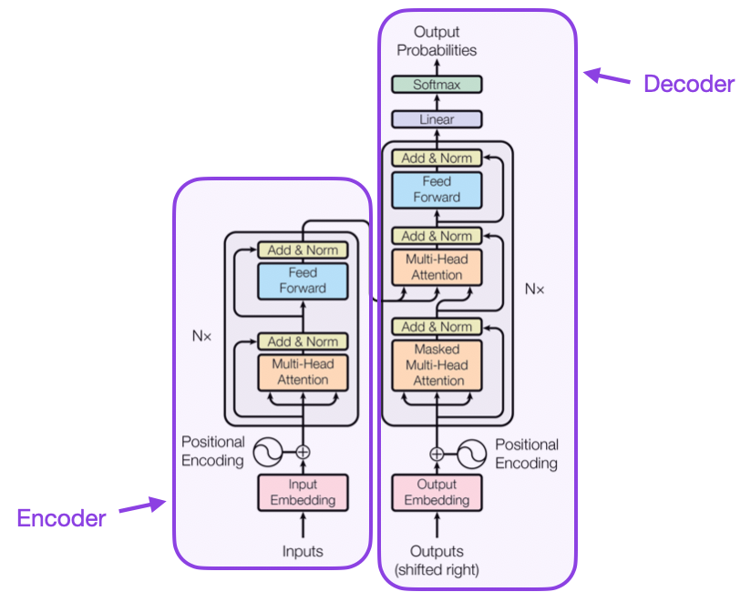
Background: Transformer and RoBERTa
Transformer encoder
Self-attention and multi-head attention
Positional information for token order
Feed-forward + residual + normalization
RoBERTa
Optimized BERT pretraining: removes Next Sentence Prediction
Dynamic masking and more pretraining data
Add a classification head and fine-tune on issue data
Fig. 2.1. Transformer architecture (Vaswani et al.)
‹#›
Notes:
[Slide 11 - Background: Transformer and RoBERTa] Time: about 50 s.
A short background on the neural models. A Transformer encoder is built from self-attention and multi-head attention, positional information so the model knows the order of tokens, and feed-forward layers with residual connections and normalization.
RoBERTa is a Transformer encoder with an optimized BERT pretraining recipe. It removes the next-sentence-prediction task, uses dynamic masking and is trained on much more data.
For our task we add a classification head on top of the encoder and fine-tune the whole model on the issue data. In full fine-tuning both the encoder and the head are updated.

Slide 12
LoRA and SetFit
LoRA: learn only low-rank updates
SetFit: two stages
W₀ (frozen)
Labeled issues
x
+
h
↓
B · A (trainable)
1. Contrastive fine-tune sentence encoder
h = W₀x + BAx, with rank r ≪ matrix dimension
Configuration: rank 48, alpha 96, dropout 0.1
Reduces trainable parameters and memory usage
↓
2. Embedding → classification head
↓
bug / feature / question
‹#›
Notes:
[Slide 12 - LoRA and SetFit] Time: about 70 s.
On the left, LoRA. Instead of updating the large pretrained weight matrix W-zero, LoRA keeps it frozen and learns a small low-rank update, the product B times A. The output is h equals W-zero x plus B A x, with a rank much smaller than the matrix dimension. In our configuration the rank is 48, alpha is 96 and dropout is 0.1. This reduces the number of trainable parameters and the memory needed for adaptation.
On the right, SetFit works in two stages. First, the sentence encoder is fine-tuned with a contrastive objective on pairs built from the labeled issues. Second, the resulting embeddings are fed to a simple classification head that predicts bug, feature or question. Because pairs can be built from few examples, SetFit is attractive when labeled data is scarce.

Slide 13
Four Evaluation Protocols
Train
Evaluate (held out)
bitcoin
bitcoin
bitcoin
bitcoin
react
react
react
react
vscode
vscode
vscode
vscode
opencv
opencv
opencv
held out
opencv
tensorflow
tensorflow
tensorflow
tensorflow
5 models, one per repository
1 model on all repositories
5 runs, one held-out repository each
5 models, one per repository
Repo-specific CV
5 folds per repository; duplicates stay in the same fold
Pooled CV
Train on the pooled training folds of all 5 repositories; held-out folds are used only for evaluation
LOO
Train on 1,200 official-train issues from 4 repositories; test on 300 issues from the held-out repository
Official Test
5 separate classifiers, each with 300 training / 300 test issues
‹#›
Notes:
[Slide 13 - Four Evaluation Protocols] Time: about 90 s.
This slide is central to the whole report. In every diagram, navy means training data and red means data used for evaluation.
Repository-specific cross-validation: for every repository we run 5-fold cross-validation, so each repository has its own models. Duplicate texts always stay in the same fold.
Pooled cross-validation: the training folds of all five repositories are combined to train one model, and it is evaluated on the held-out folds only. We ran this protocol for Logistic Regression, the sparse models and RoBERTa, but not for SetFit.
Leave-one-repository-out, or LOO: we train on 1,200 issues from four repositories and test on the 300 issues of the held-out repository. This is repeated five times and measures transfer to a repository the model has never seen. Both the training and the evaluation issues come from the official training split.
Official test: five separate classifiers, one per repository, each trained on its 300 official training issues and evaluated on its 300 official test issues.
The key message: these four protocols answer four different questions, so their scores must stay separated.

Slide 14
System Pipeline and Contributions
NLBSE’24 dataset
1,500 train + 1,500 official test issues
 | Member | Contribution
P1 | Pham Tuan Kiet | Leader, data, splits, LR
P2 | Nguyen Trung Hieu | Sparse models, fastText
P3 | Le Ngoc Anh | RoBERTa full / LoRA
P4 | Nguyen Hoang Nam | SetFit MPNet / MiniLM
P5 | Bui Tien Dung | Evaluation, ensemble, demo
Dataset service
title + body + label
Data preparation
protocol-aware splits, preprocessing
Sparse
TF-IDF models, fastText
RoBERTa
full / LoRA
SetFit
MPNet / MiniLM
Predictions and scores
predicted labels, model outputs
Common evaluation layer
Macro-F1, repository-level summaries
The vectorizer is fitted only on the training partition to avoid leakage
Interchangeable storage: in-memory, CSV, JSON
Structured result artifacts
configuration, metrics, resources
‹#›
Notes:
[Slide 14 - System Pipeline and Contributions] Time: about 70 s.
This is our shared pipeline. A dataset service loads title, body and label. A data-preparation step creates the protocol-aware splits. Then the three model families plug into the same interface and produce predictions and scores. A common evaluation layer computes Macro-F1 and repository-level summaries, and everything is saved as structured result artifacts with configuration, metrics and resources.
Two design points. First, the vectorizer is fitted only on the training partition, which avoids leakage. Second, the storage is interchangeable: the dataset service talks to an abstract repository, with in-memory, CSV and JSON implementations, so we can change persistence without touching the models or the evaluation.
On the right, the contributions. P1, Kiet, leads the project and built the data layer, the splits and the Logistic Regression baseline. P2, Hieu, built the sparse models and fastText. P3, Anh, did RoBERTa full fine-tuning and LoRA. P4, Nam, did SetFit with MPNet and MiniLM. P5, Dung, built the evaluation, ensemble and demo tools.

Slide 15
Outline
I. Introduction
Problem and project objectives
II. Dataset
NLBSE'24 data and its challenges
III. Methodology
Model families, background, evaluation protocols, pipeline
IV. Experiments & Results
Baseline, lightweight models, RoBERTa, SetFit, comparison
V. Conclusion
Key findings, limitations, future work
Notes:
[Slide 15 - Outline - Experiments & Results] Time: about 5 s.
Now the experiments and results, starting with the baseline.

Slide 16
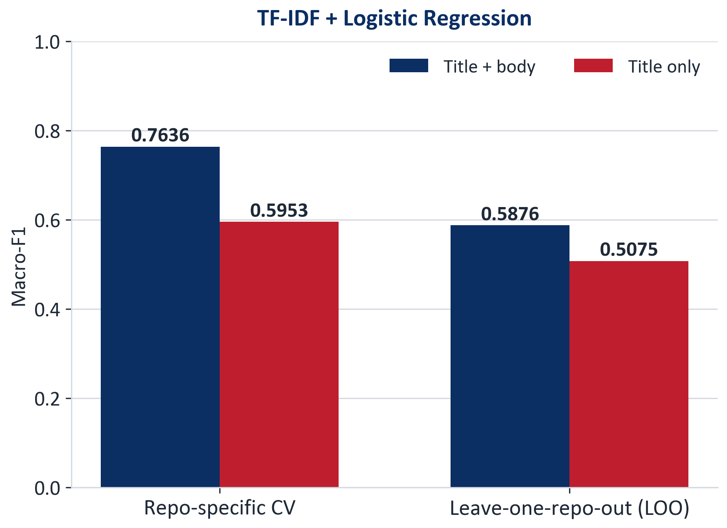
Baseline: TF-IDF + Logistic Regression
+0.0801
Title + body vs title only (LOO), paired bootstrap 95% CI [0.0484, 0.1120]
0.7636 → 0.5876
CV → LOO: unseen repositories are much harder (training data also changes)
Word 1–2 gram, min_df 2, 50,000 features, C = 4
Title-only is an ablation that removes the body
CI uses fixed predictions: excludes training variability and new-repository uncertainty
‹#›
Notes:
[Slide 16 - Baseline: TF-IDF + Logistic Regression] Time: about 90 s.
Our baseline is TF-IDF with Logistic Regression: word one-to-two-grams, minimum document frequency 2, up to 50,000 features and C equal to 4.
Using title plus body, it reaches a Macro-F1 of 0.7636 under repository-specific cross-validation. If we use the title only, the score falls to 0.5953. So the body carries a lot of information.
The same pattern appears under LOO: 0.5876 with title plus body, 0.5075 with title only. The difference is plus 0.0801, with a 95 percent bootstrap interval from 0.0484 to 0.1120, which does not contain zero. The gain is largest for the bug class, about 0.106 in F1.
A caution on that interval: it comes from a paired bootstrap on fixed predictions. It reflects the sampling of evaluation issues, but not the variability of training and not the uncertainty about new repositories.
Second message: going from cross-validation to LOO, the score drops from 0.7636 to 0.5876. Unseen repositories are much harder. We should be careful, though: LOO also changes the amount and composition of the training data, so we do not interpret the drop as a purely causal domain-shift effect.

Slide 17
Lightweight Models
Model | CV | LOO | Official
Word LinearSVC | 0.7541 | 0.5898 | 0.7498
Word + Char LinearSVC | 0.7533 | 0.6003 | 0.7591
Hashed SGD | 0.7030 | 0.6152 | 0.7322
Supervised fastText | 0.7089 | 0.5384 | 0.6896
Complement NB | 0.7054 | 0.4904 | 0.7108
Word+Char beats Word-only on LOO and Official, but needs ~8.5× the fitting time and ~11.5× the inference time
Hashed SGD has the highest LOO score (0.6152) despite a CV score of only 0.7030
Model ranking changes across protocols; each score must be reported with its protocol
Bold red = best in column (Macro-F1, seed 42)
‹#›
Notes:
[Slide 17 - Lightweight Models] Time: about 80 s.
Now the lightweight models. The table shows five models under three protocols: cross-validation, LOO and the official test. The best value in each column is in bold red.
Under cross-validation the best is word LinearSVC with 0.7541. Under LOO the best is hashed SGD with 0.6152, even though its cross-validation score is only 0.7030. Under the official test the best is word-plus-character LinearSVC with 0.7591.
So the ranking changes with the protocol. That is why every score must be reported together with its protocol.
On cost: adding character n-grams gives only a small and inconsistent gain over word-only features, but it needs roughly 8.5 times the fitting time and 11.5 times the inference time. All five frozen configurations were checked against the original run artifacts, more than 1,300 runs in total, and the official scores match.

Slide 18
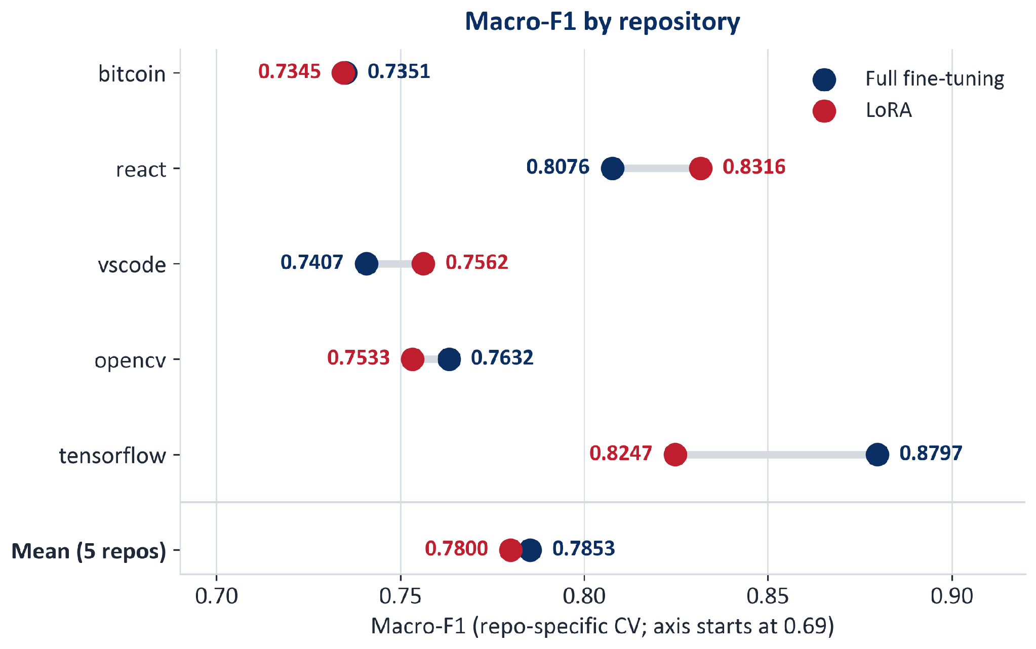
RoBERTa: Full fine-tuning vs LoRA
Repo-specific CV mean: Full 0.7853, LoRA 0.7800 (LoRA − Full = −0.0052)
LoRA − Full by repository: React +0.0240, VS Code +0.0155, TensorFlow −0.0550
Other protocols (Full / LoRA): pooled CV 0.7924 / 0.7994, LOO 0.6867 / 0.6896, official 0.8033 / 0.7937
The two training recipes differ, so differences cannot be attributed solely to the adapter mechanism
‹#›
Notes:
[Slide 18 - RoBERTa: Full fine-tuning vs LoRA] Time: about 100 s.
Now the RoBERTa results. Under repository-specific cross-validation the mean Macro-F1 is 0.7853 for full fine-tuning and 0.7800 for LoRA, so on average they are very close.
But the average hides a lot of variation. LoRA is better on react, by 0.0240, and on vscode, by 0.0155. Full fine-tuning is clearly better on tensorflow, where LoRA is lower by 0.0550. On bitcoin and opencv the two are almost equal. So the effect of the adaptation strategy is not consistent across repositories.
We also ran RoBERTa under the other three protocols. Under pooled cross-validation, LoRA reaches 0.7994 and full fine-tuning 0.7924. Under leave-one-repository-out, on repositories the model has never seen, the scores are 0.6867 for full fine-tuning and 0.6896 for LoRA, which is far above the sparse models. On the official test, full fine-tuning reaches 0.8033 and LoRA 0.7937. The official setting trains on all 300 issues of a repository, 25 percent more than a cross-validation fold, which partly explains why the scores are higher than under cross-validation. We report each protocol separately and never rank across them.
Finally, the two training recipes differ: full fine-tuning uses a learning rate of 2e-5 and LoRA 3e-4, with different weight decay. So we cannot attribute the differences only to the adapter mechanism.

Slide 19
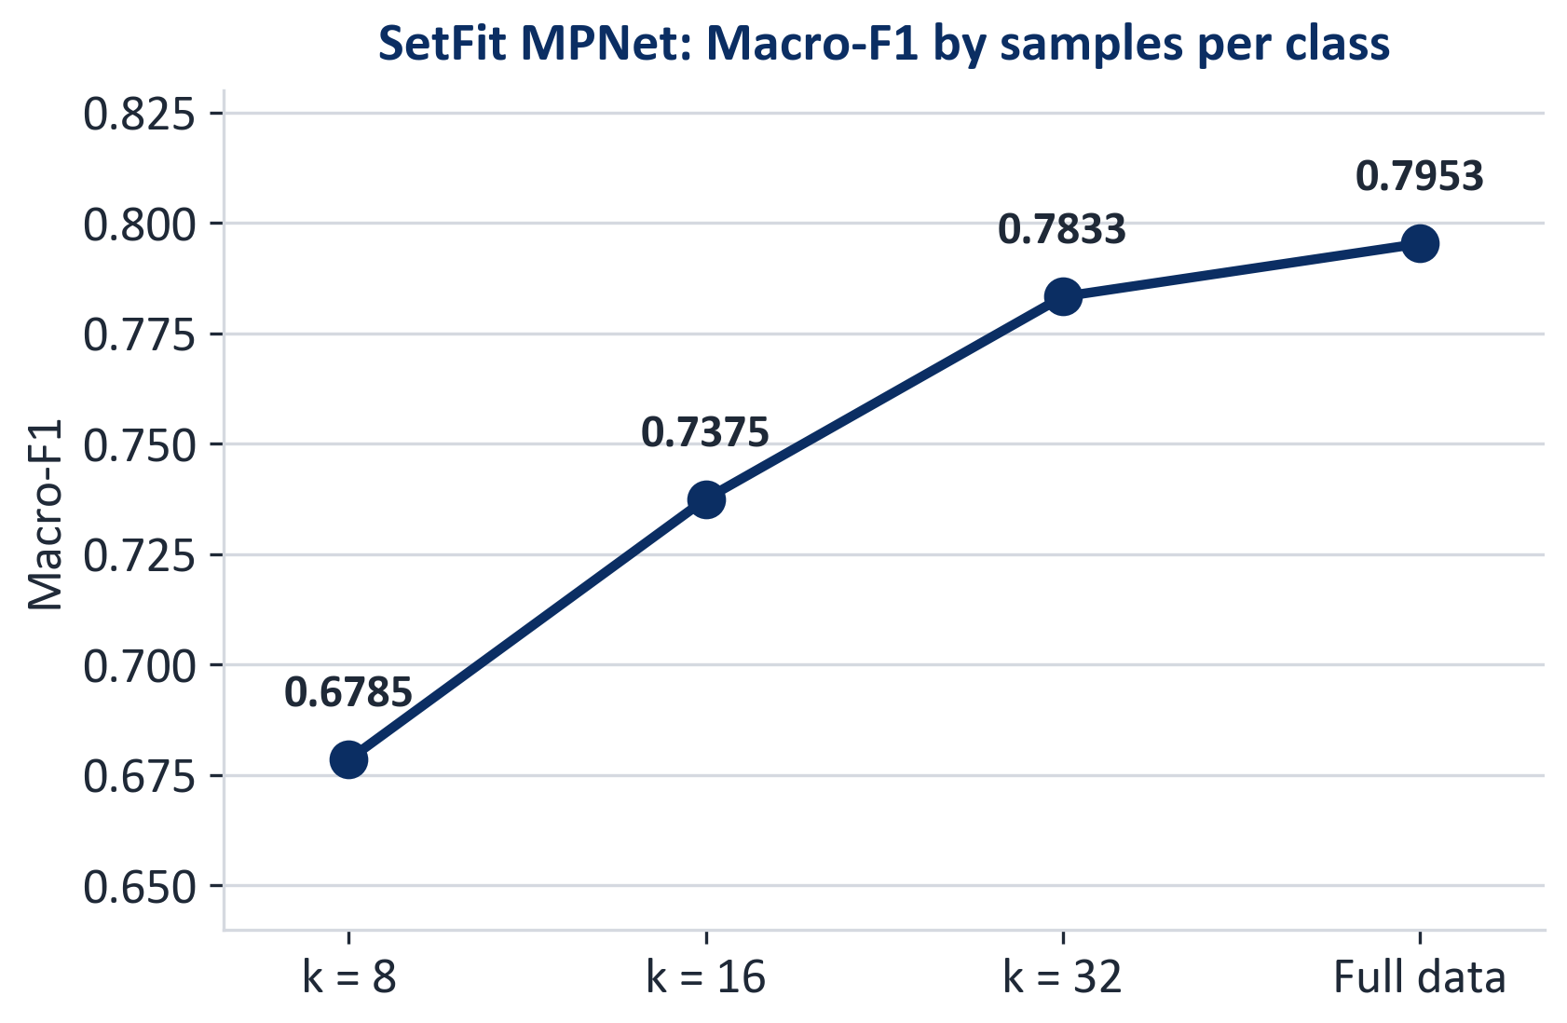
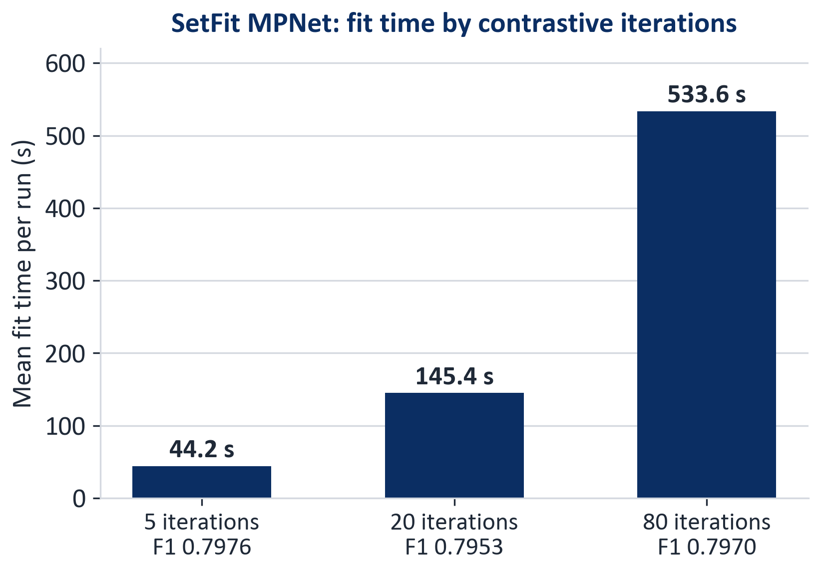
SetFit: Data Size and Contrastive Iterations
MPNet reaches 0.7953 vs MiniLM 0.7881, but MiniLM fits faster: 55.1 s vs 145.4 s (mean per run)
Fewer labeled samples clearly reduce performance; 5 iterations are nearly as good as 80 (0.7976 vs 0.7970) at ~12× lower fit time
MPNet, 20 iterations, beyond CV: LOO 0.6854, official test 0.8033 (CV 0.7953); pooled CV was not run
‹#›
Notes:
[Slide 19 - SetFit: Data Size and Contrastive Iterations] Time: about 90 s.
Now the SetFit experiments, all with MPNet unless stated.
On the left, the effect of labeled data. With 8 examples per class the Macro-F1 is 0.6785; with 16 it is 0.7375; with 32, 0.7833; and with the full cross-validation training data, 0.7953. More labeled data clearly helps, even with pretrained sentence representations.
On the right, the number of contrastive iterations. Five iterations give 0.7976 in 44 seconds. Twenty iterations give 0.7953 in 145 seconds. Eighty iterations give 0.7970 in 534 seconds. So 5 iterations are about 12 times cheaper than 80 with essentially the same score. More training does not automatically mean a better model.
MiniLM reaches 0.7881 versus 0.7953 for MPNet, but fits faster, 55 seconds compared with 145. These times are means per run in the reported environment, so they are useful for comparisons within SetFit, not as a cross-family benchmark. Also note that the 5-iteration setting was chosen using cross-validation scores, so its score may be optimistic.
Beyond cross-validation, SetFit MPNet with 20 iterations reaches 0.6854 under leave-one-repository-out, on repositories it has never seen, and 0.8033 on the official test, compared with 0.7953 under cross-validation. MiniLM reaches 0.6684 under LOO, 0.7972 on the official test and 0.7795 under pooled cross-validation. We did not run MPNet under pooled cross-validation.

Slide 20
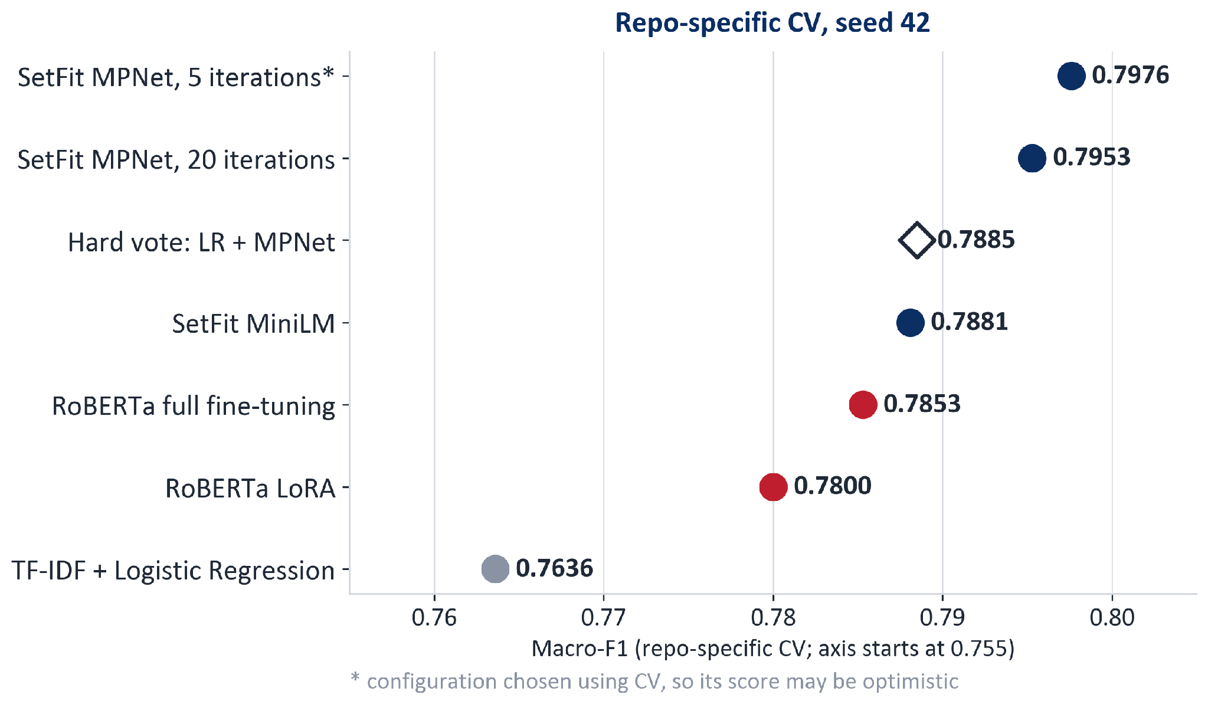
Overall Comparison (repo-specific CV)
+0.0317
MPNet − LR, paired bootstrap 95% CI [0.0085, 0.0557]
0.7885
Hard vote of LR + MPNet is below MPNet alone (0.7953)
CIs condition on fixed predictions: no training variability, no new-repository uncertainty
Pooled CV is reported separately: LoRA 0.7994, Full 0.7924
Do not rank results across different protocols
‹#›
Notes:
[Slide 20 - Overall Comparison (repo-specific CV)] Time: about 80 s.
Now the overall comparison, under the one protocol that every family shares: repository-specific cross-validation with seed 42.
The Logistic Regression baseline is the lowest at 0.7636. The SetFit and RoBERTa models are higher, between 0.78 and 0.80. Using a paired bootstrap, MPNet minus Logistic Regression is plus 0.0317, with a 95 percent interval from 0.0085 to 0.0557. So the improvement is real in this evaluation, but moderate. Again, this interval uses fixed predictions and does not include training variability.
We also tested a simple ensemble: an equal-weight hard vote of Logistic Regression and MPNet. It reaches 0.7885, which is better than Logistic Regression but below MPNet alone. With only two voters, ties are frequent and are resolved by a fixed class order, and nothing was tuned. So combining models did not help here, and we report that honestly.
Pooled cross-validation, leave-one-repository-out and the official test are shown on the next slide. Please do not rank those numbers against this chart.

Slide 21
Results Across All Four Protocols
Model | CV | Pooled CV | LOO | Official
TF-IDF + Logistic Regression | 0.7636 | 0.7601 | 0.5876 | 0.7495
Word LinearSVC | 0.7541 | 0.7570 | 0.5898 | 0.7498
Word + Char LinearSVC | 0.7533 | 0.7658 | 0.6003 | 0.7591
Hashed SGD | 0.7030 | 0.7460 | 0.6152 | 0.7322
Supervised fastText | 0.7089 | 0.7126 | 0.5384 | 0.6896
Complement NB | 0.7054 | 0.6757 | 0.4904 | 0.7108
RoBERTa full fine-tuning | 0.7853 | 0.7924 | 0.6867 | 0.8033
RoBERTa LoRA | 0.7800 | 0.7994 | 0.6896 | 0.7937
SetFit MPNet | 0.7953 | not run | 0.6854 | 0.8033
SetFit MiniLM | 0.7881 | 0.7795 | 0.6684 | 0.7972
Official test: RoBERTa full and SetFit MPNet both reach 0.8033; the best sparse model reaches 0.7591.
LOO: every model drops sharply, but the dense models (0.67 to 0.69) lose far less than the sparse models (0.49 to 0.62).
Pooled CV: no consistent effect compared with repo-specific CV (-0.030 to +0.043).
Not run: SetFit MPNet under pooled CV.
Repository-balanced Macro-F1, seed 42. Bold red = best in column. Compare scores within a column only: each protocol trains and evaluates differently. not run = no artifacts (nothing imputed).
‹#›
Notes:
[Slide 21 - Results Across All Four Protocols] Time: about 110 s.
This slide puts every frozen configuration under every protocol it was run under. The table is generated automatically from the result artifacts, so it cannot drift from the data. Read it column by column: each protocol trains and evaluates differently, so we never compare across columns. A cell that says not run means no artifacts exist; nothing is imputed.
Official test, the right-hand column. RoBERTa full fine-tuning and SetFit MPNet both reach 0.8033, SetFit MiniLM 0.7972 and RoBERTa LoRA 0.7937. The best sparse model, word-plus-character LinearSVC, reaches 0.7591 and Logistic Regression 0.7495. So on the official split the dense advantage is about 0.04 to 0.05, larger than the 0.03 we saw under cross-validation. The two top scores differ only in the sixth decimal, so we do not rank them.
Leave-one-repository-out. Every model drops sharply when the repository is unseen. But the dense models lose much less: RoBERTa full fine-tuning 0.6867, LoRA 0.6896, SetFit MPNet 0.6854 and MiniLM 0.6684, while the sparse models score between 0.49 and 0.62. Logistic Regression falls by 0.176 relative to cross-validation, the dense models by about 0.09 to 0.12.
Pooled cross-validation shows no consistent effect: relative to repository-specific cross-validation it ranges from minus 0.03 for Complement Naive Bayes to plus 0.043 for hashed SGD.
The gap is stated on the slide: SetFit MPNet was not run under pooled cross-validation. Everything is a single seed, and the new runs were produced on one laptop, so timings from different machines are not comparable.

Slide 22
Outline
I. Introduction
Problem and project objectives
II. Dataset
NLBSE'24 data and its challenges
III. Methodology
Model families, background, evaluation protocols, pipeline
IV. Experiments & Results
Baseline, lightweight models, RoBERTa, SetFit, comparison
V. Conclusion
Key findings, limitations, future work
Notes:
[Slide 22 - Outline - Conclusion] Time: about 5 s.
Finally, the conclusion.

Slide 23
Conclusion
Key Findings
The body is more informative than the title; transfer to unseen repositories is difficult (LR: 0.7636 CV → 0.5876 LOO)
Dense models are strongest under every protocol they were run: +0.03 under CV (MPNet 0.7953 vs LR 0.7636), +0.04 on the official test (0.8033 vs 0.7591) and about +0.07 under LOO (dense 0.67–0.69 vs 0.62)
A hard-vote ensemble of LR + MPNet (0.7885) does not outperform MPNet alone
Limitations
Single seed; configurations were selected on CV, so CV scores may be optimistic
Hardware and measurement conditions differ across runs, so cost results are descriptive, not a controlled Pareto comparison
SetFit MPNet was not run under pooled CV (every other model has all four protocols)
Future Work
Run SetFit MPNet under pooled CV and repeat experiments with consistent seeds
Benchmark cost on one documented hardware setup; extend class-level error analysis beyond Logistic Regression
Notes:
[Slide 23 - Conclusion] Time: about 90 s.
Our key findings.
First, the issue body is more informative than the title, and transferring to unseen repositories is difficult: for the baseline, Macro-F1 goes from 0.7636 under cross-validation to 0.5876 under LOO.
Second, dense models are the strongest under every protocol they were run. The gain is moderate under cross-validation, about 0.03 for SetFit MPNet over Logistic Regression. It is larger on the official test, 0.8033 against 0.7591 for the best sparse model, and larger again under LOO, where the dense models reach 0.67 to 0.69 against at most 0.62 for the sparse models. Sparse models stay attractive when simplicity and low cost matter and the target repository is in the training data.
Third, a simple hard-vote ensemble of Logistic Regression and MPNet, 0.7885, does not beat MPNet alone.
Now the limitations, which we consider part of the result. All results use a single seed, and configurations were selected using cross-validation, so those scores can be optimistic. Hardware and measurement conditions differ across runs, so our cost numbers are descriptive and not a controlled Pareto comparison. And SetFit MPNet was not run under pooled cross-validation.
Future work: run the remaining SetFit protocols and repeat with consistent seeds, benchmark cost on one documented hardware setup, and extend the class-level error analysis beyond Logistic Regression.

Slide 24
THANK YOU !
Notes:
[Slide 24 - Thank you / Q&A] Time: about 120 s.
Thank you for listening. We are happy to take questions.
Likely questions and short answers:
Why Macro-F1, and why average per repository? The data is balanced, but Macro-F1 prevents one strong class from hiding a weak one, and averaging per repository gives every repository equal weight.
Why does performance drop so much under LOO? Repositories have their own vocabulary and templates. LOO also changes how much and which training data the model sees, so we do not interpret the drop as a purely causal domain shift.
Why do the dense models lose less under LOO? We did not test the reason. A plausible hypothesis is that pretrained representations depend less on repository-specific vocabulary than TF-IDF features, but that is a hypothesis, not a result.
Why is a SetFit cell missing? SetFit MPNet was not run under pooled cross-validation. A SetFit fit is slow on our hardware and this run did not fit in the time available. The results table marks them as not run, never as zero.
Why did the ensemble not help? It is a two-model vote with a fixed tie rule and no tuning. It beats Logistic Regression by 0.0249 but trails MPNet by 0.0068.
Are the confidence intervals proof of significance? No. They use paired bootstrap on fixed predictions. They ignore training randomness and new-repository uncertainty, and every result is a single seed.
Why is there no Pareto front of cost versus accuracy? The runs were done on different machines and the hardware and measurement conditions are not comparable, so we only describe costs and do not claim a controlled comparison.
Is the official test used for model selection? No. Configurations were frozen using cross-validation, and the official test was run once per configuration.
What about the duplicate issues between train and test? There are 3 shared keys, 1 with conflicting labels. We kept the official split for comparability and did not report a de-duplicated score.

Slide 25
Notes:
[Slide 25 - Closing slide]
End of the presentation. Keep this slide up during questions, or go back to slide 22 (conclusion) or slide 13 (protocols) if a question needs it.

