Slide 1

Final Project Traffic Signs Detection
Ly, Kiet
CSCI E-63 Big Data Analytics
Harvard University Extension School
Prof. Zoran B. Djordjević

Slide 2
Self-driving car
Train the car to recognize traffic signs

Slide 3
Solutions
Need to build a FAST CNN algorithm objects (traffic signs) detection.
Why it has to be fast? Recognize traffic sign too late then the car may drives past red light or stop sign without stopping.
The state of the art and fastest object detection currently is YOLO. See references [1] and [2].
Model | Train Dataset | Accuraccy | FPS | CNN
YOLO | VOC | 76.8 | 67 | 24 layers convnets | Use for this project
Tiny YOLO | VOC | 57.1 | 207 | 9 layers convnets | Fast but less accurate. Work on mobile devices.

Slide 4
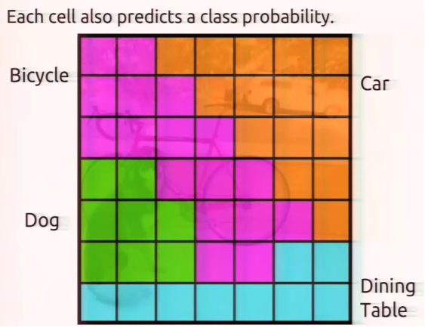
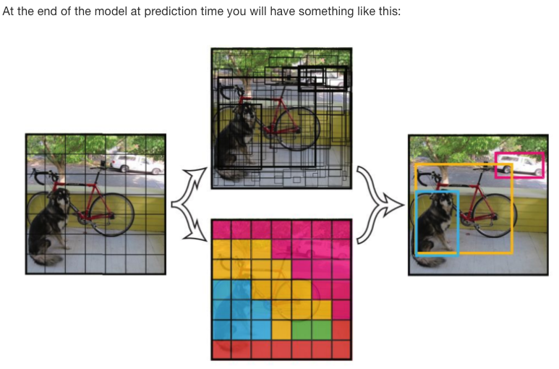
YOLO key ideas
Look at entire image only once. Hence the name You Only Look Once (YOLO)
Divide the image into grid cell (7x7) . Each cell consists of 2 bound boxes.
Each cell has a probability that it is likely one of the classes or objects.
Each bound box has a confidence score it actually encloses some object but not indicate what the object is.
See reference [7] for more detail.
The cell’s class probability and bounding boxes confident predict dog, bike, and car. The dining table object goes away as the probability is too low. Cut off is 0.25

Slide 5
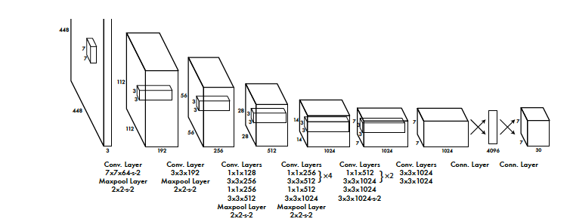
Tiny YOLO Network Layers
See reference [2]

Slide 6
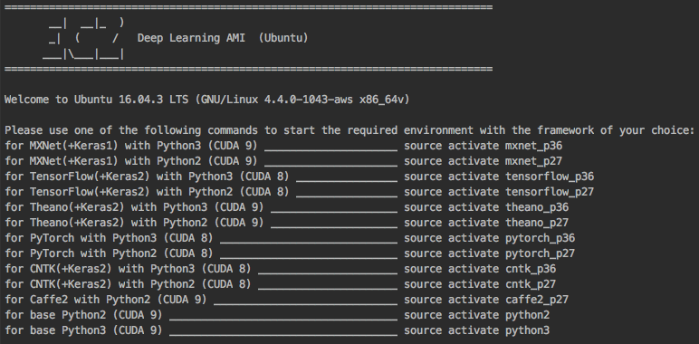
Demo
Trained the model on AWS GPU p2.xlarge instance.
Using AWS Ubuntu Deep Learning AMI with all DL tools and frameworks preinstalled.

Slide 7
Launch EC2 GPU using spotfleet request
See LyKiet_DetectTrafficSign.zip/ec2.p2.xlarge
P2.xlarge is by far the most bang for the $. Average between $0.15-0.23/hour spot price.
aws ec2 request-spot-fleet --spot-fleet-request-config file://p2.xlarge.fleet.json

Slide 8
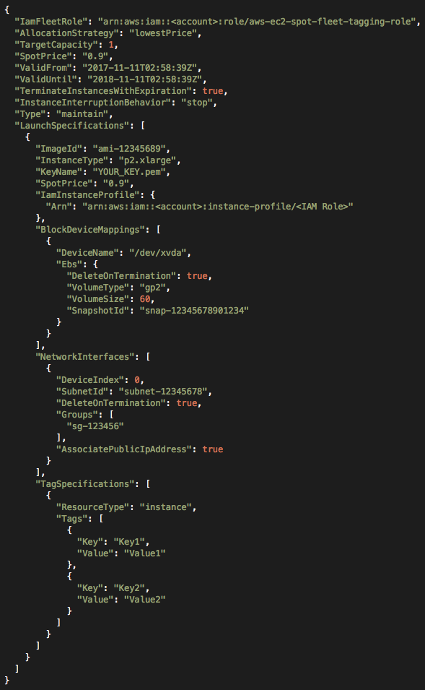
p2.xlarge.fleet.json
See https://github.com/kietly/self-driving-car/ec2.p2.xlarge/
Key attributes:
SpotPrice: “on demand price”. P2.xlarge on demand is $0.90
InstanceInterruptionBehavior: “stop”
Type: “maintain”
ImageId: “your ami-id”
AssciatePublicIpAddress: true
I started with AWS Deep Learning AMI Ubuntu, ami-405ade3a. See here for detail. https://aws.amazon.com/marketplace/pp/B077GCH38C. This AMI has all the deep learning tools and frameworks preloaded and updated monthly. Use the latest AMI.

Slide 9
Install X windows on Ubuntu and Laptop
Since we are working with objects detection in images, there will be a lot visualization going on. We need to set up X windows and have them communicate over SSH tunnel between Ubuntu EC2 and laptop.
With this setup, whenever YOLO detects an object it will pop up an X windows on your laptop display.
On Ubuntu, $sudo apt-get install xorg
On my Mac laptop, down load Xquartz from here, https://www.xquartz.org/
From mac terminal, ssh into Ubuntu p2.xlarge EC2 box.
ssh -Y -i ~/Your KEY.pem ubuntu@<ubuntu public ip>
The option -Y allows X traffic between Ubuntu and laptop over SSH.
Do all your development work in this ssh session with X traffic tunnel enable.

Slide 10
Install YOLO, tools, and training data
Open ssh terminal and login into your Ubuntu EC2 p2.xlarge instance.
Either unzip DetectTrafficSigns_LyKiet.zip OR git clone https://github.com/kietly/self-driving-car
It has all the dependencies for training stop sign detection
Stop sign data was copy from references [6].
Edit darknet/Makefile.
GPU=1
CUDNN=1
OPENCV=1
Type $make

Slide 11
Setup Bbox-Label-Tool
All the stop sign images are loaded under ./Images/003 and create coresponding ./Labels/003
This tool expects the training/label data under matching numeric folder, 003, for example.

Slide 12
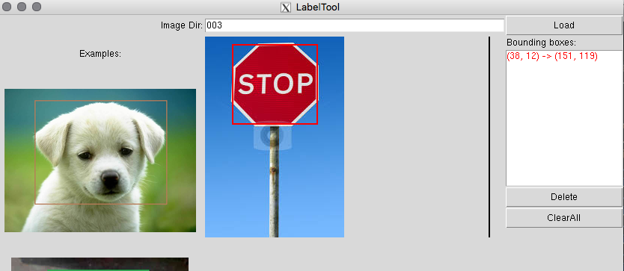
Label training dataset with Bounding Box
Change to python2 virtual env.
source activate python2 && pip install pillow
cd Bbox-Label-Tool/ && python ./main
The accuracy of prediction is highly depending on this step. Label stop sign carefully.
See reference [5], for more detail on how to how to label training data.
For each corresponding labeled images, the tool writes out bounding box coordinates.
Images/003/stopsign-00001.JPEG -> Labels/003/stopsign-00001.txt

Slide 13
Running convert.py/train_test.py
After labeling the images in ./Image/003, the label format is not in Darknet expected format. It expect the size of the bounded box is normalize between 0 – 1.0.
Update the Bbox-Label-Tool/convert.py
Update these parameters lines 32-35
mypath = "./Labels/003/” <- input dir with labels in BBox format outpath = "./Labels/stopsign/” <- output dir with labels in Darknet format classes = ["003"] <- label category number in this case ./Labels/003 cls = "003” <- make this same as classes
After convert.py completed the run, copy ./Images/003 and ./Labels/stopsign/ to darknet/data/obj/. The *.jpg/*.txt need to be in one directory.
Next we need to split data train/validate dataset.
Modify darknet/data/obj/train_test.py line 10, percentage_test = 10. It currently set train/validate to 90/10 ratio.
Run train_test.py and it puts out train.txt/test.txt.
Move the file train.txt/test.txt to data/ directory.

Slide 14

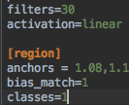
Create configuration files
cp cfg/yolo-voc.2.0.cfg cfg/yolo-obj.cfg
Edit cfg/yolo-obj.cfg and update these parameters.
Each iteration use 64 images and divide into 8 groups of
Images (64/8).
filters= (classes + 5)*5 = (1+5)*5 = 30
data/obj.data
classes= 1 train = data/train.txt valid = data/test.txt names = data/obj.names backup = backup/
data/obj.names
stopsign

Slide 15

Training
Download darknet19_448.conv.23 pre-trained weight file http://pjreddie.com/media/files/darknet19_448.conv.23. I already downloaded it for you. We start the training with pre-trained weights from ImageNets to speed up the training.
Training on the stop sign dataset to get the training weights. Note if you cloned from https://github.com/kietly/self-driving-car you must perform this step. The weight file size is > 100 MB and not allow to check in github. Here is the command to train.
./darknet detector train data/obj.data cfg/yolo-obj.cfg darknet19_448.conv.23
Stop the training when the average accuracy <= 0.06. It took about 30 mins for p2.xlarge to reach this point.
Saved output weights from training. We use the last weight file that has the highest accuracy (yolo-obj_300.weights) for prediction.

Slide 16
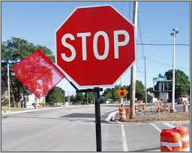

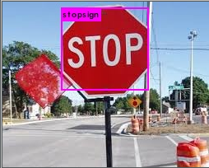
Prediction Positive
Stopsign_00008.jpg
./darknet detector test data/obj.data cfg/yolo-obj.cfg backup/yolo-obj_300.weights data/obj/stopsign_00008.jpg
prediction.jpg

Slide 17
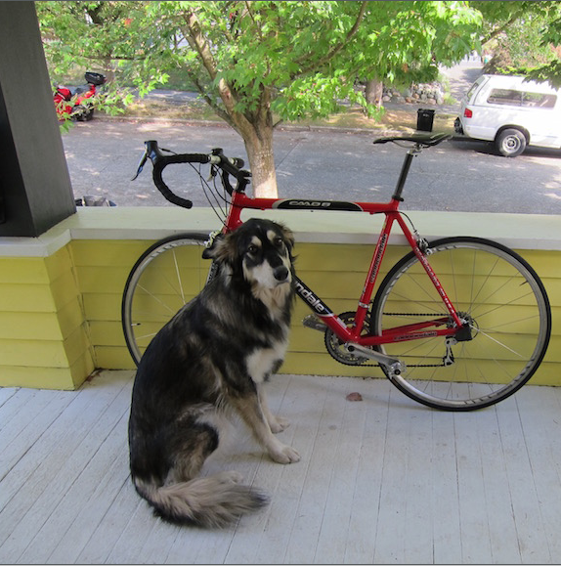
Prediction Negative
dog.jpg
./darknet detector test data/obj.data cfg/yolo-obj.cfg backup/yolo-obj_300.weights data/dog.jpg
prediction.jpg

Slide 18
YouTube URLs, Last Page
Two minute (short):
15 minutes (long):
https://youtu.be/UJocvtM0dww
https://youtu.be/AM5LwgdFsW4

Slide 19
References
Joseph Redmony, Ali Farhadi, YOLO9000 (YOLO v2 paper). https://arxiv.org/abs/1612.08242
YOLO v1 paper. https://pjreddie.com/media/files/papers/yolo_1.pdf
Train yolo2 to detect custom objects, https://timebutt.github.io/static/how-to-train-yolov2-to-detect-custom-objects/
YOLOv2 code. https://github.com/AlexeyAB/darknet
Bounding box label tool, https://github.com/puzzledqs/BBox-Label-Tool
Stop sign training dataset, http://guanghan.info/blog/en/my-works/train-yolo/
YOLOv2 explained, https://leonardoaraujosantos.gitbooks.io/artificial-inteligence/content/single-shot-detectors/yolo.html
The codes and images use for this project, https://github.com/kietly/self-driving-car

