Slide 1
Artificial Intelligence

Slide 2
Syllabus
UNIT-I INTRODUCTION: - Introduction to Artificial Intelligence, Foundations and History of Artificial Intelligence, Applications of Artificial Intelligence, Intelligent Agents, Structure of Intelligent Agents. Computer vision, Natural Language Possessing.
UNIT-II INTRODUCTION TO SEARCH: - Searching for solutions, uniformed search strategies, informed search strategies, Local search algorithms and optimistic problems, Adversarial Search, Search for Games, Alpha - Beta pruning.
UNIT-III KNOWLEDGE REPRESENTATION & REASONING: - Propositional logic, Theory of first order logic, Inference in First order logic, Forward & Backward chaining, Resolution, Probabilistic reasoning, Utility theory, Hidden Markov Models (HMM), Bayesian Networks.

Slide 3
Syllabus
UNIT-IV MACHINE LEARNING: - Supervised and unsupervised learning, Decision trees, Statistical learning models, learning with complete data - Naive Bayes models, Learning with hidden data – EM algorithm, Reinforcement learning.
UNIT-V PATTERN RECOGNITION: - Introduction, Design principles of pattern recognition system, Statistical Pattern recognition, Parameter estimation methods - Principle Component Analysis (PCA) and Linear Discriminant Analysis (LDA), Classification Techniques – Nearest Neighbor (NN) Rule, Bayes Classifier, Support Vector Machine (SVM), K – means clustering.

Slide 4
UNIT-I

Slide 5
Artificial Intelligence?
Artificial intelligence (AI) is wide-ranging branch of computer science concerned with building smart machines capable of performing tasks that typically require human intelligence.
AI can be divided into two categories:
Strong AI
Weak AI
 | Strong AI | Weak AI
Definition | The machine can actually think and perform tasks on its own just like a human being. | The devices cannot follow these tasks on their own but are made to look intelligent.
Functionality | Algorithm is stored by a computer program. | Tasks are entered manually to be performed.
Examples | There are no proper examples for Strong AI. | An automatic car or remote control devices.
Progress | Initial Stage | Advanced Stage

Slide 6
Forms of AI:
1) Weak AI:
Weak AI is an AI that is created to solve a particular problem or perform a specific task.
It is not a general AI and is only used for specific purpose.
For example, the AI that was used to beat the chess grandmaster is a weak AI as that serves only 1 purpose but it can do it efficiently.
2) Strong AI:
Strong AI is difficult to create than weak AI.
It is a general purpose intelligence that can demonstrate human abilities.
Human abilities such as learning from experience, reasoning, etc.
3) Super Intelligence
As stated by a leading AI thinker Nick Bostrom, “Super Intelligence is an AI that is much smarter than the best human brains in practically every field”.
It ranges from a machine being just smarter than a human to a machine being trillion times smarter than a human.
Super Intelligence is the ultimate power of AI

Slide 7
Artificial Intelligence?
Definition of AI: AI is actually mapping of intelligence where intelligence is boundary less. Boundaries of AI are:
Acting Humanly
Thinking Humanly
Thinking Rationally
Acting Rationally
There are hundreds of definitions of artificial intelligence. Most contain a bias as to whether the writer of the definition sees AI as dealing with thinking versus acting, and whether they see it as trying to model humans or capturing intelligence (rationality) abstractly.
Intelligence: The ability to learn and solve problems. This definition is taken from webster’s Dictionary.

Slide 8
Intelligence is composed of:
Reasoning
Learning
Problem-Solving
Perception
Linguistic Intelligence

Slide 9
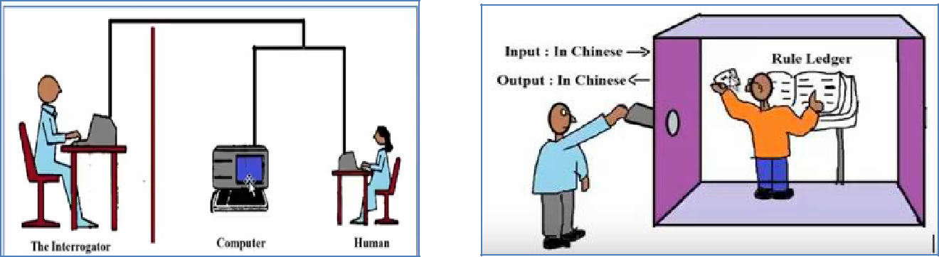
Acting humanly: The Turing Test approach
TURING TEST by ALAN TURING
CHINESE ROOM ARGUMENT(TEST)
by John Searle

Slide 10
What is the Turing Test?
The Turing Test is a method of inquiry in artificial intelligence (AI) for determining whether or not a computer is capable of thinking like a human being. The test is named after Alan Turing, the founder of the Turing Test and an English computer scientist, cryptanalyst, mathematician and theoretical biologist.
Turing proposed that a computer can be said to possess artificial intelligence if it can mimic human responses under specific conditions. The original Turing Test requires three terminals, each of which is physically separated from the other two. One terminal is operated by a computer, while the other two are operated by humans.
During the test, one of the humans functions as the questioner, while the second human and the computer function as respondents. The questioner interrogates the respondents within a specific subject area, using a specified format and context. After a preset length of time or number of questions, the questioner is then asked to decide which respondent was human and which was a computer.
The test is repeated many times. If the questioner makes the correct determination in half of the test runs or less, the computer is considered to have artificial intelligence because the questioner regards it as "just as human" as the human respondent.
https://youtu.be/4VROUIAF2Do
https://www.techtarget.com/searchenterpriseai/definition/Turing-test#:~:text=The%20Turing%20Test%20is%20a,cryptanalyst%2C%20mathematician%20and%20theoretical%20biologist.

Slide 11
CHINESE ROOM ARGUMENT(TEST) by John Searle
The Chinese Room Argument is a philosophical thought experiment that challenges the idea that artificial intelligence can truly understand language and have genuine intelligence. The argument was proposed by philosopher John Searle in 1980 and is named after a room in which a person who doesn’t understand Chinese is able to answer questions in Chinese by following a set of instructions
The argument goes like this: imagine a person who doesn’t understand Chinese is placed in a room with a set of instructions in English for manipulating Chinese symbols. The person receives questions in Chinese through a slot in the door and uses the instructions to produce a response in Chinese, which is then passed back through the slot. From the outside, it appears as though the person understands Chinese and is able to answer questions, but in reality, the person is just following a set of rules without actually understanding the meaning of the symbols.
Searle argues that this thought experiment demonstrates that a computer program that simulates human understanding of language, such as a chatbot, does not truly understand the meaning of the language it is processing. The program is just following a set of rules without actually understanding the meaning of the language.

Slide 12
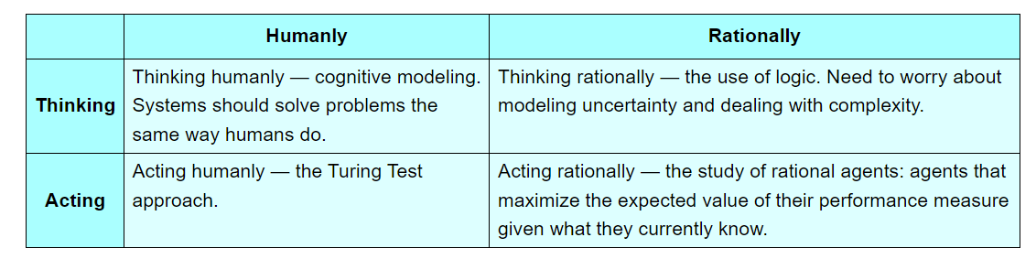
Boundaries of AI

Slide 13
Acting humanly: The Turing Test approach
Capabilities to pass Alan Turing test:
natural language processing to enable it to communicate successfully in English
knowledge representation to store what it knows or hears
automated reasoning to use the stored information to answer questions and to draw new conclusions;
machine learning to adapt to new circumstances and to detect and extrapolate patterns.
To pass the total Turing Test, the computer will need:
Computer vision to perceive objects, and
robotics to manipulate objects and move about.

Slide 14
Thinking humanly: The cognitive modeling approach
If we are going to say that a given program thinks like a human, we must have some way of determining how humans think. We need to get inside the actual workings of human minds. There are three ways to do this:
through introspection—trying to catch our own thoughts as they go by;
through psychological experiments—observing a person in action; and
through brain imaging—observing the brain in action.

Slide 15
Thinking rationally: The “laws of thought” approach
The Greek philosopher Aristotle was one of the first to attempt to codify “right thinking,” that is, irrefutable reasoning processes. His syllogisms provided patterns for argument structures that always yielded correct conclusions when given correct premises—for example, “Socrates is a man; all men are mortal; therefore, Socrates is mortal.” These laws of thought were supposed to govern the operation of the mind; their study initiated the field called logic. Remember, logic is the prerequisite to study AI. There are two main obstacles to this approach.
It is not easy to take informal knowledge and state it in the formal terms required by logical notation, particularly when the knowledge is less than 100% certain.
There is a big difference between solving a problem “in principle” and solving it in practice.

Slide 16
Acting rationally: The rational agent approach
An agent is just something that acts (agent comes from the Latin agere, to do). Expectations from agents of AI : all computer programs do something, but computer agents are expected to do more: operate autonomously, perceive their environment, persist over a prolonged time period, adapt to change, and create and pursue goals. A rational agent is one that acts so as to achieve the best outcome or, when there is uncertainty, the best expected outcome. The rational-agent approach has two advantages over the other approaches.
It is more general than the “laws of thought” approach because correct inference is just one of several possible mechanisms for achieving rationality.
It is more amenable to scientific development than are approaches based on human behavior or human thought.

Slide 17
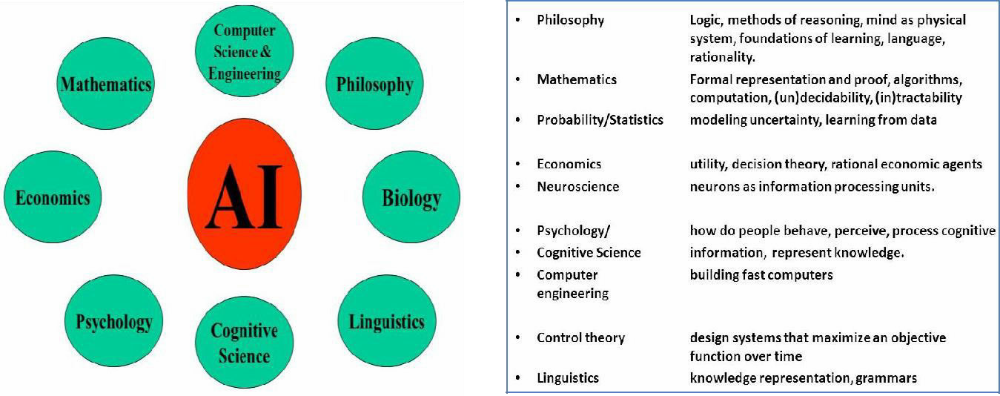
Foundation of AI

Slide 18
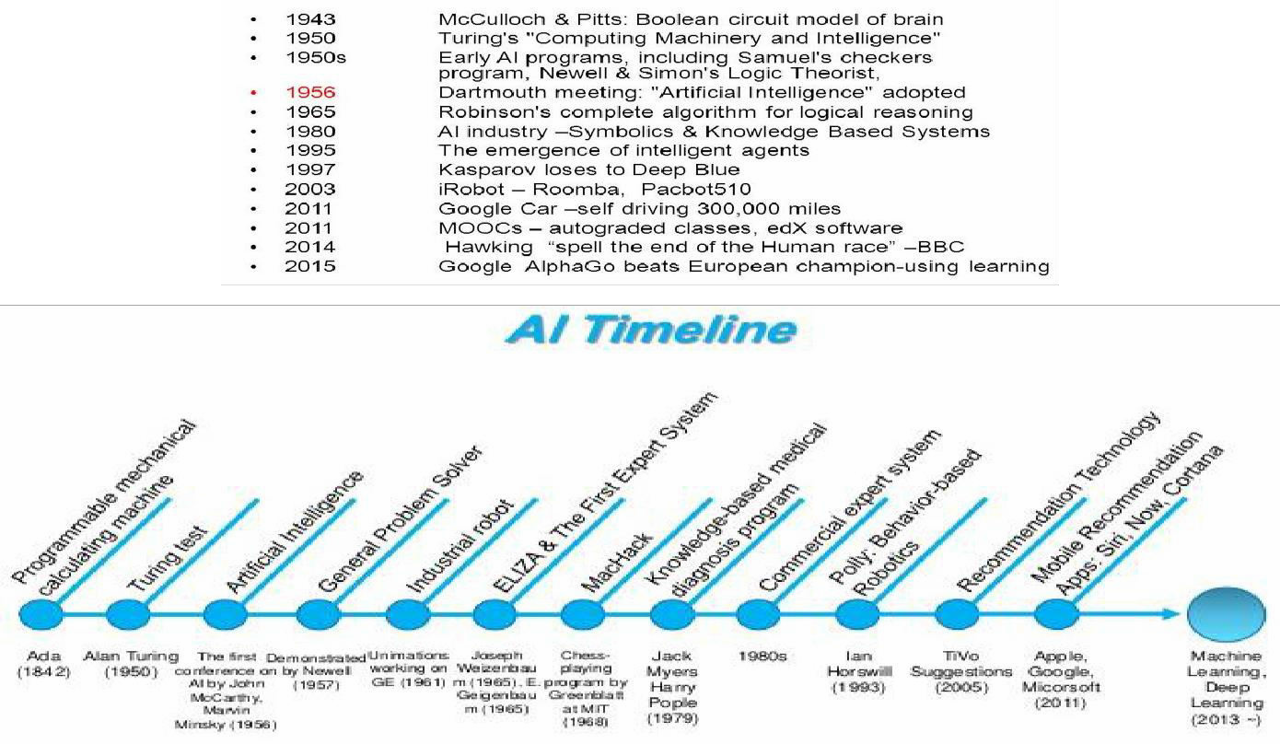
History of AI

Slide 19
The first work that is now generally recognized as AI was done by Warren McCulloch and Walter Pitts (1943). They drew on three sources:
knowledge of the basic physiology
function of neurons in the brain
the formal analysis of propositional logic
Turing's theory of computation: They proposed a model of artificial neurons in which each neuron is characterized as being "on" or "off," with a switch to "on" occurring in response to stimulation by a sufficient number of neighbouring neurons
Claude Shannon (1950) and Alan Turing (1953) were writing chess programs for von Neumann-style conventional computers.

Slide 20
At the same time, two graduate students in the Princeton mathematics department, Marvin Minsky and Dean Edmonds, built the first neural network computer in 1951.
Newell and Simon's early success was followed up with the General Problem Solver, or GPS. Unlike Logic Theorist, this program was designed from the start to imitate human problem-solving protocols
Herbert Gelernter (1959) constructed the Geometry Theorem Prover. Like the Logic Theorist, it proved theorems using explicitly represented axioms.
Arthur Samuel wrote a series of programs for checkers (draughts) that eventually learned
to play tournament-level checkers. Along the way, he disproved the idea that computers can only do what they are told to, as his program quickly learned to play a better game than its creator.
McCarthy defined the high-level language Lisp, which was to become the dominant AI programming language.
Rosenblatt proved the famous perceptron convergence theorem, showing that his learning algorithm could adjust the connection strengths of a perceptron to match any input data.

Slide 22
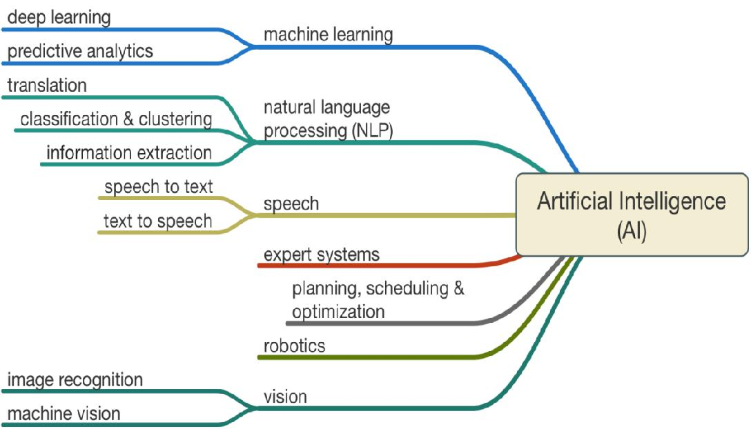
Applications of AI

Slide 23
Example-1 Air Operations Division (AOD)
Air Operations Division (AOD) - uses AI for the rule based expert systems.
The AOD has use for artificial intelligence for surrogate operators for combat and training simulators, mission management aids, support systems for tactical decision making, and post processing of the simulator data into symbolic summaries.
Airplane simulators are using artificial intelligence in order to process the data taken from simulated flights
Simulated aircraft warfare computers are able to come up with the best success scenarios in these situations

Slide 24
Example-2 Computer Science:
Computer Science: AI researchers have created many tools to solve the most difficult problems in computer science
time sharing,
interactive interpreters,
graphical user interfaces
and the computer mouse,
rapid development environments,
the linked list data structure,
automatic storage management,
symbolic programming,
functional programming,
dynamic programming
object-oriented programming

Slide 25
Example-3 Education:
Education: Number of companies that create robots to teach subjects to children ranging from biology to computer science.
Intelligent tutoring systems: An ITS called SHERLOCK teaches Air Force technicians to diagnose electrical systems problems in aircraft. Another example is DARPA, Defense Advanced Research Projects Agency, which used AI to develop a digital tutor to train its Navy recruits in technical skills in a shorter amount of time.

Slide 26
Example-4 Finance: Algorithmic Trading
Finance: Algorithmic Trading involves the use of complex AI systems to make trading decisions at speeds several orders of magnitudes greater than any human is capable of, often making millions of trades in a day without any human intervention. Such trading is called High-frequency Trading. Many banks, funds, and proprietary trading firms now have entire portfolios which are managed purely by AI systems

Slide 27
Hospitals and medicine
Media and E-commerce:
Music
News, publishing and writing
Online and telephone customer service
Toys and games
Transportation: Fuzzy Logic controllers have been developed for automatic gearboxes in automobiles. For example, the 2006 Audi TT, feature the DSP transmission which utilizes Fuzzy Logic.

Slide 28
Healthcare:
AI and ML technology has been particularly useful in the healthcare industry because it generates massive amounts of data to train with and enables algorithms to spot patterns faster than human analysts. Medecision developed an algorithm that detects 8 variables in diabetes patients to determine if hospitalization is required
An app called BiliScreen utilizes a smartphone camera, ML tools, and computer vision algorithms to detect increased levels of bilirubin in the sclera (white portion) of a person’s eye, which is used to screen people for pancreatic cancer.
This cancer has no telltale symptoms, hence it has one of the worst prognoses of all cancers.
NuMedii, a biopharma company, has developed a platform called Artificial Intelligence for Drug Discovery (AIDD), which uses big data and AI to detect the link between diseases and drugs at the systems level.
GNS Healthcare uses ML algorithms to match patients with the most effective treatments for them.

Slide 29
Entertainment:
A familiar application of AI in everyday life is seen with services like Netflix or Amazon, wherein ML algorithms analyze the user’s activity and compare it with that of other users to determine which shows or products to recommend. The algorithms are becoming intelligent with time—to the extent of understanding that a user may want to buy a product as a gift and not for him/her, or that different family members have different watching preferences.

Slide 30
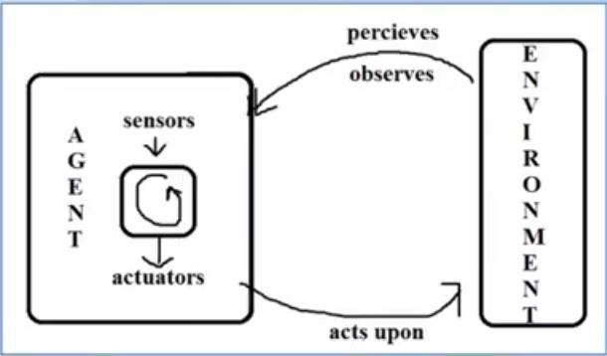
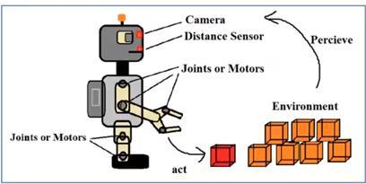
Intelligent Agents
Intelligent agent is a program or software that perceives (or observes or senses) its environment through sensors, thinks intelligently and acts upon that environment through its actuators (to perform actions on the environment or produce output). Example: Robotics Agent

Slide 31
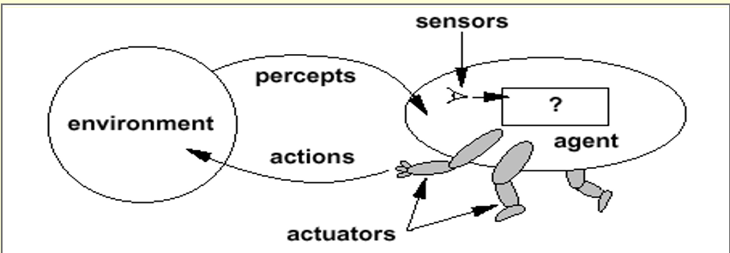
Intelligent Agents

Slide 32
Intelligent Agents
An intelligent agent is a program that can make decisions or perform a service based on its environment, user input and experiences. These programs can be used to autonomously gather information on a regular, programmed schedule or when prompted by the user in real time. Intelligent agents may also be referred to as a bot, which is short for robot.
In agents that employ artificial intelligence (AI), user input is collected using sensors, like microphone or cameras, and agent output is delivered through actuators, like speakers or screens. The practice of having information brought to a user by an agent is called push technology

Slide 33
characteristics of intelligent agents
Common characteristics of intelligent agents are adaptation based on experience, real time problem solving, analysis of error or success rates and the use of memory-based storage and retrieval.
For enterprises, intelligent agents can be used for applications in data mining, data analytics and customer service and support (CSS). Consumers can also use intelligent agents to compare the prices of similar products and notify the user when a website update occurs.
Intelligent agents are also similar to software agents which are autonomous computer programs.

Slide 34
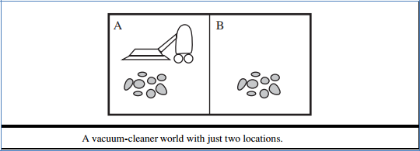
Intelligent Agents
Agents and its environment:
Percept
Percept sequence
Agent function
Agent table
Agent program
Example—the vacuum-cleaner world
This particular world has just two locations: squares A and B.
The vacuum agent perceives which square it is in and whether there is dirt in the square.
It can choose to move left, move right, suck up the dirt, or do nothing.

Slide 35
Concept of Rationality
Rationality means that an AI agent is assumed to take account of available information and uncertainty, potential costs and benefits, and to act consistently (logically) in choosing the best action.
What is rational at any given time depends on four things:
The performance measure that defines the criterion of success.
The agent’s prior knowledge of the environment.
The actions that the agent can perform.
The agent’s percept sequence to date.
A Rational Agent is an agent which takes the right action for every perception. By doing so, it maximizes the performance measure that makes an agent be the most successful.

Slide 36
Definition of a rational agent
ideal rational agent
“For each possible percept sequence, a rational agent should select an action that is expected to maximize its performance measure, given the evidence provided by the percept sequence and whatever built-in knowledge the agent has, that is the task of rational agent is to improve the performance measure depends on percept sequence”

Slide 37
Omniscience, learning, and autonomy
An omniscient agent knows the actual outcome of its actions and can act accordingly; but omniscience is impossible in reality
A rational agent not only to gather information but also to learn as much as possible from what it perceives. The agent’s initial configuration could reflect some prior knowledge of the environment, but as the agent gains experience this may be modified and augmented.
Successful agents split the task of computing the agent function into three different periods: when the agent is being designed, some of the computation is done by its designers; when it is deliberating on its next action, the agent does more computation; and as it learns from experience, it does even more computation to decide how to modify its behavior.
To the extent that an agent relies on the prior knowledge of its designer rather than AUTONOMY on its own percepts, we say that the agent lacks autonomy. A rational agent should be autonomous—it should learn what it can to compensate for partial or incorrect prior knowledge

Slide 38
Omniscient agent vs Rational agent
An omniscient (perfect) agent knows the actual outcome of its actions and can act accordingly; but perfection is impossible in reality.
• Rationality is NOT the same as perfection. • Rationality maximizes expected performance, while perfection maximizes actual performance.
Rational agents are different from Omniscient agents because a rational agent tries to get the best possible outcome with the current perception, which leads to imperfection. A chess AI can be a good example of a rational agent because, with the current action, it is not possible to foresee every possible outcome

Slide 39
Task Environment
Task environments are essentially the “problems” to which rational agents are the “solutions”.
Properties of TASK environment:
Fully observable vs. partially observable
Single agent vs. multi-agent
Deterministic vs. stochastic
Episodic vs. sequential
Static vs. dynamic
Discrete vs. continuous
Known vs. unknown

Slide 40
Task Environment
Task Environment | Observable | Agents | Deterministic/ Stochastic | Episodic/ Sequential | Static/ Dynamic | Discrete/ Continuous
Crossword Puzzle
Chess
Taxi-Driving
Medical Diagnosis
Image Analysis
Part-Picking Robot
Interactive English Tutor

Slide 41
Task Environment
Task Environment | Observable | Agents | Deterministic/ Stochastic | Episodic/ Sequential | Static/ Dynamic | Discrete/ Continuous
Crossword Puzzle | Fully | Single-Agent | Deterministic | Sequential | Static | Discrete
Chess | Fully | Multi-Agent | Stochastic | Sequential | Dynamic | Continuous
Taxi-Driving | Partially | Multi-Agent | Stochastic | Sequential | Dynamic | Continuous
Medical Diagnosis | Partially | Single-Agent | Stochastic | Sequential | Dynamic | Continuous
Image Analysis | Fully | Single-Agent | Stochastic | Episodic | Static | Continuous
Part-Picking Robot | Partially | Single-Agent | Stochastic | Episodic | Dynamic | Continuous
Interactive English Tutor | Partially | Multi-Agent | Stochastic | Sequential | Dynamic | Discrete

Slide 42
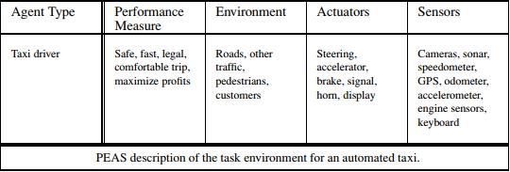
Specifying the task environment
For the acronymically minded, we call this the PEAS (Performance, Environment, Actuators, Sensors) description. In designing an agent, the first step must always be to specify the task environment as fully as possible.
Performance – which qualities it should have?
Environment – where it should act?
Actuators – how will it perform actions?
Sensors – how will it perceive environment?

Slide 43
Structure of an Agent
The job of AI is to design an agent program that implements the agent function— the mapping from percepts to actions. We assume the program will run on some sort of computing device with physical sensors and actuators – we call this architecture:
Agent = architecture + program
Agent program take the current percept as input from the sensors and return an action to the actuators.

Slide 44
Three Forms of Intelligent Agent
Intelligent Agent can come in any of the three forms, such as:-
Human-Agent
Robotic Agent
Software Agent

Slide 45
Three Forms of Intelligent Agent
These three forms are described below:
Human-Agent: A Human-Agent use Eyes, Nose, Tongue and other sensory organs as sensors to percept information from the environment and uses limbs and vocal-tract as actuators to perform an action based on the information
Robotic Agent: Robotics Agent uses cameras and infrared radars as sensors to record information from the Environment. It uses reflex motors as actuators to deliver output back to the environment.
Software Agent: Software Agents use keypad strokes, audio commands as input sensors and display screens as actuators.
For Example– AI-based smart assistants like Siri, Alexa. They use voice sensors to request the user’s request and search for the relevant information in secondary sources without human intervention, and actuators like its voice or text module relay information to the environment

Slide 46
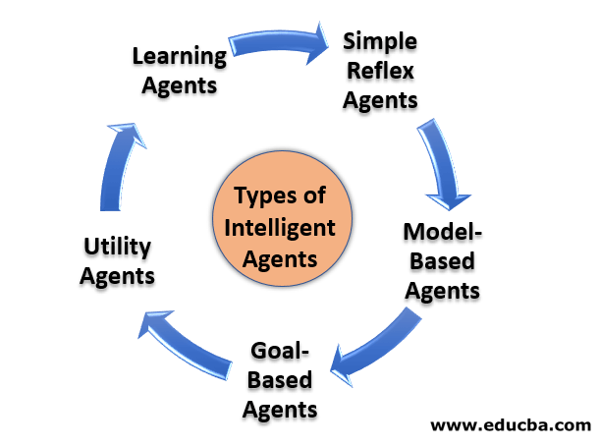
Intelligent Agent Types & its functionality
Five basic kinds of agent programs that embody the principles underlying almost all intelligent systems:
Simple reflex agents;
Model-based reflex agents;
Goal-based agents;
Utility-based agents.
Learning agents.

Slide 47
Simple Reflex Agents
They are the basic form of agents and function only in the current state. They have very low intelligence capability as they don’t have the ability to store past state. These types of agents respond to events based on pre-defined rules, which are pre-programmed. They perform well only when the environment is fully observable. Thus, these agents are helpful only in a limited number of cases, something like a smart thermostat. Simple Reflex Agents hold a static table from where they fetch all the pre-defined rules for acting.
Problems with Simple reflex agents are :
Very limited intelligence.
No knowledge of non-perceptual parts of the state.
Usually too big to generate and store.
If there occurs any change in the environment, then the collection of rules need to be updated.

Slide 48
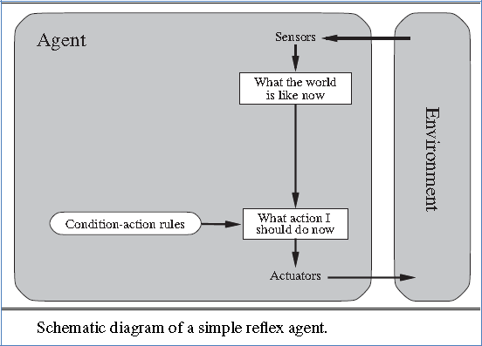
Intelligent Agent Types & its functionality
Simple reflex agents:

Slide 49
Model-based reflex agents:
It is an advanced version of the Simple Reflex agent. Like Simple Reflex Agents, it can also respond to events based on the pre-defined conditions; on top of that, it can store the internal state (past information) based on previous events. Model-Based Agents update the internal state at each step. These internal states aid agents in handling the partially observable environment. To perform any action, it relies on both internal state and current percept. However, it is almost impossible to find the exact state when dealing with a partially observable environment.
A model-based agent has two important factors:
Model: It is knowledge about "how things happen in the world," so it is called a Model-based agent.
Internal State: It is a representation of the current state based on percept history.
These agents have the model, "which is knowledge of the world" and based on the model they perform actions.
Updating the agent state requires information about:
How the world evolves
How the agent's action affects the world.

Slide 50
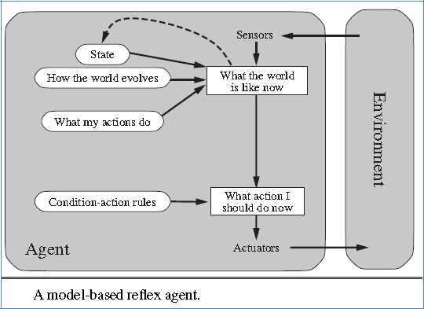
Intelligent Agent Types & its functionality
Model-based reflex agents:

Slide 51
Goal-Based Agents
The action taken by these agents depends on the distance from their goal (Desired Situation). The actions are intended to reduce the distance between the current state and the desired state. To attain its goal, it makes use of the search and planning algorithm. One drawback of Goal-Based Agents is that they don’t always select the most optimized path to reach the final goal.
The knowledge that supports its decisions is represented explicitly and can be modified, which makes these agents more flexible. They usually require search and planning. The goal-based agent’s behavior can easily be changed.
This shortfall can be overcome by using Utility Agent described below.

Slide 52
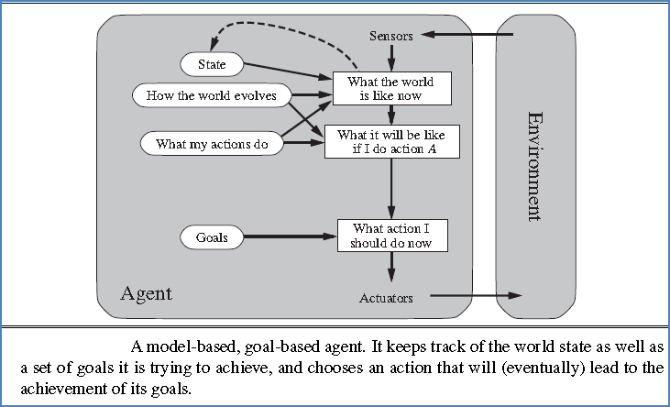
Intelligent Agent Types & its functionality
Goal-based agents:

Slide 53
4. Utility Agents
The action taken by these agents depends on the end objective, so they are called Utility Agents. Utility Agents are used when there are multiple solutions to a problem, and the best possible alternative has to be chosen. The alternative chosen is based on each state’s utility. Then, they perform a cost-benefit analysis of each solution and select one that can achieve the minimum cost goal.
Utility describes how “happy” the agent is. Because of the uncertainty in the world, a utility agent chooses the action that maximizes the expected utility. A utility function maps a state onto a real number which describes the associated degree of happiness.

Slide 54
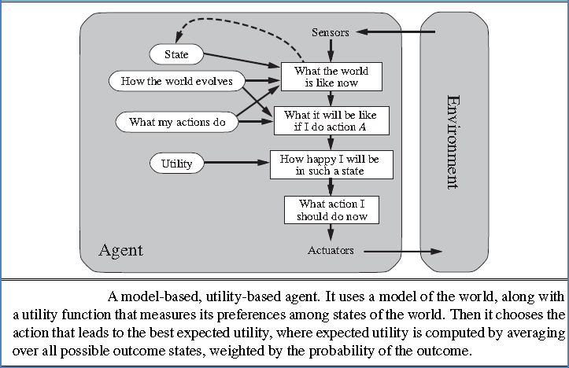
Intelligent Agent Types & its functionality
Utility-based agents:

Slide 55
5. Learning Agents
Learning Agents have learning abilities so that they can learn from their past experiences. These types of agents can start from scratch and, over time, can acquire significant knowledge from their environment. The learning agents have four major components which enable them to learn from their experience.
Learning element: It is responsible for making improvements by learning from the environment
Critic: The learning element takes feedback from critics which describes how well the agent is doing with respect to a fixed performance standard.
Performance element: It is responsible for selecting external action
Problem Generator: This component is responsible for suggesting actions that will lead to new and informative experiences.

Slide 56
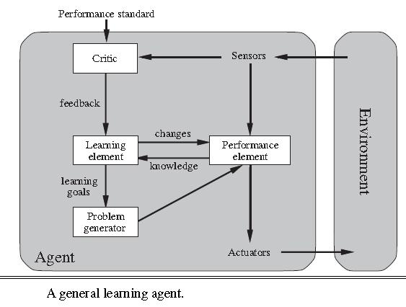
Intelligent Agent Types & its functionality
Learning agents:

Slide 57
Computer Vision
Computer vision is a field of computer science that works on enabling computers to see, identify and process images in the same way that human vision does, and then provide appropriate output. If AI enables computers to think, computer vision enables them to see, observe and understand.
Computer vision works much the same as human vision, except humans have a head start. Human sight has the advantage of lifetimes of context to train how to tell objects apart, how far away they are, whether they are moving and whether there is something wrong in an image.
Computer vision trains machines to perform these functions, but it has to do it in much less time with cameras, data and algorithms rather than retinas, optic nerves and a visual cortex. Because a system trained to inspect products or watch a production asset can analyze thousands of products or processes a minute, noticing imperceptible defects or issues, it can quickly surpass human capabilities.
Computer vision is used in industries ranging from energy and utilities to manufacturing and automotive – and the market is continuing to grow. It is expected to reach USD 48.6 billion by 2022.

Slide 58
Computer Vision Hierarchy:
Computer vision is divided into three basic categories that are as following:
Low-level vision: includes process image for feature extraction.
Intermediate-level vision: includes object recognition and 3D scene Interpretation
High-level vision: includes conceptual description of a scene like activity, intention and behavior.

Slide 59
How does computer vision work?
Computer vision needs lots of data. It runs analyses of data over and over until it discerns distinctions and ultimately recognize images. For example, to train a computer to recognize automobile tires, it needs to be fed vast quantities of tire images and tire-related items to learn the differences and recognize a tire, especially one with no defects.
Two essential technologies are used to accomplish this: a type of machine learning called deep learning and a convolutional neural network (CNN).

Slide 60
How does computer vision work?
Machine learning uses algorithmic models that enable a computer to teach itself about the context of visual data. If enough data is fed through the model, the computer will “look” at the data and teach itself to tell one image from another. Algorithms enable the machine to learn by itself, rather than someone programming it to recognize an image.
A CNN helps a machine learning or deep learning model “look” by breaking images down into pixels that are given tags or labels. It uses the labels to perform convolutions (a mathematical operation on two functions to produce a third function) and makes predictions about what it is “seeing.” The neural network runs convolutions and checks the accuracy of its predictions in a series of iterations until the predictions start to come true. It is then recognizing or seeing images in a way similar to humans.
Much like a human making out an image at a distance, a CNN first discerns hard edges and simple shapes, then fills in information as it runs iterations of its predictions. A CNN is used to understand single images. A recurrent neural network (RNN) is used in a similar way for video applications to help computers understand how pictures in a series of frames are related to one another.

Slide 61
Computer vision applications
Applications are:
face recognition,
object recognition,
location recognition and tracking,
Forensics,
Virtual Reality,
Robotics,
Navigation Security

Slide 62
Computer vision examples
Image classification sees an image and can classify it (a dog, an apple, a person’s face). More precisely, it is able to accurately predict that a given image belongs to a certain class. For example, a social media company might want to use it to automatically identify and segregate objectionable images uploaded by users.
Object detection can use image classification to identify a certain class of image and then detect and tabulate their appearance in an image or video. Examples include detecting damages on an assembly line or identifying machinery that requires maintenance.
Object tracking follows or tracks an object once it is detected. This task is often executed with images captured in sequence or real-time video feeds. Autonomous vehicles, for example, need to not only classify and detect objects such as pedestrians, other cars and road infrastructure, they need to track them in motion to avoid collisions and obey traffic laws.(7)
Content-based image retrieval uses computer vision to browse, search and retrieve images from large data stores, based on the content of the images rather than metadata tags associated with them. This task can incorporate automatic image annotation that replaces manual image tagging. These tasks can be used for digital asset management systems and can increase the accuracy of search and retrieval.

Slide 63
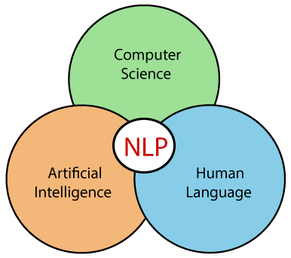
Natural Language Processing (NLP)
NLP stands for Natural Language Processing, which is a part of Computer Science, Human language, and Artificial Intelligence. It is the technology that is used by machines to understand, analyse, manipulate, and interpret human's languages. It helps developers to organize knowledge for performing tasks such as translation, automatic summarization, Named Entity Recognition (NER), speech recognition, relationship extraction, and topic segmentation.

Slide 64
History of NLP
(1940-1960) - Focused on Machine Translation (MT)
The Natural Languages Processing started in the year 1940s.
1948 - In the Year 1948, the first recognizable NLP application was introduced in Birkbeck College, London.
1950s - In the Year 1950s, there was a conflicting view between linguistics and computer science. Now, Chomsky developed his first book syntactic structures and claimed that language is generative in nature.
In 1957, Chomsky also introduced the idea of Generative Grammar, which is rule based descriptions of syntactic structures.
(1960-1980) - Flavored with Artificial Intelligence (AI)

Slide 65
Advantages of NLP
NLP helps users to ask questions about any subject and get a direct response within seconds.
NLP offers exact answers to the question means it does not offer unnecessary and unwanted information.
NLP helps computers to communicate with humans in their languages.
It is very time efficient.
Most of the companies use NLP to improve the efficiency of documentation processes, accuracy of documentation, and identify the information from large databases.

Slide 66
Disadvantages of NLP
A list of disadvantages of NLP is given below:
NLP is unpredictable
NLP may require more keystrokes.
NLP is unable to adapt to the new domain, and it has a limited function that's why NLP is built for a single and specific task only.

Slide 67
Components of NLP
There are the following two components of NLP -
Natural Language Understanding (NLU) Natural Language Understanding (NLU) helps the machine to understand and analyse human language by extracting the metadata from content such as concepts, entities, keywords, emotion, relations, and semantic roles.
NLU mainly used in Business applications to understand the customer's problem in both spoken and written language.
NLU involves the following tasks -
It is used to map the given input into useful representation.
It is used to analyze different aspects of the language.
Natural Language Generation (NLG) Natural Language Generation (NLG) acts as a translator that converts the computerized data into natural language representation. It mainly involves Text planning, Sentence planning, and Text Realization.

Slide 68
Difference between NLU and NLG
NLU | NLG
NLU is the process of reading and interpreting language. | NLG is the process of writing or generating language.
It produces non-linguistic outputs from natural language inputs. | It produces constructing natural language outputs from non-linguistic inputs.

Slide 69
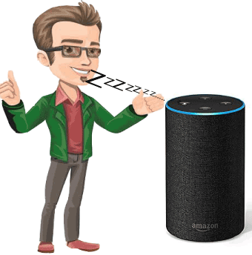
Applications of NLP
There are the following applications of NLP -
Question Answering
Question Answering focuses on building systems that automatically answer the questions asked by humans in a natural language.

Slide 70
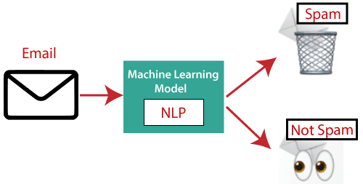
Applications of NLP
Spam Detection

Slide 71

Applications of NLP
Sentiment Analysis
Sentiment Analysis is also known as opinion mining. It is used on the web to analyse the attitude, behaviour, and emotional state of the sender. This application is implemented through a combination of NLP (Natural Language Processing) and statistics by assigning the values to the text (positive, negative, or natural), identify the mood of the context (happy, sad, angry, etc.)

Slide 72
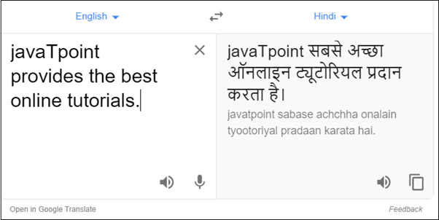
Applications of NLP
Machine Translation

Slide 73
Applications of NLP
Spelling correction
Speech Recognition Speech recognition is used for converting spoken words into text. It is used in applications, such as mobile, home automation, video recovery, dictating to Microsoft Word, voice biometrics, voice user interface, and so on.
Chatbot Implementing the Chatbot is one of the important applications of NLP. It is used by many companies to provide the customer's chat services.
Information extraction Information extraction is one of the most important applications of NLP. It is used for extracting structured information from unstructured or semi-structured machine-readable documents.

Slide 74
Thanks

