Slide 1
Artificial Intelligence RCA-403

Slide 2
Syllabus
UNIT-I INTRODUCTION: - Introduction to Artificial Intelligence, Foundations and History of Artificial Intelligence, Applications of Artificial Intelligence, Intelligent Agents, Structure of Intelligent Agents. Computer vision, Natural Language Possessing.
UNIT-II INTRODUCTION TO SEARCH: - Searching for solutions, uniformed search strategies, informed search strategies, Local search algorithms and optimistic problems, Adversarial Search, Search for Games, Alpha - Beta pruning.
UNIT-III KNOWLEDGE REPRESENTATION & REASONING: - Propositional logic, Theory of first order logic, Inference in First order logic, Forward & Backward chaining, Resolution, Probabilistic reasoning, Utility theory, Hidden Markov Models (HMM), Bayesian Networks.

Slide 3
Syllabus
UNIT-IV MACHINE LEARNING: - Supervised and unsupervised learning, Decision trees, Statistical learning models, learning with complete data - Naive Bayes models, Learning with hidden data – EM algorithm, Reinforcement learning.
UNIT-V PATTERN RECOGNITION: - Introduction, Design principles of pattern recognition system, Statistical Pattern recognition, Parameter estimation methods - Principle Component Analysis (PCA) and Linear Discriminant Analysis (LDA), Classification Techniques – Nearest Neighbor (NN) Rule, Bayes Classifier, Support Vector Machine (SVM), K – means clustering.

Slide 4
UNIT-II

Slide 5
Introduction to Search: Problem solving through AI
Problem solving is the method to reach the desired goal or finding a solution to a given situation. This method of solving problem through AI involves the process of defining the search space, deciding start state and goal state and then finding the path from start state to goal state through search space.
The movement from start state to goal state is guided by set of rules specifically designed for that particular problem called the production rules. The production rules are the valid moves described by the problems

Slide 6
Introduction to Search: Problem solving through AI
The reflex agent of AI directly maps states into action. Whenever these agents fail to operate in an environment where the state of mapping is too large and not easily performed by the agent, then the stated problem dissolves and sent to a problem-solving domain which breaks the large stored problem into the smaller storage area and resolves one by one. The final integrated action will be the desired outcomes.
On the basis of the problem and their working domain, different types of problem-solving agent defined and use at an atomic level without any internal state visible with a problem-solving algorithm. The problem-solving agent performs precisely by defining problems and several solutions. So we can say that problem solving is a part of artificial intelligence that encompasses a number of techniques such as a tree, B-tree, heuristic algorithms to solve a problem.
We can also say that a problem-solving agent is a result-driven agent and always focuses on satisfying the goals.

Slide 7
Introduction to Search: Problem solving through AI
Steps problem-solving in AI: The problem of AI is directly associated with the nature of humans and their activities. So we need a number of finite steps to solve a problem which makes human easy works.
These are the following steps which require to solve a problem :
Goal Formulation: This one is the first and simple step in problem-solving. It organizes finite steps to formulate a target/goals which require some action to achieve the goal. Today the formulation of the goal is based on AI agents.
Problem formulation: It is one of the core steps of problem-solving which decides what action should be taken to achieve the formulated goal. In AI this core part is dependent upon software agent which consisted of the following components to formulate the associated problem.

Slide 8
Introduction to Search: Problem solving through AI
State Space representation of problem
A State is a representation of problem elements at a given moment.
A State Space is the set of all states reachable from the initial state.
A state space forms a graph in which the nodes are states and the arcs between nodes are actions.
In the state space, a path is a sequence of states connected by a sequence of actions.
Problem: It is the question which is to be solved.
Search is the process of finding the solution in state space.
Well-defined problem has three major components: initial state, final (goal) state, space including transition function or path function.
A Solution of the problem is a path from initial state to goal state

Slide 9
Introduction to Search: Problem solving through AI
Components to formulate the associated problem:
Initial State: This state requires an initial state for the problem which starts the AI agent towards a specified goal. In this state new methods also initialize problem domain solving by a specific class.
Action: This stage of problem formulation works with function with a specific class taken from the initial state and all possible actions done in this stage.
Transition: This stage of problem formulation integrates the actual action done by the previous action stage and collects the final stage to forward it to their next stage.
Goal test: This stage determines that the specified goal achieved by the integrated transition model or not, whenever the goal achieves stop the action and forward into the next stage to determines the cost to achieve the goal.
Path costing: This component of problem-solving numerical assigned what will be the cost to achieve the goal. It requires all hardware software and human working cost.

Slide 10
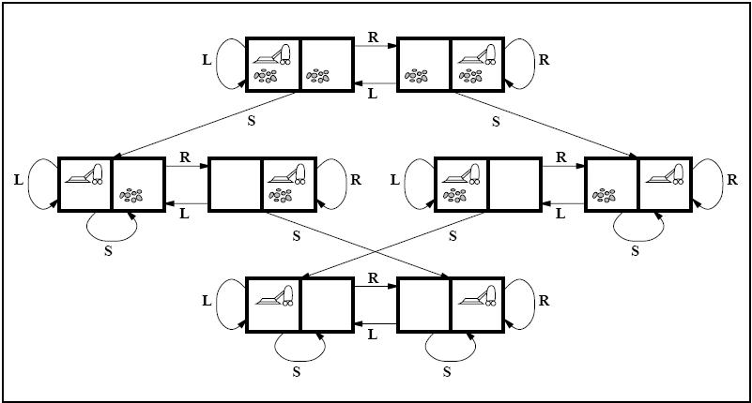
Introduction to Search: Problem solving through AI
Example: Vacuum Cleaning Agent
States: The state is determined by both the agent location and the dirt locations
Initial State: Any state can be designated as the initial state.
Actions: Left, Right, and Suck.
Goal: This checks whether all the squares are clean.
Path Cost: Each steps costs 1, so the path cost is the number of steps in the path.

Slide 11
Introduction to Search: Problem solving through AI
Example: 8 Puzzle Problem
The eight tile puzzle consist of a 3 by 3 (3*3) square frame board which holds 8 movable tiles numbered 1 to 8. One square is empty, allowing the adjacent tiles to be shifted. The objective of the puzzle is to find a sequence of tile movements that leads from a starting configuration to a goal configuration.
7 | 4 | 2
1 | 5
6 | 3 | 8
1 | 2 | 3
8 |  | 4
7 | 6 | 5

Slide 12
Introduction to Search: Problem solving through AI
Example: 8 Puzzle Problem
States: It specifies the location of each of the 8 tiles and the blank in one of the nine squares.
Initial state: Any state can be designated as the initial state.
Goal: Many goal configurations are possible one such is shown in the figure
Legal moves ( or state): They generate legal states that result from trying the four actions-
Blank moves left
Blank moves right
Blank moves up
Blank moves down
Path cost: Each step costs 1, so the path cost is the number of steps in the path.

Slide 13
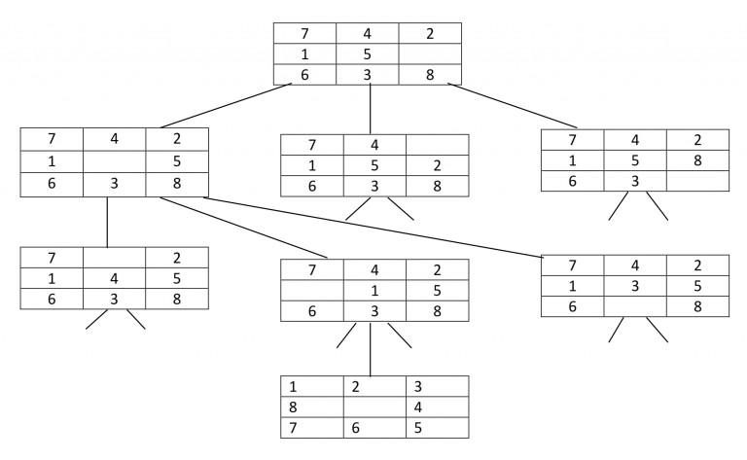
Introduction to Search: Problem solving through AI
Example: 8 Puzzle Problem (Search/ State Space Representation)

Slide 14
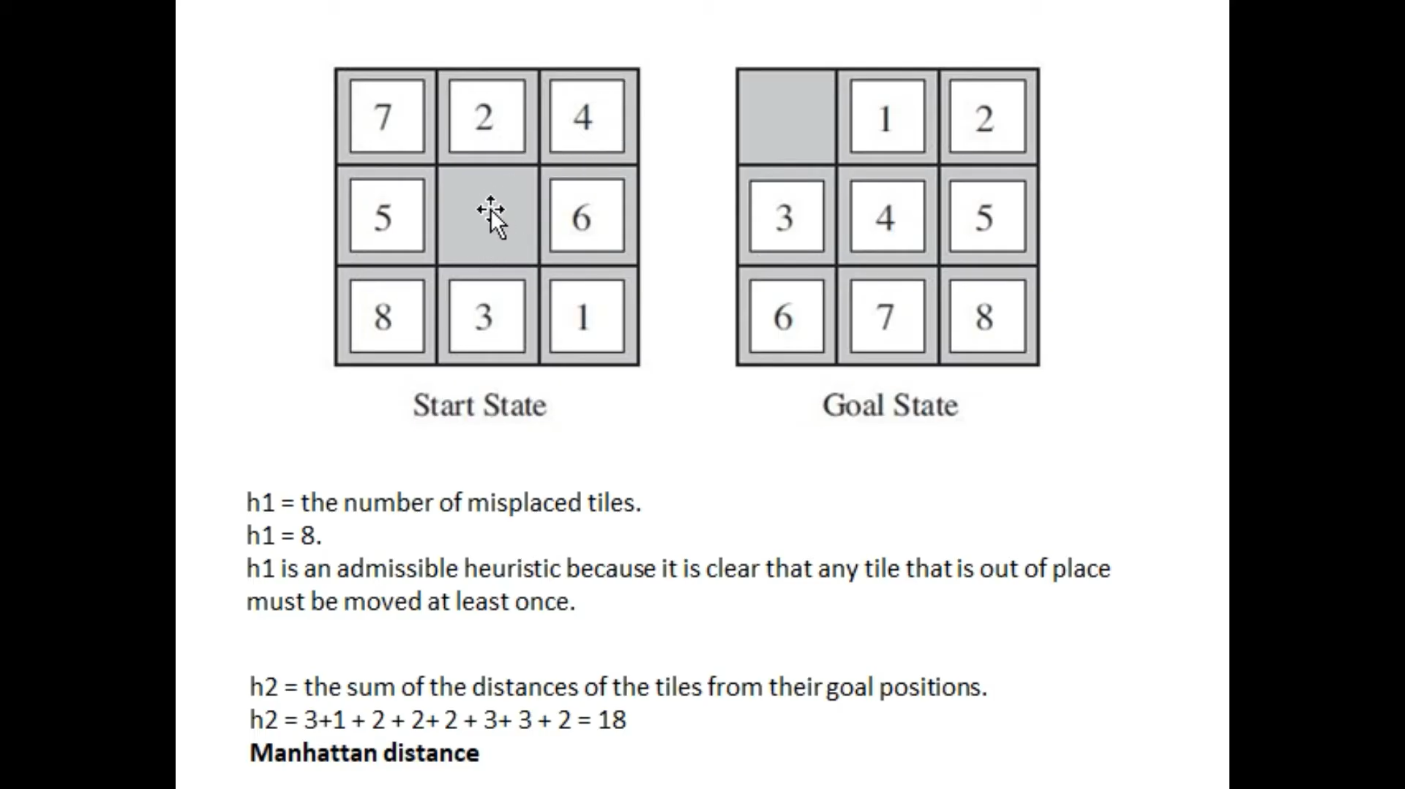

Slide 15
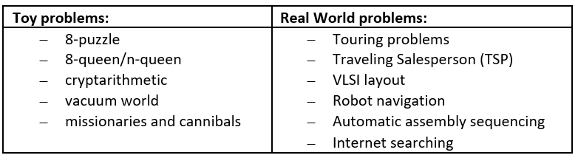
Toy Problem Vs. Real World Problem

Slide 16
Cryptarithmetic Problem
Cryptarithmetic Problem is a type of constraint satisfaction problem where the game is about digits and its unique replacement either with alphabets or other symbols. In cryptarithmetic problem, the digits (0-9) get substituted by some possible alphabets or symbols. The task in cryptarithmetic problem is to substitute each digit with an alphabet to get the result arithmetically correct. We can perform all the arithmetic operations on a given cryptarithmetic problem.
The rules or constraints on a cryptarithmetic problem are as follows:
There should be a unique digit to be replaced with a unique alphabet.
The result should satisfy the predefined arithmetic rules, i.e., 2+2 =4, nothing else.
Digits should be from 0-9 only.
There should be only one carry forward, while performing the addition operation on a problem.
The problem can be solved from both sides, i.e., lefthand side (L.H.S), or righthand side (R.H.S)
Let’s understand the cryptarithmetic problem as well its constraints better with the help of an example:
Given a cryptarithmetic problem, i.e., S E N D + M O R E = M O N E Y

Slide 17
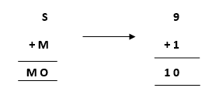
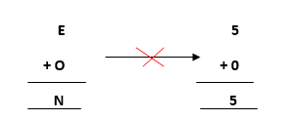
Cryptarithmetic Problem S E N D + M O R E = M O N E Y
Follow the below steps to understand the given problem by breaking it into its subparts:
Starting from the left hand side (L.H.S) , the terms are S and M. Assign a digit which could give a satisfactory result. Let’s assign S->9 and M->1.
Hence, we get a satisfactory result by adding up the terms and got an assignment for O as O->0 as well.
Now, move ahead to the next terms E and O to get N as its output.

Slide 18
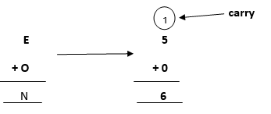
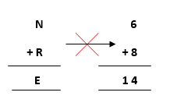
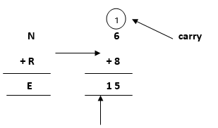
Cryptarithmetic Problem S E N D + M O R E = M O N E Y
Adding E and O, which means 5+0=0, which is not possible because according to cryptarithmetic constraints, we cannot assign the same digit to two letters. So, we need to think more and assign some other value.
Note: When we will solve further, we will get one carry, so after applying it, the answer will be satisfied.
Further, adding the next two terms N and R we get,
But, we have already assigned E->5. Thus, the above result does not satisfy the values
because we are getting a different value for E. So, we need to think more.
Again, after solving the whole problem, we will get a carryover on this term, so our answer will be satisfied.
where 1 will be carry forward to the above term

Slide 19
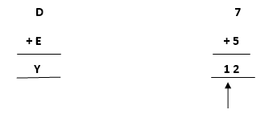
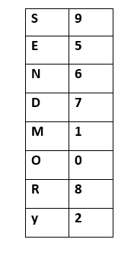

Cryptarithmetic Problem S E N D + M O R E = M O N E Y
Let’s move ahead.
Again, on adding the last two terms, i.e., the rightmost terms D and E, we get Y as its result.
Keeping all the constraints in mind, the final resultant is as follows:
where 1 will be carry forward to the above term
This is the representation of the assignment of the digits to the alphabets.

Slide 20
Problem Representation in AI
The most common methods of problem representation in AI are:-
State Space Representation
Problem Reduction
PRODUCTION SYSTEM
The production system is a model of computation that can be applied to implement search algorithms and model human problem solving. Such problem solving knowledge can be packed up in the form of little quanta called productions. It consists of:
Set of rules
Database
Control strategy
Rule applier

Slide 21
Problem Representation in AI
Production System: Four classes of production systems
A monotonic production system
A non monotonic production system
A partially commutative production system
A commutative production system
Advantages of production systems
Production systems provide an excellent tool for structuring AI programs.
Production Systems are highly modular because the individual rules can be added, removed or modified independently.
Disadvantage is the facts that it may be very difficult analyze the flow of control within a production system because the individual rules don’t call each other.

Slide 22
Problem Representation in AI
Water-Jug Problem:
Statement: We are given 2 jugs, a 4-litre one and a 3-litre one. Neither have any measuring markers on it. There is a pump that can be used to fill the jugs with water. How can we get exactly 2 litres of water into the 4-litre jug?
The state space for this problem can be defined as
{(x, y) where x = 0,1,2,3,4 & y = 0,1,2,3}
‘x’ represents the number of liters of water in the 4-litre jug and ‘y’ represents the number of litre of water in the 3-litre jug. The initial state is (0, 0) that is no water on each jug. The goal state is to get (2, n) for any value of ‘n’.
PRODUCTION SYSTEM

Slide 23
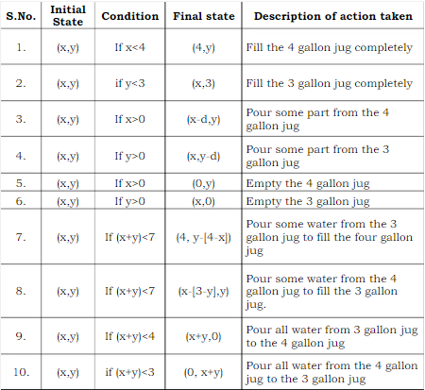
Problem Representation in AI
Assumptions:
We can fill a jug from the pump.
We can pour water out of a jug to the ground.
We can pour water from one jug to another.
There is no measuring device available.
The production rules for “WATER-JUG” Problem are formulated as →
PRODUCTION SYSTEM

Slide 24
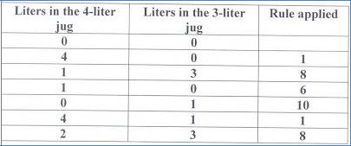
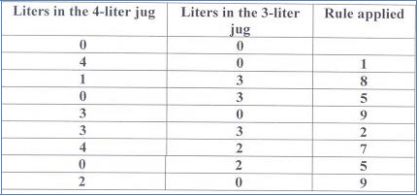
Problem Representation in AI
One solution is applying the rules in the sequence 2, 9, 2, 7, 5, 9. The solution is presented in the following table:-
Rule Applied | Water in 4 litre jug | Water in 3 litre jug
Start State | 0 | 0
2 | 0 | 3
9 | 3 | 0
2 | 3 | 3
7 | 4 | 2
5 | 0 | 2
9 | 2 | 0
PRODUCTION SYSTEM

Slide 25
Problem Representation in AI
Missionaries & Cannibals
Statement: In this problem, three missionaries and three cannibals must cross a river using a boat which can carry at most two people, under the constraint that, for both banks, that the missionaries present on the bank cannot be outnumbered by cannibals. The boat cannot cross the river by itself with no people on board.
ASSUMPTION: Consider that both the missionaries (M) and cannibals(C) are on the same side of the river.
PRODUCTION SYSTEM

Slide 26
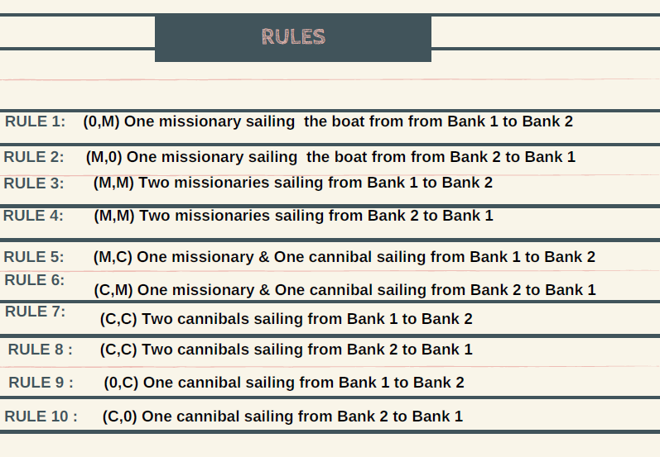
Problem Representation in AI
The production rules for “Missionaries & Cannibals” Problem are formulated as →
PRODUCTION SYSTEM

Slide 27
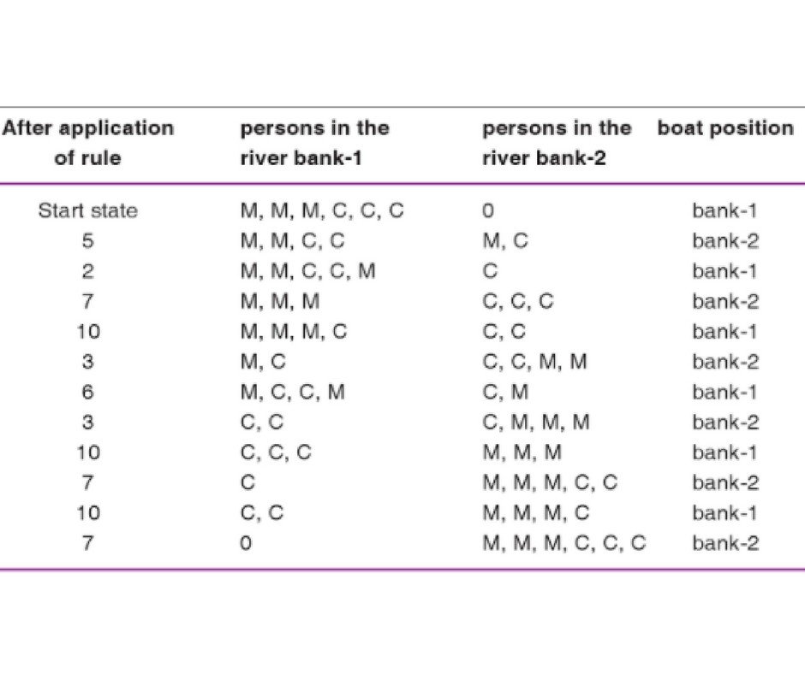
Problem Representation in AI
One solution is applying the rules in the sequence (5,2,7,10,3,6,3,10,7,10,7).The solution is presented in the RHS table →
PRODUCTION SYSTEM

Slide 28
AI & Search Process
Searching can be defined as a sequence of steps that transforms the initial state to the goal state. The searching process in AI can be broadly classified into two major types:
Brute Force Search or uninformed or blind search.
Heuristic Search or informed search.
Measuring Problem-Solving Performance
Completeness
Optimality
Time Complexity
Space Complexity

Slide 29
AI & Search Process
Uninformed or Blind search or Brute Force Search: Uninformed search algorithms do not have additional information about state or search space other than how to traverse the tree, so it is also called blind search.
Various Uninformed search are:
Breadth-first search
Uniform-cost search
Depth-first search and Depth-limited search
Iterative deepening depth-first search
Bidirectional search

Slide 30
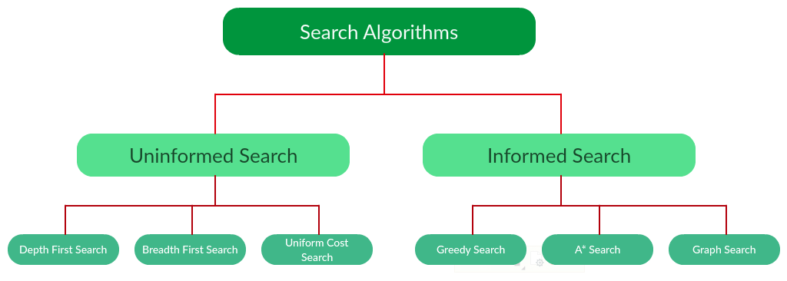

Slide 31
AI & Search Process
Heuristic Search or informed search: Informed search algorithm contains an array of knowledge such as how far we are from the goal, path cost, how to reach to goal node, etc. ... This knowledge help agents to explore less to the search space and find more efficiently the goal node.
Various Informed search are:
Hill Climbing
Best-First Search
A* Algorithm
AO* Algorithm
Beam Search
Constraint Satisfaction
Min-Max Search & Alpha - Beta pruning

Slide 32
Uninformed Search Techniques
Breadth First Search (BFS)
Breadth First Search (BFS) searches breadth-wise in the problem space.
BFS was invented in late 1950s by E. F. Moore, who used it find shortest path out of a maze.
Breadth-First search is like traversing a tree where each node is a state which may be a potential candidate for solution.
It expands nodes from the root of the tree and then generates one level of the tree at a time until a solution is found.
It is very easily implemented by maintaining a queue (FIFO) of nodes

Slide 33
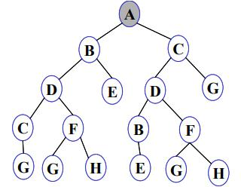
Uninformed Search Techniques
A
B
C
D
E
D
G
C
F
B
F
Breadth First Search (BFS): Consider the following State Space Search
FRINGE
BFS traverse is ABCDEDG (Explore nodes). As G is the GOAL node

Slide 34
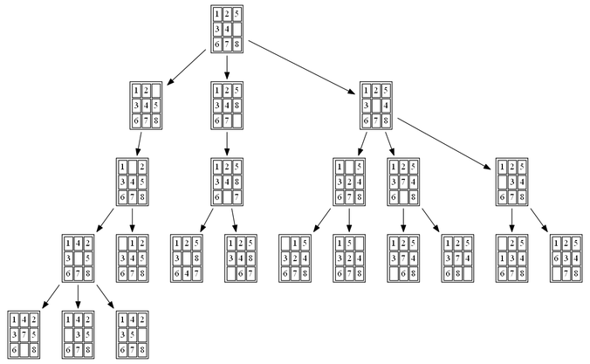
Uninformed Search Techniques
Breadth First Search (BFS):
8-Puzzle Problem

Slide 35
Uninformed Search Techniques
Breadth First Search (BFS)
Advantages:
Finds the path of minimal length to the goal - If there is more than one solution then BFS can find the minimal one that requires less number of steps.
If there is a solution, BFS will definitely find it out.
Disadvantages:
Amount of memory is proportional to the number of nodes stored,
If the solution is farther away from the root, breath first search will consume lot of time.

Slide 36
Uninformed Search Techniques
Performance Measure of Breadth First Search (BFS)
Completeness: it is easy to see that breadth-first search is complete that it visit all levels given that d factor is finite, so in some d it will find a solution.
Optimality: breadth-first search is not optimal until all actions have the same cost (because it always finds the shallowest node first)
Space complexity: O(b^{d})
Time Complexity: O(b^{d})
Note: b is branching factor and d is the depth of a tree

Slide 37
Uninformed Search Techniques
Uniform Cost Search (UCS)
Uniform-cost search expands nodes in order of their cost from the root.
Uniform-cost is guided by path cost rather than path length like in BFS
The algorithms starts by expanding the root, then expanding the node with the lowest cost from the root, the search continues in this manner for all nodes. The nodes are stored in a priority queue.
Uniform Cost Search can also be used as Breadth First Search if all the edges are given a cost of 1.

Slide 38
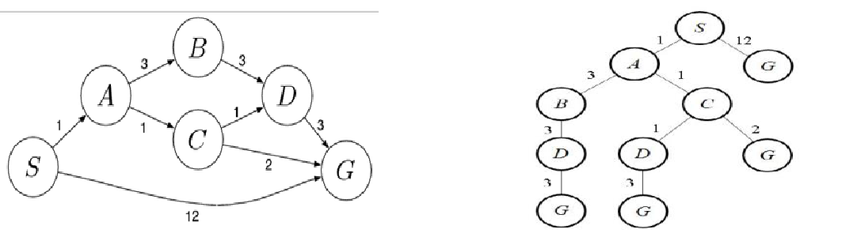
Uninformed Search Techniques
Uniform Cost Search (UCS): Consider the following State Space Search
Initialization: {[S, 0]}
{[S→A , 1], [S→G, 12]}
{[S→A→C, 2], [S→A→B, 4], [S→G, 12]}
{[S→A→C→D, 3], [S→A→B, 4], [S→A→C→G, 4 ], [S→G, 12]}
{[S→A→B, 4], [S→A→C→G, 4], [S→A→C→D→G, 6], [S→G, 12]}
{[S→A→C→G, 4], [S→A→C→D→G, 6], [S→A→B→D, 7], [S→G, 12]}
Gives the final output as S→A→C→G.
Final Path is SACG

Slide 39
Uninformed Search Techniques
Uniform Cost Search (UCS)
Advantages:
Guaranteed to find the least-cost solution
Disadvantages:
Exponential storage required.
Open list must be kept sorted (as a priority queue).
Must change cost of a node on open if a lower-cost path to it is found.

Slide 40
Uninformed Search Techniques
Performance Measure of Uniform Cost Search (UCS)
Completeness: It is obvious that UCS is complete if the cost of each step exceeds some small positive integer, this to prevent infinite loops..
Optimality: UCS is always optimal in the sense that the node that it always expands is the node with the least path cost.
Space complexity: UCS is guided by path cost rather than path length so it is hard to determine its complexity in terms of b and d, so if we consider C to be the cost of the optimal solution, and every action costs at least e, then the algorithm worst case is O(b^{C/e}).
Time Complexity: O(b^{C/e})
Note: C is cost of optimal solution and every action costs at least e

Slide 41
Uninformed Search Techniques
Depth First Search (DFS)
DFS progresses by expanding the first child node of the search tree that appears and thus going deeper and deeper until a goal node is found, or until it hits a node that has no children. Then the search backtracks, returning to the most recent node it hasn’t finished exploring. DFS investigated in 19th century by French Mathematician Charles Pierre as a strategy for solving mazes.
DFS is implemented using STACK (Last In First Out)

Slide 42
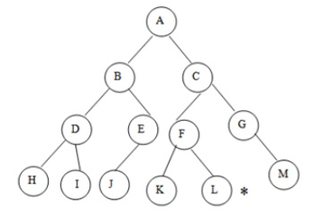
Uninformed Search Techniques
Depth First Search (DFS): Consider the following State Space Search
A
B | C
B | F | G
B | F | M
B | F
B | K | L
DFS traverses ACGMFL (Explore nodes). As L is the GOAL node

Slide 43
Uninformed Search Techniques
Depth First Search (DFS)
Advantages:
Depth-first search requires less memory since only the nodes on the current path are stored. This contrasts with breadth-first search, where all of the trees that have so far been generated must be stored.
The depth-first search may find a solution without examining much of the search space at all. This contrasts with breadth-first search in which all parts of the tree must be examined to level n before any nodes on level n + i can be examined. This is particularly significant if many acceptable solutions exist. Depth-first search can stop when one of them is found.
Disadvantages:
May find a sub-optimal solution (one that is deeper or more costly than the best solution)
Incomplete: without a depth bound, one may not find a solution even if one exists.

Slide 44
Uninformed Search Techniques
Performance Measure of Depth First Search(DFS)
Completeness: DFS is not complete
Optimality: DFS is not optimal
Time complexity: O(b^{m}).
Space Complexity: O(bm)
Note: b is branching factor and m is the maximum depth
When is DFS appropriate? space is restricted solutions tend to occur at the same depth in the tree you know how to order nodes in the list of neighbours so that solutions will be found relatively quickly

Slide 45
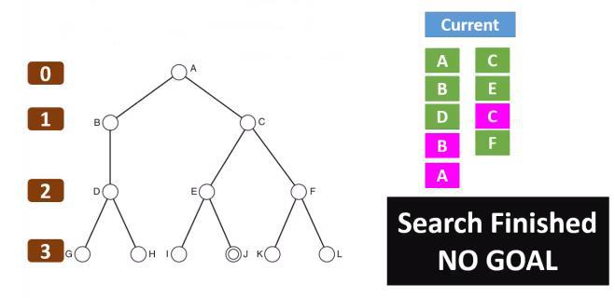
Uninformed Search Techniques
Depth Limited Search (DLS)
The unbounded tree problem appeared in DFS can be fixed by imposing a limit on the depth that DFS can reach, this limit we will call depth limit l, this solves the infinite path problem. Consider the following state graph with Depth is 2 and Goal node is J

Slide 46
Uninformed Search Techniques Depth Limited Search (DLS)
Depth limited search is the new search algorithm for uninformed search. The unbounded tree problem happens to appear in the depth-first search algorithm, and it can be fixed by imposing a boundary or a limit to the depth of the search domain. We will say that this limit as the depth limit, making the DFS search strategy more refined and organized into a finite loop. We denote this limit by l, and thus this provides the solution to the infinite path problem that originated earlier in the DFS algorithm. Thus, Depth limited search can be called an extended and refined version of the DFS algorithm. In a nutshell, we can say that to avoid the infinite loop status while executing the codes, and depth limited search algorithm is being executed into a finite set of depth called depth limit

Slide 47
Uninformed Search Techniques Depth Limited Search (DLS)
This algorithm essentially follows a similar set of steps as in the DFS algorithm.
The start node or node 1 is added to the beginning of the stack.
Then it is marked as visited, and if node 1 is not the goal node in the search, then we push second node 2 on top of the stack.
Next, we mark it as visited and check if node 2 is the goal node or not.
If node 2 is not found to be the goal node, then we push node 4 on top of the stack.
Now we search in the same depth limit and move along depth-wise to check for the goal nodes.
If Node 4 is also not found to be the goal node and depth limit is found to be reached, then we retrace back to nearest nodes that remain unvisited or unexplored.
Then we push them into the stack and mark them visited.
We continue to perform these steps in iterative ways unless the goal node is reached or until all nodes within depth limit have been explored for the goal.

Slide 48
Uninformed Search Techniques Depth Limited Search (DLS)
When we compare the above steps with DFS, we may found that DLS can also be implemented using the queue data structure. In addition to each level of the node needs to be computed to check the finiteness and reach of the goal node from the source node.
Depth-limited search is found to terminate under these two clauses:
When the goal node is found to exist.
When there is no solution within the given depth limit domain.

Slide 49
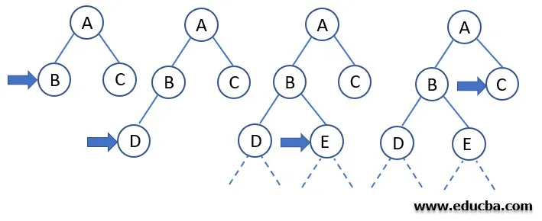
Uninformed Search Techniques Depth Limited Search (DLS)

Slide 50
Uninformed Search Techniques Depth Limited Search (DLS)
Algorithm of the example
We start with finding and fixing a start node.
Then we search along with the depth using the DFS algorithm.
Then we keep checking if the current node is the goal node or not.
If the answer is no: then we do nothing.
If the answer is yes: then we return.
Now we will check whether the current node is lying under the depth limit specified earlier or not.
If the answer is not: then we do nothing.
If the answer is yes, we will explore the node further and save all of its successors into a stack.
Now we call the function of DLS iteratively or recursively for all the nodes of the stack and go back to step 2.
Thus we have successfully explored all the nodes in the given depth limit and found the goal node if it exists within a specified depth limit.

Slide 51
Uninformed Search Techniques Depth Limited Search (DLS)
Advantages of Depth Limited Search
Depth limited search is better than DFS and requires less time and memory space.
DFS assures that the solution will be found if it exists infinite time.
There are applications of DLS in graph theory particularly similar to the DFS.
To combat the disadvantages of DFS, we add a limit to the depth, and our search strategy performs recursively down the search tree.
Disadvantages of Depth Limited Search
The depth limit is compulsory for this algorithm to execute.
The goal node may not exist in the depth limit set earlier, which will push the user to iterate further adding execution time.
The goal node will not be found if it does not exist in the desired limit.

Slide 52
Uninformed Search Techniques Depth Limited Search (DLS)
Performance Measure of Depth Limited Search (DLS)
Completeness: The limited path introduces another problem which is the case when we choose l < d, in which is our DLS will never reach a goal, in this case we can say that DLS is not complete.
Optimality: One can view DFS as a special case of the depth DLS, that DFS is DLS with l = infinity. DLS is not optimal even if l > d.
Space complexity: O(bl)
Time Complexity: O(b^{l})
Note: b is branching factor and l is the limited depth (l < d) as d is depth of tree

Slide 53
Uninformed Search Techniques
Depth-First Iterative Deepening Search
It is a search strategy resulting when you combine BFS and DFS, thus combining the advantages of each strategy, taking the completeness and optimality of BFS and the modest memory requirements of DFS.
IDS works by looking for the best search depth d, thus starting with depth limit 0 and make a BFS and if the search failed it increase the depth limit by 1 and try a BFS again with depth 1 and so on – first d = 0, then 1 then 2 and so on – until a depth d is reached where a goal is found.

Slide 54
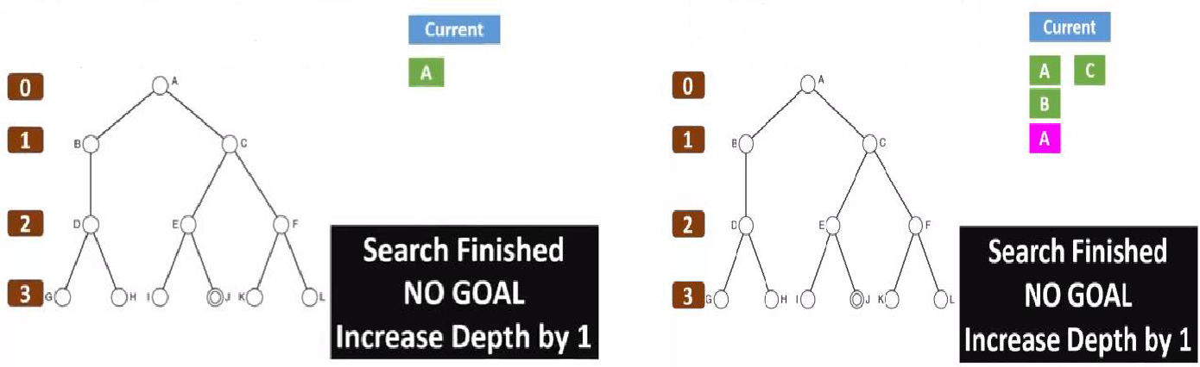
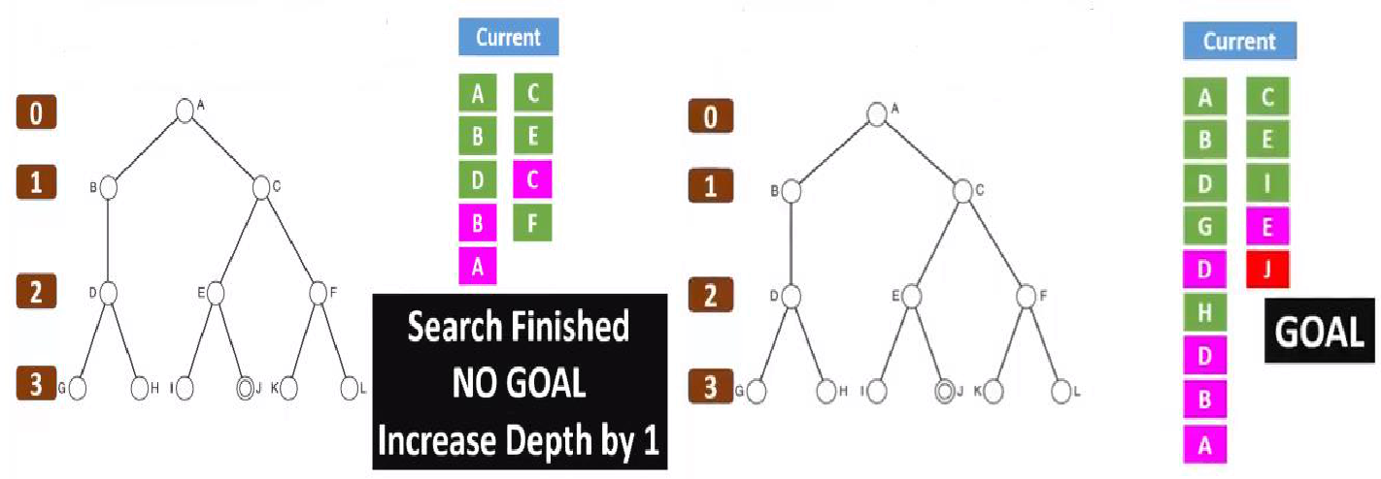
Uninformed Search Techniques
Depth-First Iterative Deepening Search Example:

Slide 55
Uninformed Search Techniques
Performance Measure of Depth-First Iterative Deepening Search (IDS)
Completeness: IDS is like BFS, is complete when the branching factor b is finite
Optimality: IDS is also like BFS optimal when the steps are of the same cost.
Space complexity: O(bd)
Time Complexity: O(b^{d})
Note: b is branching factor and d is depth of tree

Slide 56
Uninformed Search Techniques
Bi-directional Search
Bidirectional Search, as the name implies, searches in two directions at the same time: one forward from the initial state and the other backward from the goal
We can consider bidirectional approach when-
Both initial and goal states are unique and completely defined.
The branching factor is exactly the same in both directions.

Slide 57
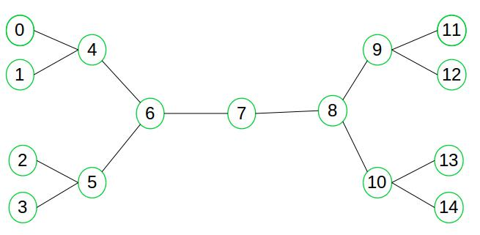
Uninformed Search Techniques
Bi-directional Search: Consider the following state graph, suppose we need to find if there exists a path from vertex 0 to vertex 14.

Slide 58
Uninformed Search Techniques
Bi-directional Search
Advantages:
The merit of bidirectional search is its speed. Sum of the time taken by two searches (forward and backward) is much less than the O(bd) complexity.
It requires less memory.
Disadvantages:
Implementation of bidirectional search algorithm is difficult because additional logic must be included to decide which search tree to extend at each step.
One should have known the goal state in advance.
The algorithm must be too efficient to find the intersection of the two search trees.
It is not always possible to search backward through possible states.

Slide 59
Uninformed Search Techniques
Performance Measure of Bi-directional Search
Completeness: Bidirectional search is complete when we use BFS in both searches, the search that starts from the initial state and the other from the goal state.
Optimality: Bidirectional search is optimal when BFS is used and paths are of a uniform cost – all steps of the same cost.
Space complexity: O(b^{d/2})
Time Complexity: O(b^{d/2})
Note: b is branching factor and d is depth of tree

Slide 60
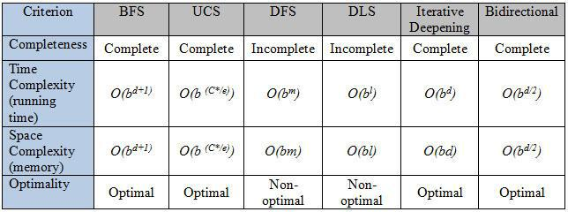
Uninformed Search Techniques
b = Branching factor
d = Depth of the shallowest solution
m = Maximum depth of the search tree
l = Depth Limit
Comparison of Uninformed Search

Slide 61
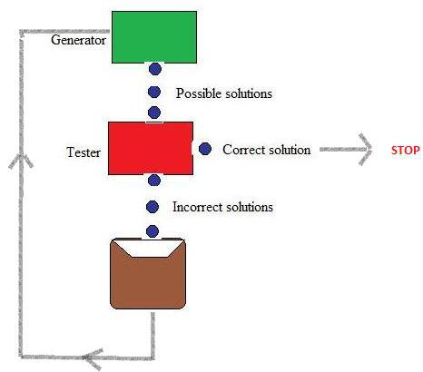
Heuristic (Informed) Search Techniques
Generate and Test Search
Generate and Test search guarantee to find a solution if done systematically and there exist a solution. It is the simplest heuristic search technique which used DFS with backtracking.
Algorithm:
Step 1: Generate a possible solution
Step 2: Test & see if this is the expected solution
Step 3: If the solution has been found QUIT
else GOTO step 1.

Slide 62
Heuristic (Informed) Search Techniques
Hill Climbing Search:
Hill climbing algorithm is a local search algorithm which continuously moves in the direction of increasing elevation/value to find the peak of the mountain or best solution to the problem. It terminates when it reaches a peak value where no neighbor has a higher value.
Hill Climbing is the variant of Generate and Test method. The Generate and Test method produce feedback which helps to decide which direction to move in the search space.
Greedy approach: Hill-climbing algorithm search moves in the direction which optimizes the cost.
No backtracking: It does not backtrack the search space, as it does not remember the previous states.

Slide 63
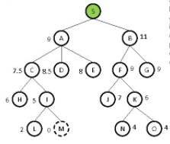
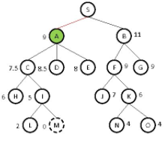
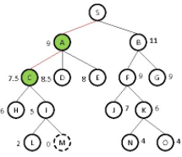
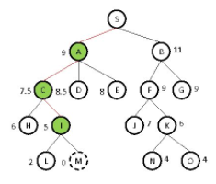
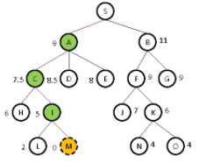
Heuristic (Informed) Search Techniques
Hill Climbing Search:
Example our aim is to find a path from S to M associate heuristics with every node. h(n) = heuristic function as its evaluation function

Slide 64
Heuristic (Informed) Search Techniques
Hill Climbing Search:
Advantages:
Useful for AI problems where knowledge of the path is not important, so in obtaining the problem solution, it is not recorded.
It is also helpful to solve pure optimization problems where the objective is to find the best state according to the objective function.
Disadvantages:
This technique works but as it uses local information that’s why it can be fooled. The algorithm doesn’t maintain a search tree, so the current node data structure need only record the state and its objective function value. It assumes that local improvement will lead to global improvement.

Slide 65
Heuristic (Informed) Search Techniques
Hill Climbing Search:
Disadvantages:
Local maximum: It is a state which is better than its neighboring state however there exists a state which is better than it(global maximum). This state is better because here the value of the objective function is higher than its neighbors.
Plateau: It is a flat region of state space where neighboring states have the same value.
Ridge: It is region which is higher than its neighbors but itself has a slope. It is a special kind of local maximum.

Slide 66
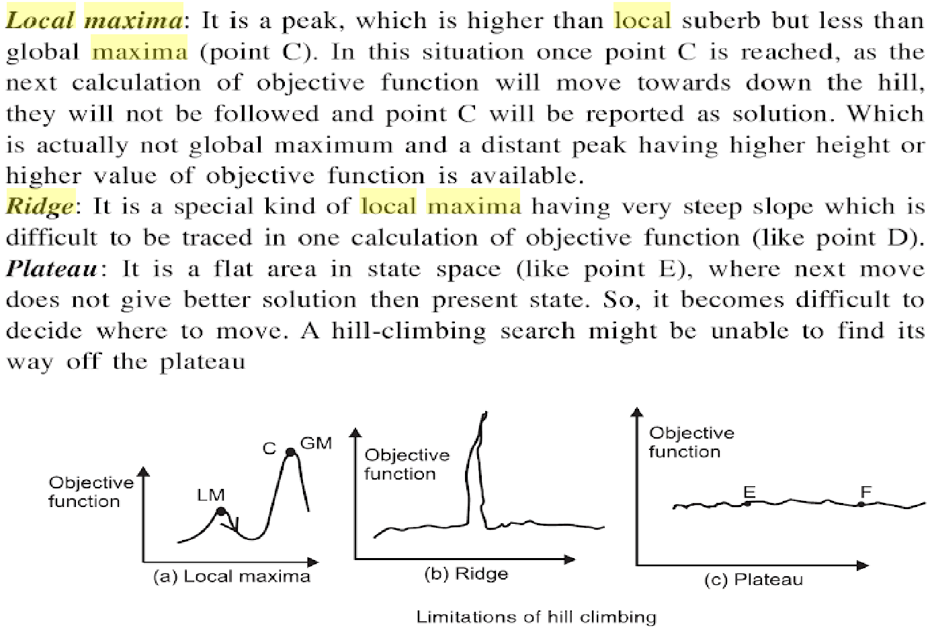
Heuristic (Informed) Search Techniques
Hill Climbing Search: Disadvantages

Slide 67
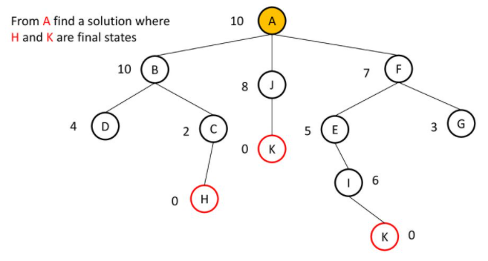
Heuristic (Informed) Search Techniques
Hill Climbing Search: Disadvantages (Local Maxima)

Slide 68
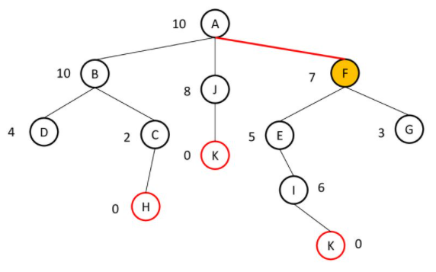
Heuristic (Informed) Search Techniques
Hill Climbing Search: Disadvantages (Local Maxima)

Slide 69
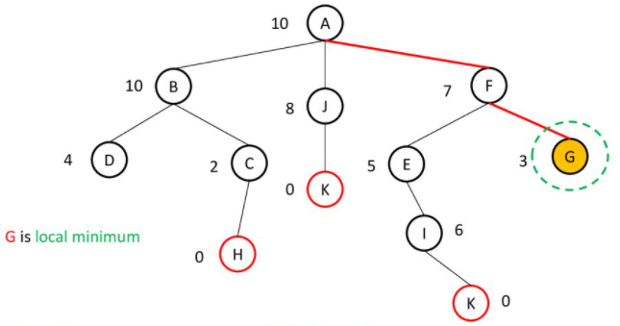
Heuristic (Informed) Search Techniques
Hill Climbing Search: Disadvantages (Local Maxima)
Hill Climbing is sometimes called greedy local search because it grabs a good neighbour state without thinking ahead about where to go next

Slide 70
Heuristic (Informed) Search Techniques
Types of Hill Climbing Search:
Simple hill Climbing
Steepest-Ascent hill-climbing
Simulated Annealing
Simple hill climbing is the simplest way to implement a hill climbing algorithm. It only evaluates the neighbor node state at a time and selects the first one which optimizes current cost and set it as a current state. It only checks it's one successor state, and if it finds better than the current state, then move else be in the same state. This algorithm has the following features:
Less time consuming
Less optimal solution and the solution is not guaranteed

Slide 71
Heuristic (Informed) Search Techniques
Steepest-Ascent algorithm is a variation of simple hill climbing algorithm. This algorithm examines all the neighboring nodes of the current state and selects one neighbor node which is closest to the goal state. This algorithm consumes more time as it searches for multiple neighbors.
Stochastic hill climbing does not examine for all its neighbor before moving. Rather, this search algorithm selects one neighbor node at random and decides whether to choose it as a current state or examine another state.
Simulated annealing algorithm picks a random move, instead of picking the best move. If the random move improves the state, then it follows the same path.

Slide 72
Heuristic (Informed) Search Techniques
Best First Search:
In the Best-First Search, “best-first” refers to the method of exploring the node with the best “score” first.
Search start from root node, node to be expanded next is selected on the basis of evaluation function f(n). An evaluation function is used to assign a score to each candidate node. Node having lowest value of f(n) is selected first as it indicates that the goal is nearest from this node.
It is implemented using priority queue, highest priority is given to the node have least f(n) value.

Slide 73
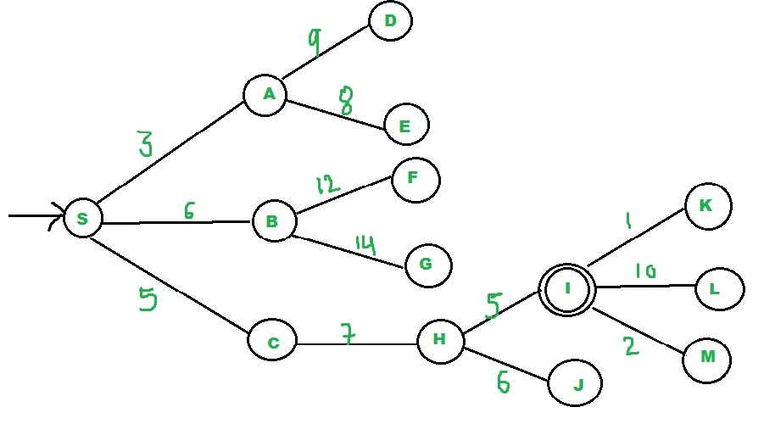
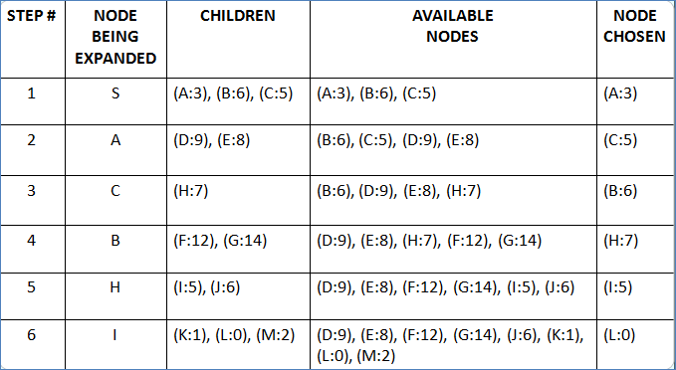
Heuristic (Informed) Search Techniques
Best First Search:
Path is SACBHI

Slide 74
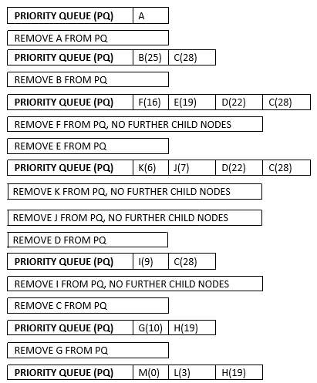
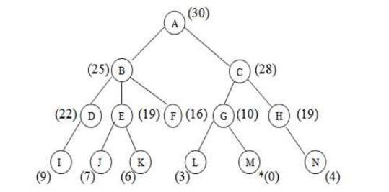
Heuristic (Informed) Search Techniques
Best First Search:

Slide 75
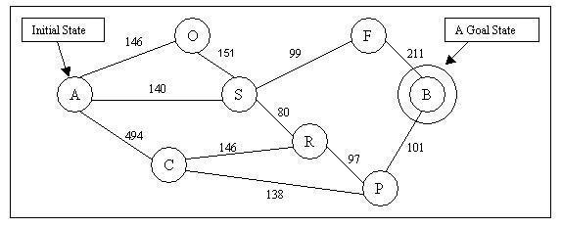
Heuristic (Informed) Search Techniques
Best First Search: Find the path using Best First Search!!!

Slide 76
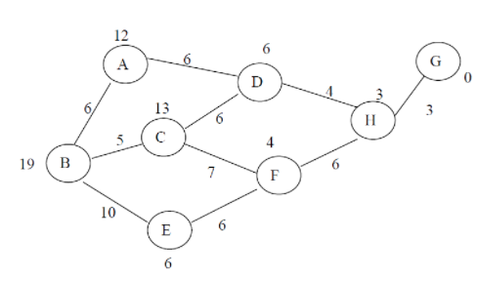
Heuristic (Informed) Search Techniques
Best First Search: Find the path using Best First Search!!!

Slide 77
Heuristic (Informed) Search Techniques
Best First Search:
Advantages:
It is more efficient than that of BFS and DFS.
Time complexity of Best first search is much less than Breadth first search.
The Best first search allows us to switch between paths by gaining the benefits of both breadth first and depth first search. Because, depth first is good because a solution can be found without computing all nodes and Breadth first search is good because it does not get trapped in dead ends.
Disadvantages:
Sometimes, it covers more distance than our consideration

Slide 78
Heuristic (Informed) Search Techniques
A* Algorithm
Starting from a specific starting node of a graph, it aims to find a path to the given goal node having the smallest cost
A* Algorithm is the specialization of Best First Search in which the cost associated with a node is f(n) = g(n) + h(n), where g(n) is the cost of the path from the initial state to node n and h(n) is the heuristic estimate or the cost or a path from node n to a goal. Thus, f(n) estimates the lowest total cost of any solution path going through node n. At each point, a node with lowest f value is chosen for expansion.
A* algorithm guides an optimal path to a goal if the heuristic function h(n) is admissible, meaning it never overestimates actual cost
The * represents that the algorithm is admissible as it guarantees to give optimal solution.

Slide 79
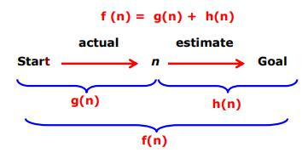
Heuristic (Informed) Search Techniques
A* Algorithm
Where,
f(n) = evaluation function.
g(n) = actual cost of current node from start node.
h(n) = heuristic value i.e., estimated cost of current node from goal node.

Slide 80
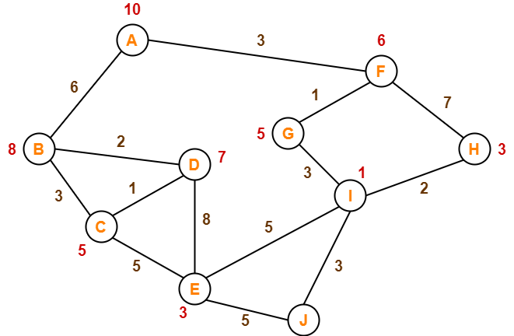
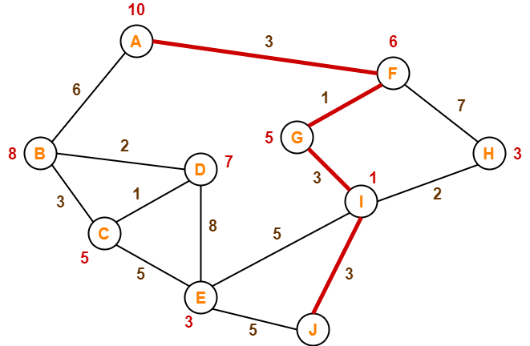
Heuristic (Informed) Search Techniques
A* Algorithm: Consider the following graph, the numbers written on edges represent the distance between the nodes and the numbers written on nodes represent the heuristic value.
Find the most cost-effective path to reach from start state A to final state J using A* Algorithm.

Slide 81
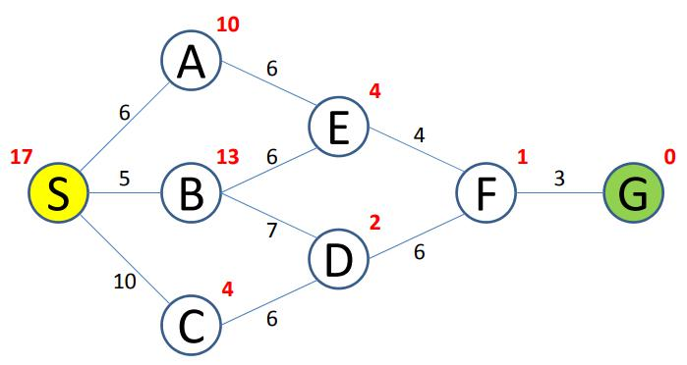
Heuristic (Informed) Search Techniques
A* Algorithm: Consider the following graph, the numbers written on edges represent the distance between the nodes and the numbers written on nodes represent the heuristic value.
Find the most cost-effective path to reach from start state S to final state G using A* Algorithm.

Slide 82
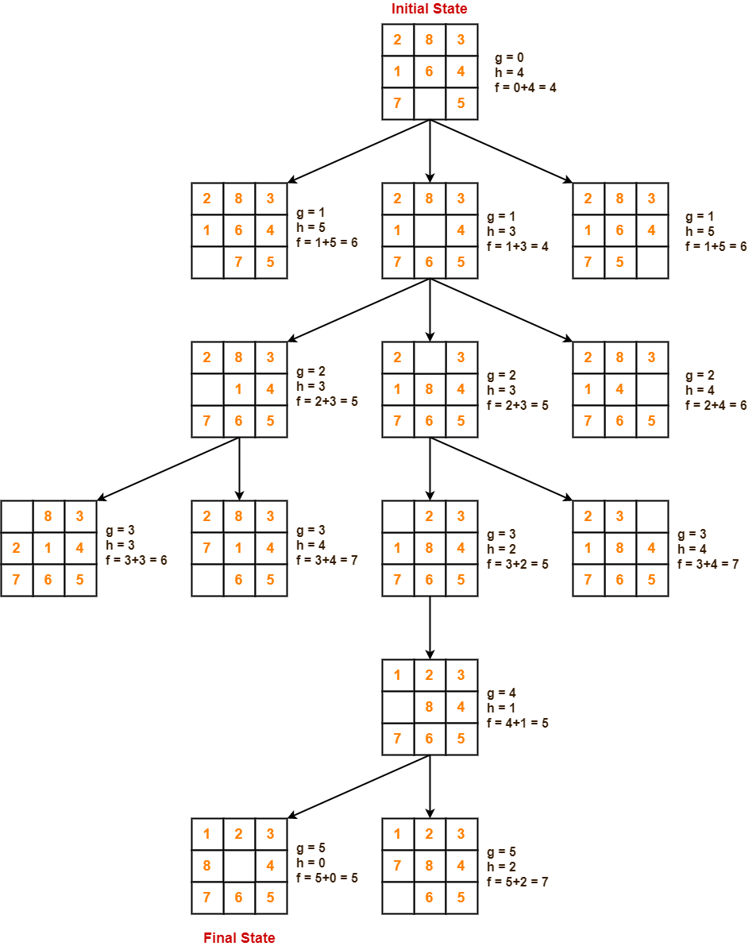

Slide 85
Heuristic (Informed) Search Techniques
A* Algorithm:
Advantages:
It is complete and optimal.
It is the best algorithm, there is no other optimal algorithm guaranteed to expand fewer nodes than A*
Disadvantages:
Although being the best path finding algorithms, but A* search algorithm does not produce the shortest path always because it heavily depends/ relies on heuristics.

Slide 86
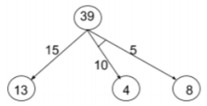
Heuristic (Informed) Search Techniques
AO* Algorithm is based on problem decomposition i.e. breakdown goal into simpler sub-goals. This decomposition generates generate arcs called AND arcs and several arcs may emerge from single node called OR arcs. That’s why called it AND-OR Graph. It is also called problem reduction search algorithm.
Nodes in the graph point to a number of successor nodes, all of which must be solved in order for the arc to point to a solution up to its parent nodes. Each node in the graph will also have a heuristic value associate with it.
f(n) = g(n)+h(n)
It is an efficient method to explore a solution path.
Example: Consider the AO graph given, AO *algorithm expand
next to which node?

Slide 87
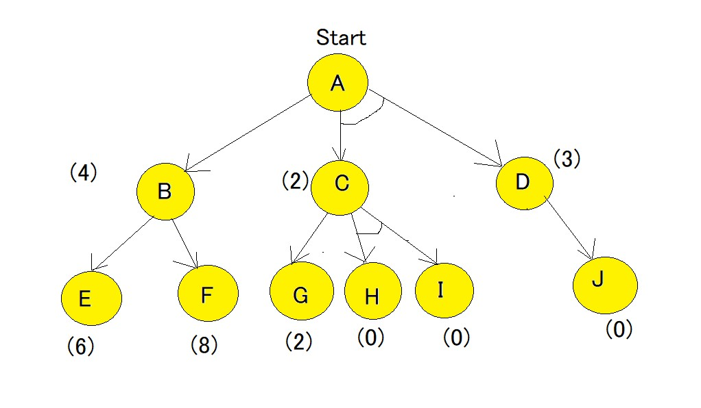
Example-1
Here, in the above example all numbers in brackets are the heuristic value i.e h(n). Each edge is considered to have a value of 1 by default.

Slide 88

Example-1
Step-1 Starting from node A, we first calculate the best path. f(A-B) = g(B) + h(B) = 1+4= 5 , where 1 is the default cost value of travelling from A to B and 4 is the estimated cost from B to Goal state. f(A-C-D) = g(C) + h(C) + g(D) + h(D) = 1+2+1+3 = 7 ,
here we are calculating the path cost as both C and D because they have the AND-Arc. The default cost value of travelling from A-C is 1, and from A-D is 1, but the heuristic value given for C and D are 2 and 3 respectively hence making the cost as 7.
The minimum cost path is chosen i.e A-B

Slide 89

Example-1
Step-2 Using the same formula as step-1, the path is now calculated from the B node, f(B-E) = 1 + 6 = 7. f(B-F) = 1 + 8 = 9 Hence, the B-E path has lesser cost. Now the heuristics have to be updated since there is a difference between actual and heuristic value of B. The minimum cost path is chosen and is updated as the heuristic , in our case the value is 7. And because of change in heuristic of B there is also change in heuristic of A which is to be calculated again. f(A-B) = g(B) + updated((h(B)) = 1+7=8

Slide 90

Example-1
Step-3 Comparing path of f(A-B) and f(A-C-D) it is seen that f(A-C-D) is smaller. Hence f(A-C-D) needs to be explored. Now the current node becomes C node and the cost of the path is calculated, f(C-G) = 1+2 = 3 f(C-H-I) = 1+0+1+0 = 2 f(C-H-I) is chosen as minimum cost path,also there is no change in heuristic since it matches the actual cost. Heuristic of path of H and I are 0 and hence they are solved, but Path A-D also needs to be calculated , since it has an AND-arc. f(D-J) = 1+0 = 1, hence heuristic of D needs to be updated to 1. And finally the f(A-C-D) needs to be updated. f(A-C-D) = g(C) + h(C) + g(D) + updated((h(D)) = 1+2+1+1 =5.
As we can see that the solved path is f(A-C-D).

Slide 91
What is the difference between A* Algorithm and AO* algorithm?
Both are part of informed search technique and use heuristic values to solve the problem.
The solution is guaranteed in both algorithm.
A* always gives an optimal solution (shortest path with low cost) But It is not guaranteed to that AO* always provide an optimal solutions.
Reason: Because AO* does not explore all the solution path once it got solution.

Slide 92

Heuristic (Informed) Search Techniques
AO* Algorithm Example 2: Consider the following AO graph, which of the following node(s), identified by their heuristic value, could the algorithm expand/refine next?

Slide 93

Heuristic (Informed) Search Techniques
AO* Algorithm Example 3:
Graph (RHS) represents an AO graph with the values labeled in. The value in a single line circle is an estimate of cost. The value in a double lined circle, a SOLVED node, is the actual value. Each edge is labeled with a different cost. What is the value of the root node for the optimal solution for the AO graph?

Slide 94
Heuristic (Informed) Search Techniques
AO* Algorithm:
Advantages:
It is an optimal algorithm.
If traverse according to the ordering of nodes.
It can be used for both OR and AND graph.
Disadvantages:
Sometimes for unsolvable nodes, it can’t find the optimal path. Also, AO* does not explore all the solution path once it got solution

Slide 95
Adversarial Search
It relates to competitive environment in which the agent goals are conflict giving rise to adversarial search.
There are two methods for game playing:
Min-Max Procedure
Alpha-Beta Pruning (Cut-offs)
Min-Max Search: Min-Max strategy is a simple strategy for two player game. Here, one player is called “maximizer” and the other called “minimizer. Maximizer tries to maximize its score while minimizer tries to minimize maximizer’s score.
It is also assumed that the maximizer makes the first move (not essential, as minimizer can also make first move). The maximizer, always tries to go a position where the static evaluation function value is the maximum positive value.

Slide 96

Adversarial Search
Min-Max Search: Consider the following tree graph example
The maximizer being the player to make the first move, and will move to node D because the static evaluation function value for that is maximum. . The same above figure shows that if the minimizer has to make the first move, it will go to node B because the static evaluation function value at that node will be advantageous to it.
Once the static evaluation function is applied at the leaf nodes, backing up values can begin. First we compute the backed-up values at the parents of the leaves.

Slide 97

Adversarial Search
Min-Max Search: Consider the following tree graph example

Slide 98
Mini-Max Algorithm in Artificial Intelligence
Mini-max algorithm is a recursive or backtracking algorithm which is used in decision-making and game theory. It provides an optimal move for the player assuming that opponent is also playing optimally.
Mini-Max algorithm uses recursion to search through the game-tree.
Min-Max algorithm is mostly used for game playing in AI. Such as Chess, Checkers, tic-tac-toe, go, and various tow-players game. This Algorithm computes the minimax decision for the current state.
In this algorithm two players play the game, one is called MAX and other is called MIN.
Both the players fight it as the opponent player gets the minimum benefit while they get the maximum benefit.
Both Players of the game are opponent of each other, where MAX will select the maximized value and MIN will select the minimized value.
The minimax algorithm performs a depth-first search algorithm for the exploration of the complete game tree.
The minimax algorithm proceeds all the way down to the terminal node of the tree, then backtrack the tree as the recursion.

Slide 99
Working of Min-Max Algorithm:
The working of the minimax algorithm can be easily described using an example. Below we have taken an example of game-tree which is representing the two-player game.
In this example, there are two players one is called Maximizer and other is called Minimizer.
Maximizer will try to get the Maximum possible score, and Minimizer will try to get the minimum possible score.
This algorithm applies DFS, so in this game-tree, we have to go all the way through the leaves to reach the terminal nodes.
At the terminal node, the terminal values are given so we will compare those value and backtrack the tree until the initial state occurs. Following are the main steps involved in solving the two-player game tree:

Slide 100

Example-1
Step-1: In the first step, the algorithm generates the entire game-tree and apply the utility function to get the utility values for the terminal states. In the below tree diagram, let's take A is the initial state of the tree. Suppose maximizer takes first turn which has worst-case initial value =- infinity, and minimizer will take next turn which has worst-case initial value = +infinity.

Slide 101

Example-1
Now, first we find the utilities value for the Maximizer, its initial value is -∞, so we will compare each value in terminal state with initial value of Maximizer and determines the higher nodes values. It will find the maximum among the all.
For node D max(-1,- -∞) => max(-1,4)= 4
For Node E max(2, -∞) => max(2, 6)= 6
For Node F max(-3, -∞) => max(-3,-5) = -3
For node G max(0, -∞) = max(0, 7) = 7

Slide 102

Example-1
Step 3: In the next step, it's a turn for minimizer, so it will compare all nodes value with +∞, and will find the 3rd layer node values.
For node B= min(4,6) = 4
For node C= min (-3, 7) = -3

Slide 103

Example-1
Step 4: Now it's a turn for Maximizer, and it will again choose the maximum of all nodes value and find the maximum value for the root node. In this game tree, there are only 4 layers, hence we reach immediately to the root node, but in real games, there will be more than 4 layers.
For node A max(4, -3)= 4
That was the complete workflow of the minimax two player game.

Slide 104
Properties of Mini-Max algorithm:
Complete- Min-Max algorithm is Complete. It will definitely find a solution (if exist), in the finite search tree.
Optimal- Min-Max algorithm is optimal if both opponents are playing optimally.
Time complexity- As it performs DFS for the game-tree, so the time complexity of Min-Max algorithm is O(bm), where b is branching factor of the game-tree, and m is the maximum depth of the tree.
Space Complexity- Space complexity of Mini-max algorithm is also similar to DFS which is O(bm).

Slide 105
Limitation of the minimax Algorithm:
The main drawback of the minimax algorithm is that it gets really slow for complex games such as Chess, go, etc. This type of games has a huge branching factor, and the player has lots of choices to decide. This limitation of the minimax algorithm can be improved from alpha-beta pruning which we have discussed in the next topic.

Slide 106
Adversarial Search - Alpha-Beta Pruning
Alpha-beta pruning is a modified version of the minimax algorithm. It is an optimization technique for the minimax algorithm.
As we have seen in the minimax search algorithm that the number of game states it has to examine are exponential in depth of the tree. Since we cannot eliminate the exponent, but we can cut it to half. Hence there is a technique by which without checking each node of the game tree we can compute the correct minimax decision, and this technique is called pruning. This involves two threshold parameter Alpha and beta for future expansion, so it is called alpha-beta pruning. It is also called as Alpha-Beta Algorithm.
Alpha-beta pruning can be applied at any depth of a tree, and sometimes it not only prune the tree leaves but also entire sub-tree.
The two-parameter can be defined as:
Alpha: The best (highest-value) choice we have found so far at any point along the path of Maximizer. The initial value of alpha is -∞.
Beta: The best (lowest-value) choice we have found so far at any point along the path of Minimizer. The initial value of beta is +∞.

Slide 107
Adversarial Search - Alpha-Beta Pruning
The Alpha-beta pruning to a standard minimax algorithm returns the same move as the standard algorithm does, but it removes all the nodes which are not really affecting the final decision but making algorithm slow. Hence by pruning these nodes, it makes the algorithm fast.

Slide 108
Adversarial Search - Alpha-Beta Pruning
Alpha-Beta pruning is a search algorithm that seeks to decrease the number of nodes that are evaluated by mini-max algorithm in its search tree.
α is a value which is best for Max player (highest value)
β is a value which is best for Min player (lowest value)
Each node will keep its α-β values, and pruning done by following way:
For Min node, if β<= α of max ancestor, PRUNE.
For Max node, if β>= α of min ancestor, PRUNE.

Slide 109
Condition for Alpha-beta pruning:
The main condition which required for alpha-beta pruning is:
α>=β
Key points about alpha-beta pruning:
The Max player will only update the value of alpha.
The Min player will only update the value of beta.
While backtracking the tree, the node values will be passed to upper nodes instead of values of alpha and beta.
We will only pass the alpha, beta values to the child nodes.

Slide 110

Working of Alpha-Beta Pruning:
Let's take an example of two-player search tree to understand the working of Alpha-beta pruning
Step 1: At the first step the, Max player will start first move from node A where α= -∞ and β= +∞, these value of alpha and beta passed down to node B where again α= -∞ and β= +∞, and Node B passes the same value to its child D.

Slide 111

Example-1
Step 2: At Node D, the value of α will be calculated as its turn for Max. The value of α is compared with firstly 2 and then 3, and the max (2, 3) = 3 will be the value of α at node D and node value will also 3.
Step 3: Now algorithm backtrack to node B, where the value of β will change as this is a turn of Min, Now β= +∞, will compare with the available subsequent nodes value, i.e. min (∞, 3) = 3, hence at node B now α= -∞, and β= 3.
In the next step, algorithm traverse the next successor of Node B which is node E, and the values of α= -∞, and β= 3 will also be passed.

Slide 112

Example-1
Step 4: At node E, Max will take its turn, and the value of alpha will change. The current value of alpha will be compared with 5, so max (-∞, 5) = 5, hence at node E α= 5 and β= 3, where α>=β, so the right successor of E will be pruned, and algorithm will not traverse it, and the value at node E will be 5.

Slide 113

Example-1
Step 5: At next step, algorithm again backtrack the tree, from node B to node A. At node A, the value of alpha will be changed the maximum available value is 3 as max (-∞, 3)= 3, and β= +∞, these two values now passes to right successor of A which is Node C.
At node C, α=3 and β= +∞, and the same values will be passed on to node F.
Step 6: At node F, again the value of α will be compared with left child which is 0, and max(3,0)= 3, and then compared with right child which is 1, and max(3,1)= 3 still α remains 3, but the node value of F will become 1.

Slide 114

Example-1
Step 7: Node F returns the node value 1 to node C, at C α= 3 and β= +∞, here the value of beta will be changed, it will compare with 1 so min (∞, 1) = 1. Now at C, α=3 and β= 1, and again it satisfies the condition α>=β, so the next child of C which is G will be pruned, and the algorithm will not compute the entire sub-tree G.

Slide 115

Example-1
Step 8: C now returns the value of 1 to A here the best value for A is max (3, 1) = 3. Following is the final game tree which is the showing the nodes which are computed and nodes which has never computed. Hence the optimal value for the maximizer is 3 for this example.

Slide 116
Move Ordering in Alpha-Beta pruning:
The effectiveness of alpha-beta pruning is highly dependent on the order in which each node is examined. Move order is an important aspect of alpha-beta pruning.
It can be of two types:
Worst ordering: In some cases, alpha-beta pruning algorithm does not prune any of the leaves of the tree, and works exactly as minimax algorithm. In this case, it also consumes more time because of alpha-beta factors, such a move of pruning is called worst ordering. In this case, the best move occurs on the right side of the tree. The time complexity for such an order is O(b^{m}).
Ideal ordering: The ideal ordering for alpha-beta pruning occurs when lots of pruning happens in the tree, and best moves occur at the left side of the tree. We apply DFS hence it first search left of the tree and go deep twice as minimax algorithm in the same amount of time. Complexity in ideal ordering is O(b^{m/2}).

Slide 117

Example-1

Slide 118


Slide 119


Slide 120
End of UNIT-II

