Slide 1




















EDrishti project
Reference file management system application

Slide 2



















































































TEAM MEMBERS
1. DEEPAKASH GAUTAM(2200290140051 m )
(Team Leader )

Slide 3


INTRODUCTION
This Project is related to maintain all the details of the employees of CRIS and Indian Railways , Internal confidential and Internal documentation .

Slide 4































Technology Used
Java
JSP
Server (Web Sphere )
Database (Oracle)

Slide 5
HARDWARE USED
Processor i5
16 GB RAM

Slide 6
CONCLUSION
I would like to conclude that this project maintains confidential data .
The project has to be revamp from its current version 2 or version 3.
Version 2 will be considered as a well designed user interface where as version 3 will be considered as developing its backend code in spring .

Slide 7
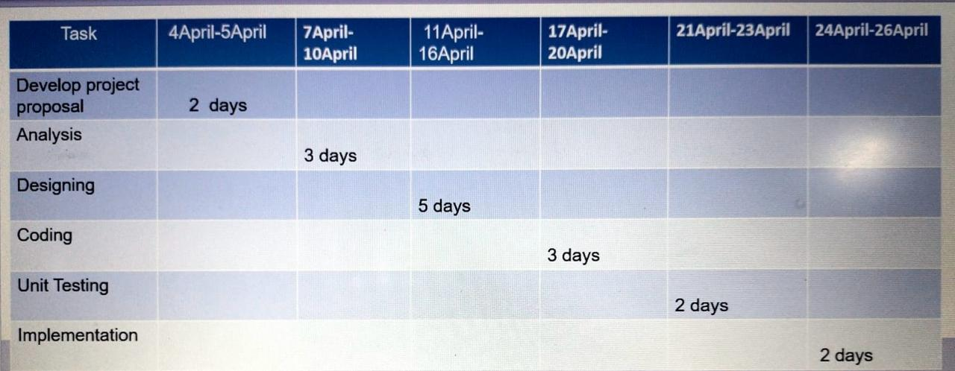
GANTT CHART

Slide 8


