Slide 1

Mini Project (KCA353) Odd Semester Session 2024-25
AI QUIZIFY(GD-12)
Presented By:
SHAGUN (2300290140167)
SAKSHI GUPTA (2300290140154)
SARTHAK GUPTA(2300290140159)
SHIVANSH DUBEY(2300290140175)
Project Supervisor:
Dr. Vipin Kumar
(Associate Professor)

Slide 2
Content
Introduction (1 slide)
Literature Review (2 slides)
Objective of the Project (1 slide)
Technology
Hardware Requirements (Development Environment, Server requirement (if required), Client requirement (if required).
Software Requirements (Language and Platforms like Frameworks, VS code, Android Studio and Jupyter notebook etc. )
Modules (2-3 slides)
Workflow (1 slide)
Reports (For Example: Project : Student Monitoring System, so reports like: Student Marks, Subjects, companies visit, and student appears in placement etc.)
References (1 slide)
Notes:
Font Styles: Times New Roman + Font Size: 25

Slide 3
Introduction
AI Quizify is a web platform where users can sign up or log in to take quizzes.
After logging in, users can choose a quiz subject, making the experience personalized and fun.
Built using the MERN stack (MongoDB, Express.js, React.js, Node.js), it connects the interface with the backend to manage data smoothly.
Tailwind CSS ensures the site looks good and works well on any device, automatically adjusting to different screen sizes.
Notes:
Font Styles: Times New Roman + Font Size: 25

Slide 4
Literature Review
Existing Systems
Traditional Quiz Apps: Often lack interactivity and personalization.
Online Learning Platforms: Offer quizzes but may not use AI effectively.
Technological Advancements
AI in Education:
Personalizes learning experiences.
Adapts to individual student needs.
Notes:
Font Styles: Times New Roman + Font Size: 25

Slide 5
Literature Review (Contd.)
Benefits of AI in Quizzes
Real-Time Feedback : Instant scoring and suggestions.
Personalized Questions : Tailors difficulty based on user ability.
Increased Engagement : Uses gamification techniques to motivate learners.
Notes:
Font Styles: Times New Roman + Font Size: 25

Slide 6
Objective of the Project
Main Goals:
Create an interactive quiz platform
Utilize AI for adaptive questioning
Provide analytics for user performance
Notes:
Font Styles: Times New Roman + Font Size: 25

Slide 7
Technology (Hardware Requirements)
Development Environment:
Pc/Laptop with at least 8 GB RAM.
Processor : i5 or equivalent.
Server Requirements:
Node.js server
Client Requirements:
Web Browser(Chrome,Firefox etc).
Internet Connection (for Online Quizzes).
Notes:
Font Styles: Times New Roman + Font Size: 25

Slide 8
Technology (Software Requirements)
MERN Stack:
MongoDB : NoSQL database for storing questions and user data
Express.js : Web framework for building APIs
React : Front-end library for user interface
Node.js : Back-end runtime for server-side logic
Notes:
Font Styles: Times New Roman + Font Size: 25

Slide 9
Modules
User Login/Signup:
Allows users to create an account or log in with existing credentials.
Quiz Selection:
Users can choose quizzes based on subjects or topics of interest.
Quiz Submission and Scoring:
Users answer questions and submit quizzes for automatic AI scoring.
Dashboard:
Displays individual user performance, quiz history, and overall scores.

Slide 10
Workflow/Gantt Chart
User Journey:
User Registration/Login
Users take quizzes
AI adapts questions
Results and analytics provided
Notes:
Font Styles: Times New Roman + Font Size: 25

Slide 11
Reports
User Performance Reports:
Track individual user scores over time.
Display Top 3 Performer.
Popular Topics Report:
Most selected quiz topics by users.
Subject areas where users score the highest or lowest.
.
Notes:
Font Styles: Times New Roman + Font Size: 25

Slide 12
References
MERN Stack Tutorial : DigitalOcean: How to Build a MERN Stack App
AI-Generated Quiz Systems : OpenAI API Documentation
JWT Authentication in MERN : Dev.to: JWT Authentication in MERN Stack
Tailwind CSS for UI Design : Tailwind CSS Official Documentation
Scoring and Leaderboard Systems : Medium: How to Build a Leaderboard in MongoDB
React for Building Quiz Components : FreeCodeCamp: Building a Quiz App with React
Node.js and Express for API Backend :
MongoDB Database Design for Quiz Systems : MongoDB Schema Design
Building Dashboards with React : Hashnode: Building a Dashboard in React
Security Best Practices in MERN Stack : Owasp.org: Node.js Security Best Practices
Notes:
Font Styles: Times New Roman + Font Size: 25

Slide 13
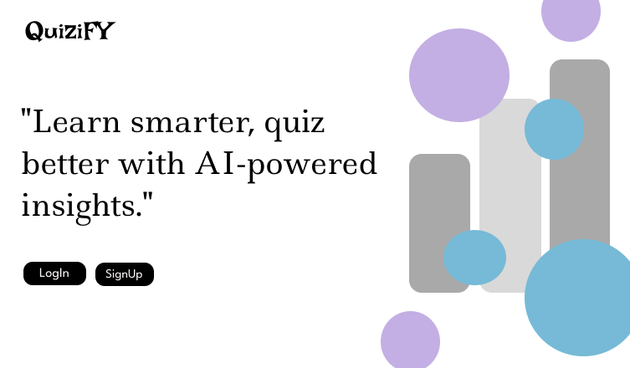
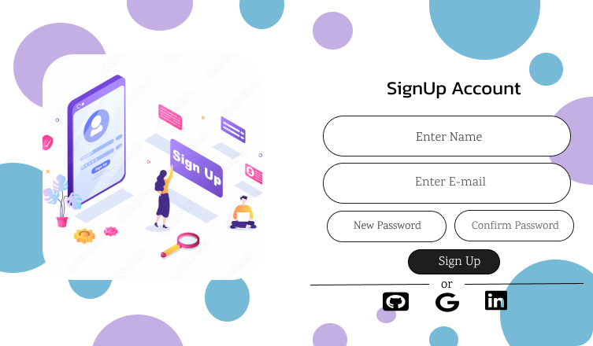
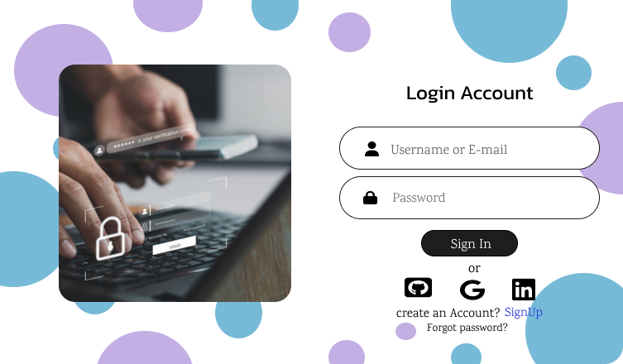
Expected Outcome
Notes:
Font Styles: Times New Roman + Font Size: 25

Slide 14
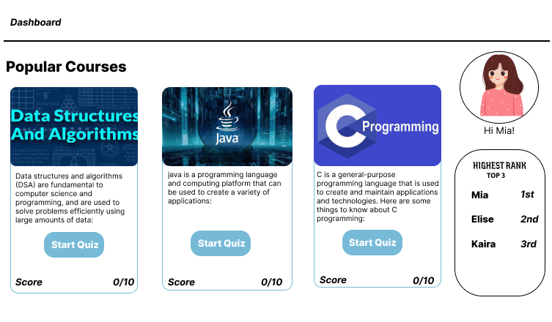
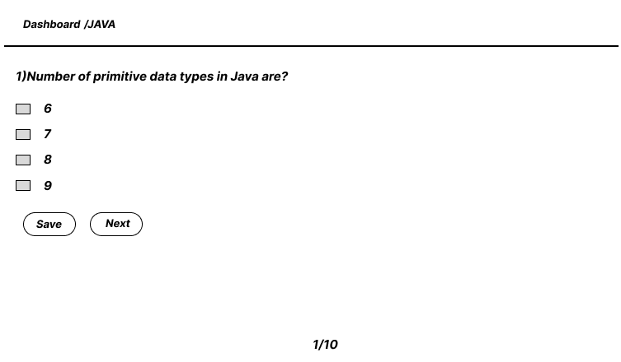
Modules (Contd.)
Notes:
Font Styles: Times New Roman + Font Size: 25

