Slide 1

Mini Project (KCA353) Odd Semester Session 2024-25
BULLRUN
Presented By:
OM Singhal : 2300290140111
Piyush Chaturvedi : 2300290140115
Ritakshi Singh : 2300290140141
Ritika: 2300290140145
Project Supervisor:
Prof. Monika Kansal
Associate Professor

Slide 2
Content
Introduction
Literature Review
Objective of the Project
Technology
Software Requirements
Modules
Workflow
Reports
References
Notes:
Font Styles: Times New Roman + Font Size: 25

Slide 3
Introduction
BullRun is an innovative platform which provides stock market evaluation. In this project, we created a dashboard having various stocks names with their prices as well as the option to buy or sell those stocks.
Key Features in the project:
Portfolio Tracking
Market News
IPO Release
Orders tracking
Notes:
Font Styles: Times New Roman + Font Size: 25

Slide 4
Literature Review
Previous Research
Many researchers have looked into how stock markets work, especially how technology has changed the way people trade. For example, Zhang et al. (2020) talked about how algorithmic trading has made markets more liquid (easier to buy and sell), but it has also caused more ups and downs. Another study by Kumar and Goyal (2019) highlighted the importance of giving investors real-time data to help them make better decisions, especially in developing markets.
Mobile Trading Adoption
The popularity of mobile trading has grown rapidly in the last decade. A study by Martin and Lee (2021) noted that more than 60% of younger investors prefer trading through their mobile phones. The shift to mobile has encouraged platforms to offer real-time notifications, which help users react faster to market changes.
Notes:
Font Styles: Times New Roman + Font Size: 25

Slide 5
Literature Review (Contd.)
Market Trends
Recently, more people have been investing in stocks, especially through social media and online platforms. The COVID-19 pandemic sped this up, as Barber and Odean (2020) noted, with more individual investors joining the market. This trend brings both opportunities and challenges for platforms like BullRun, which need to serve a wide variety of users.
Gaps in Research
Even though a lot has been written about stock markets and IPOs, there aren’t many platforms that combine both trading and IPO features. BullRun aims to fill this gap by creating a platform that helps users stay engaged and improve their investment strategies.
Notes:
Font Styles: Times New Roman + Font Size: 25

Slide 6
Objective of the Project
BullRun aims to provide a seamless, user-friendly, and real-time stock trading experience for users, enabling them to invest in the stock market efficiently and securely. The platform focuses on:
Real-Time Trading: Offering real-time stock data and updates to allow users to make informed investment decisions.
User Accessibility: Simplifying the trading process with an intuitive user interface, making it accessible for both beginners and experienced traders.
Secure Transactions: Ensuring safe and reliable financial transactions through integrated payment gateways for depositing and withdrawing funds.
Portfolio Management: Allowing users to track their investments, manage their portfolios, and view transaction history with ease.
Performance Optimization: Utilizing the MERN stack to build a scalable and responsive web application that can handle high traffic while maintaining performance.
Notes:
Font Styles: Times New Roman + Font Size: 25

Slide 7
Technology (Software Requirements)
Visual Studio Code
Windows 10 and above
Framework: React, Node.js, Express.js
Database: MongoDB
Github
YH Finance API
Vite: A tool which provides efficient frontend development service.
Notes:
Font Styles: Times New Roman + Font Size: 25

Slide 8
Modules: Authentication
Objective:
Manage user authentication and authorization.
Features:
User Registration: Email/Phone-based signup.
Login/Logout: Secure login using JWT.
Password Reset: Password recovery using OTP or email.
User Roles: Define roles (admin, trader, etc.).
Notes:
Font Styles: Times New Roman + Font Size: 25

Slide 9
Modules: Dashboard
Objective:
Provide an overview of stock market data and user portfolio.
Features:
Real-time stock data visualization (charts, graphs).
User portfolio summary: Invested stocks, current balance.
Transaction history: Overview of past buy/sell transactions.
Stock watchlist: Add and monitor favorite stocks.
Notes:
Font Styles: Times New Roman + Font Size: 25

Slide 10
Modules: Explore
Objective:
Fetch real-time stock market data.
Features:
Real-time API integration for stock prices (via services like YH Finance API).
Historical data: Show past stock performance for analysis.
News Integration: Stock-related news for market insights.
Notes:
Font Styles: Times New Roman + Font Size: 25

Slide 11
Modules: Orders
Objective:
Enable users to buy and sell stocks.
Features:
Place Buy/Sell Orders: Market, Limit, and Stop orders.
Live order book: Display pending and completed trades.
Transaction confirmation: Secure verification before order execution.
Funds management: Balance tracking for purchases and sales.
Notes:
Font Styles: Times New Roman + Font Size: 25

Slide 12
Modules: Admin Panel
Objective:
Backend management for admins.
Features:
User management: View, activate/deactivate user accounts.
Stock management: Add/remove stocks available for trading.
Reports: View platform usage, active traders, transaction volumes.
Notes:
Font Styles: Times New Roman + Font Size: 25

Slide 13
Modules: Payment
Objective:
Handle user funds for trading.
Features:
Add/Withdraw Funds: Integration with payment gateways for seamless transactions.
Wallet balance: View available funds for trading.
Transaction history: Log of deposits, withdrawals, and transfers.
Notes:
Font Styles: Times New Roman + Font Size: 25

Slide 14
WORKFLOW
User visited
Login
verified
Dashboard
Explore without account
Not verified
Signup successful
Explore
Sign Up
Portfolio/ Watchlist
If available
Buy/Sell stocks
Check Funds
Buy/Sell
Stocks
Funds Added
If not available
At Confirmation
Go to Add Funds
Checkout
Notes:
Font Styles: Times New Roman + Font Size: 25

Slide 15
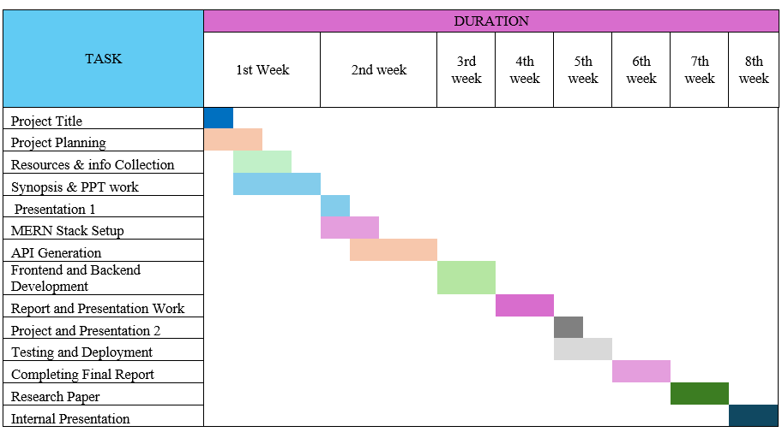
Gantt Chart
Notes:
Font Styles: Times New Roman + Font Size: 25

Slide 16
REPORTS
The three main stock market segments in India are Large cap, mid cap, and small cap:
Large cap: Companies ranked 1st to 100th in terms of market capitalization
Mid cap: Companies ranked 101st to 250th in terms of market capitalization
Small cap: Companies ranked 251st and onwards in terms of market capitalization
These categories are based on market capitalization, and the risk associated with each segment is different:
Large cap: These stocks are considered the lowest risk, and are generally more conservative investments
Mid cap: These stocks are in the middle in terms of risk, and are considered safer than individual mid-cap stocks when invested in as mutual funds
Small cap: These stocks are considered the highest risk, and are more susceptible to competition, uncertainties, and economic downturns.
Notes:
Font Styles: Times New Roman + Font Size: 25

Slide 17
References
1-MERN Stack Technologies:
MongoDB Documentation. (n.d.). Database Guide. Referenced for database management and NoSQL queries.
Express.js Documentation. (n.d.). Express API. Used for building RESTful services and managing the backend.
React.js Documentation. (n.d.). React Developer Guide. Used as a front-end framework for building user interfaces.
Node.js Documentation. (n.d.). Node.js API. Backend technology for server-side development.
2-Payment Gateway Integration:
Razorpay API Documentation. (n.d.). Payment Gateway API. For integrating payment solutions within the platform.
3-Other Technical Resources:
GitHub. (n.d.). Various Repositories. Used for referencing code snippets and best practices for MERN stack projects.
MDN Web Docs. (n.d.). JavaScript, HTML, and CSS Documentation. For front-end technologies and responsive design principles.
Notes:
Font Styles: Times New Roman + Font Size: 25

