Slide 1

Major Project (KCA451) Even Semester Session 2024-25
MadiMatri
Aryan Sain (2300290140041)
Ashraf Khan (2300290140042)
Arjun Srivastava (2300290140039)
Abhishek Yadav (2300290140009)
<
Project Supervisor:
Ms. Komal Salgotra
Assistant Professor

Slide 2
Introduction
Effective drug inventory management is essential for patient safety and accurate dispensing.
Traditional inventory methods often lead to medication errors, stockouts, and inefficiencies.
Poor management increases operational costs and compromises patient safety.
Technological advancements offer better accuracy and streamlined inventory processes.
This project develops a comprehensive Drug Inventory and Supply Chain Tracking System.
The system aims to improve efficiency, reduce errors, and ensure regulatory compliance.
Notes:
Font Styles: Times New Roman + Font Size: 25

Slide 3
Objective
1.Track Medications in Real Time: Allow staff to see current stock levels and expiration dates instantly.
2.Low Stock Alerts: Implementing alerts for low inventory thresholds is straightforward and ensures timely reordering.
Notes:
Font Styles: Times New Roman + Font Size: 25

Slide 4

Technology (Hardware Requirements)
Development Environment:
Intel/AMD processor
Minimum 4GB RAM
SSD storage for improved performance
Notes:
Font Styles: Times New Roman + Font Size: 25

Slide 5

Technology (Software Requirements)
Frontend: React and Material UI for a user-friendly interface.
Backend: Node.js and Express.js for server-side development, and MongoDB for data storage.
Notes:
Font Styles: Times New Roman + Font Size: 25

Slide 6
Modules
1.User Authentication:
Role-Based Access:
Admins: Full system control and management.
Hospital Staff: Ability to place orders and manage inventory.
Vendors: Access to manage shipments and track orders.
2.Inventory Management:
Key Features:
Track drug quantities, expiration dates, and batch numbers.
Ensure accurate and timely inventory updates.
Notes:
Font Styles: Times New Roman + Font Size: 25

Slide 7
3. Order Management:
Functionality:
Place orders directly with vendors.
Track order status from placement to delivery.
4. Vendor Management:
Monitoring:
Track vendor performance metrics.
Assess delivery times and quality of service.
5. Reporting and Analytics:
Insights:
Generate reports on drug usage trends.
Monitor inventory levels for informed decision-making.
Notes:
Font Styles: Times New Roman + Font Size: 25

Slide 8
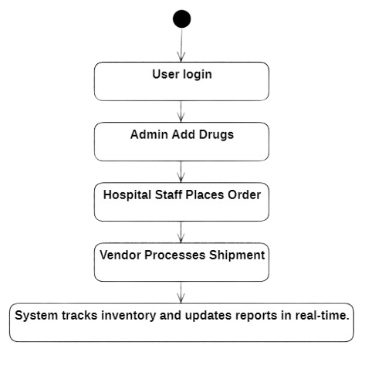
Workflow
User logs in → Admin adds new drugs and vendors → Hospital staff places orders → Vendors manage shipments → System tracks inventory and updates reports in real-time.
Notes:
Font Styles: Times New Roman + Font Size: 25

Slide 9
Reports
These reports are designed to provide actionable insights into inventory levels, drug consumption, and vendor performance. The key reports include:
Low Stock Alerts: Monitors inventory and triggers alerts when stock levels drop critically.
Drug Expiration Warnings: Tracks expiration dates and warns when medications approach expiration.
Vendor Performance Reports: Evaluates vendors based on delivery times, accuracy, and product quality.
Drug Consumption Trends: Analyzes medication usage patterns across institutions for demand forecasting.
Notes:
Font Styles: Times New Roman + Font Size: 25

Slide 10
References
Supply Chain Management in Healthcare:
S. Chopra & P. Meindl, (2015). Supply Chain Management: Strategy, Planning, and Operation. Pearson.
This book provides insights into supply chain optimization and strategies that are applicable to the healthcare industry.
Drug Inventory Management Systems:
J. Smith (2018). Efficient Drug Inventory Systems in Hospitals. International Journal of Pharmaceutical Sciences, 42(3), 215-230.
This paper highlights the challenges faced by hospitals in managing drug inventories and how automated systems can streamline these processes.
Notes:
Font Styles: Times New Roman + Font Size: 25

Slide 11
THANK YOU

