Slide 1
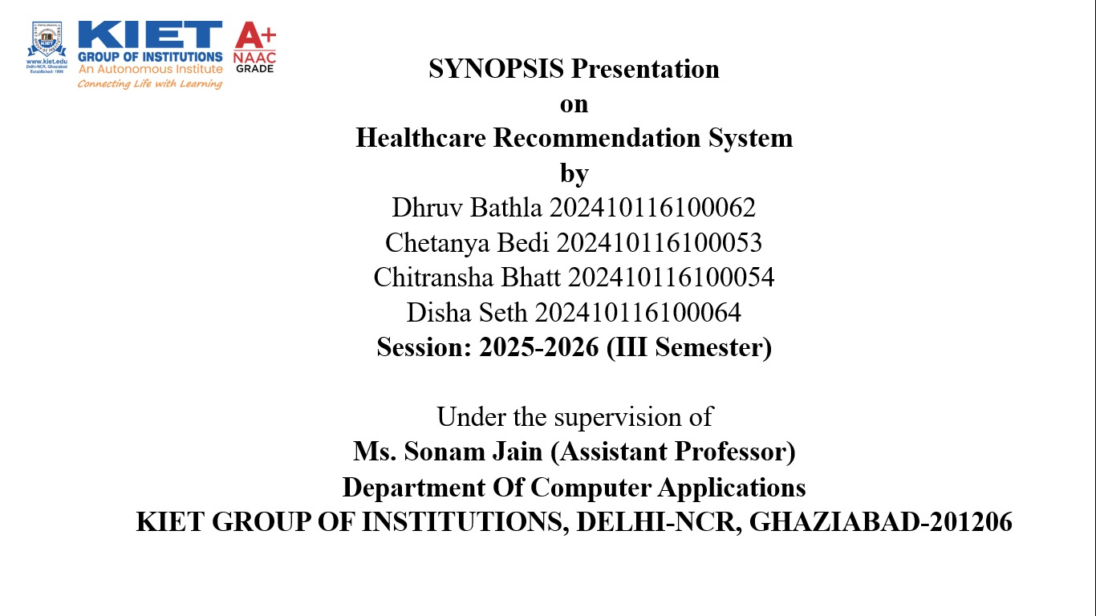

Slide 2


Transforming Patient Care
Project Overview
The Healthcare Recommendation System is a web-based AI platform designed to deliver personalized, evidence-based, and secure health insights directly to users.
AI-Driven
Leveraging machine learning for intelligent recommendations.
It integrates advanced technologies to create a comprehensive and user-friendly solution for modern healthcare challenges.
Interactive
Featuring a responsive chatbot for dynamic user engagement.

Slide 3

Features & Objectives
Core Features
Personalized & trustworthy recommendations.
AI chatbot with Random Forest risk prediction.
Personalized Insights: Empowering better decision
making for individual health.
Transparent Risk Prediction: Clear rationales for
forecasted health risks.
Data Privacy & Security: Upholding the highest
confidentiality standards.
Smooth User Experience: Delivering an
engaging and intuitive platform.

Slide 4





Defining the Horizon
Project Scope
Evidence-Based Recommendations
Insights grounded in validated medical guidelines.
Personalized Insights
Tailored health information for unique user profiles.
AI-Powered Chatbot
Intelligent conversational agent for health queries.
Interactive Data Visualization
Charts for BMI, glucose, BP, and other key metrics.
Multi-Format Input
Supports CSV, Excel data uploads.

Slide 5
Building Blocks
Methodology & Tech Stack
⚙ Methodology
🛠 Tech Stack
Agile Development: Iterative cycles for continuous improvement.
Flask + Frontend: Python-based backend with HTML, CSS, and Bootstrap for responsive UI.
Frontend
HTML5, CSS3, Bootstrap, Plotly.js
Random Forest ML: Core model for robust risk prediction.
Pandas & NumPy: Essential libraries for efficient data handling.
Plotly.js & PyMuPDF: For dynamic visualizations and comprehensive PDF support.
Backend
Flask (Python)
Machine Learning
Scikit-learn (Random Forest)
Data Processing
Pandas, NumPy, PyMuPDF

Slide 6
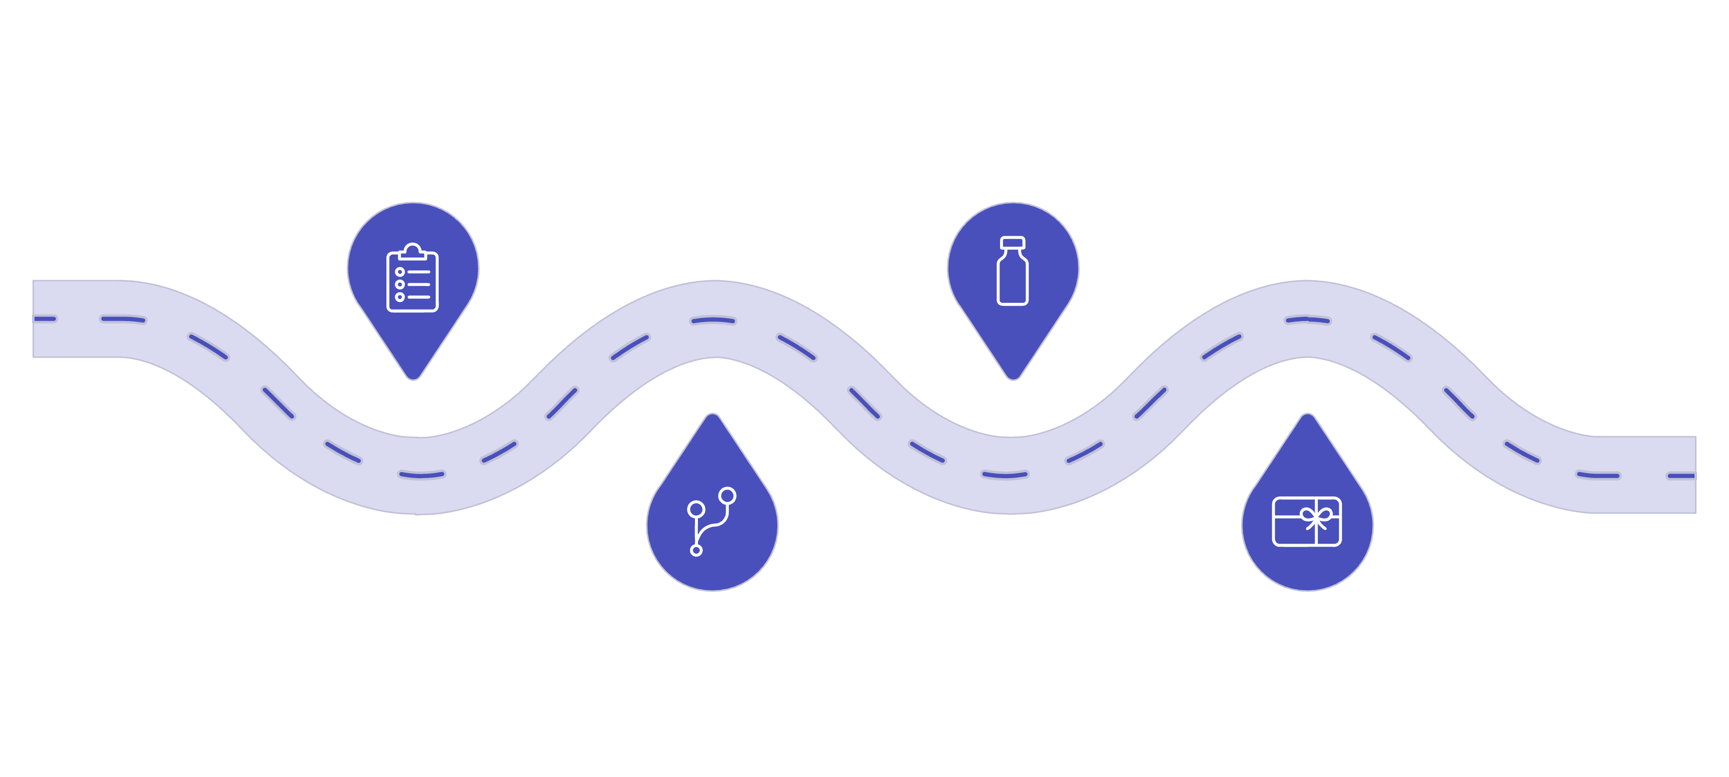




Roadmap to Launch
Project Timeline
Requirements
Testing
Week 1-2: gather clinical and technical needs
Week 6-10 : validate, QA, and deploy to production
Development
Delivery
Week 3-5: build system and train ML models
Week 11-15: final handoff and project closeout
This phased approach ensures systematic development, rigorous testing, and timely delivery of a high-quality product.

Slide 7
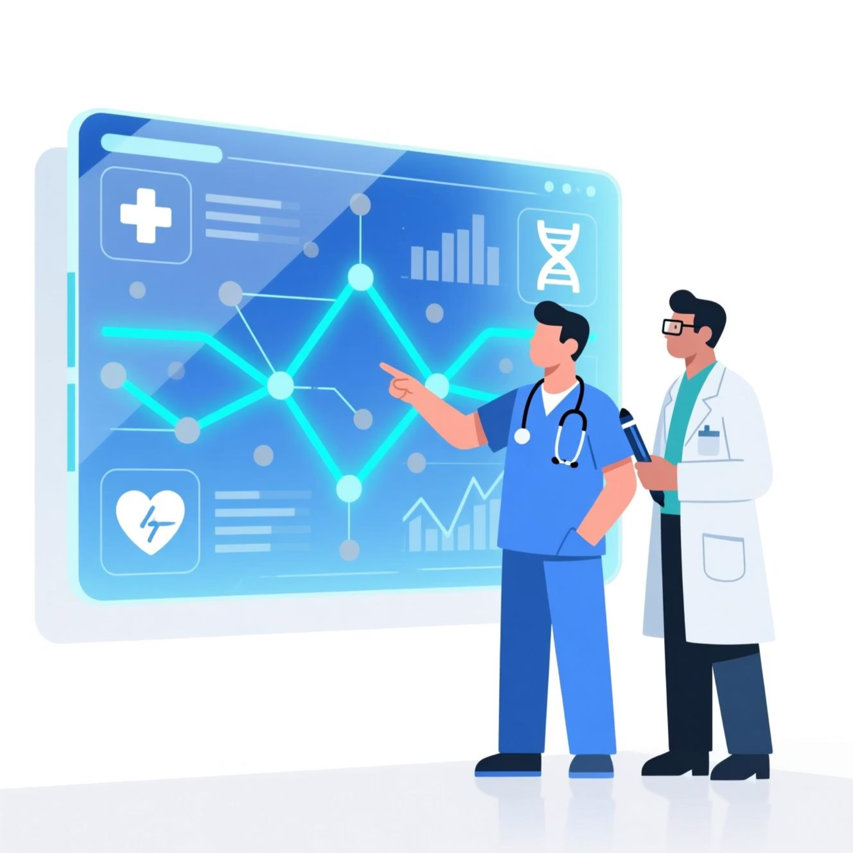
Beyond the Build
Outcomes & Applications
Personalized Health Recommendations
Provides users with tailored health tips, preventive measures, and lifestyle suggestions based on their input data.
Early Risk Detection
Helps identify potential health risks (like diabetes, hypertension, or obesity) at an early stage through data analysis.
Improved Health Awareness
Educates users about their health parameters and encourages healthier lifestyle choices.
User-Friendly Digital Health Platform
Offers an accessible, easy-to-use platform where users can track health records and receive instant insights.
Integration with AI/ML & APIs

Slide 8
The Path Forward
Future Scope & Conclusion
Future Scope
Conclusion
Voice-Enabled Chatbot: Enhanced accessibility and natural user interaction.
The Healthcare Recommendation System is poised to revolutionize healthcare management by:
Multi-Language Support: Expanding reach to a global user base.
Delivering personalized, AI-driven recommendations.
Empowering patients & clinicians with actionable insights.
Building a scalable, research-ready platform for the future.
We are committed to enhancing health outcomes through innovation and technology.

