Slide 1
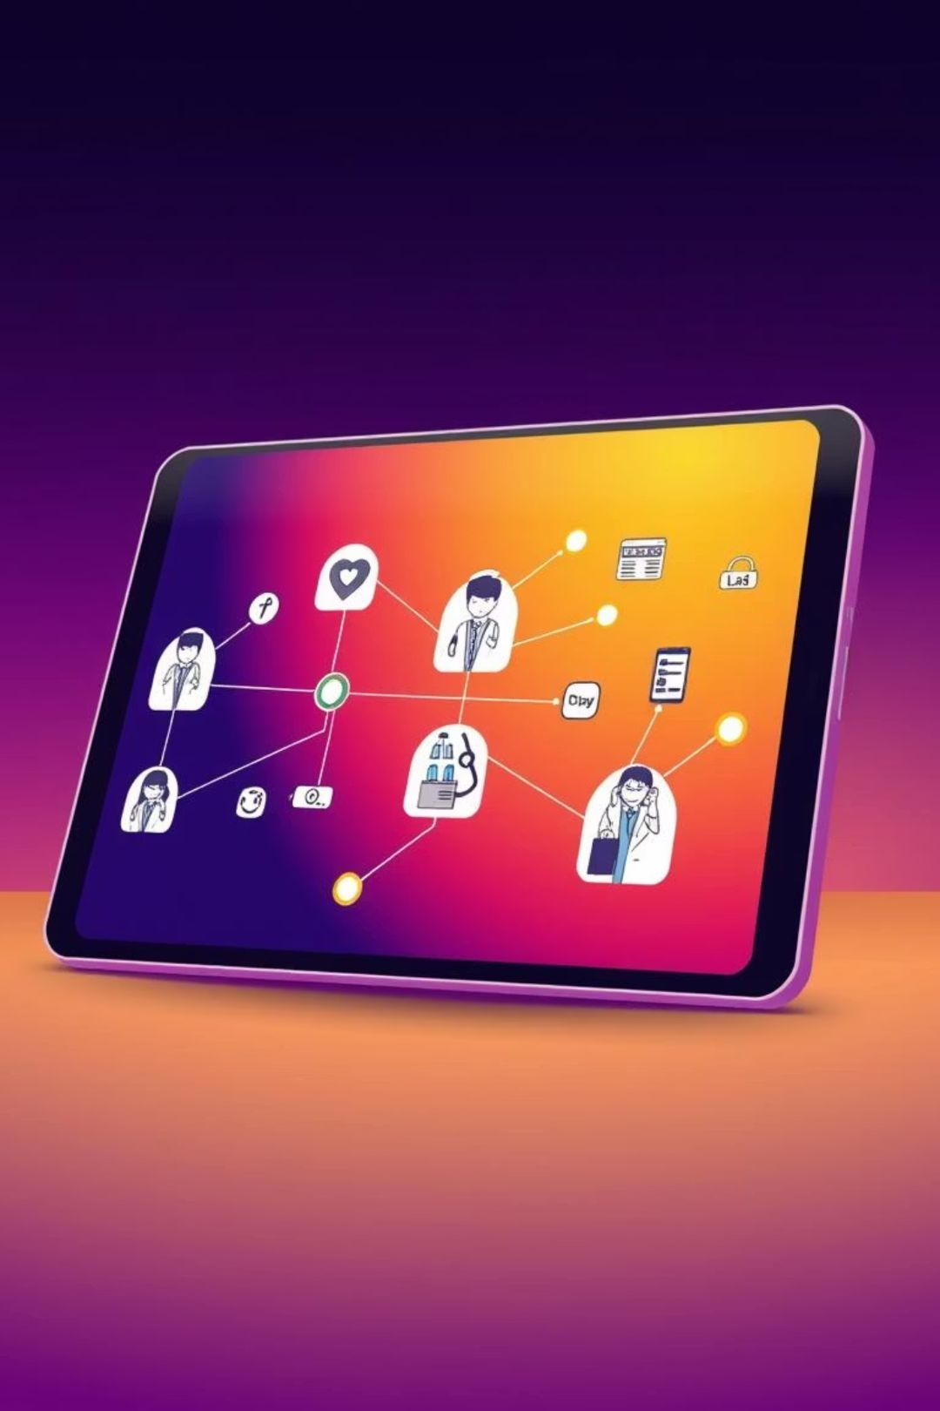
MediConnect – Streamlining Your Healthcare Journey
Welcome to MediConnect, your all-in-one platform designed to simplify the complex world of healthcare. We empower patients to navigate their health needs with unprecedented ease and confidence.

Slide 2
The Healthcare Maze: Problems We Solve
Navigating Specialities
Fragmented Services
Slow Recommendations
Patients often struggle to identify the correct specialist for their symptoms, leading to delayed or inefficient care pathways.
The current system lacks a unified platform for doctor consultations, medicine orders, and lab bookings, creating disjointed experiences.
The process of finding and booking a doctor can be time-consuming, highlighting the need for faster, AI-assisted recommendations.

Slide 3
MediConnect: Simplified System Workflow
Our platform guides patients through a logical and intuitive sequence, from initial symptom input to comprehensive healthcare access.
01
02
03
Patient Login
Symptom Input
Doctor Recommendation
Secure access to their personalized healthcare dashboard.
Users describe their symptoms, which are then analyzed by the system.
AI-powered suggestions for appropriate specializations.
04
05
Doctor List & Booking
Pharmacy & Lab Access
Browse recommended doctors and book appointments seamlessly.
Direct links to order medications and schedule diagnostic tests.

Slide 4

Visualising the MediConnect Journey
Login
Enter Symptoms
AI Mapping
Recommend Specialist

Slide 5

Key Features of MediConnect
Symptom-based doctor recommendations for precise guidance.
Integrated pharmacy ordering for prescription fulfillment.
Flexible exploration of doctors by specific specialization.
Seamless diagnostic lab test booking at preferred centers.
Access to general doctor exploration for broader choices.
Convenient online and offline appointment booking options.

Slide 6

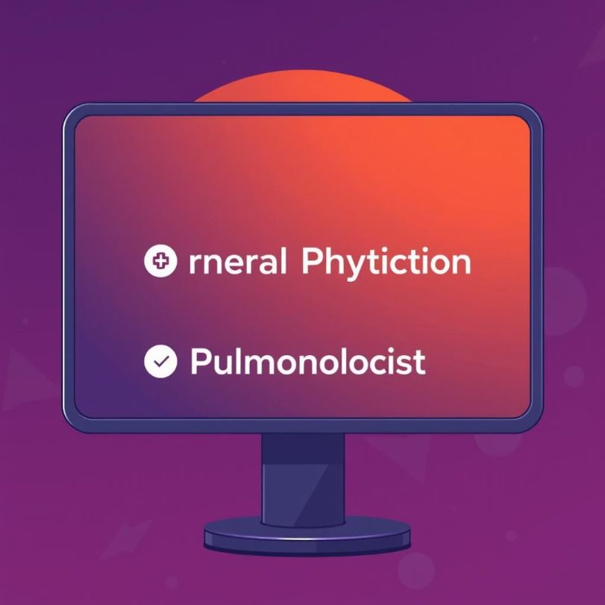
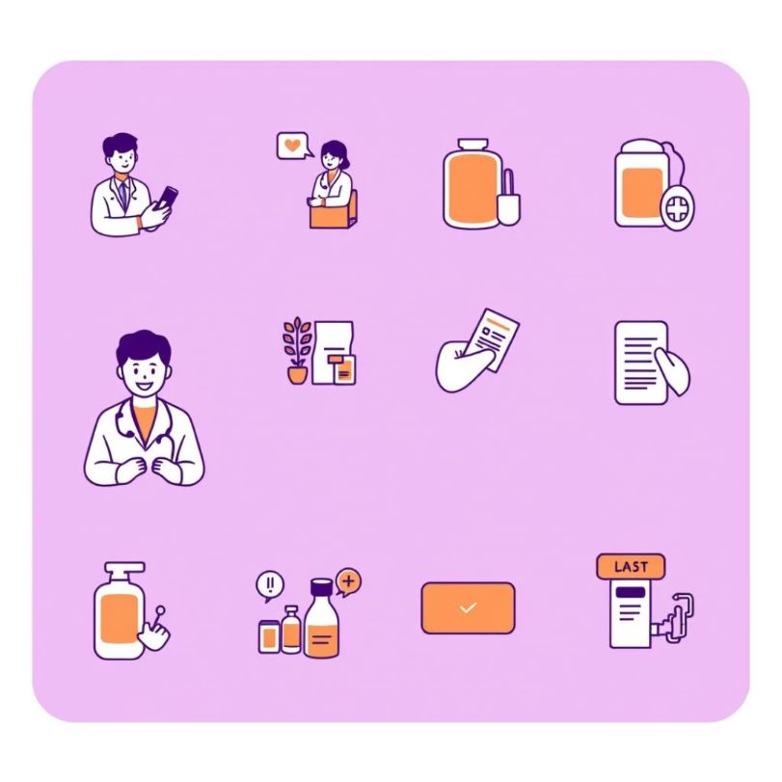
MediConnect in Action: An Example Use Case
Patient Scenario
System Response
Complete Journey
A user logs in and enters symptoms: "Fever, persistent cough."
MediConnect's intelligent system suggests appropriate specializations: General Physician or Pulmonologist.
The patient proceeds to book an appointment, receives a digital prescription, orders necessary medicines through the platform, and schedules a follow-up blood test at a nearby lab.

Slide 7

Under The Hood: Technology Driving MediConnect
Our robust architecture ensures a seamless, responsive, and secure healthcare experience for all users.
Frontend
Backend
Built with React / React Native for intuitive and cross-platform user interfaces.
Powered by Node.js / Java Spring Boot for scalable and efficient server-side operations.
Database
Future AI
Utilizes MongoDB / MySQL to manage vast amounts of patient and provider data securely.
Planned integration of AI/ML for advanced symptom mapping and predictive insights.

Slide 8
Transforming Healthcare: Key Benefits
⏱️
🔄
🌐
Time Efficiency
Integrated Journey
Enhanced Accessibility
Significantly reduces the time patients spend identifying and selecting the appropriate doctor.
Provides a holistic and connected healthcare experience, from doctor consultation to medicine and lab services.
Boosts the overall accessibility and convenience of healthcare services for all users.

Slide 9
MediConnect: The Future of Patient Care
MediConnect is envisioned as a comprehensive, patient-centered platform that will continue to evolve.
1
2
3
AI Chatbot
Insurance Integration
Telemedicine
Advanced AI chatbot for personalized symptom checking and preliminary guidance.
Seamless integration with insurance providers for streamlined claims and coverage.
Direct video consultation capabilities for remote medical appointments.
MediConnect is not just a platform; it's a commitment to a more efficient, accessible, and integrated future for healthcare.

