Slide 1

SYNOPSIS Presentation
on
SENTIMENT ANALYSIS On GOVERNMENT SCHEMES
by
Tanishka Gupta 2400290140216
Shipra Upadhyay 2400290140194
Sonam Dobriyal 2400290140208
Tanisha Jain 2400290140215
Session:2025-2026 (III Semester)
Under the supervision of
Dr. Neelam Rawat (Associate Professor)
Department Of Computer Applications
KIET GROUP OF INSTITUTIONS, DELHI-NCR, GHAZIABAD-201206
Presentation Date: 25/08/2025

Slide 2
1. Title Slide:
Project title, team members, and presentation date.
2. Project Overview:
Briefly introduce the project, its purpose, and the problem it solves.
Highlight the project's significance and potential impact.
3. Project Objectives:
Clearly state the specific objectives of the project.
Explain what the project aims to achieve and how success will be measured.
4. Project Scope:
Define the boundaries of the project, outlining what is included and excluded.
Specify the key features, functionalities and modules
5. Methodology:
Describe the chosen software development methodology (e.g., Agile, Waterfall).
Explain the tools and technologies used for this approach.
6. Timeline:
Present a visual representation of the project schedule, including major milestones and deadlines.
Use a Gantt chart or similar diagram to show the project's timeline.
7. Project Outcome: Highlight the final result of the project, such as:
Research Paper Publication
Web/Mobile Application Development
Patent Filing/Grant

Slide 3
PROJECT OVERVIEW
The project aims to analyze public views about government schemes using social media data.
News are collected in regional Indian languages like Hindi, Marathi, Tamil, etc.
We translate all news into English using the Google Translate API.
TextBlob model is used to perform multilingual sentiment classification.
This helps identify whether people support or criticize various schemes.
The insights can help government officials and policymakers improve initiatives.
It combines NLP, machine learning and data analytics.
This work shows how social media can be used to monitor the impact of public policies.

Slide 4
PROJECT OBJECTIVE
To collect real news related to major government schemes in India.
To translate multilingual news into English using an API.
To clean, preprocess, and prepare the text data for analysis.
To implement a TextBlob-based sentiment analysis model for classification.
To evaluate and visualize the sentiment data in graphical form.
To help policymakers understand public perception through data-driven insights.
To publish findings as a research paper for academic contribution.
To promote digital governance and transparency using AI tools.

Slide 5
PROJECT SCOPE
In Scope:
Data scraping from News Headlines (hashtags, keywords).
Translation of regional language text to English.
Preprocessing (null data removal, cleaning).
Sentiment classification using TextBlob.
Visualization of public opinion trends.
Out of Scope:
Fake news detection and verification.
Sarcasm detection in news.
Analysis of voice or multimedia content.
Deep behavioral psychology analysis.
Comprehensive policy recommendation system

Slide 6
METHODOLOGY
We followed the Agile methodology with iterative progress and feedback.
Tools & Technologies used:
Python, Jupyter Notebook
Google Translate API for translation
TextBlob model
Pandas and NumPy for data handling

Slide 7
TIMELINE
Phase | Duration
Literature Review | Week 1 – 2
Data Collection | Week 3 – 4
Translation & Preprocessing | Week 5 – 6
Model Training | Week 7 – 8
Model Testing | Week 9
Result Analysis & Visualization | Week 10 – 11
Report & Presentation | Week 12
Used Gantt chart to plan weekly goals.
Each phase reviewed at the end of each week.
Agile helped with flexibility and changes.
Deadlines were set for data, model, and visualization tasks.

Slide 8
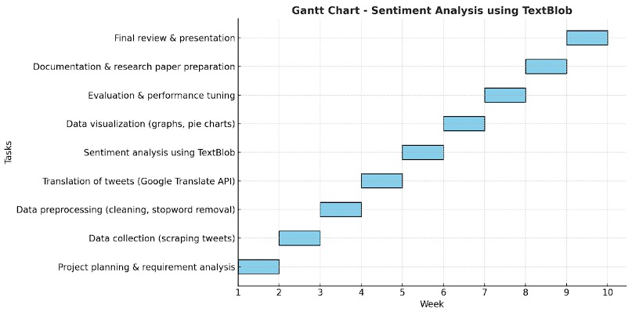
GANTT CHART
Used Gantt chart to plan weekly goals.
Each phase reviewed at the end of each week.
Agile helped with flexibility and changes.
Deadlines were set for data, model, and visualization tasks.

Slide 9
PROJECT OUTCOME
Built a functional system for multilingual sentiment analysis of news.
Successfully categorized news into positive, negative, or neutral.
Generated graphs and pie charts summarizing public opinion.
Proposed to publish as a Research Paper in an AI/NLP conference.
Can be converted into a Live Dashboard for policy monitoring.
Supports UN SDG 16 by improving transparency and public participation.
Future scope includes:
Real-time tweet monitoring
Fake news detection
Support for more Indian languages
Helps government and researchers improve schemes based on public feedback

Slide 10
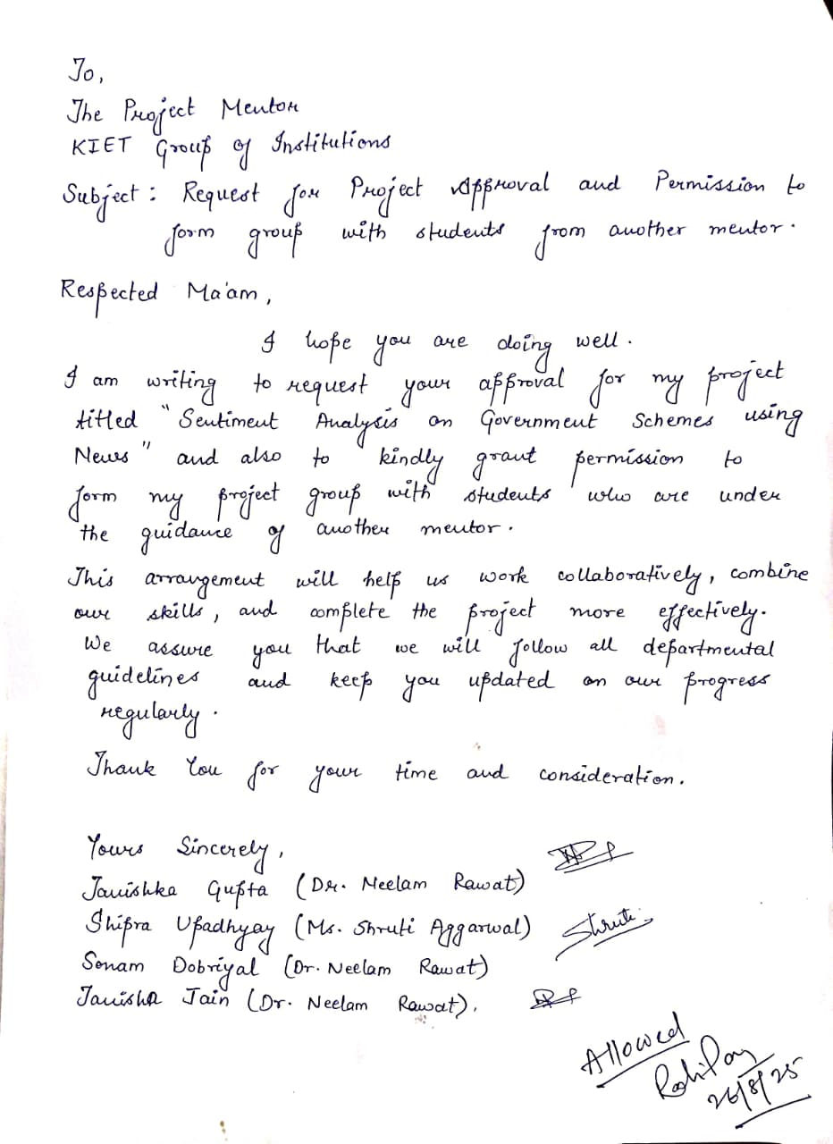
CONSENT LETTER

Slide 11
THANK YOU

