Slide 1

SYNOPSIS Presentation On
SKILL SWAP
by
Akansha Tyagi 202410116100014
Akshita Gupta 202410116100017
Akanksha Dwivedi 202410116100012
Aashi 202410116100004
Session:2025-2026 (IV Semester)
Under the supervision of
Dr. Shashank Bharadwaj Department Of Computer Applications
KIET GROUP OF INSTITUTIONS, DELHI-NCR, GHAZIABAD-201206

Slide 2

Project Overview
What is Skill Swap?
An intelligent peer-to-peer learning platform leveraging AI for semantic skill matching. Unlike traditional keyword- based systems, Skill Swap uses vector embeddings and ChromaDB to deliver accurate, meaningful connections between learners.
AI-generated explanations powered by local LLM provide transparency in every match.

Slide 3
Problsm S Significancs
Problem Solved
Traditional platforms rely on rigid keyword matching, resulting in poor accuracy and missed learning opportunities.
Significance
Creates an intelligent, transparent, and cost-efficient skill exchange ecosystem using advanced AI techniques.

Slide 4
Project Objectives
01
02
03
Integrate Local LLM
Generate transparent, human-readable match explanations
Develop AI-Based Semantic Matching
Build a system that understands skill relationships beyond keywords
Implement Vector Similarity Search
Use embeddings and ChromaDB for intelligent matching
04
05
Build Production-Ready Application
Deploy a scalable full-stack solution
Demonstrate Applied AI
Showcase real-world AI implementation in education technology

Slide 5
Project Scope
Inclusions
JWT-based authentication system Skill profile creation and management Embedding generation pipeline Vector storage using ChromaDB
AI-based semantic matching engine LLM-powered explanation system
Exclusions
Real-time video calling (planned for future phase) Paid cloud AI APIs (using local models for cost efficiency)

Slide 6

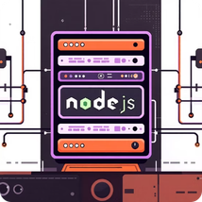


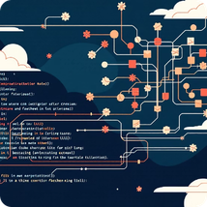
Technology Stack
Frontend
React.js, Tailwind CSS, Axios
Backend
Node.js, Express.js, MVC Architecture
Database
MongoDB, Mongoose ODM
AI S Vector System
Ollama (Phi/TinyLlama), Embeddings Model, ChromaDB
Version Control
Git & GitHub

Slide 7
Development Timeline
Week 1
Requirement Analysis & System Design
1
2
Weeks 2–3
Frontend & Backend Development
Week 4
Authentication & Profile Module
3
4
Week 5
Embeddings & ChromaDB Integration
Week 6
AI Matching & LLM Integration
5
6
Week 7
Testing & Optimization
Week 8
Documentation & Deployment
7

Slide 8
Expected Outcomes
1
2
3
Functional AI Application
Complete web platform with intelligent matching capabilities
Semantic Matching System
Vector-based similarity search delivering accurate skill connections
Transparent AI Explanations
Human-readable justifications for every match recommendation
4
5
Cost-Efficient Architecture
Offline AI system eliminating dependency on expensive cloud APIs
Scalable Foundation
Production-ready architecture supporting future expansion

Slide 9
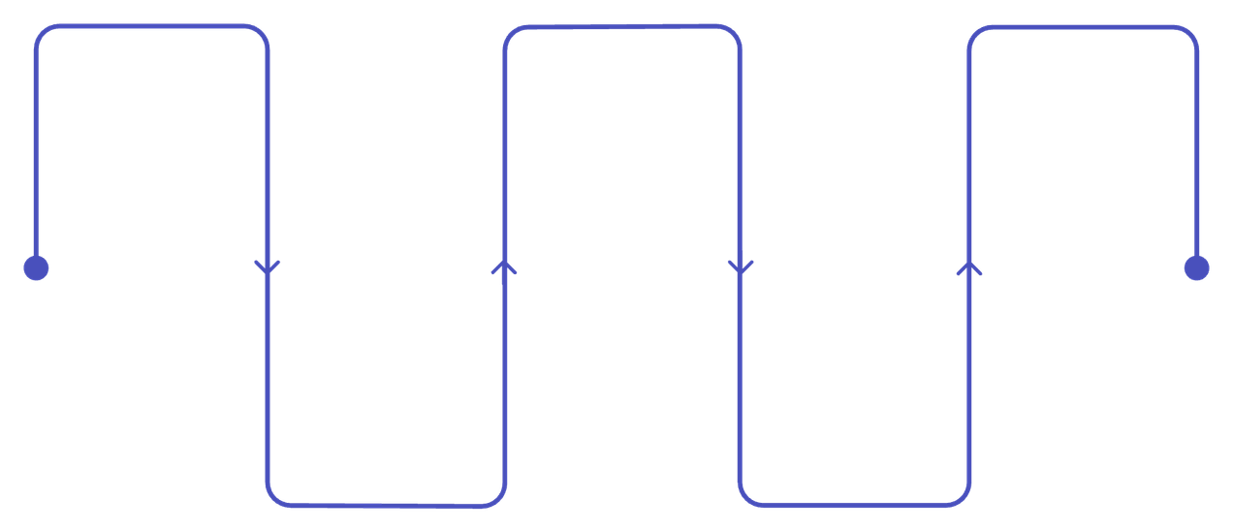
Future Expansion
Real-time Chat System
Enable instant communication between matched learners
Real-time Chat
Enable instant learner
communication
AI Gap Analysis
Identify skill deficiencies automatically
Cloud Deployment
Scale platform for global users
Skill Rating S Feedback
Build trust through peer review mechanisms
AI Skill Gap Analysis
Personalized Recos
Tailored learning pathways and
content
Identify learning paths and skill deficiencies
Skill Rating
Peer reviews to build trust
Personalized Recommendations
Suggest learning opportunities based on user goals
Strategic roadmap for scaling the platform and enhancing user experience through advanced features.
Cloud Deployment S Scaling
Expand infrastructure for global accessibility

Slide 10
Thank You
Skill Swap demonstrates the convergence of full-stack development and applied AI, delivering a scalable, intelligent platform for meaningful skill exchange and peer learning.

