Slide 1

Real-Time Fake Website Detection Browser Extension
Protect users instantly as they browse: detect phishing, spoofing and malicious sites with real‑time ML scoring, clear alerts and lightweight privacy‑preserving checks.

Slide 2



The Rising Threat of Fake Websites
Phishing as the primary entry
Visual ambiguity
High cost of fraud
Users typically can't distinguish crafted domains and look‑alike pages at a glance, increasing click risk.
Financial losses and identity theft from fake sites run into billions annually—affecting individuals and businesses alike.
Over 90% of cyber attacks begin with phishing or deceptive websites, making detection a priority for defenders.

Slide 3

Why Real‑Time Detection Matters
Rapid evolution
Minimise exposure
Frontline defence
Fraudulent sites are created and retired quickly; detection must be instantaneous to be effective.
Delays in identifying malicious pages leave users vulnerable to credential theft and drive‑by downloads.
Browser extensions operate where users interact, providing alerts and blocking before damage occurs.

Slide 4
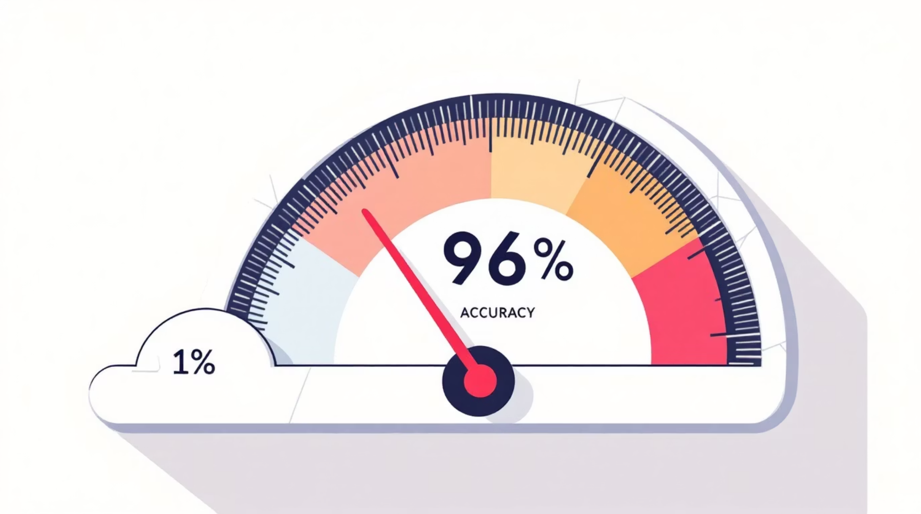
Machine Learning Powers Detection Accuracy
Modern classifiers analyse lexical URL patterns, hosting behaviour and network signals. Ensemble approaches combine lightweight models for speed with deeper models for edge cases.
Proven performance
LGBM classifiers trained on 87 engineered features have achieved ~96.5% accuracy in phishing detection (Morey et al., 2024). Combining multiple feature families raises precision and reduces false positives.

Slide 5
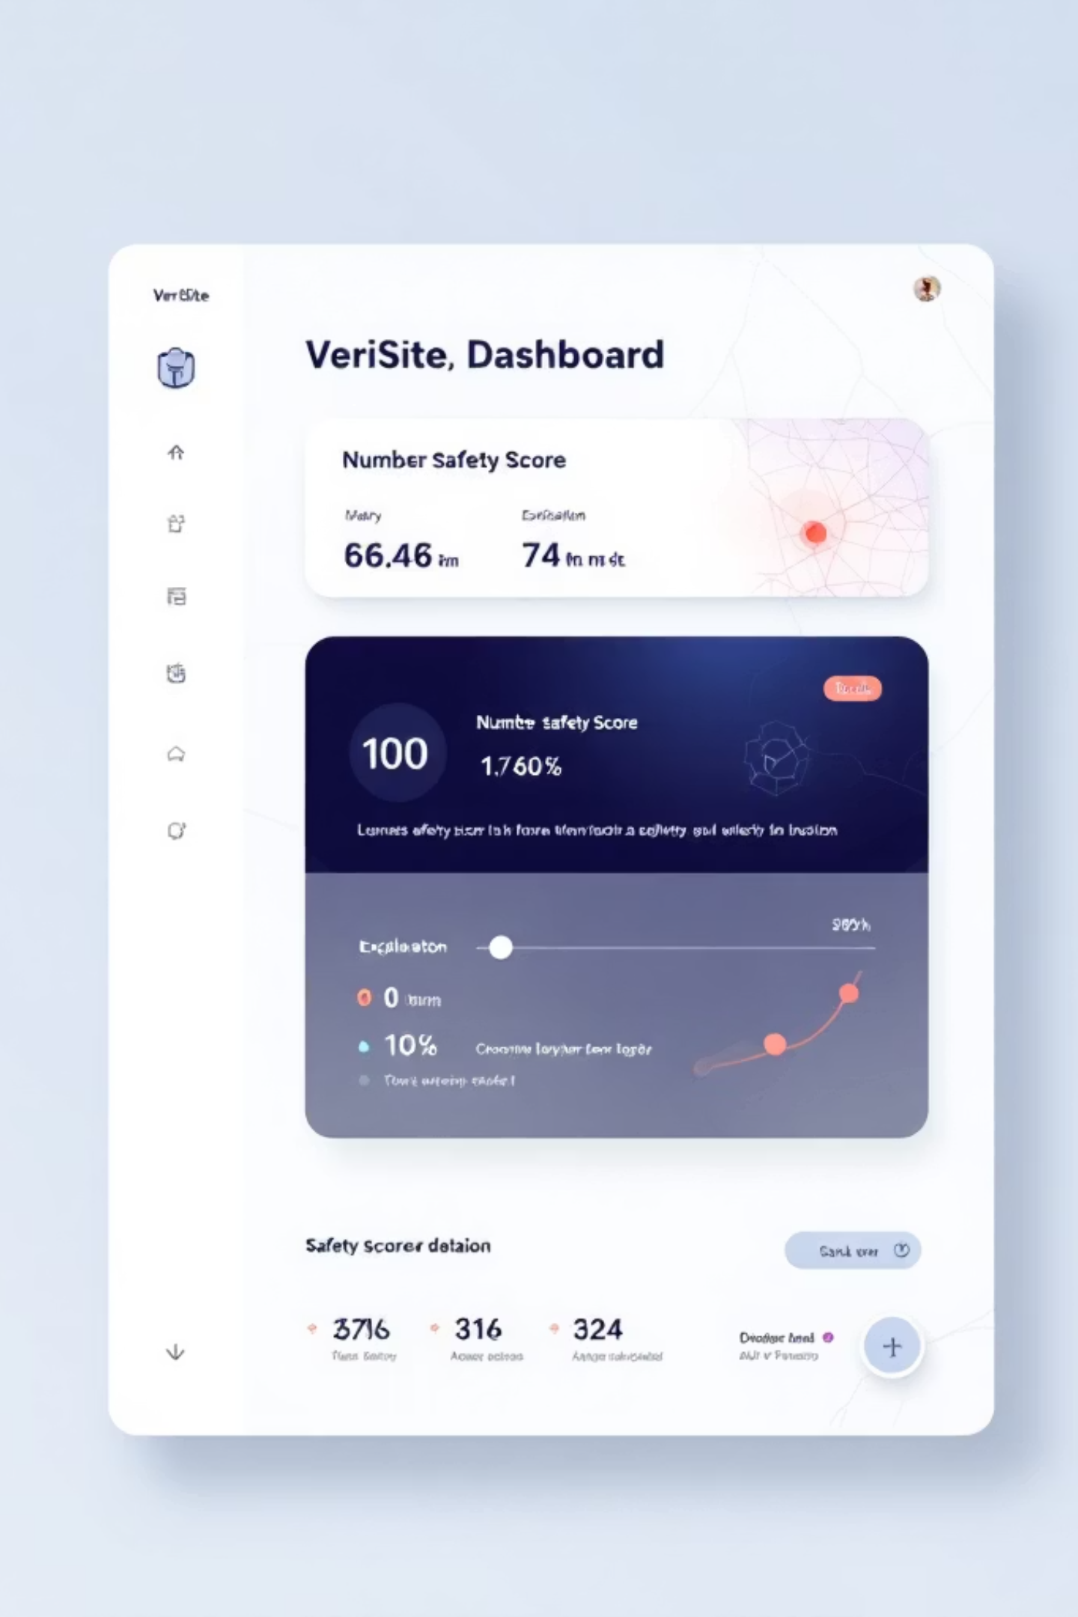
Cutting‑Edge Research: VeriSite & Real‑Time Scoring
VeriSite demonstrates that fine‑tuned DeBERTa v3 embeddings of URL text combined with a neural scorer produce meaningful safety scores (0 = malicious to 100 = benign), enabling rapid triage with minimal context.
URL‑first signals
Lightweight deployment
Textual cues and token patterns are strong indicators when models are carefully fine‑tuned.
Models can run or be queried via a small cloud API to keep the extension responsive.

Slide 6
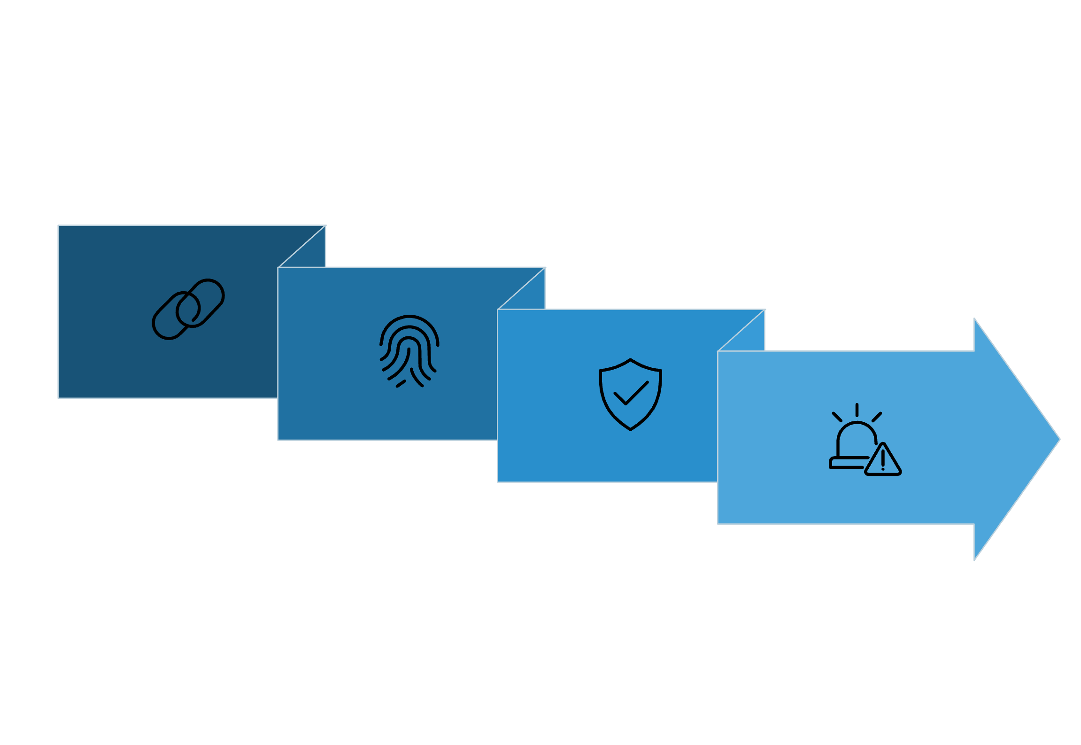

How These Extensions Work Under the Hood
Extract features
Warn/block
Capture URL
Score & cross-check
Extensions capture the URL, extract features (length, SSL, domain age, lexical tokens), score with ML models, cross‑check threat feeds (Google Safe Browsing, PhishTank, VirusTotal) and present an actionable alert or block in real‑time.

Slide 7



Impact & Future Outlook
Reduce harm
Deeper telemetry
Empowered users
Real‑time detection reduces phishing success and lowers user losses, increasing overall digital trust.
Future extensions may blend browser telemetry, network flow analysis and user interaction signals for richer context-aware protection.
Clear, actionable alerts and explanations help users make safer choices without heavy friction.

Slide 8


Conclusion: Safer Browsing Starts with Real‑Time Detection
Fake websites are an evolving global threat. Machine learning browser extensions deliver immediate, effective defence—essential for protecting users in India and worldwide. Adopt real‑time checks today: one reliable URL decision at a time.
Tip: Prioritise fast, explainable alerts and privacy‑conscious design when building or choosing an extension.

