Slide 1

Online Placement Registration & Grievance Redressal System

Slide 2


The Challenge in Traditional Systems
Traditional placement and grievance systems create barriers for students and institutions alike, leading to inefficiencies and lost opportunities.
Manual paperwork causes delays and lack of transparency
Students struggle to register and track placements or complaints
Authorities face inefficient complaint management
Result: Frustration, lost opportunities, and low trust

Slide 3
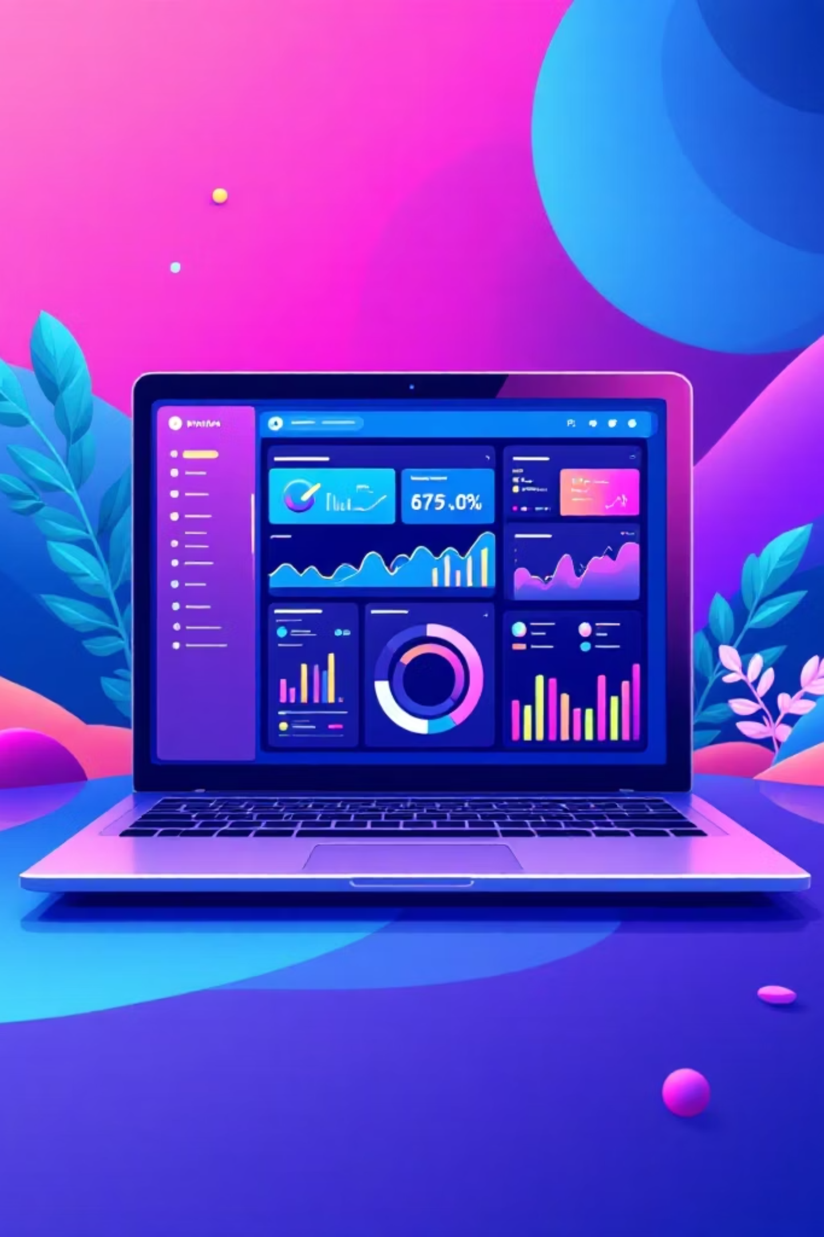




Introducing Our Digital Solution
Unified Platform
Single web platform for placement registration and grievance handling
MERN Stack
Built with React.js frontend, Node.js backend, MongoDB database
Real-Time Updates
Role-based access with seamless communication
Always Accessible
Desktop and mobile access anytime, anywhere

Slide 4
Key Features Overview
01
02
03
Placement Registration
Grievance Submission
Status Tracking
Students submit profiles and apply for jobs online with digital documentation
Easy complaint filing with detailed descriptions, attachments, and priority levels
Real-time updates on application and grievance progress with notifications
04
Role-Based Access
Separate dashboards for students, placement officers, and administrators

Slide 5

System Architecture & Technology Stack
1
2
3
Frontend
Backend
Database
React.js with responsive UI for smooth user experience across all devices
Node.js + Express.js handling API requests and business logic efficiently
MongoDB for flexible, scalable data storage of users, complaints, and placements

Slide 6



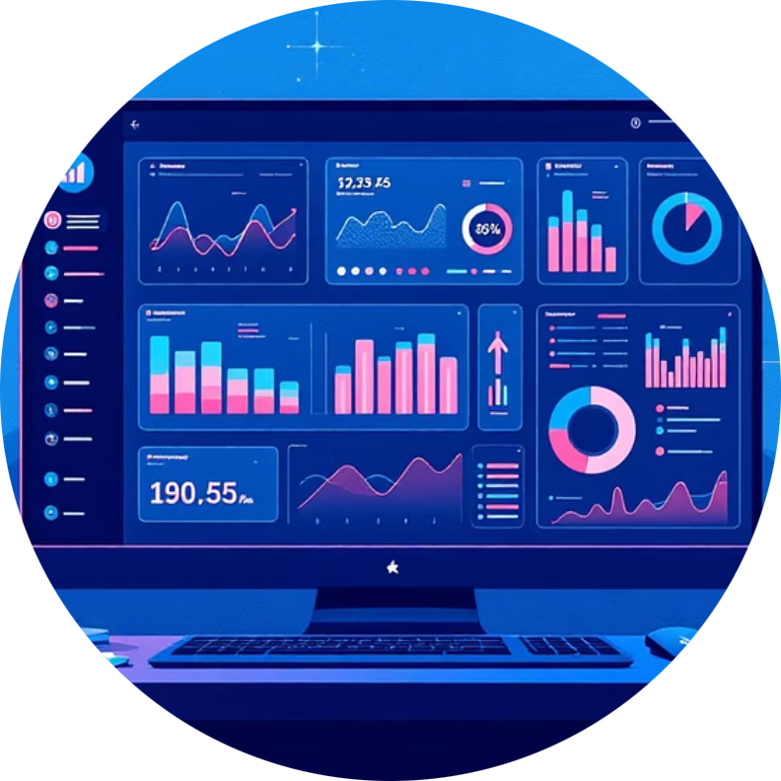
User Roles & Workflows
Students
Placement Officers
Grievance Officers
Administrators
Register profiles, apply for placements, submit grievances
Manage student applications, schedule interviews, update status, and coordinate recruitment
Receive, assign, and resolve complaints with complete audit trails and documentation
Oversee system health, manage users, generate reports, and maintain analytics dashboards

Slide 7
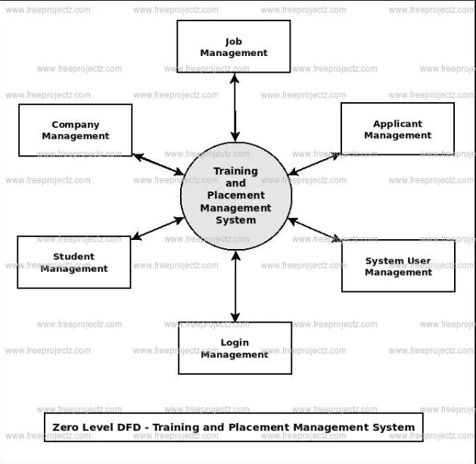
ZERO LEVEL DFD

Slide 8
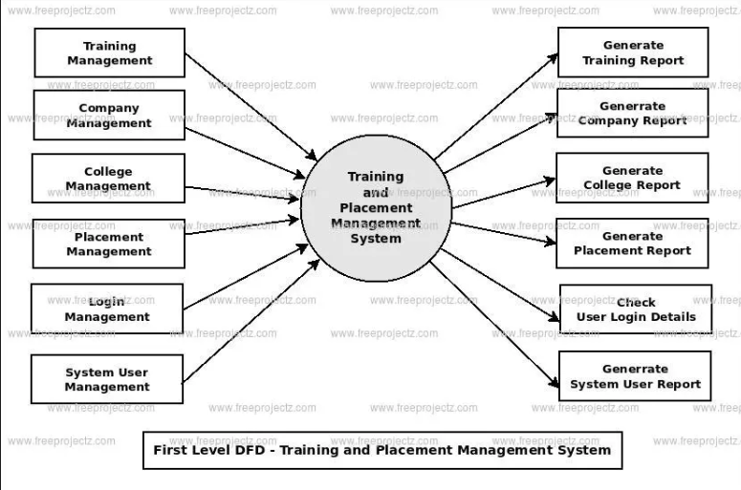
FIRST LEVEL DFD

Slide 9
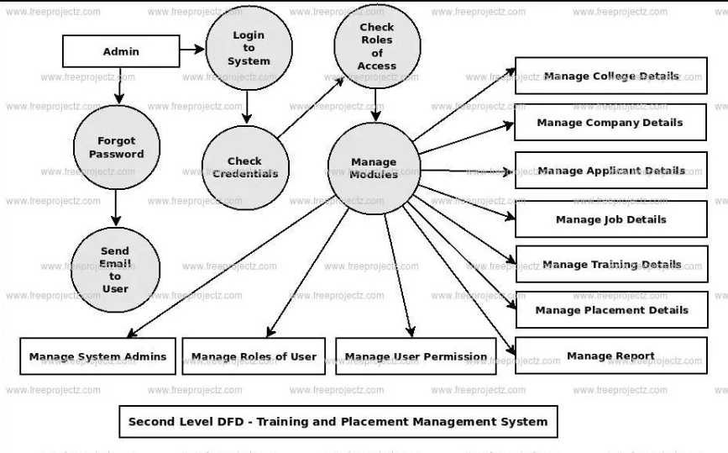
SECOND LEVEL DFD

Slide 10

Benefits & Impact
70%
24/7
100%
Efficiency Gain
Availability
Transparency
Reduces manual effort and processing time
Continuous access for students and officers
Real-time tracking and notifications
Streamlines placement and grievance processes with automation
Enhances transparency and trust through visibility
Improves student satisfaction and institutional responsiveness
Data-driven insights for continuous improvement and policy making

Slide 11





The Future of E-Governance in Education
AI Integration
AI-powered complaint classification and intelligent prioritization
Chatbot Support
Multilingual grievance assistance and automated responses
Mobile Expansion
Dedicated mobile apps for on-the-go access
Blockchain
Tamper-proof records and secure document verification

