Slide 1
MediSphere AI
Smart Clinical Recommendation & Consultation System
DOULAT BISWAL (202410116100070)
DOLLY PRAJAPATI (202410116100069)
GARGI SINGH (202410116100072)
Session:2025-2026 (IV Semester)
Under the supervision of
Ms. Annu Yadav
Assistant Professor
Department Of Computer Applications
KIET GROUP OF INSTITUTIONS, DELHI-NCR, GHAZIABAD-201206

Slide 2
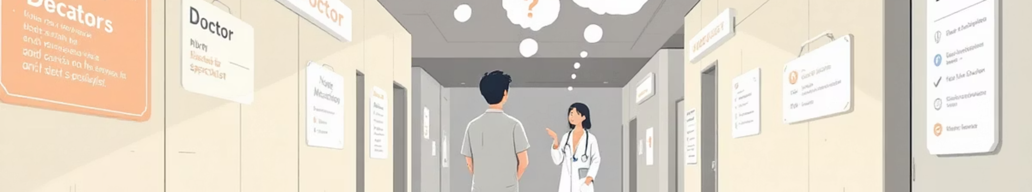
Problem Statement
Problems in Current Healthcare System
Patients consult wrong specialists
Delay in treatment due to confusion
No early risk identification
No AI assistance in symptom analysis
No centralized digital consultation system
These challenges increase medical risk and reduce healthcare efficiency.

Slide 3

Proposed Solution
MediSphere AI – Our Solution
An AI-powered healthcare system that:
Analyzes patient symptoms
Predicts medical risk level
Recommends appropriate specialist
Enables appointment booking
Supports doctors with AI-generated summary
Generates simple consultation billing

Slide 4

System Modules
System Roles
Patient
Doctor
Admin
Register/Login
Enter symptoms
View risk score
Book appointment
Download bill
View appointments
View AI summary
Add diagnosis
Generate bill
Manage doctors & patients
Monitor appointments
View analytics & revenue

Slide 5
Patient Workflow
01
02
03
Register / Login
Enter symptoms
AI analyzes input
04
05
06
System shows:
View doctors & fees
Book appointment
Risk Level (Low / Medium / High)
Recommended Specialist
Confidence %
07
Download consultation bill

Slide 6
Doctor & Billing Workflow
Doctor Process
Billing System
Login
View appointment requests
Review AI-generated patient summary
Add diagnosis & prescription
Confirm consultation
Predefined consultation fee
Auto-generated digital bill
Payment status (Paid / Pending)
Admin revenue tracking

Slide 7
AI-Based Symptom Analysis
How AI Works
Patient enters symptoms
System processes keywords
Matches symptoms with medical dataset
Calculates severity score
Recommends specialist
Example
Input: Chest pain + sweating
Output: Specialist → Cardiologist Risk Level → High Confidence → 87%

Slide 8
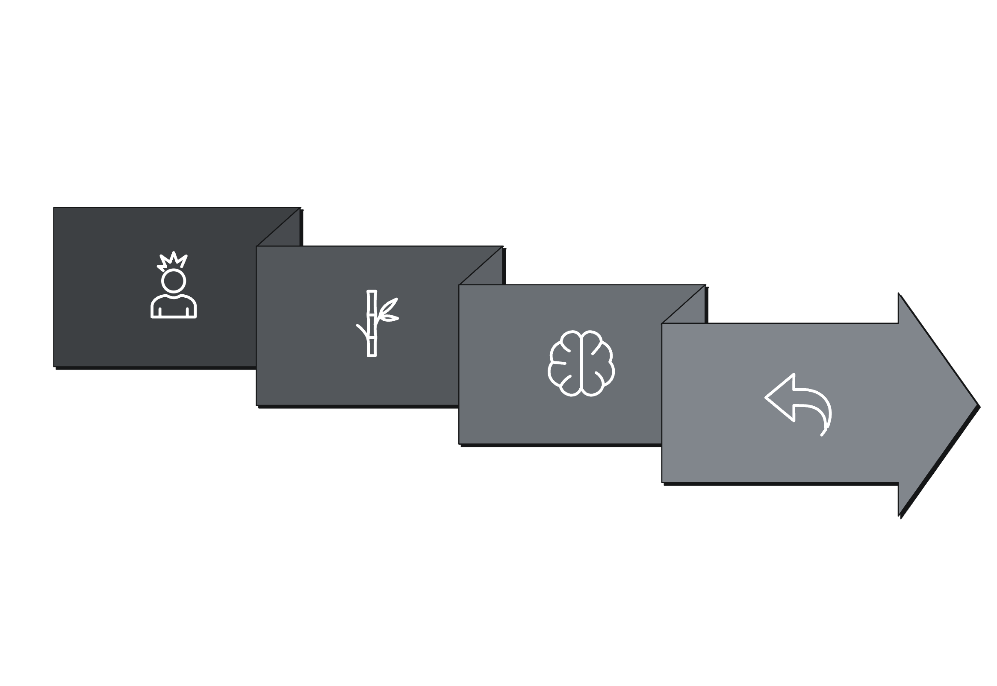
System Architecture
Backend
Response
Frontend
AI Engine
Secure authentication using JWT.

Slide 9
Tech Stack
Frontend
Backend
Database
Tools
React.js
Bootstrap
Axios
Spring Boot
Spring Security
JWT Authentication
MongoDB
Git & GitHub
Postman
AI Engine
Rule-Based Symptom Analysis Engine

Slide 10

Conclusion
MediSphere AI simplifies healthcare access by intelligently guiding patients to the correct specialist and predicting risk levels using AI-assisted symptom analysis.
Thank You

