Slide 1

SYNOPSIS Presentation
on
HomeEase
by
Ankit Kumar Shahi 202410116100028
Ankit Sisodia 202410116100029
Ansh Mishra 202410116100030
Ambikeshwar Dutt Dwivedi 202410116100022
Session:2025-2026 (4th Semester)
Under the supervision of
Ms. Riya Rai
Department Of Computer Applications
KIET GROUP OF INSTITUTIONS, DELHI-NCR, GHAZIABAD-201206

Slide 2

Project Overview: HomeEase
HomeEase is an intuitive web-based platform designed to seamlessly connect customers with local, professional home service providers. From plumbing to electrical work, cleaning to technical assistance, HomeEase simplifies the process of finding and booking reliable help right from your device.
Online service booking for ultimate convenience
Streamlined provider registration and vetting
Centralized management for administrators
Our goal is to redefine customer satisfaction in the home services sector by making booking effortless and reliable.

Slide 3
Project Objectives: Enhancing Home Service Experience
The core mission of HomeEase is to revolutionize how home services are accessed and managed. Our key objectives focus on creating a superior, user-centric platform that addresses common pain points in the industry.
1
2
3
Effortless Online Booking
Verified Provider Network
Automated Booking Processes
Provide a simple and intuitive system for customers to book services.
Connect customers with rigorously vetted and highly-rated service professionals.
Eliminate manual booking challenges through efficient automation.
4
5
Transparent Service Delivery
Robust Admin Control
Enhance clarity and communication throughout the service lifecycle.
Enable efficient oversight and management of all platform activities.

Slide 4
Comprehensive Project Scope
HomeEase is meticulously designed to cater to the distinct needs of its three primary user groups: customers, service providers, and administrators. Our current scope lays a robust foundation, with an eye towards future enhancements.
Customer Features
Service Provider Features
Super Admin Capabilities
Seamless registration and login
Intuitive service browsing and selection
Effortless booking initiation
Real-time booking status tracking
Detailed profile registration
Comprehensive service listing management
Flexible availability management
Efficient booking acceptance and management
Streamlined provider approval process
Holistic user management
Centralized booking monitoring
Comprehensive report generation
Looking ahead, we plan to integrate advanced payment gateways and real-time chat functionalities to further enrich the user experience.

Slide 5
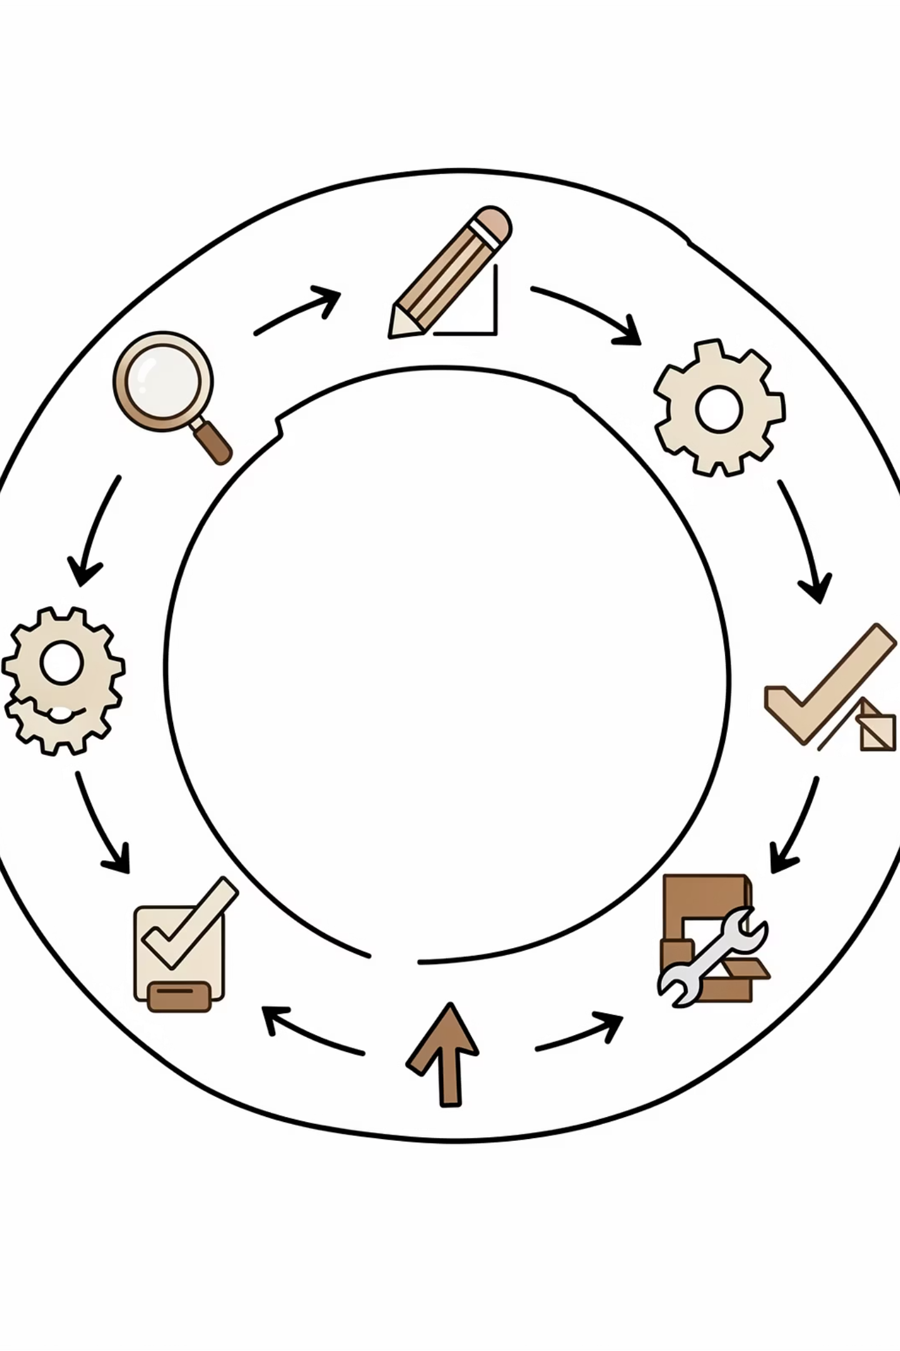
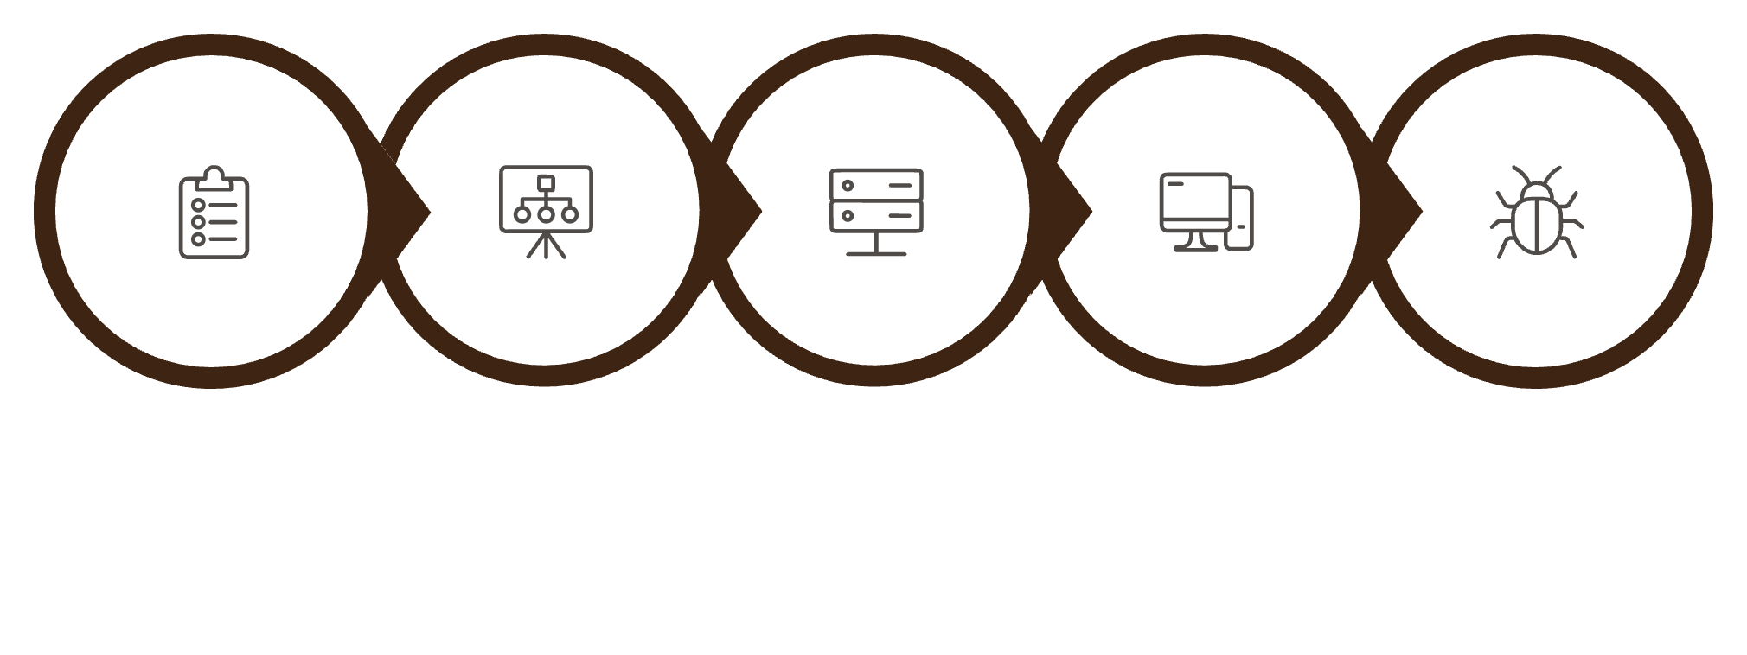
Methodology: Agile-Based Development
Our project adopts a dynamic Agile-based development methodology, emphasizing iterative progress, flexibility, and continuous improvement. This approach ensures that HomeEase evolves responsively to user needs and market demands.
Requirements
Design
Backend
Frontend
Testing
By breaking down the project into smaller, manageable modules, we can ensure regular testing and rapid iteration, significantly enhancing product quality and development efficiency.

Slide 6
Technology Used: The Power of MERN Stack
HomeEase is built upon the robust and scalable MERN (MongoDB, Express.js, React.js, Node.js) stack, a powerful combination of technologies known for delivering high-performance, dynamic web applications.
Frontend: React.js
Backend: Node.js, Express.js
Database: MongoDB
Authentication: JWT
For interactive user interfaces.
For flexible, scalable data storage.
For secure user verification.
For server-side logic and APIs.
Tools: VS Code, Postman, GitHub
For efficient development and collaboration.
This cutting-edge stack ensures a responsive, secure, and easily maintainable platform, capable of scaling with our growth.

Slide 7







System Workflow: A Seamless Journey
The HomeEase system is designed around a clear, intuitive workflow that orchestrates the interaction between customers, providers, and administrators, ensuring every service request is handled with precision and efficiency.
User Registration & Login
Customers securely access the platform.
Service Selection
Customers browse and choose their desired service.
Booking Request Submission
Customer initiates a service booking.
Admin Assignment
Administrator allocates a suitable provider.
Provider Acceptance
Assigned provider confirms the booking.
Service Completion
Provider successfully delivers the service.
User Feedback
Customer provides valuable input on the service.
This structured process ensures transparent communication and coordinated effort, leading to superior service delivery.

Slide 8
Project Timeline: Delivering HomeEase
Our development schedule is carefully planned to ensure timely delivery of HomeEase, with each phase allocated sufficient time for thorough execution and quality assurance. The entire project is slated for completion within 9 Weeks, reflecting our commitment to efficiency.
Requirement Analysis
1 Week
System Design
1 Weeks
Backend Development
3 Weeks
Frontend Development
3 Weeks
Testing
1 Week
Documentation
1 Week
Total Duration: 9 Weeks
This agile timeline allows for focused sprints and consistent progress toward our launch goal.

Slide 9
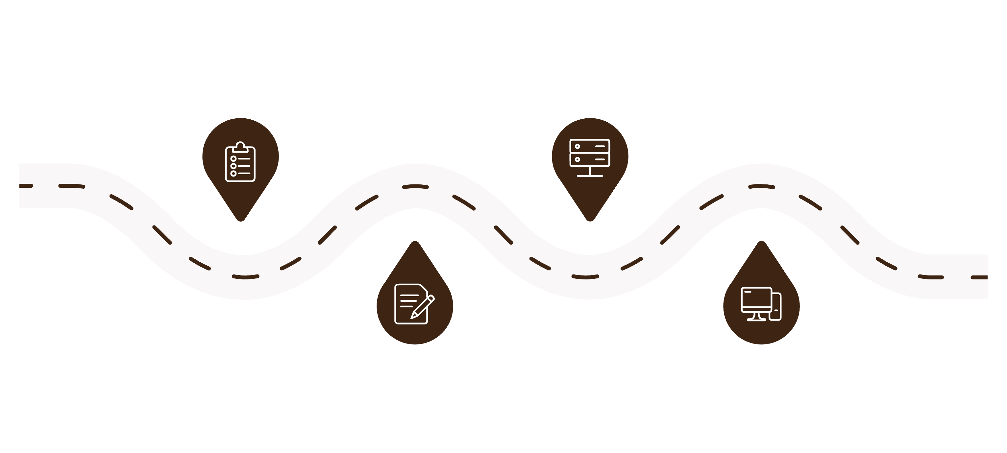
Project Timeline: Detailed Gantt View
To provide a more granular view of our development schedule, this Gantt-like timeline illustrates key phases across a 9-week period, ensuring clarity on task sequencing and duration. This expanded timeline allows for more thorough development and testing.
Analysis
Backend
Week 1: Requirement Analysis
Weeks 3-5: Backend Development
Design
Frontend
Week 2: System Design
Weeks 6-8: Frontend Development
This visual representation emphasizes our commitment to a structured yet adaptive development process, ensuring each phase is completed with precision.

Slide 10
Project Outcome: Empowering Home Services
Upon successful completion, HomeEase delivers a powerful and comprehensive platform that not only meets but exceeds its initial objectives. The system stands as a testament to efficient development and thoughtful design.
Fully Functional Booking System
Secure User Authentication
Efficient Service Management
Ensuring data privacy and secure access for all users.
A reliable and easy-to-use platform for all service needs.
Streamlined processes for providers and administrators.
Enhanced Customer Experience
Optimized Admin Control
A user-friendly interface leading to higher satisfaction.
Comprehensive tools for oversight and operational efficiency.
HomeEase proudly fulfills all functional requirements, ready to transform the home services landscape.

Slide 11
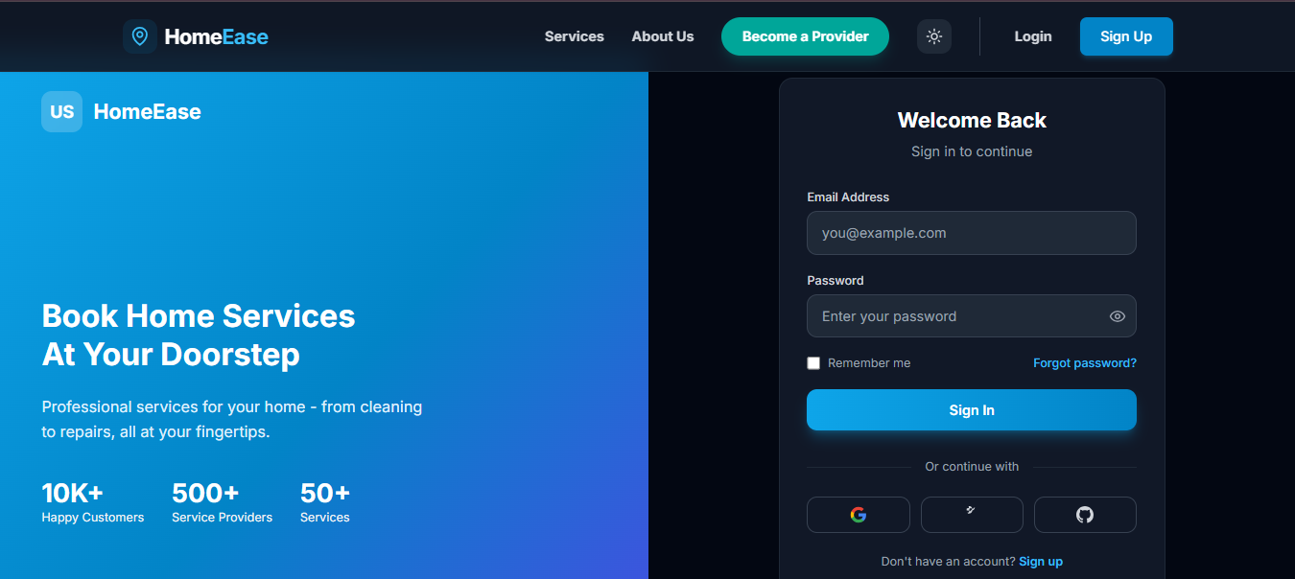
Project Visuals: Screenshot References
Login & Authentication Module

Slide 12
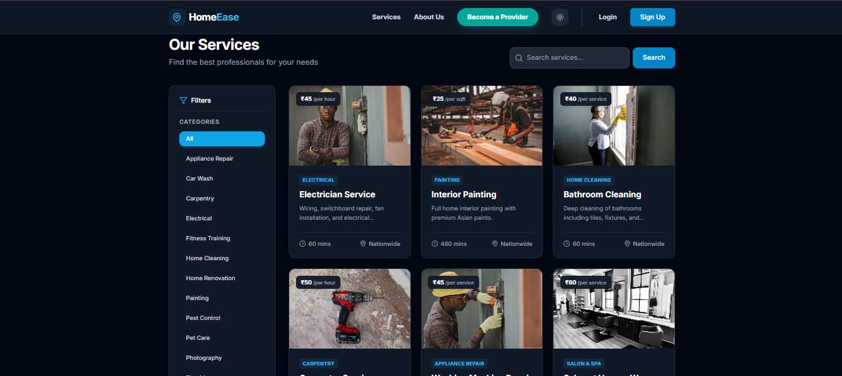
Service Marketplace Interface

Slide 13
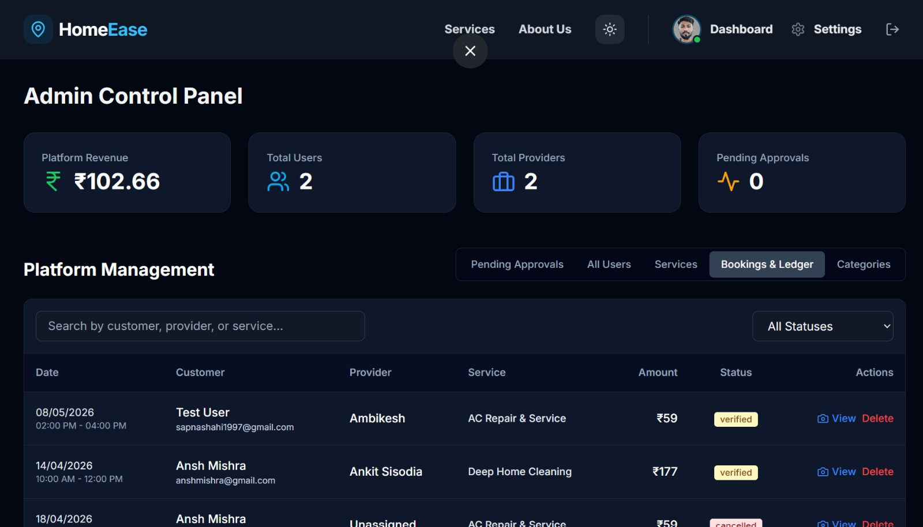
Admin Control Panel

Slide 14
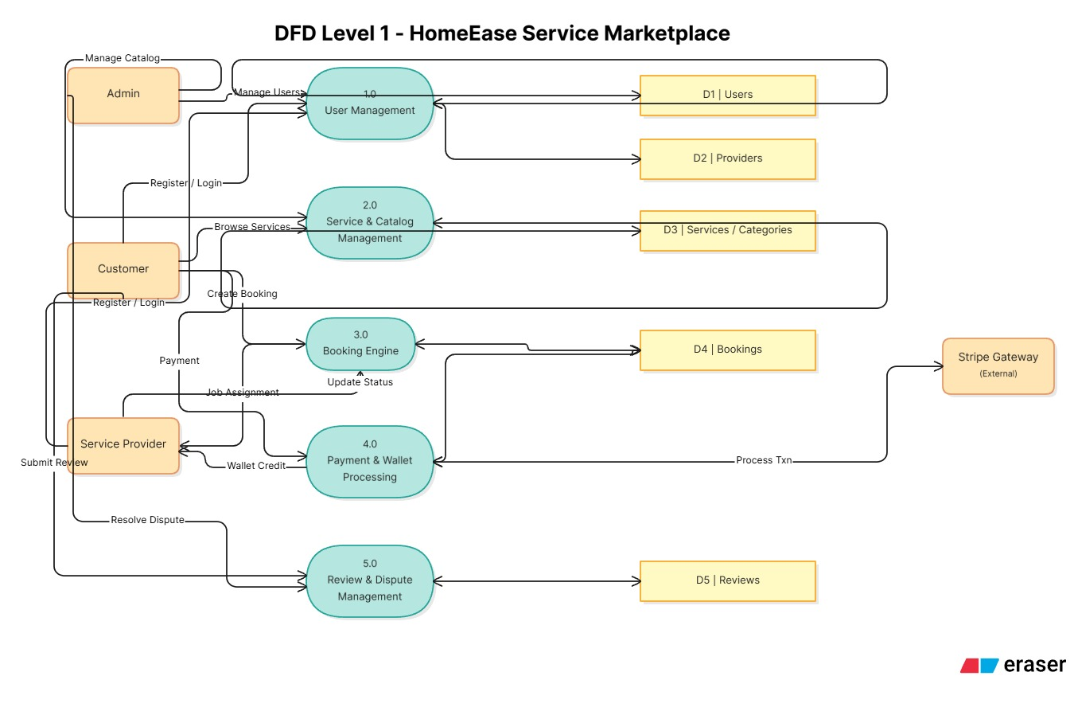
DFD Level 1 Diagram

Slide 15
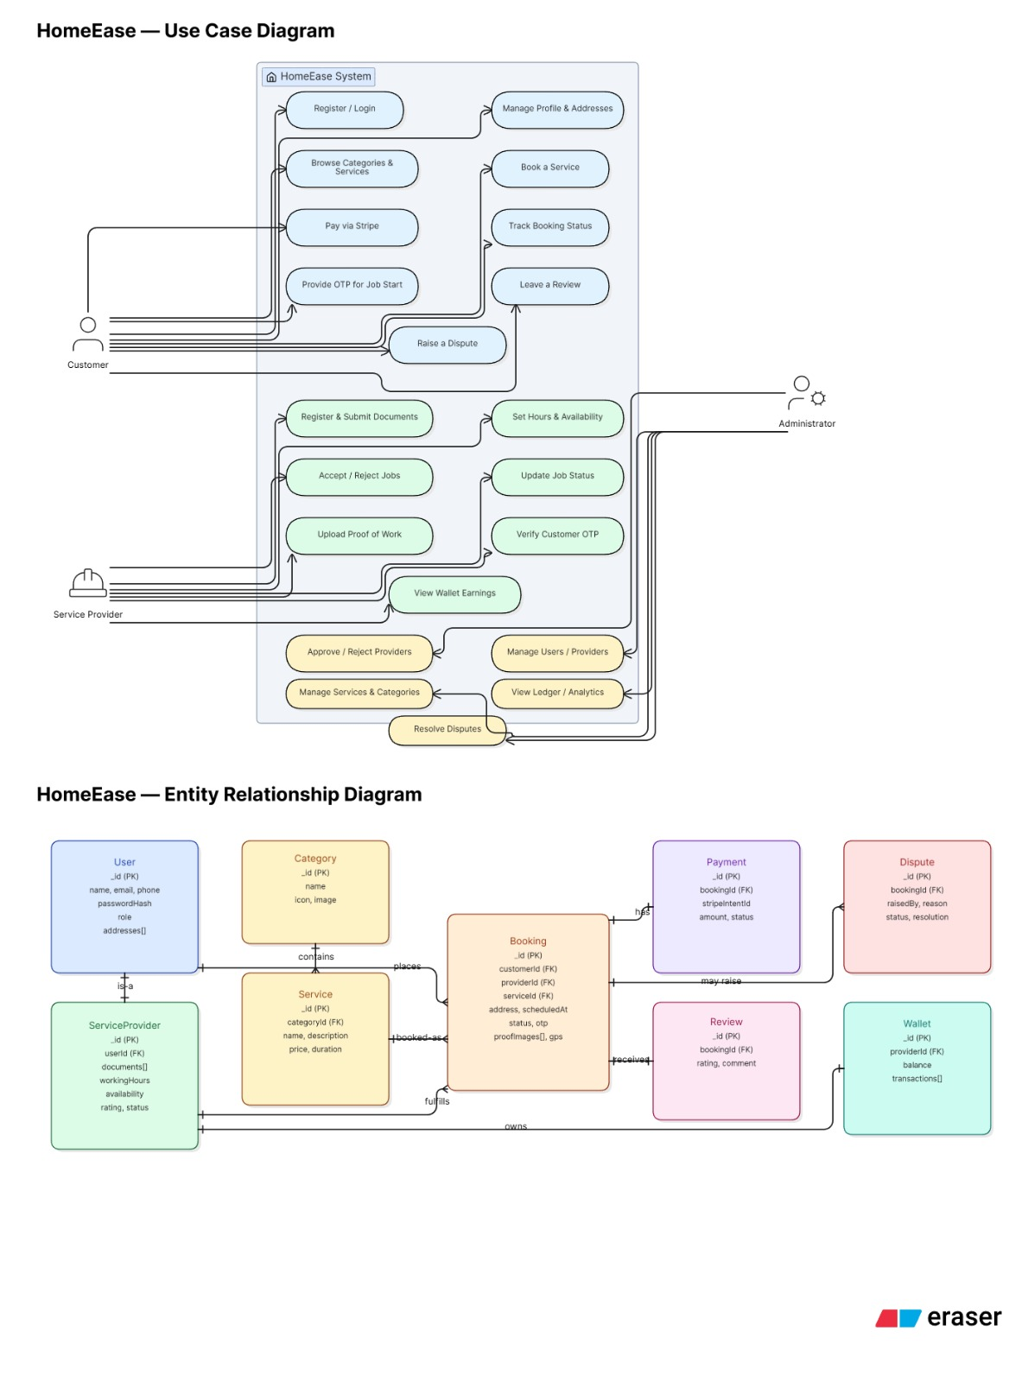
Use Case & ER Diagram

Slide 16

Thank You for Your Time
We appreciate the opportunity to present the HomeEase project and its vision for simplifying home services. Our commitment to innovation and user satisfaction drives every aspect of this platform.
HomeEase – Making Home Services Easy
We welcome any questions you may have about the project, its functionalities, or future prospects. Let's make home services truly effortless.

