Slide 1

SYNOPSIS Presentation
on
PERSONALIZED LEARNING PLATFORM
by
Abhishek Mishra – 202410116100008 Abhijeet Singh – 202410116100007 Alok Kumar – 202410116100018 Anand Patel – 202410116100023
Session:2025-2026 (IV Semester)
Under the supervision of
Dr. Shashank Bhardwaj Associate Professor
Department Of Computer Applications
KIET GROUP OF INSTITUTIONS, DELHI-NCR, GHAZIABAD-201206

Slide 2

Personalized Learning Platform
An AI-driven, adaptive learning system built on the MERN stack and Google Gemini API, delivering a unique, data-informed learning path to every student.

Slide 3
PROJECT OVERVIEW
The Problem with One-Size-Fits-All Learning
The Core Gap
PLP Answer
Who Benefits
Platforms like Coursera, Udemy, and Google Classroom deliver identical content, assessments, and learning paths to every student - regardless of comprehension speed, prior knowledge, or cognitive strengths. The global e-learning market is projected to exceed $400 billion by 2027, yet personalization remains largely unsolved.
Combines an internal analytics engine with Google Gemini AI to create adaptive, data-driven learning paths for every individual student.
Schools, colleges, coaching centers, and self-directed learners are accessible through any modern web browser.
Students fall behind or remain under-challenged
Teachers cannot track 50+ students individually in real time
Institutions lack predictive, AI-assisted intelligence in their LMS

Slide 4












PROJECT OBJECTIVES
What PLP Is Built to Achieve
Adaptive Classification
Composite Engagement Score
Classify each learner into Beginner, Developing, Proficient, or Advanced using a weighted quiz-score algorithm updated after every submission.
A 0–100 real-time score weighing quiz attempts (30%), course breadth (20%), streak consistency (30%), and materials viewed (20%).
AI-Powered Study Plans
Adaptive Quiz Engine
Google Gemini generates personalized weekly plans with daily tasks, focus areas, and duration calibrated to the student's level and goals.
Quiz difficulty auto-adjusts based on the student's last 3 attempts: below 40% → Easy, 40–70% → Medium, above 70% → Hard.
At-Risk Detection
Secure Role-Based Access
Automatically flags students with engagement below 40 or scores below 40, surfacing them prominently on the teacher dashboard with risk badges.
JWT authentication with bcrypt hashing, rate limiting, and strict role-based middleware separating student and teacher workflows.

Slide 5
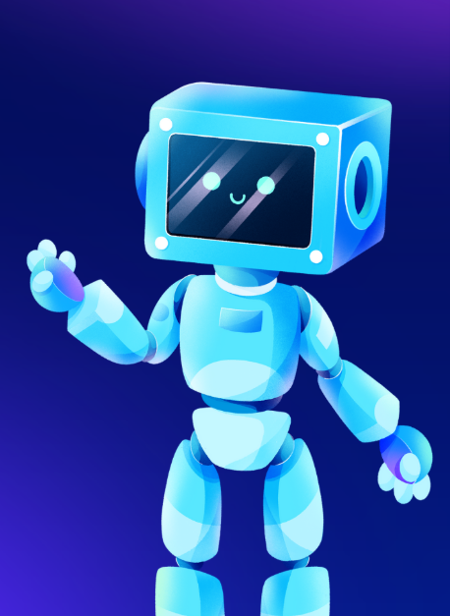
PROJECT SCOPE
Features, Roles & Boundaries
Student Experience
Personalized dashboard: AI level badge, streak, performance trend chart
Adaptive quizzes with AI-generated explanations
On-demand AI feedback and weekly study plan generator
Multi-format materials: YouTube, PDF, PowerPoint
Weak topic visualization with accuracy bars
Teacher Experience
Class-wide analytics: course performance chart, AI level distribution
At-risk student detection with last-active date and risk badges
AI-powered quiz generation by topic, difficulty, and count
Course creation, material upload, and quiz bank management

Slide 6
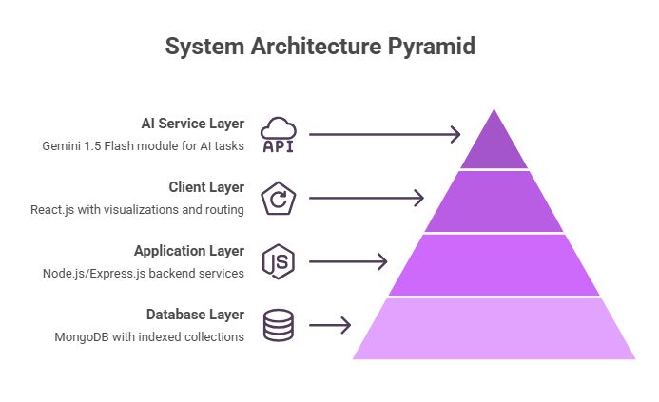
METHODOLOGY
System Architecture
Three-Tier Architecture
Client Layer
React.js with Recharts visualizations, Axios interceptors, and React Router v6 protected routes.
Database Layer
MongoDB with six indexed collections: Users, Courses, Materials, Quizzes, Progress, AIInteractionLogs.
Application Layer
AI Service Layer
Node.js / Express.js backend with modular services, centralized error handling, and standardized API responses.
Abstracted Gemini 1.5 Flash module exposing generateStudyPlan(), generateQuiz(), and generateFeedback().

Slide 7



REQUIREMENTS
Hardware & Software Requirements
Hardware Specifications
Software Stack
Component
Recommended
Frontend
Processor
Quad-core 2.5 GHz+
React.js 18, Vite, Tailwind CSS 3, React Router v6, Recharts, Axios, Lucide React
RAM
8 GB+
Backend
Storage
50–100 GB SSD
Node.js, Express.js 4, Mongoose 8, JWT, Bcrypt.js, Multer, Helmet.js, express-validator
Network
10 Mbps+ broadband
Client Device
Desktop/laptop, Chrome or Firefox
Database & AI
MongoDB Atlas, Google Gemini 1.5 Flash API - deployed on Vercel.

Slide 8
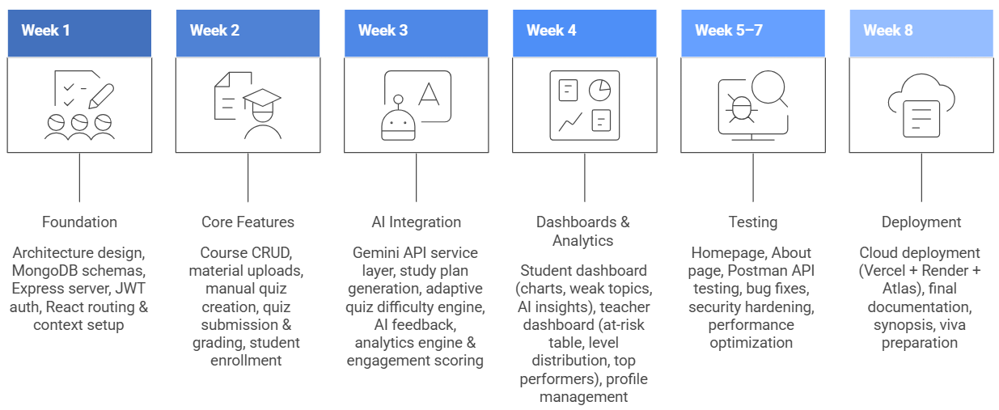
TIMELINE
8-Week Project Schedule
The Agile sprint structure ensures each phase delivers a testable, functional increment — reducing integration risk and enabling continuous feedback throughout development.

Slide 9
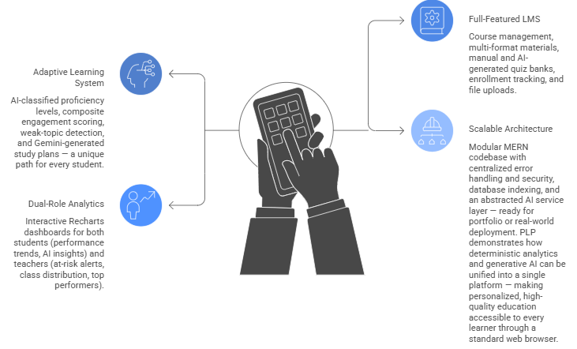

PROJECT OUTCOME
An Adaptive Learning Platform
PLP demonstrates how deterministic analytics and generative AI can be unified into a single platform - making personalized, high-quality education accessible to every learner through a standard web browser.

