Slide 1

Major Project-II (CA401P) Even Semester Session 2025-2026
MystiGo
Tripti Rajput(202410116100225 )
Vanshika Tyagi(202410116100237)
Vikas Singh(202410116100244)
Project Supervisor:
Dr. Amit Kumar Gupta
Ms. Anita Yadav
Dr. Neelam Rawat
Project Incharge :
Dr. Ankit Verma
Ms. Annu Yadav

Slide 2
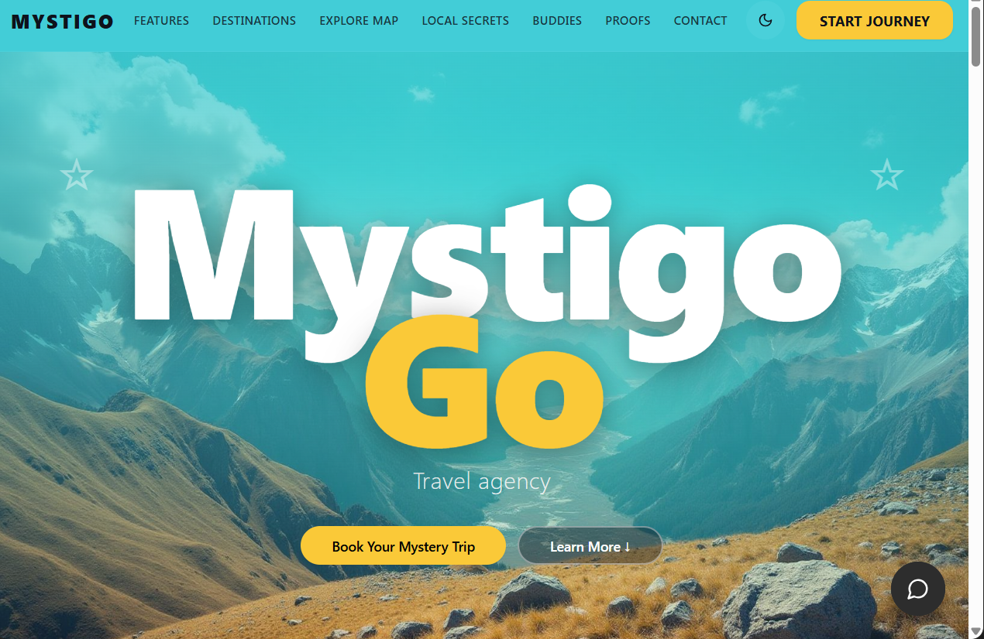
Project Overview
AI-powered smart travel planning platform
• Provides mystery destination experiences.
• Generates personalized day-wise itineraries.
• Compares transport options like flights, trains, and buses.
• Recommends hotels with pricing and ratings.
• Includes AI chatbot assistance for travel guidance.
• Provides maps and navigation support.
• Allows PDF export of complete itinerary.
Significance:
• Simplifies trip planning.
• Saves user time and effort.
• Provides personalized travel experiences.
• Reduces decision fatigue.
• Enhances user engagement with AI-based features.

Slide 3

Project Objectives
Develop an AI-powered travel planning platform.
• Generate smart personalized itineraries.
• Provide mystery destination experiences.
• Compare transport and hotel options efficiently.
• Integrate AI chatbot assistance.
• Design a responsive and user-friendly interface.
• Provide downloadable PDF itineraries.
Success measured using:
• User satisfaction
• Recommendation accuracy
• System performance
• API response efficiency
• User engagement

Slide 4
Project Scope
Included:
• User authentication
• AI itinerary generation
• Mystery destination feature
• Hotel recommendations
• Transport comparison
• Maps integration
• AI chatbot support
• PDF export
• Responsive UI development
Excluded:
• International visa processing
• Real-time flight ticket booking
• Offline GPS tracking
• Multi-language voice assistant

Slide 5
Methodology
Development Methodology: Agile
Process:
1. Requirement Analysis
2. UI/UX Design
3. Frontend Development
4. Backend Development
5. API Integration
6. Database Design
7. Testing & Validation
8. Deployment
Tools & Technologies:
• HTML5
• CSS3
• JavaScript
• React.js
• Node.js
• Express.js
• MySQL
• Google Maps API
• AI API

Slide 6
Timeline
• Requirement Analysis – 1 Week
• UI/UX Design – 1 Week
• Frontend Development – 3 Weeks
• Backend Development – 3 Weeks
• API Integration – 2 Weeks
• Testing & Evaluation – 2 Weeks
• Documentation – 1 Week
Major Milestones:
• Frontend Completion
• Backend API Integration
• AI Chatbot Integration
• Final Testing & Deployment

Slide 7
Project Outcome
Expected Outcome:
• Smart Travel Planning Platform
• AI-generated personalized itineraries
• Mystery destination recommendation system
• Hotel and transport comparison module
• Chatbot-based travel assistance
• Downloadable PDF itinerary system
Future Scope:
• Voice-based travel assistant
• Real-time booking integration
• Multi-language support
• Mobile application development
• Advanced AI recommendation engine

Slide 8
Conclusion
MystiGo provides an AI-powered solution for smart and personalized travel planning.
The system simplifies trip management through mystery destinations, itinerary generation, hotel recommendations, transport comparison, chatbot assistance, and maps integration.
The platform improves travel convenience, enhances user experience, and provides an efficient all-in-one travel planning solution.

