Slide 1

Introduction to AI(AI101B) Even Semester Session 2024-25
Title - House Price Prediction
Tanishka Gupta(202410116100218)
Shipra Upadhyay(202410116100196)
Vanshika Garg(202410116100235)
Tripti Rajput(202410116100225)
Project Supervisor:
Mr. Apoorv Jain
Assistant Professor

Slide 2
Content
Introduction
Problem Statement
Project Objectives
Methodology
Tools and Technology
Dataset Description
EDA Insights
Data Visualization
Project Outcome
Future Enhancement
Conclusion
References

Slide 3

Introduction
Real estate is a vital component of the economy.
Traditional methods for estimating house prices are subjective and error-prone.
Machine learning (ML) offers a reliable, consistent, and scalable solution.
This project uses ML to predict house prices using historical data.

Slide 4

Problem Statement
Manual house valuation is prone to human bias and inaccuracy.
Lack of real-time, data-driven price forecasting tools.
Objective: Create an ML-based prediction system for property valuation.

Slide 5

Project Objectives
Develop an ML model to predict house prices based on property features.
Utilize regression techniques: Linear, Ridge, and Lasso.
Assist buyers, sellers, and investors in making data-informed decisions.

Slide 6
Methodology
1. Data Preprocessing: Handle missing values, encode categorical’s, scale features.
2. Exploratory Data Analysis (EDA): Understand data trends and correlations.
3. Model Development: Train and compare multiple regression models.
4. Model Evaluation: Use RMSE and R² Score to evaluate performance.

Slide 7
Tools and Technologies
Programming Language: Python
Libraries: Pandas, NumPy, Scikit-learn, Matplotlib, Seaborn
Platform: Google Colab for coding and collaboration

Slide 8
Dataset Description
Source: Kaggle - House Prices: Advanced Regression Techniques
Features include: Area, Rooms, Year Built, Neighborhood, Quality, etc.
Data Types: Numerical and Categorical variables

Slide 9
EDA Insights
High correlation: GarageArea (0.88), GarageCars (0.88).
Sale Price distribution is right-skewed.
Neighborhoods show significant price variation.
Box plots and heatmaps used for visualization.

Slide 10
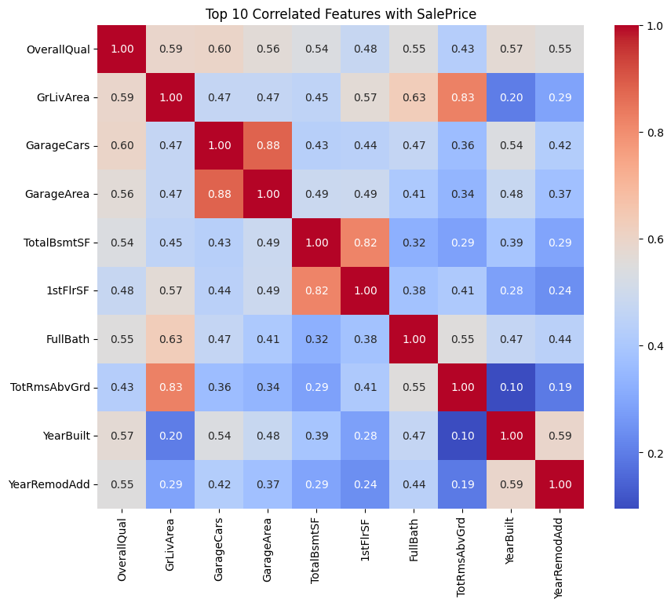
Data Visualization

Slide 11
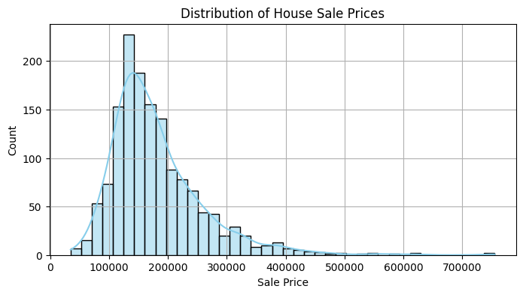
Distribution of House Sale Price

Slide 12
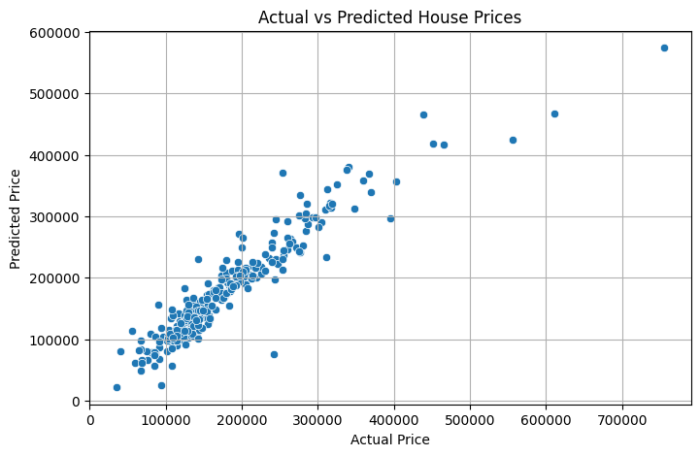
Actual vs Predicted Prices
Scatter plot shows near-linear relationship
Model performs well in $100k–$400k range
Performance drops for luxury houses (outliers)

Slide 13
Project Outcomes
Developed a machine learning-based prediction system
Achieved accurate price predictions with reliable metrics
User-friendly and interpretable model
Potential integration into real estate websites or apps

Slide 14

Future Enhancements
Add more features: crime rate, amenities, real-time listings
Incorporate advanced models: XGBoost, Neural Networks
Develop web/mobile interface for end-users
Integrate GIS data for geospatial insights

Slide 15
Conclusion
Project demonstrates ML’s utility in real estate valuation
Accurate and scalable prediction system
Practical applications for buyers, sellers, and investors
Lays foundation for future research and development

Slide 16
References
Scikit-learn Developers. (2023). Scikit-learn: Machine Learning in Python.
Kaggle. (n.d.). House Prices: Advanced Regression Techniques Dataset. Retrieved from: (https://www.kaggle.com/competitions/house-prices-advanced-regressiontechniques )
Brownlee, J. (2020). How to Evaluate Machine Learning Models. Machine Learning Mastery. Retrieved from: (https://machinelearningmastery.com/how-toevaluate-machine- learning-models/ )

Slide 17

Thank You

