Slide 1

Artificial Intelligence (AI101B)
Even Semester Session 2024-25
Traffic Light Control System
Minakshi Tomar 202410116100119
Jatin Gupta 202410116100094
Mukul Dhiman 202410116100126
Jitendra Kumar 202410116100095
Project Supervisor: Mr.Apoorv Jain
(Assistant Professor)

Slide 2
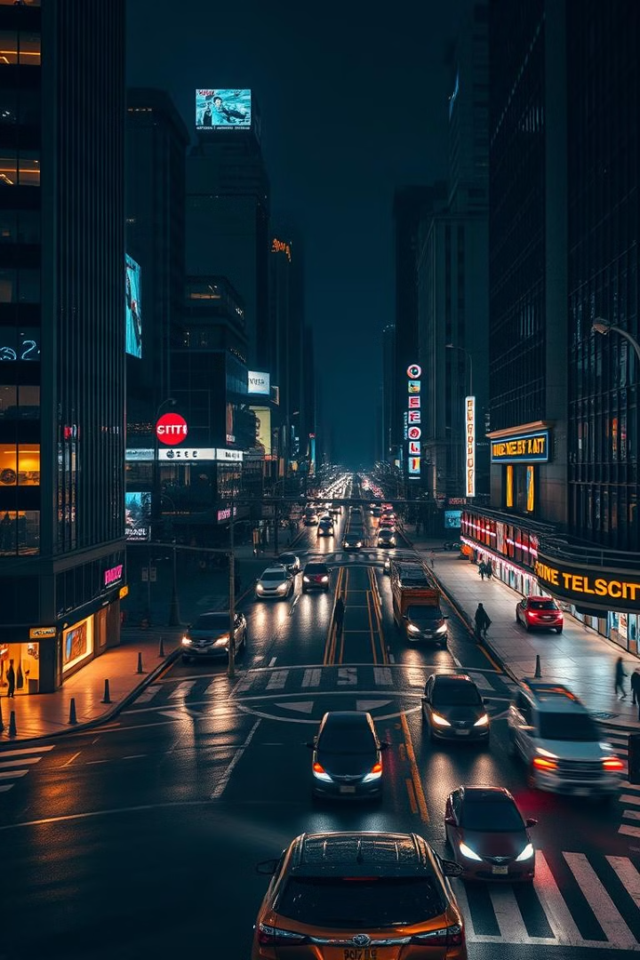
Introduction
Traffic congestion is a major urban challenge.
Traditional traffic lights follow fixed time intervals, causing inefficiency.
Machine Learning can dynamically adjust signal timing based on real-time traffic data.
This project uses Linear Regression to optimize green light duration.

Slide 3
Objective
Reduce waiting time and improve traffic flow efficiency.
Minimize fuel wastage and emissions by decreasing idle time.
Adapt signal timings based on vehicle count at intersections.
Implement a data-driven approach for smart traffic control.

Slide 4
Methodology
1. Data Collection
Dataset includes Vehicle Count and Traffic Light Duration.
Stored in CSV file (test.csv).
2. Data Preprocessing
Data loaded using Pandas.
Cleaning: Handling missing values, outliers, normalization.
Split: 80% training, 20% testing.

Slide 5
Model Development
Algorithm Used: Linear Regression
Feature: Vehicle Count
Target: Traffic Light
DurationTraining Process: Model learns the relationship between vehicle count and required light duration.
Prediction: Generates optimal signal timing for real-time traffic conditions.

Slide 6
Model Evaluation
After training the Linear Regression model, its performance is evaluated using various metrics to measure accuracy and reliability.
Performance Metrics
Visual Evaluation
Findings & Optimization

Slide 7
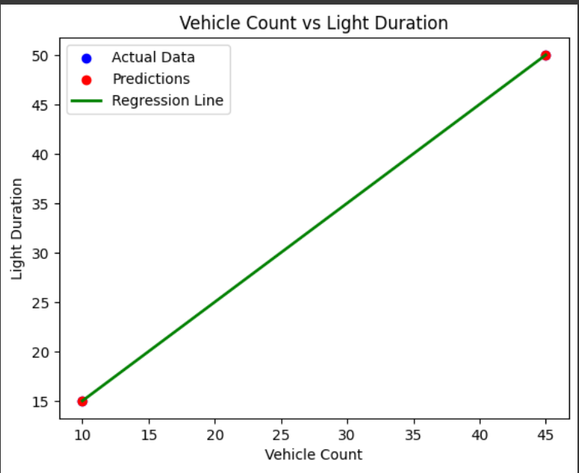
Code Implementation
Technologies Used:
Pandas – Data handling
NumPy – Numerical operations
Matplotlib – Visualization
Scikit-learn – Machine Learning

Slide 8
Future Enhancements
Advanced Machine Learning Models
Historical Data Analysis
Multi-Lane Traffic Control
Simulation & Visualization Improvements
Cloud-Based Data Processing

Slide 9
Outcomes & Findings
Traffic flow optimization achieved through machine learning-based signal control.
Strong correlation found between vehicle count and signal duration.
Predictive modeling helps estimate optimal green light duration in real time.
Data-driven insights assist in reducing congestion and improving efficiency.
Model evaluation metrics guide further improvements for better accuracy.

Slide 10
Conclusion
Efficient traffic light management using machine learning.
Reduces congestion, fuel consumption, and travel time.
Scalable for smart cities and real-time traffic optimization.
Future advancements can further enhance system accuracy and performance.

Slide 11
THANK YOU

