Slide 1

INTRODUCTION TO AI(AI101B) Even Semester Session 2024-25
STUDENT PERFORMANCE PREDICTION
SHANTANU YADAV(202410116100193)
SONAM DOBRIYAL(202410116100210)
SHIVAM CHATURVEDI(202410116100198)
VINEET KUMAR(202410116100246)
Project Supervisor:
Mr Apoorv Jain
Assist. Professor

Slide 2
Content
Introduction
Objective
Methodology
Code
Outcomes
References
Notes:
Font Styles: Times New Roman + Font Size: 25

Slide 3
Introduction
Credit card fraud analysis is a crucial aspect of financial security, involving the detection and prevention of unauthorized transactions. Machine learning algorithms are increasingly used to identify fraudulent patterns in transaction data. This analysis helps financial institutions reduce losses, protect customers, and maintain trust in the payment system.
Notes:
Font Styles: Times New Roman + Font Size: 25

Slide 4
Objective of the Project
The primary objective of this project is to design and implement a robust machine learning pipeline to accurately detect fraudulent credit card transactions from a real-world dataset. Given the highly imbalanced nature of fraud detection—where genuine transactions vastly outnumber fraudulent ones—the project emphasizes the importance of handling class imbalance using techniques such as SMOTE (Synthetic Minority Oversampling Technique) and class weighting. The project explores and compares multiple classification algorithms, including Random Forest and Logistic Regression, with a focus on evaluating key performance metrics such as precision, recall, F1-score, and the area under the ROC and Precision-Recall curves. Additional goals include preprocessing the data effectively (including scaling features like transaction amount and time), interpreting feature importance, and visualizing correlations to enhance model interpretability. Ultimately, the project aims to develop a scalable, reliable solution that can help financial institutions minimize losses by proactively identifying suspicious activity while maintaining a low false-positive rate.
Notes:
Font Styles: Times New Roman + Font Size: 25

Slide 5
Methodology
Data Collection : The dataset used contains credit card transactions labeled as fraudulent or legitimate.
Data Preprocessing: Cleaned the dataset and handled missing values.
Feature Selection and Engineering: Analyzed feature correlations.
Selected meaningful variables to improve model performance.
Model Selection and Training : Applied machine learning models, primarily the Random Forest Classifier.
Handled class imbalance using SMOTE for oversampling the minority class.
Model Evaluation : Evaluated model using metrics like accuracy, precision, recall, F1-score.
Notes:
Font Styles: Times New Roman + Font Size: 25

Slide 6
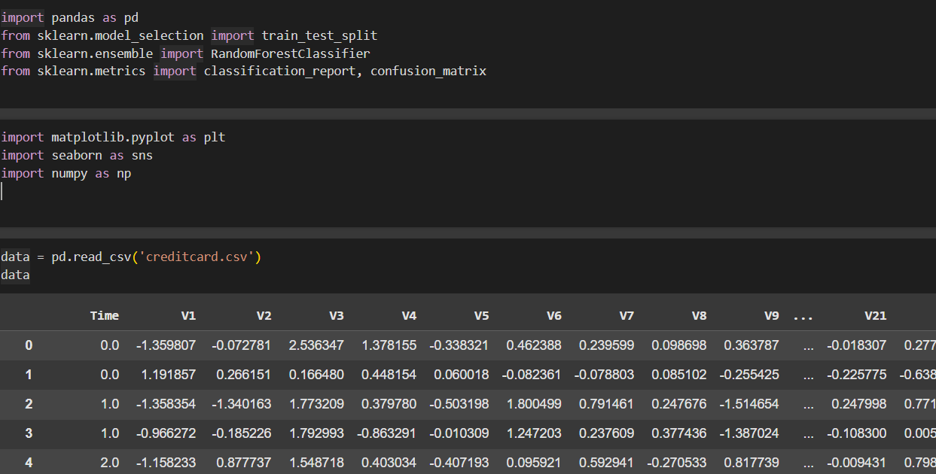
Code
Loading and exploring Dataset
Notes:
Font Styles: Times New Roman + Font Size: 25

Slide 7
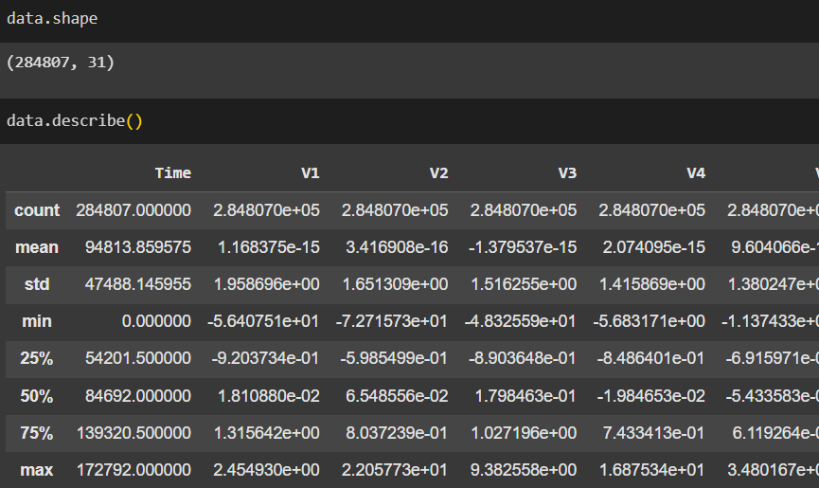
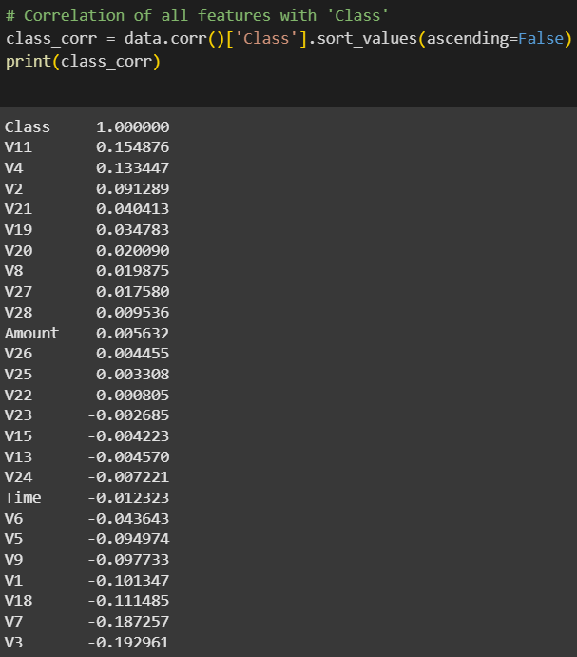
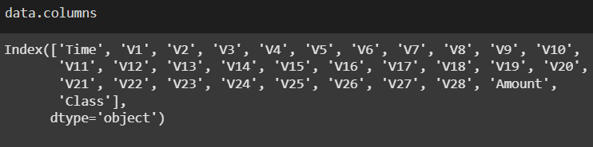

Slide 8
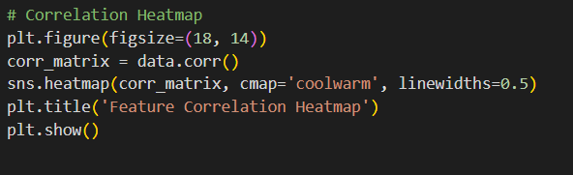
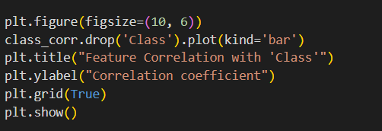
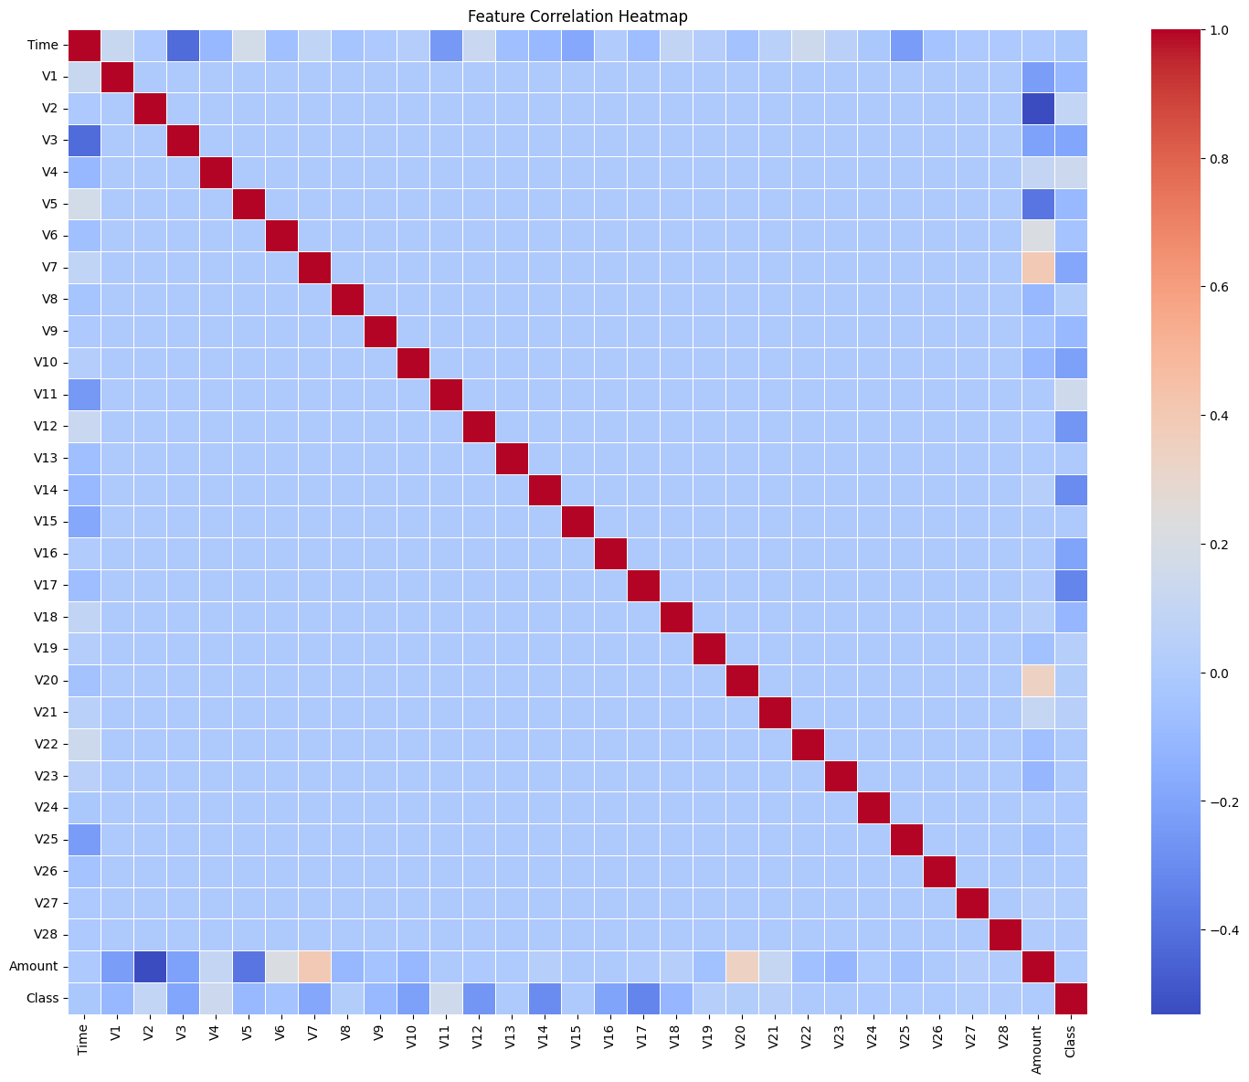
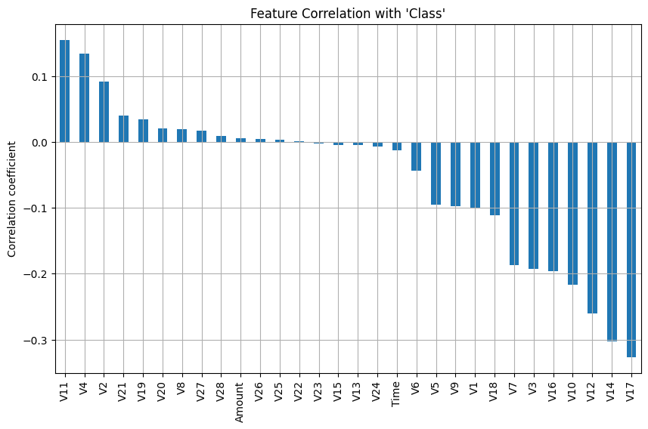

Slide 9
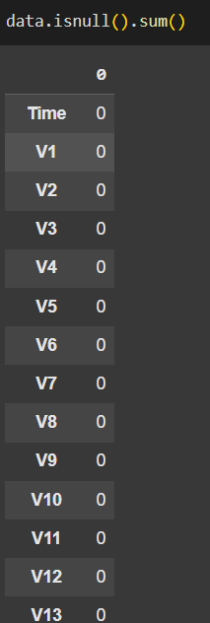
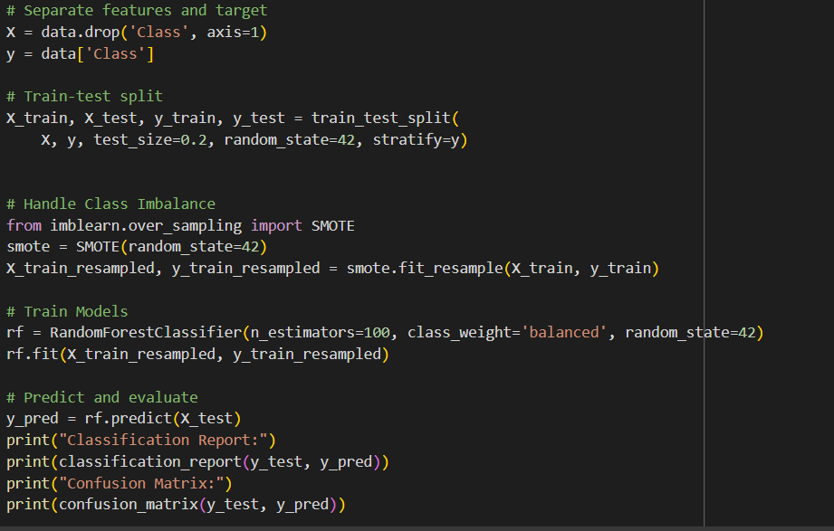

Slide 10
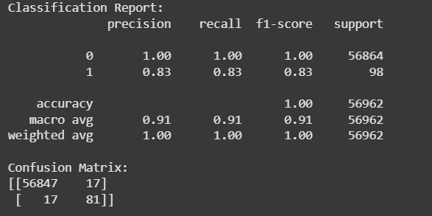
CLASSIFICATION REPORT
Precision (Class 1): 83% of predicted frauds were actually frauds.
Recall (Class 1): 83% of actual frauds were correctly detected.
F1-Score: Harmonic mean of precision and recall — balanced performance.
Support: Number of true samples per class.
Accuracy: 1.00 (​99.94%)
 | Predicted Non-Fraud | Predicted Fraud
Actual Non-Fraud | 56847 (True Negatives) | 17 (False Positives)
Actual Fraud | 17 (False Negatives) | 81 (True Positives)
CONFUSION MATRIX :
False Positives (17): Legitimate transactions wrongly flagged as fraud.
False Negatives (17): Fraudulent transactions missed by the model.

Slide 11
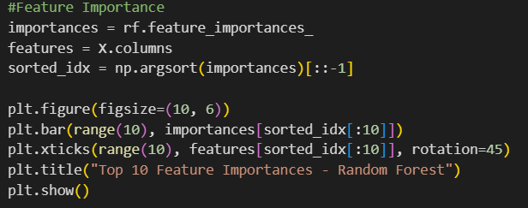
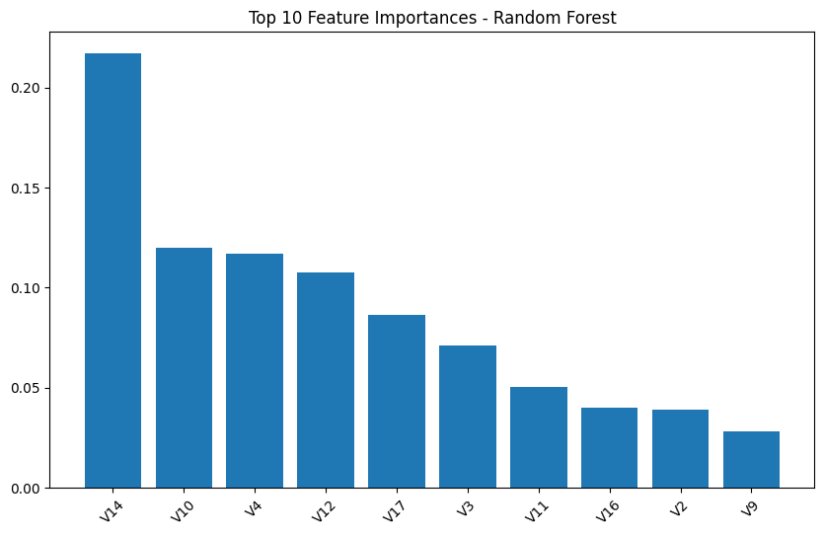
FEATURE IMPORTANCE

Slide 12
Outcome
Accuracy: 100% (56928 out of 56962 predictions were correct).
Class 0 (Non-Fraud):Precision, Recall, F1-score = 1.00 → Almost perfect.
Class 1 (Fraud):Precision = 0.83 → 83% of predicted frauds were correct.
The model performs extremely well, especially on the majority class.
For fraud detection (minority class):Catches 83% of frauds
Keeps false alarms relatively low.
Notes:
Font Styles: Times New Roman + Font Size: 25

Slide 13
References
Kaggle Dataset:
https://www.kaggle.com/datasets/mlg-ulb/creditcardfraud
Notes:
Font Styles: Times New Roman + Font Size: 25

