Slide 1

Customer Segmentation Using Cluster
Artificial Intelligence(AI101B) Even Semester Session 2024-25
Tannoo Shukla (202410116100220)
Tanya Singh (202410116100222)
Tannu Modanwal (202410116100221)
Trapti Rajput (202410116100224)

Slide 2

Customer Segmentation via Clustering: An Introduction
Customer segmentation is a powerful marketing strategy that groups customers into homogenous segments based on shared characteristics. These groups allow businesses to tailor marketing efforts, increase product relevance, and ultimately enhance customer satisfaction. This project leverages unsupervised machine learning, primarily clustering algorithms, to analyze complex customer data and uncover natural groupings without pre-labeled categories. By doing so, we aim to reveal actionable insights for more effective customer engagement and business growth.

Slide 3
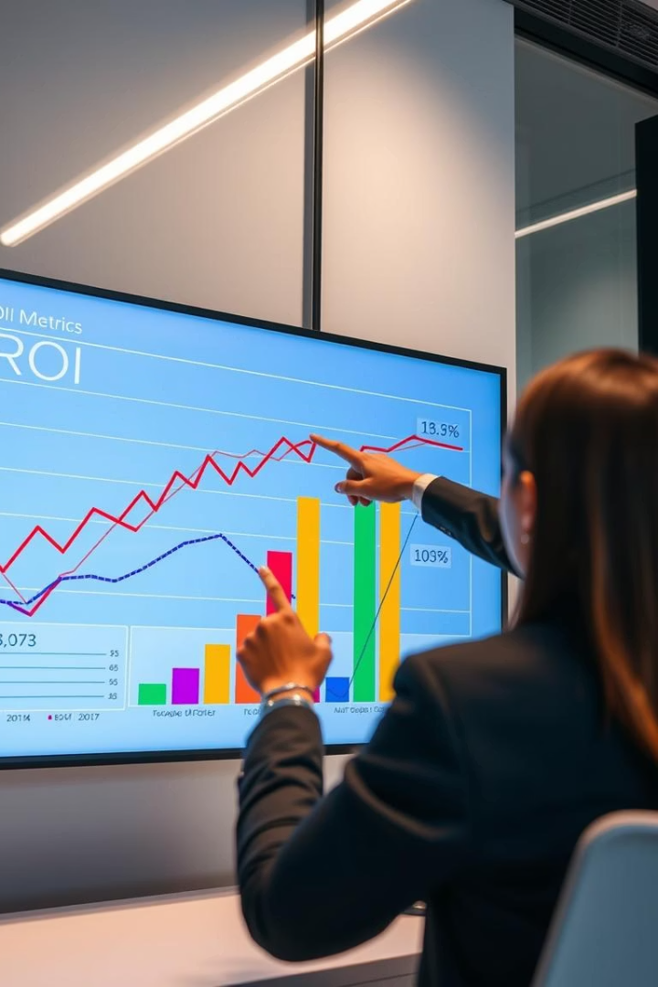
The Importance of Customer Segmentation
1
Improved Targeting Precision
2
Increased Marketing ROI
By segmenting customers, businesses achieve 40% better targeting accuracy, allowing campaigns to focus on relevant audiences.
Personalized and segment-focused marketing efforts lead to a 25% increase in return on investment from campaigns.
3
Enhanced Lifetime Value
Segment-specific strategies boost customer lifetime value by 15%, encouraging long-term loyalty and repeat purchases.

Slide 4
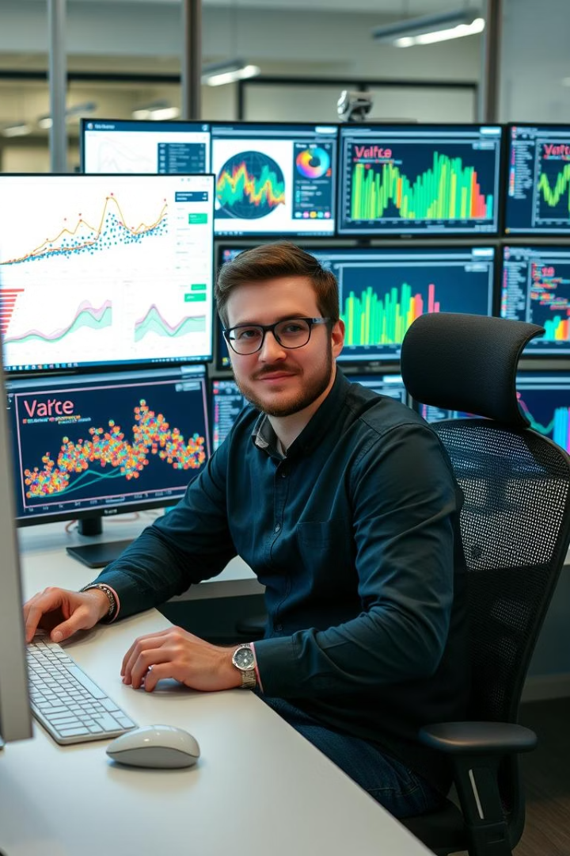
Methodology: Clustering Algorithms
K-Means Clustering
Partitions data into k distinct clusters by minimizing distance to cluster centroids for effective grouping.
Hierarchical Clustering
Forms a nested tree of clusters, either by merging or splitting, enabling multi-level grouping insights.
DBSCAN
Identifies clusters based on data density, robustly handling noise and outliers in customer data distribution.
Evaluation Metrics
Algorithms are compared using Silhouette scores and Calinski-Harabasz indices to validate cluster quality.

Slide 5
Data Collection and Preprocessing
Sources and Features
Data Cleaning & Engineering
CRM systems, transaction histories, web analytics
Removed duplicates, handled missing values gracefully
Demographic details, purchase behavior, service interactions
Created RFM (Recency, Frequency, Monetary) metrics for segmentation
Applied PCA reducing dimensionality while preserving 95% variance

Slide 6
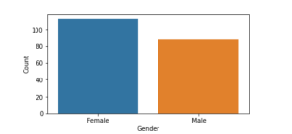
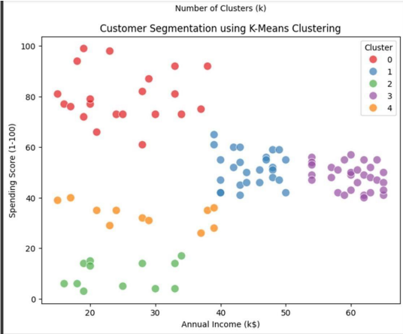
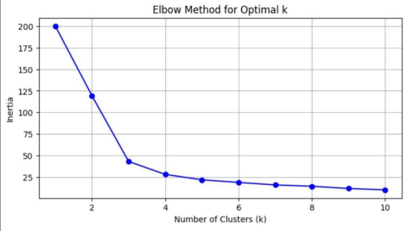
Graphs:

Slide 7
Results: Customer Segment Profiles
High-Value Customers
Potential Loyalists
Price-Sensitive Shoppers
New Customers
They spend moderately with improving purchase frequency, representing promising future loyalty among 30% of the base.
Recent acquisitions with limited historical data, covering 25%, offering opportunities for early engagement.
This top 20% generate the majority of revenue, exhibit frequent purchases, and show low risk of churn.
Making infrequent, low-value purchases and at a high risk of leaving, constituting 25% who require targeted retention.

Slide 8
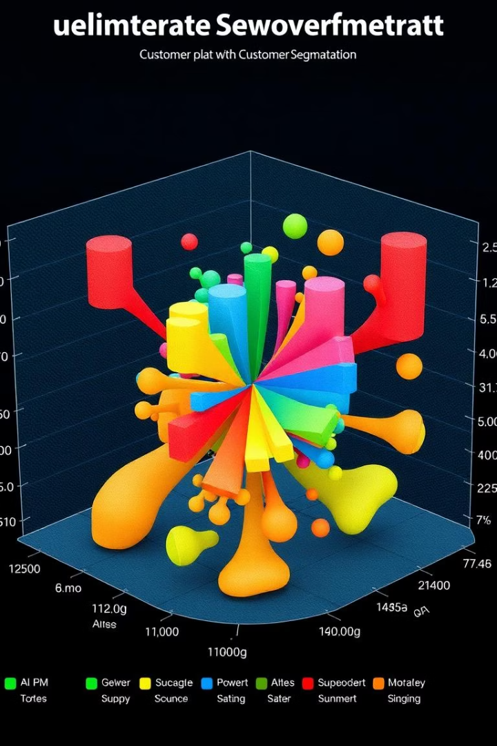
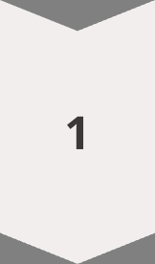
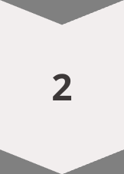
Visualization: Segment Distribution
3D Scatter Plot
Displays clusters with axes representing recency, frequency, and monetary value, color-coded by segment.
Radar Charts
Illustrate average feature values of each segment, highlighting unique behaviors and spending patterns.

Slide 9

Business Applications
Pricing Strategies
Customer Service Prioritization
Adjust prices based on price sensitivity for optimized revenue and competitiveness.
Product Development
Targeted Marketing
Design products addressing unique needs of distinct segments to boost adoption and satisfaction.
Focus resources on high-value customers to maximize retention and loyalty.
Create personalized campaigns tailored to segment preferences across email and digital ads.

Slide 10
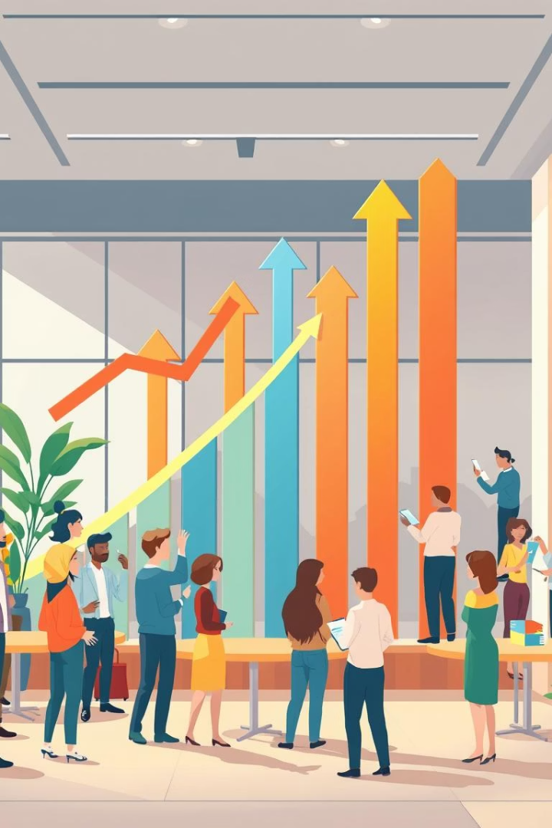
Conclusion: Driving Value with Segmentation
Actionable Insights from Clustering
Enhancing Customer Engagement
Our use of clustering algorithms reveals meaningful segments that can inform strategic decisions.
Segment-specific marketing and development increase personalization, customer satisfaction, and profitability.
Ongoing Improvement
Continuous monitoring and refinement ensure sustained business success and adapting to evolving customer behaviors.

Slide 11
Thank You

