Slide 1
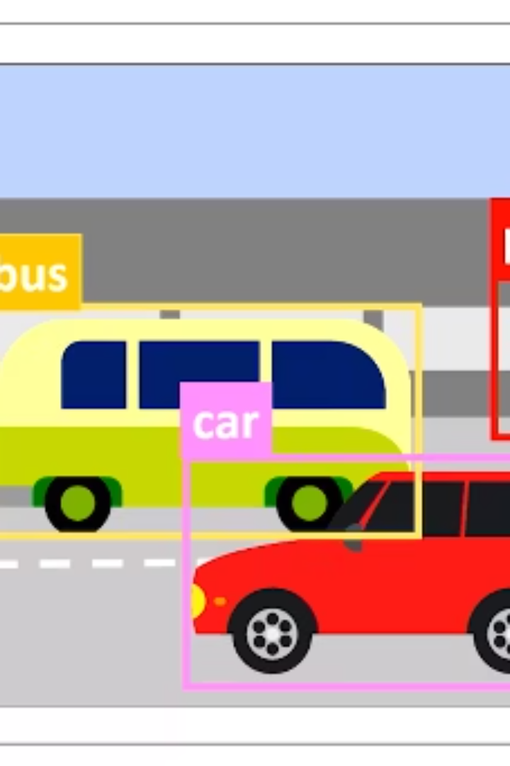
Object Detection in Images using YOLOv5
This mini project explores object detection using the YOLOv5 model. Presented By- TechnoGeeks Kiran Yadav (202410116100102) Gulshan Kumari (202410116100078) Dolly Prajapati(202410116100069) Khushi Kumari (202410116100101)

Slide 2
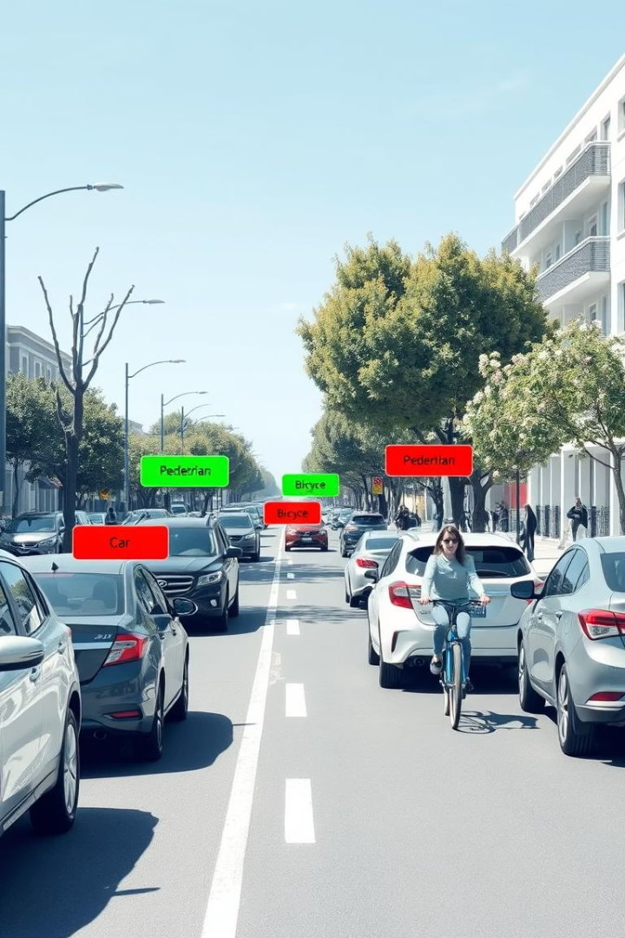
What is Object Detection?
Key Computer Vision Task
Object Identification
Determines what objects are present in the scene.
Detects and locates objects in images with bounding boxes.
Use Cases
Self-driving cars
Security systems
Medical imaging

Slide 3

Technologies & Libraries
Automation Tools
Python Libraries
Google Colab
Cloud platform to run Python code seamlessly.
torch: Deep learning framework
YOLOv5 Toolkit (from Ultralytics) -Official GitHub codebase for the YOLOv5 model.
opencv: Image processing
pathlib, os: File management
IPython.display: Display outputs
google.colab.files: Image uploads
Data set
COCO Dataset (Common Objects in Context)

Slide 4
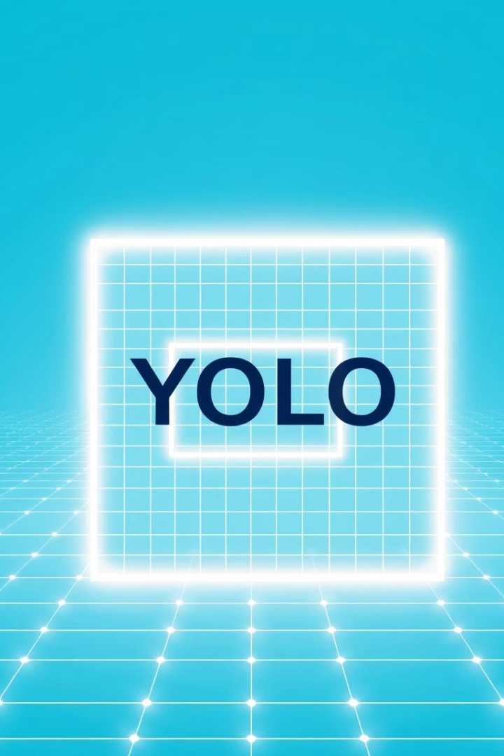
What is YOLOv5?
Unified Detection Model
Lightweight & Fast
Detects objects in one forward pass for real-time speed.
Efficient architecture making it easy to deploy.
Pretrained on COCO
Recognizes 80+ common objects from a large dataset.
YOLOv5 breaks the image into grid cells
Each grid cell is responsible for detecting objects whose center falls in that cell.

Slide 5
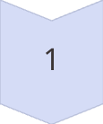
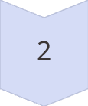
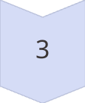
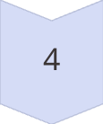

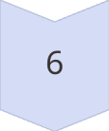
YOLOv5 Internal Workflow
Image Input
Resized to 640x640 pixels
Feature Extraction
Backbone extracts important features
Feature Enhancement
Neck refines multi-scale feature maps
Prediction Head
Outputs bounding boxes, classes, and confidence
Post-processing
NMS removes overlapping duplicates
Final Output
Objects detected and labeled on image

Slide 6
YOLOv5 Model Architecture
1
Backbone (CSPDarknet)
Extracts basic visual features from the input image (like edges, shapes, textures).
Think of it like a visual scanner that looks at the image and converts it into useful data
2
Neck (PANet)
Helps the model understand features at multiple scales (small, medium, large objects).
Combines low-level details (edges, colors) with high-level concepts (shapes, objects).
3
Head
Takes the output from the neck and makes predictions:
Bounding boxes
Class labels
Confidence scores
4
Output
Final detections with labels

Slide 7
Project Workflow
Clone Repository
1
Get YOLOv5 code from GitHub
2
Install Dependencies
Set up required libraries and tools
Upload Image
3
Provide image for detection
4
Run Detection
Execute detect.py with model weights
Display Output
5
View detected objects with bounding boxes

Slide 8
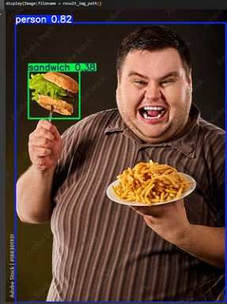
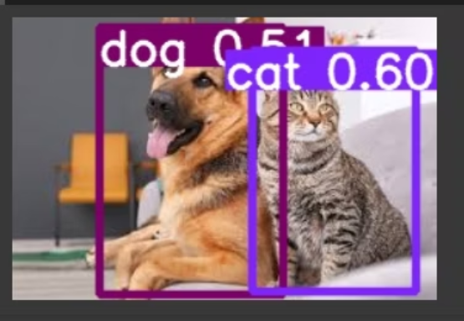
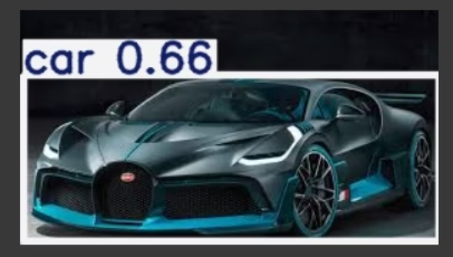
OUTPUT

Slide 9
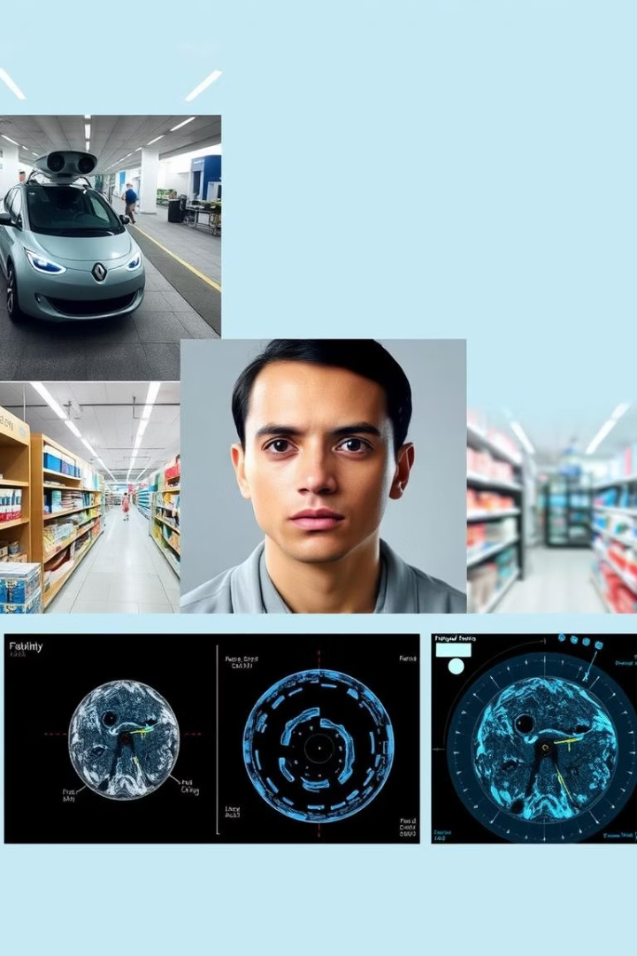
Real-World Applications
Autonomous Vehicles
Pedestrian and obstacle detection for safety
Security Systems
Facial recognition and anomaly detection
Retail Analytics
Counting people and products in stores
Medical Imaging
Identifying conditions from scans automatically

Slide 10
THANK YOU

