Slide 1

EmotionEcho: Decoding Sentiment with BERT
Unveiling emotions hidden in text through advanced AI techniques.

Slide 2

The Problem: Why Emotion Detection Matters
Real-Time Sentiment
Wide Applications
Supports mental health, marketing, and crisis responses.
Social media data offers immediate public emotion insights.
Market Growth
Emotion AI market expected to reach $36B by 2028.

Slide 3
The Data: Tweets and 13 Shades of Feeling
Dataset Overview
Class Imbalance
27,338 tweets labeled with 13 distinct emotions.
Joy dominates, while emotions like anger are less frequent.
Source: Kaggle
This imbalance affects classification performance.

Slide 4

The Model: Leveraging BERT for Contextual Understanding
BERT Advantage
Training Setup
Bidirectional training captures language nuance effectively.
Fine-tuned on emotion dataset using a single GPU.
Model Size
Transformer with 110 million parameters ensures deep learning.

Slide 5
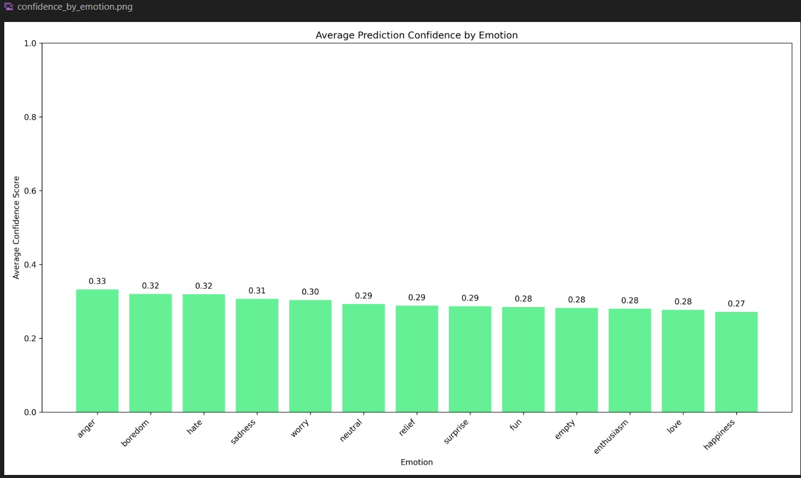

Results: Promising Insights, Room for Growth
Overall accuracy: 32.4% for 13 emotions
Baseline TFIDF model scored 18% accuracy, showing BERT's advantage.
Joy achieved best precision at 60%
Confusion matrix reveals overlaps between sadness and fear.
Disgust had the lowest precision at 15%

Slide 6





Challenges: Navigating Imbalance and Limits
Class Imbalance
Rare emotions have fewer training examples.
Resource Constraints
Single GPU limits training scale and complexity.
Overfitting Risks
Small dataset size risks model overfitting.
Limited Tuning
Time restricted hyperparameter optimization.

Slide 8

Improvements: Future Directions
1
Augment Data
Use techniques to balance class frequencies.
2
Multi-Label Classification
Enable detection of multiple emotions in a tweet.
3
Larger Models
Experiment with bigger BERT variants for performance gains.
4
External Knowledge
Integrate emotion lexicons and knowledge bases.

Slide 9

Conclusion: Emotions at Scale - Let's Connect!
Unlocking Insight
Emotion detection reveals valuable trends in text data.
Proven Potential
BERT shows promise in nuanced emotion classification.
Join Us
Collaborate and innovate in the Emotion AI space.
Connect on LinkedIn to continue this exciting journey.

