Slide 1


Predicting Crime Rates: A Data-Driven Approach
Explore how data predicts crime trends in urban areas for safer cities. Understand key factors, techniques, and challenges in crime prediction.
by KARTIK AGARWAL

Slide 2
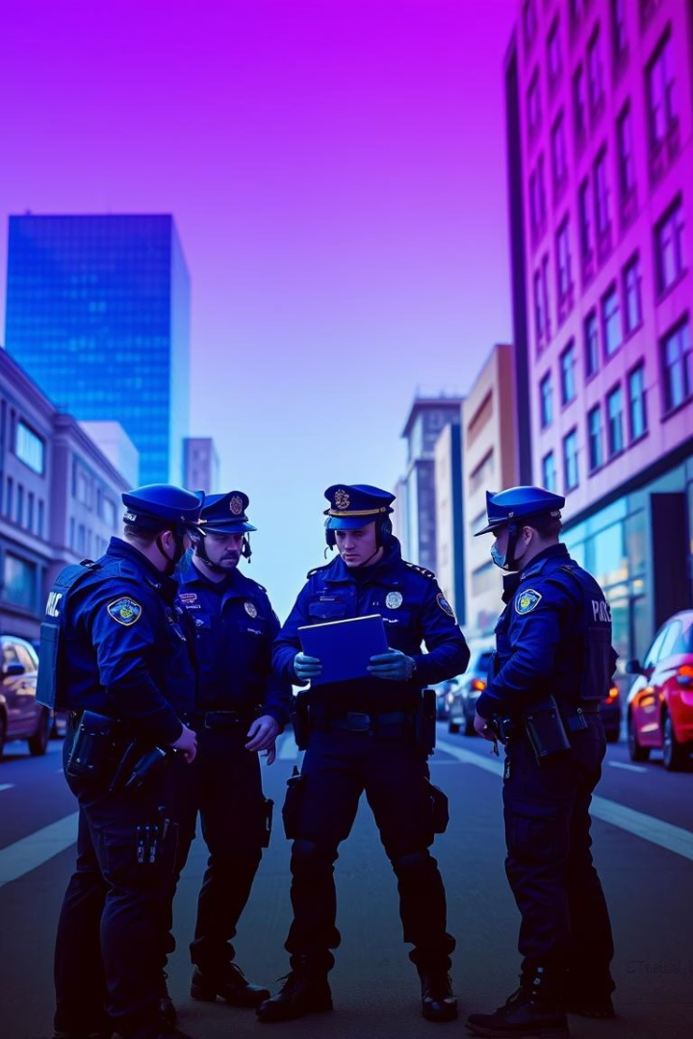
Why Predict Crime?
Resource Allocation
Prevention Strategies
Optimize police deployment, supporting $193B spent annually in the US.
Enable targeted interventions to stop crime before it happens.
Public Safety & Economy
Reduce victimization, fear, and property value loss by 15-20%.

Slide 3
Factors Influencing Crime Rates
Socioeconomic
Environmental & Demographic
Policing & Seasonal
Poverty rises +5% crime (NYC data)
Hot spot policing cuts crime 15% in Boston
Brighter lighting lowers crime by 10%
Unemployment +1% leads to +2% property crime
Crime spikes 10-15% during summer
Higher density (+1000 people/sq mile) raises crime 3%
Age group 15-24 is critical

Slide 4

Methodologies for Crime Prediction
Statistical Models
Machine Learning
Linear regression (60-70% accuracy), time series (70-80%)
Random forests (80-85%), neural networks (85-90%)
Spatial Analysis
Hot spot mapping and geographic profiling to locate crime areas

Slide 5
Case Studies
Chicago
New York City
London
Predictive policing cut shootings by 15% (2012-2017)
CompStat reduced major crimes by 20% in the 1990s
Crime mapping contributed to 10% drop in burglaries (2015-2020)

Slide 6





Challenges and Limitations
Data Quality
Privacy
Ethics
Model Complexity
Incomplete or biased datasets limit accuracy
Balancing prediction benefits and individual rights
Avoiding discriminatory outcomes in model use
Overfitting and evolving crime patterns challenge prediction
Prediction models require significant resources for maintenance and updates.

Slide 7





Ethical Considerations and Mitigation
Audit Bias
Identify and fix demographic skews in data
Transparency
Explainable AI fosters public trust
Community Involvement
Civilian oversight for accountability
Data Privacy
Anonymize data and enforce access controls
Independent Review
Ethics boards ensure responsible usage

Slide 8





The Future of Crime Prediction
Real-Time Mapping
Integration of cameras and sensors for instant alerts
AI-Driven Policing
Proactive interventions using predictive algorithms
Citizen Engagement
Mobile apps empower public reporting and info sharing
Social Integration
Combining data with services to tackle crime root causes
Crime Reduction
Potential for 30-40% further decrease with advanced tech

