Slide 1

Introduction to AI (AI101B) Even Semester Session 2024-25 Project on SIMPLE SALES DATA AND VISUALIZATION
Submitted By: InnoLearners
Devanshi Singhal (202410116100060)
Aanchal (202410116100002)
Deepanshu Ruhela (202410116100056)
Dhwani Panchal (202410116100063)
Project Supervisor:
Mr. Apoorv Jain
Assistant Professor

Slide 2

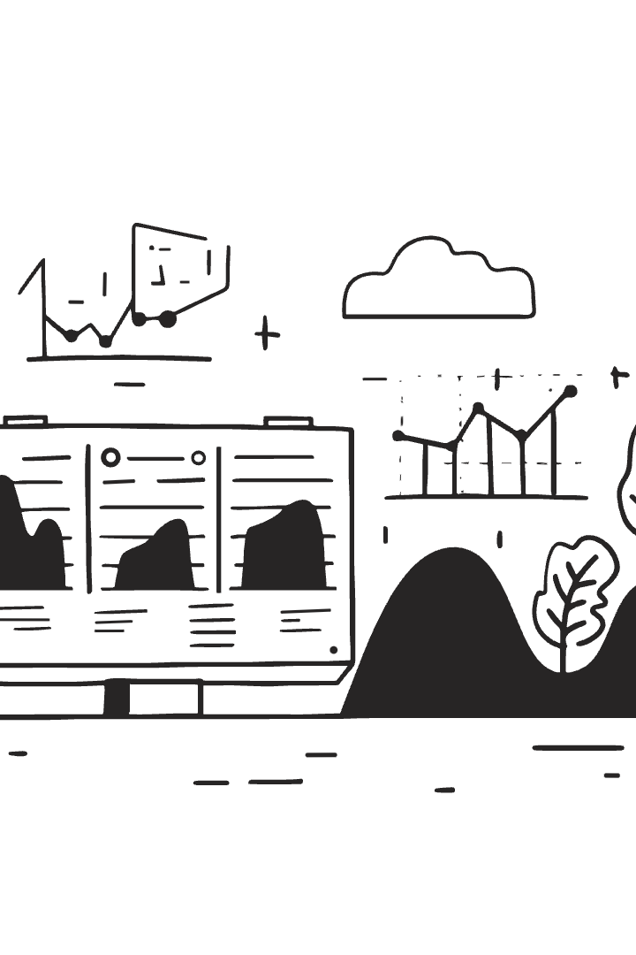
Data Visualization in Sales
Data visualization transforms raw sales data into insightful visuals. It's crucial for sales decision-making, providing improved insights, faster analysis, and clearer communication. Popular tools in the industry include Matplotlib, Seaborn, and Plotly. This presentation will cover data extraction, analysis, and visual representation.

Slide 3
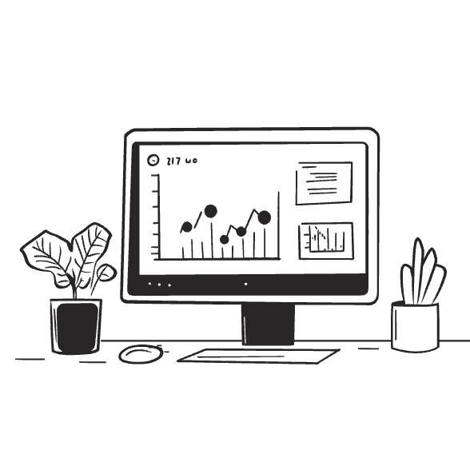
Data Sources & Extraction Methodologies
Common data sources in sales include CRM systems (Salesforce, HubSpot). Also marketing automation platforms, website analytics (Google Analytics), and social media data.
Data extraction techniques involve CSV/Excel exports and web scraping.
Data cleaning and preprocessing are vital for effective visualization. Pandas are frequently used for data extraction and cleaning.

Slide 4

Python Libraries for Data Visualization
Python offers powerful tools for data visualization. Key libraries include:
Matplotlib: Basic plotting library.
Seaborn: Higher-level statistical graphics.
Plotly: Interactive visualizations.
Matplotlib is foundational, Seaborn enhances
aesthetics, and Plotly offers dynamic interaction.

Slide 5
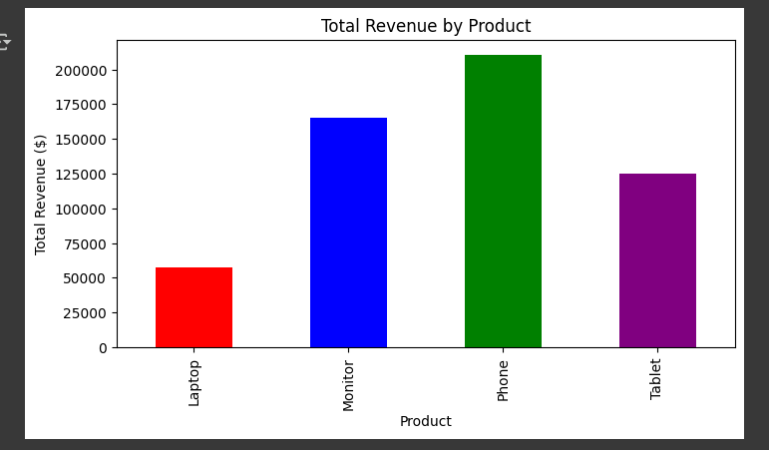
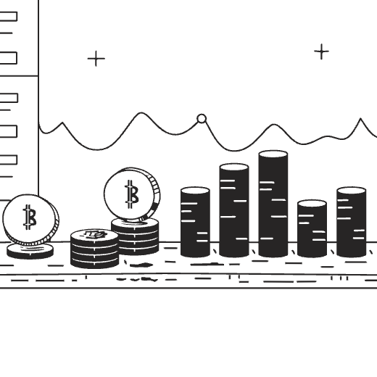
Visualizing Sales Trends Over Time
Use Matplotlib/Seaborn to visualize sales data over time. Create line charts showing monthly/quarterly trends.
Add labels, titles, and legends for clear communication.
Highlights: Identify seasonal patterns and growth areas.

Slide 6

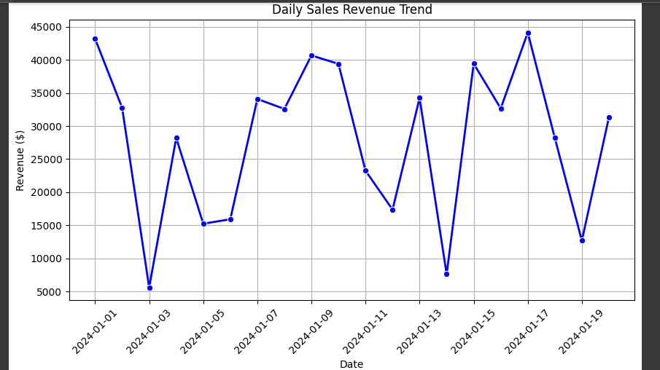
Representing Sales Performance by Region
Use Plotly to create interactive geographical maps. Visualize sales performance across regions.
Use color gradients (choropleth maps) to show sales volume.
Add tooltips to display detailed information on hover.

Slide 7
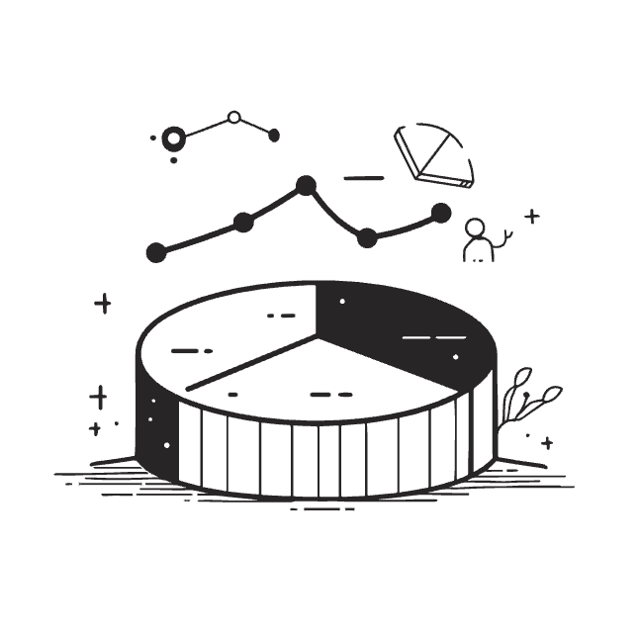
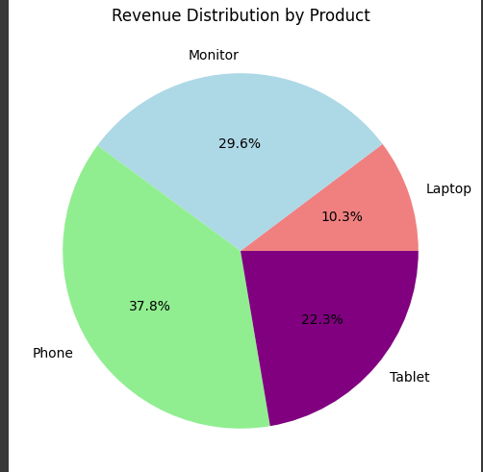
Analyzing Product Sales Mix
Create a pie chart or bar chart to represent product sales mix. Highlight best-selling and underperforming items.
Aids in product strategy and inventory management.
Use clear labels and percentages for easy interpretation.

Slide 8

Correlation Analysis and Scatter Plots
Introduce correlation between sales variables (e.g., marketing spend and revenue). Create scatter plots to visualize relationships.
Add trendlines to emphasize correlation.
Optimizing marketing investments based on correlation analysis.

Slide 9
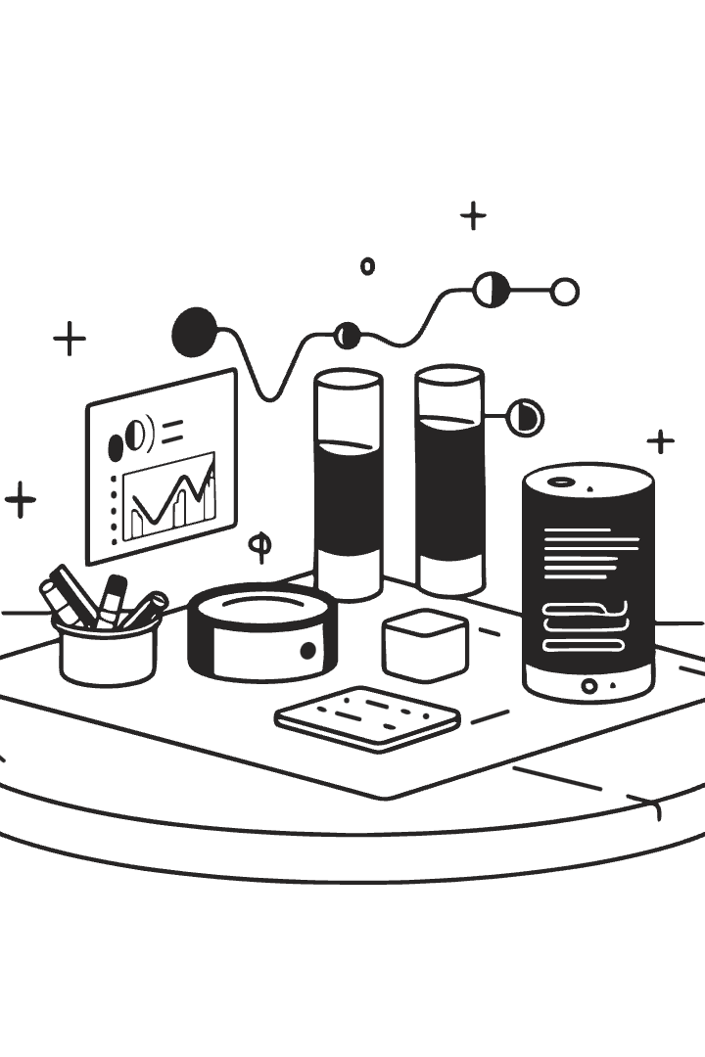
Conclusion & Future Directions
Data visualization is powerful in sales and marketing. Recap: extraction, visualization, and interpretation.
Explore dashboard creation, advanced analytics, and predictive modeling.

