Slide 1
AI-Based Number Guessing Game

Slide 2
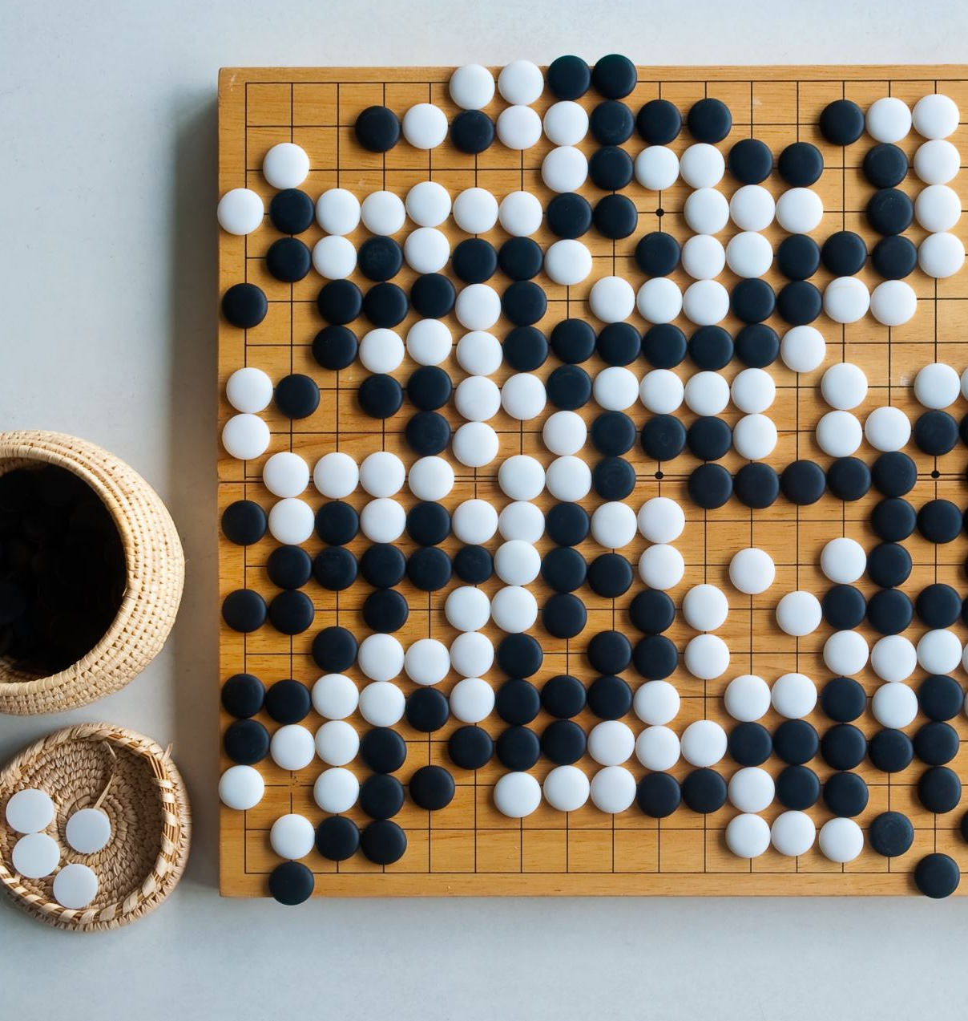
Introduction
The AI-Based Number Guessing Game is an interactive game where a user tries to guess a random number between 1 and 100. The game provides AI-powered hints using Google Cloud APIs. Users can input their guesses via text or voice commands.

Slide 3

Technologies Used
Python (Core Programming)
Google Cloud Speech-to-Text API (Voice recognition)
Google Cloud Natural Language API (AI-generated hints)
Tkinter (GUI for user interaction)
PyAudio (Voice recording)

Slide 4
How It Works
1. A random number between 1 and 100 is generated.
2. The user inputs their guess via text or voice.
3. The AI provides hints using sentiment analysis.
4. If the guess is correct, the game congratulates the user.

Slide 5

Conclusion & Future Improvements
This project demonstrates the use of AI in gaming and interactive applications.
Future improvements:
Adding difficulty levels.
Supporting multiple languages for voice input.
Enhancing UI/UX with animations.

Slide 6
THANK YOU

