Slide 1

Mini Project-II (ID201B) Even Semester Session 2025-26
SNIPE & STRIKE
ANKIT KUMAR SHAHI (202410116100028)
ANKIT SISODIYA (202410116100029)
ANSH MISHRA (202410116100030)
Project Supervisor:
Dr. Vipin Kumar
Associate Professor

Slide 2
Content
Introduction
Literature Review
Objective of the Project
Technology
Hardware Requirements
Software Requirements
Modules
Workflow
References
Notes:
Font Styles: Times New Roman + Font Size: 25

Slide 3
Introduction
A 2D shooting game developed using HTML5, JavaScript, and Canvas API.
The game involves a player-controlled shooter fighting off waves of enemies while managing health and ammo.
Implements different difficulty levels, power-ups, and a scoring system.
Notes:
Font Styles: Times New Roman + Font Size: 25

Slide 4
Literature Review
Evolution of 2D shooting games from arcade classics to modern web- based versions.
Technologies used: HTML5 Canvas, JavaScript for rendering and interactions.
AI-based enemy behavior and collision detection for smooth gameplay.
Importance of UI, difficulty scaling, and power-ups in game design.
Notes:
Font Styles: Times New Roman + Font Size: 25

Slide 5
Objective of the Project
To develop an interactive 2D shooting game with increasing difficulty levels.
Provide an engaging user experience with smooth gameplay mechanics.
Implement a scoring system and leaderboard to track player progress.
Explore power-ups and different enemy types for enhanced gameplay.
Notes:
Font Styles: Times New Roman + Font Size: 25

Slide 6
Technology (Hardware Requirements)
A computer with basic processing power.
Minimum 2 GB RAM (Recommended: 4GB or more).
Internet browser supporting JavaScript (Chrome, Firefox, Edge, etc.).
Notes:
Font Styles: Times New Roman + Font Size: 25

Slide 7
Technology (Software Requirements)
Operating System: Windows, macOS, Linux.
Development Environment: Visual Studio Code, or any code editor.
Technologies: HTML, CSS, JavaScript, Python(Flask).
Notes:
Font Styles: Times New Roman + Font Size: 25

Slide 8
Modules
Player Module
Manages player movement using keyboard input.
Track Player health and ammo level.
Detect collisions with enemy and power-ups.
Handles shooting mechanics (firing bullets).
Enemy Module
Spawn enemies at different locations based on difficulty level.
Controls enemy movement patterns.
Manages enemy health.
Notes:
Font Styles: Times New Roman + Font Size: 25

Slide 9
Modules (Contd.)
Bullet Module
Creates bullets when the player shoots.
Updates bullet trajectory and removes bullets when out of bounds.
Detects collision with enemies and removes hit enemies.
Implements bullet limits to add a challenge for players.
Power-up Module
Randomly spawns power-ups on the game field.
Types of power-ups:
Ammo Boost – Increases the player's available bullets.
Health Pack – Restores some of the player’s health.
Detects collisions with the player and applies the power-up effect.
Disappears after a certain time if not collected.
Notes:
Font Styles: Times New Roman + Font Size: 25

Slide 10
Modules (Contd.)
UI Module
Displays game elements:
Score Counter – Updates dynamically as the player defeats enemies.
Health Bar – Shows the player's remaining health.
Ammo Counter – Displays the number of bullets left.
Handles game state screens
Main Menu – Start game, choose difficulty.
Game Over Screen – Shows final score and allows restarting.
High Score System – Saves and displays top scores.
Game Module
Controls the main game loop (continuous frame updates).
Manages interactions between all game objects.
Checks for win/loss conditions and transitions to the game-over state.

Slide 11
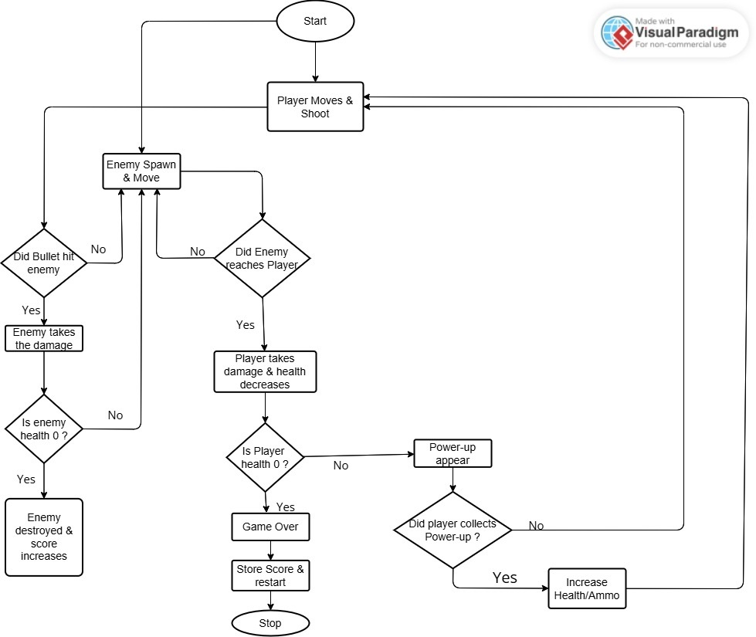
Workflow
Notes:
Font Styles: Times New Roman + Font Size: 25

Slide 12
References
Mozilla Developer Network (MDN) – https://developer.mozilla.org
W3Schools JavaScript Guide – https://www.w3schools.com/js/
HTML5 Canvas API Documentation – https://developer.mozilla.org/en-US/docs/Web/API/Canvas_API
GeeksforGeeks (JS & Game Development) – https://www.geeksforgeeks.org/
FreeCodeCamp – Game Development with JavaScript – https://www.freecodecamp.org/news/
Notes:
Font Styles: Times New Roman + Font Size: 25

