Slide 1

Mini Project-I (K24MCA18P) Odd Semester Session 2024-25
Library Management System
Manish Pandey 2426MCA1674
Present: Kartik Agarwal 2426MCA1671
Project Supervisor:
Mr. Arpit Dogra
Asst Professor KIET

Slide 2

Introduction
Knowledge Access
Efficient Management
System Solution
Libraries play a vital role in making knowledge accessible to all.
Managing a large library efficiently can be challenging due to the growing number of books and users.
This project aims to develop a Library Management System to streamline library operations.

Slide 3
Literature Review
Technical Feasibility
Operational Feasibility
Economic Feasibility
The project leverages reliable technologies like HTML, CSS, PHP, and MySQL, ensuring efficient development.
The system addresses core library needs, including book management, user registration, and loan tracking, with a user-friendly interface.
The cost-effective development approach allows for scalability and adaptability in the future.

Slide 4

Objective of the Project
1
Automation
2
User Accessibility
Automate library operations to eliminate manual processes and reduce errors.
Enhance user accessibility with an intuitive platform that is easy to navigate.
3
Efficiency
4
Data Integrity
Improve efficiency in book tracking, loan management, and report generation.
Ensure data integrity and provide real-time updates on book availability and user information.

Slide 5





Technology
HTML
CSS
JavaScript
PHP
Provides the structural foundation for the website.
Controls the visual presentation of the website.
Adds interactivity and dynamic behavior to the website.
Handles server-side logic and database interaction.
MySQL
Bootstrap
APIs
Stores and manages the library data.
Provides a CSS framework for faster development.
Used for integrating with other services for features like notifications.

Slide 6







Modules
1
Admin Dashboard
2
User Management
3
Book Catalog
4
Issue & Return
5
Overdue Notifications
6
Reports & Analytics
7
Search & Recommendations

Slide 7
Workflow/Gantt Chart
Requirements Gathering
1
Identify the specific needs and features of the library.
2
System Design
Create a detailed design for the system's architecture and modules.
Development
3
Develop the code for the frontend and backend, as well as the database schema.
4
Integration
Combine the different modules and ensure they work seamlessly.
Testing
5
Thoroughly test the system's functionality to identify and resolve any bugs.
6
Deployment
Make the system available to users in the library.
Post-Launch Support
7
Provide ongoing support to ensure the system runs smoothly and address any issues.

Slide 8
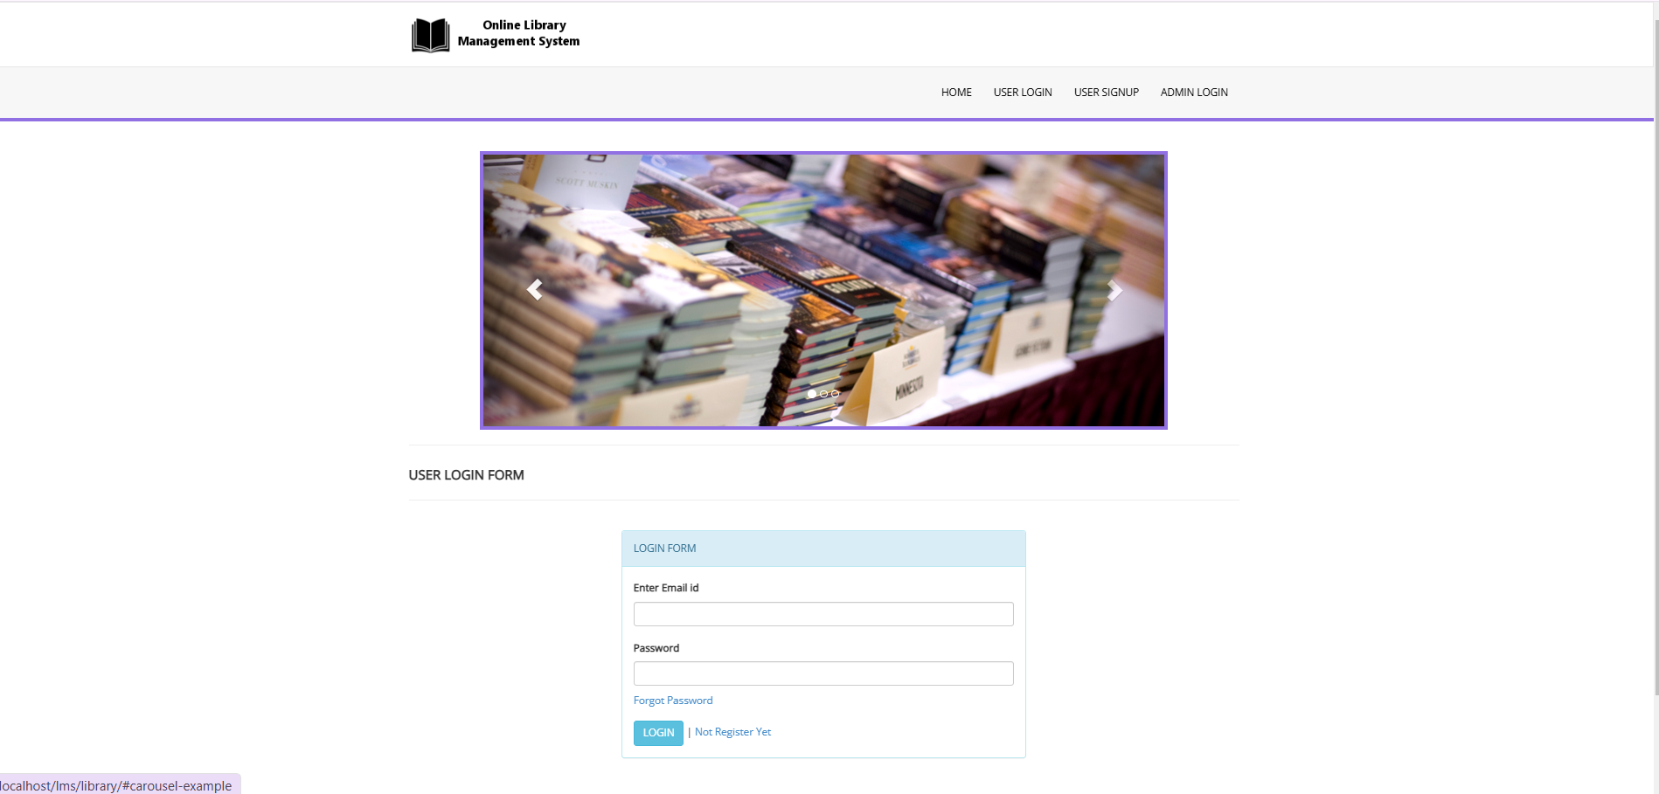
Output
The system features a user-friendly interface, as seen in the dashboard

Slide 9
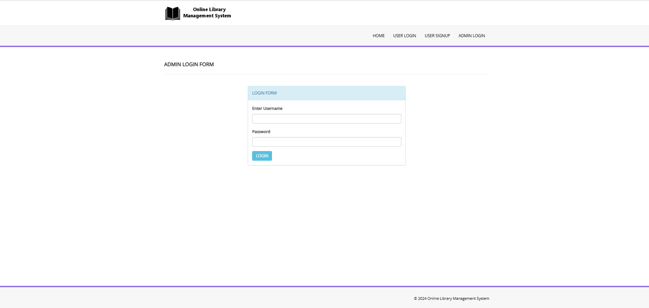
Output
The project resulted in a functional Library Management System. This screenshot shows the login page

Slide 10
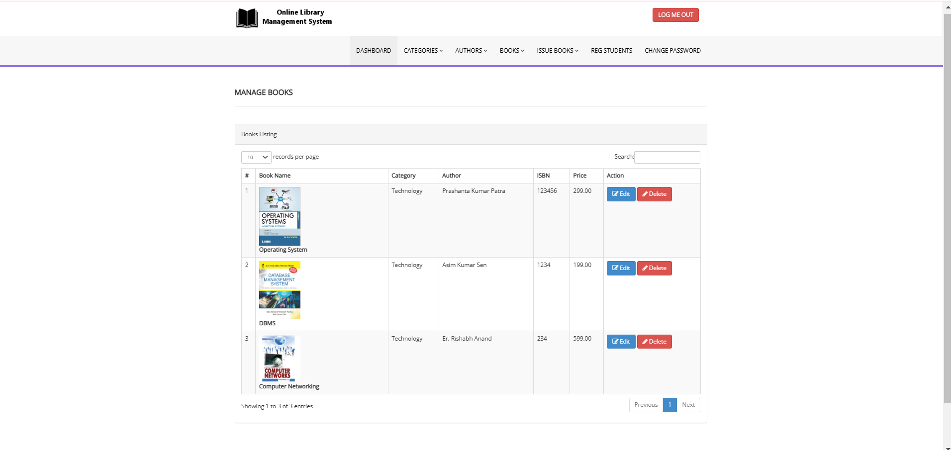
Output
The system offers features such as book catalog browsing, issue/return management, and report generation. The project successfully addressed the need for a comprehensive library management solution.

