Slide 1

Mini Project-I (K24MCA18P) Odd Semester Session 2024-25
Home Assistant
Shalendra Sharma (2426MCA175)
Ritik (2426MCA174)
Project Supervisor:
Ms. Divya Singhal

Slide 2
Content
Introduction
Literature Review
Objective of the Project
Technology
Hardware Requirements
Software Requirements
Modules
Workflow
Reports
References
Notes:
Font Styles: Times New Roman + Font Size: 25

Slide 3

Introduction
Beauty and Werepairs, and carpentry.
Home Assistant as Your Personal Home Services Manager
Home Assistant is more than just a smart home platform; it's your personal assistant for all things home-related. Imagine having a assistant at your fingertips, ready to connect you with skilled professionals for a variety of services, from electrical work to plumbing and beyond.
Beauty and Wellness: Pamper yourself with a
variety of beauty treatment ,including haircuts,
manicures, pedicures, and massages.
Home Services: Keep your home clean and well
maintained with services like deep cleaning ,paint,
plumbing, electrical repaired installed by experts.
Notes:
Font Styles: Times New Roman + Font Size: 25

Slide 4
Literature Review
Market Impact:
Increased Competition: Home assistant websites have intensified competition among service providers, potentially leading to lower prices and improved quality of service.
Enhanced Visibility: For service providers, these platforms offer increased visibility to a wider customer base, expanding their reach and potential clientele.
Notes:
Font Styles: Times New Roman + Font Size: 25

Slide 5
Literature Review (Contd.)
Long-Term Impact: The long-term impact of home assistant websites on the service industry
and consumer behavior requires further investigation.
Quality Assurance: Developing effective mechanisms to ensure the quality of service
providers listed on these platforms remains a challenge.
Data Privacy and Security: Addressing concerns related to data privacy and security,
especially in the context of sharing personal information with service providers.
Customer Satisfaction: Conducting in-depth studies to measure customer satisfaction with
home assistant websites and identify areas for improvement.
Notes:
Font Styles: Times New Roman + Font Size: 25

Slide 6
Objective of the HomeAssistant
Provide a convenient platform for customers to access a wide range of services at home. This eliminates the need for customers to travel to service providers and saves them time and effort.
Provide 24x7 Services: By using our platform you can get services 24x7.
Availability: It is available in urban areas as well as rural areas.
To provide competitive pricing and transparent billing. Home Assistant strives to offer competitive rates for the services provided. They may also provide upfront pricing estimates and transparent billing practices to ensure that customers are aware of the costs involved before booking an appointment.
To enhance customer satisfaction through excellent service. Home Assistant prioritizes customer satisfaction and aims to provide a positive experience for homeowners. They may offer features like online reviews, customer support, and guarantees to ensure that customers are satisfied with the services they receive.
By achieving these objectives, Home Assistant seeks to become a trusted and reliable platform
for homeowners in need of various home services, providing convenience, quality, and satisfaction.
Notes:
Font Styles: Times New Roman + Font Size: 25

Slide 7
Technology (Hardware Requirements)
1.Server Hardware
Web Server: A reliable server to host your website. This could be a dedicated server, a virtual private server (VPS), or cloud-based solution like AWS, Google Cloud, or Azure.
2. CPU: intel core i3/i5/i7 or ryzen5/ryzen7.
3. RAM: 8GB or more.
4.Storage: SSD for high-speed Storage.
5.Network Interface: Ethernet for stable and fast network connections.
6.Screen resolution of at least 800x600 is require for proper and complete viewing of screen.
Higher resolution will be accepted.
Notes:
Font Styles: Times New Roman + Font Size: 25

Slide 8

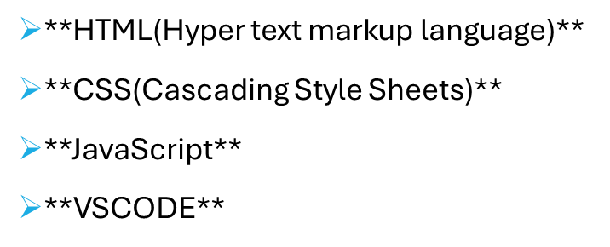


Technology (Software Requirements)
Notes:
Font Styles: Times New Roman + Font Size: 25

Slide 9
Modules
1. User Registration:
Customers and service providers create accounts on the platform, providing necessary information like contact details, location, and service offerings.
2. Service Listing:
Service providers list their services on the platform, specifying details such as the type of service, location, pricing, and availability.
3. Customer Search:
Customers search for specific services based on their needs, using filters like location, keywords, or service category.
4. Service Selection and Booking:
Customers choose the desired service and service provider based on factors like ratings, reviews, and pricing.
They proceed to book the service, specifying the preferred date and time.
Notes:
Font Styles: Times New Roman + Font Size: 25

Slide 10
Modules (Contd.)
Home Improvement Marketplace: Connects customers with contractors for home renovation or improvement projects.
Pet Care Services: Offers services like pet sitting, grooming, or walking.
Home Cleaning Services: Provides professional cleaning services for homes or offices.
Handyman Services: Offers a variety of odd jobs or small repairs.
By offering a combination of these modules, home assistant websites aim to create a seamless and efficient platform for both customers and service providers, simplifying the process of finding and booking services.
Notes:
Font Styles: Times New Roman + Font Size: 25

Slide 11
Workflow/Gantt Chart
Breakdown of Key Milestones:
Project Planning – Identifying goals, timelines, and resources.
Requirement Gathering – Collecting all necessary features like messaging, notifications, etc.
UI/UX Design – Creating wireframes, and user interface prototypes.
Frontend Development – Building user-facing features and chat UI.
Backend Development – Setting up servers, database integration, authentication, etc.
API Integration – Connecting frontend and backend, enabling message handling, and notifications.
Testing – Ensuring the app functions correctly through unit and integration tests.
Bug Fixing & Optimizations – Addressing issues found during testing.
Notes:
Font Styles: Times New Roman + Font Size: 25

Slide 12
Reports
Customer Acquisition: Tracks the number of new customers acquired over time, including
sources of acquisition (e.g., website, mobile app, referrals).
Customer Retention: Measures the percentage of customers who continue to use the platform and book
services.
Customer Satisfaction: Analyzes customer feedback through reviews, ratings, and surveys to gauge satisfaction levels.
Service Utilization: Tracks the frequency of service bookings and cancellations.
Service Popularity: Identifies the most popular services requested by customers.
Notes:
Font Styles: Times New Roman + Font Size: 25

Slide 13
References
W3 School
Javatpoint
Youtube
Chat GPT
Notes:
Font Styles: Times New Roman + Font Size: 25

Slide 14


