Slide 1
Apoorva Srivastava Suruchi Sinha
INDIAN EDUCATION
STATISTICS
(Project on Bigdata)

Slide 2
ABSTRACT
As per Census, a person aged seven and above who can both read and write with understanding in any language, is treated as literate. A person, who can only read but cannot write, is illiterate. The data provides details of State Code, District Code, Area Name, Age-group, literates, illiterates, Literate without education level, below primary, primary, middle, Matric/Secondary, Higher secondary/Intermediate Pre-University/Senior secondary, Non-technical diploma or certificate not equal to degree, Technical diploma or certificate not equal to degree, Graduate & above and Unclassified education level.

Slide 3
SOFTWARE REQUIREMENTS
Hive
Hadoop
Java
Virtual Box
CentOS 7

Slide 4
HARDWARE REQUIREMENTS
RAM: 8 GB DDR4
Hard Disk: 256GB ssd drive.
Processor: i5 / i7 /i9 take latest version.
Graphics: purchase Media latest version.

Slide 5
Functional Requirements
Coordination
Enter project details
Dependencies / Constraints
Create Task
Delete Task

Slide 6
Non Functional Requirements
Performance Requirements
Databse requirements
Other requirements
Hardware constraints
Software constraints

Slide 7
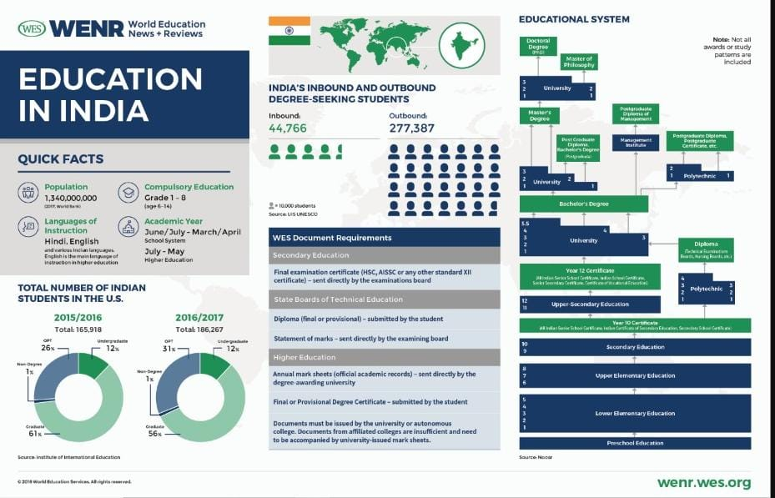

Slide 8
Thankyou

