Slide 1


Slide 2


KIET Group of Institutions
Department of Computer Science
Project:
Privlok+ (Password Keeper)

Slide 3
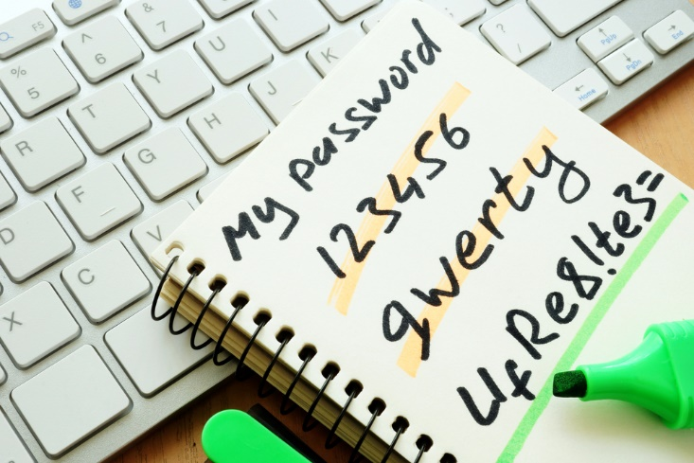

Privlok+
MENTOR:
Team Leader:
Dr. Vipin Kumar
Sachin Rathi

Slide 4

Privlok+ ( Privacy + Locker)
A Password keeper Android App

Slide 5




Slide 6

PRIVACY
FREE
Easy to use
Better Security
Save all data internally.

Slide 7

Privacy
Better Security.
Every user can save their password in there mobile.
User remember their passwords all time.
No warry about loosing their data .

Slide 8
Features+
Secure Password Generator
Automatically Backup
Recovery Option
Save and Autofill Passwords
Item Storage
Sharing Support

Slide 9
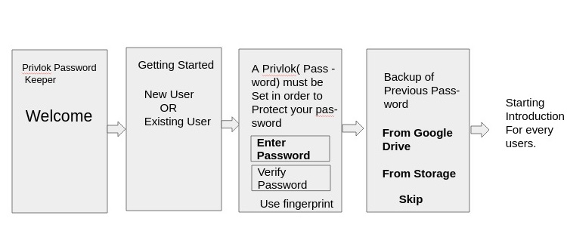
Flow Chart
(Introduction Interface)

Slide 10
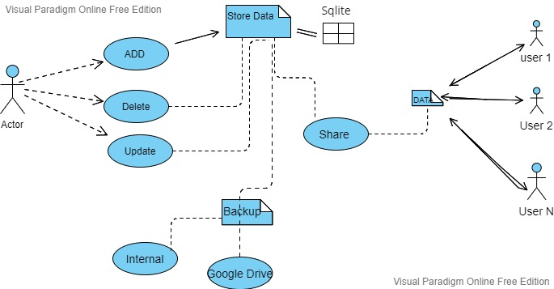

Slide 11
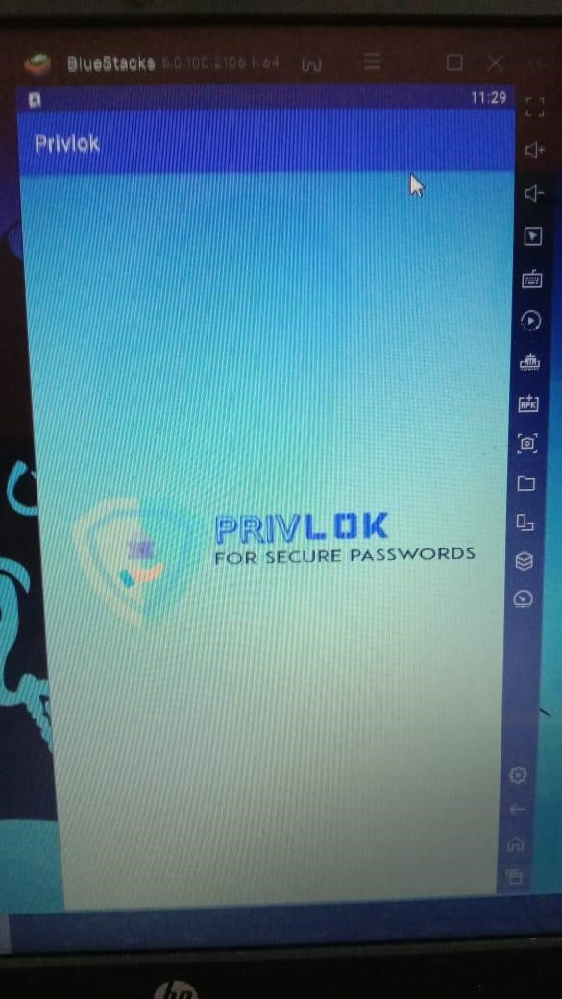
Application Format

Slide 12
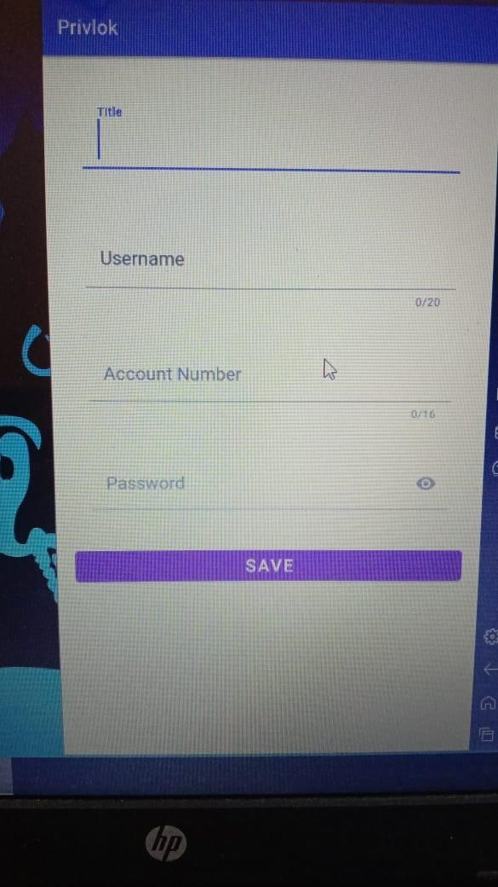

Slide 13
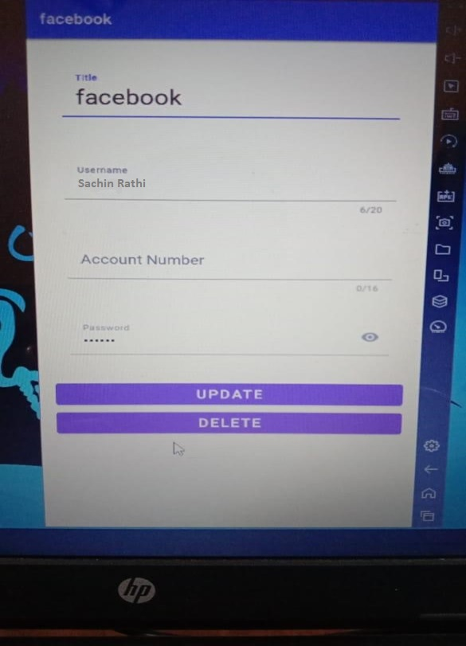

Slide 14
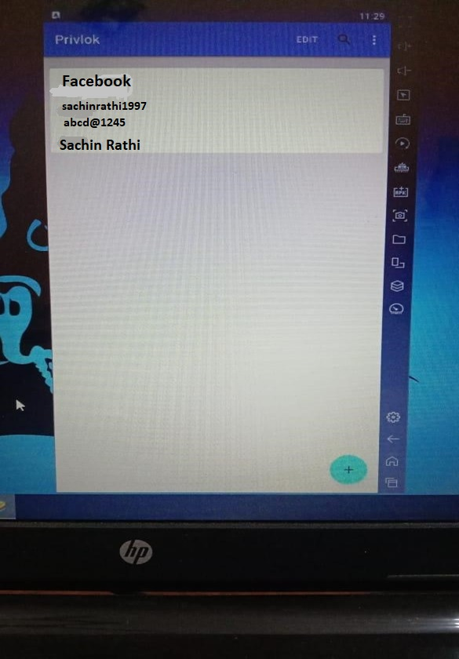

Slide 15
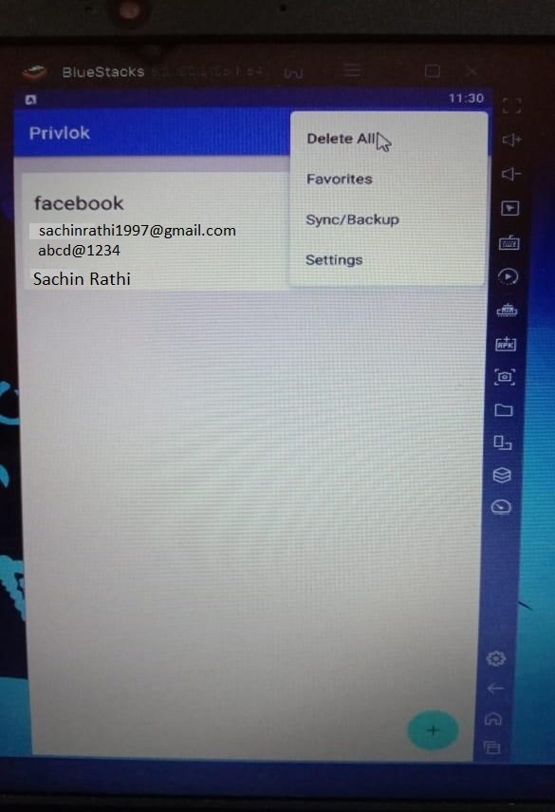

Slide 16

THANK YOU

Slide 17

FEEDBACK

