Slide 1

WorkPlace Coaction System
at
KIET GROUP OF INSTITUTIONS, GHAZIABAD
Under Supervision of:
Dr Arun Kumar Tripathi
Professor
Department of Computer Application
By:
Niranjan Darshan
Abhishek Kumar Yadav

Slide 2
Introduction
WorkPlace Coaction System is a web application (or personal Application) which help to manage and organize the employees at workplace. This system is used for fast pace work environment. At every places there are lots of work to be done by the employeer and employee.
This system help to smoothly run the organization in systematic manner.
Work to manage the essential data and assign task to the employee on its own Web application more securely.

Slide 3
Software and hardware Requirement
Software Requirement :
Operating System( Windows)
Google Chrome
Xampp Server
HardWare Requirement:
Desktop /PC
No such requirement recognized till.

Slide 4
Functional Requirement
For the proper functioning of the application one need to :
Know the localhost port number.
Remember Login Credential.
Must have data inserted by the authority of the workplace.

Slide 5
Modules
Admin Activity.
Data Feeding
Updation
Deletion of Employee details
Employee Activity.
Updation of Employee Personal data
View Profile.

Slide 6
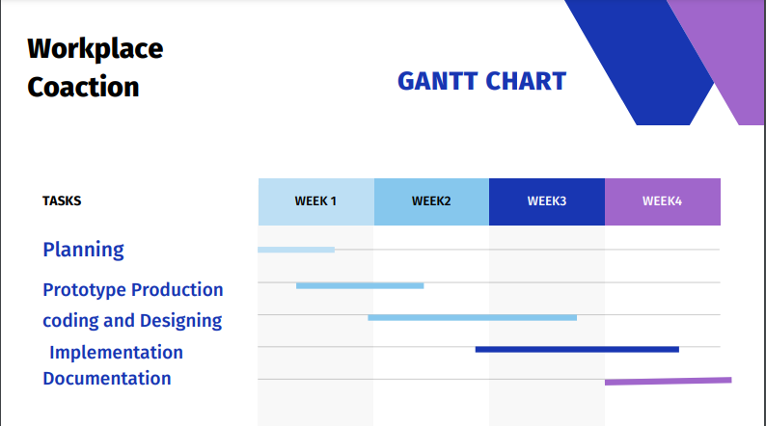
Gantt Chart

Slide 7
Service and society
This System is useful for any general organization.
This will be useful for large and small scale organization.
Store data securely and serve when credentials are valid.
Systematic functioning of an organization will increase the efficiency of the office.
Growth in business will serve the society the best.

Slide 8
Future Work
Email Verification.
Contact Number Verification by OTP.

Slide 9
Thank You !

