Slide 1
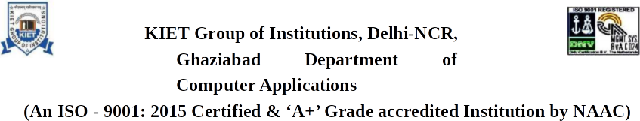
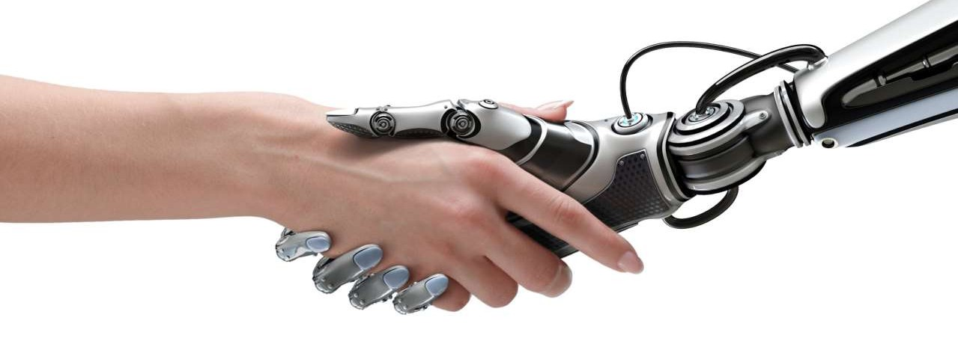
s
Presentation On - ARTIFICIAL INTELLIGENCE
Submitted By - Nirmit Bansal
Semester- 6th
University Roll- 1900290140022

Slide 2
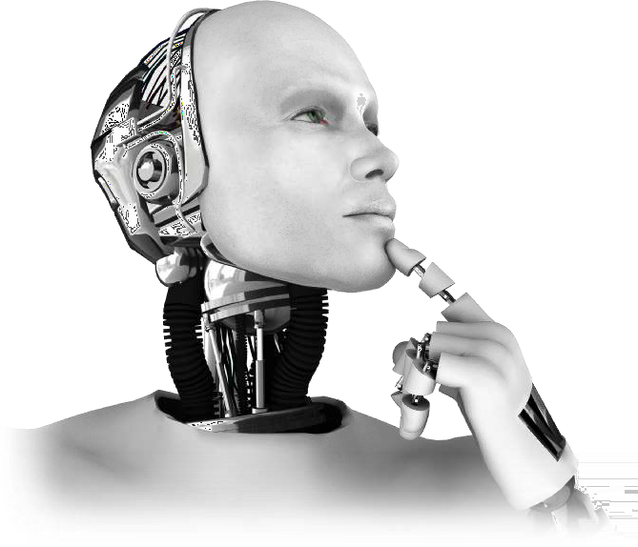
Contents
Definition
Early History
Current status of AI
Challenges for AI
Future of AI
Pros & Cons
Conclusion

Slide 3
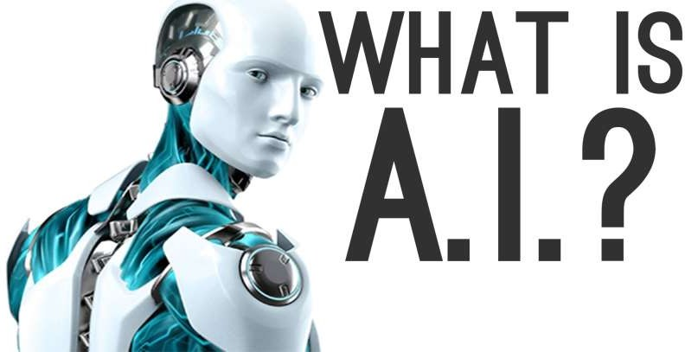
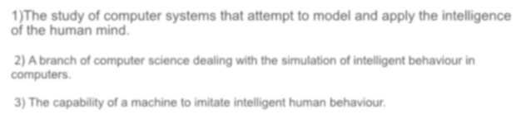


The study of computer systems that attempt to model and apply the intelligence of the human mind.
A branch of computer science dealing with the simulation of intelligent behaviour in
computers.
The capability of a machine to imitate intelligent human behaviour.

Slide 4

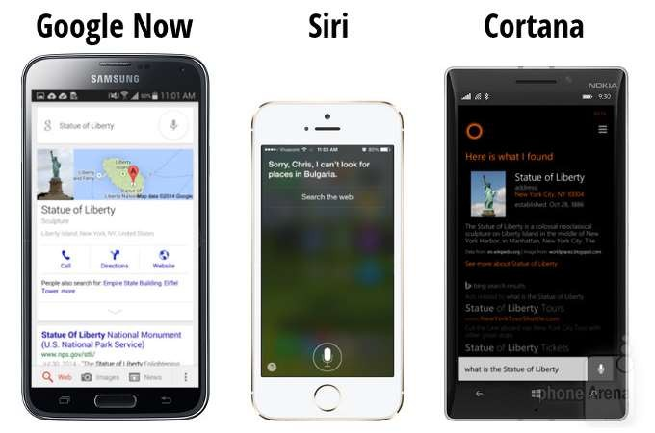

Google Now, Siri
and Cortana are all intelligent digital personal assistants on various platforms (iOS, Android, and Windows Mobile). In short, they help find useful information when we ask for it using our voice.
We can use them to make calls, send messages, set reminders, take notes, recognize music, find great restaurants, check your calendar, and more.

Slide 5
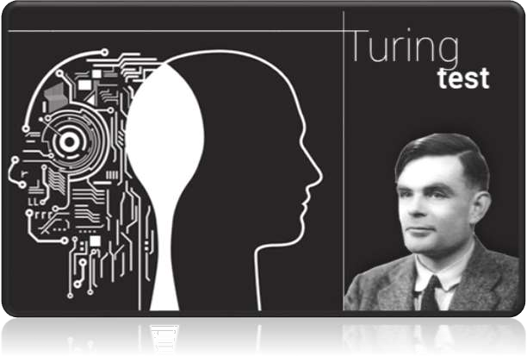

Early History
In 1950 English mathematician Alan Turing wrote a landmark paper titled “Computing
Machinery and Intelligence” that asked the question: “Can
machines think?”
Further work came out of a 1956 workshop at Dartmouth sponsored by John McCarthy. In the proposal for that workshop, he coined the phrase a “study of Artificial Intelligence”

Slide 6


AI have taken many shapes and forms over recent years
Mobile Phones ( Siri/ Cortana)
Video Games Characters
GPS/ Voice Recognition
Robotics
Google has been a major play on AI transcendence and Deep Learning.
Deep learning is a machine learning based on algorithms.

Slide 7
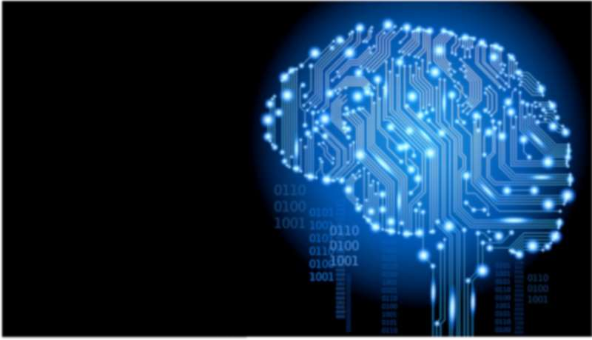
CHALLENGES
Computing Power
Tolerance Power
Intuitive Thinking
Judging Power

Slide 8





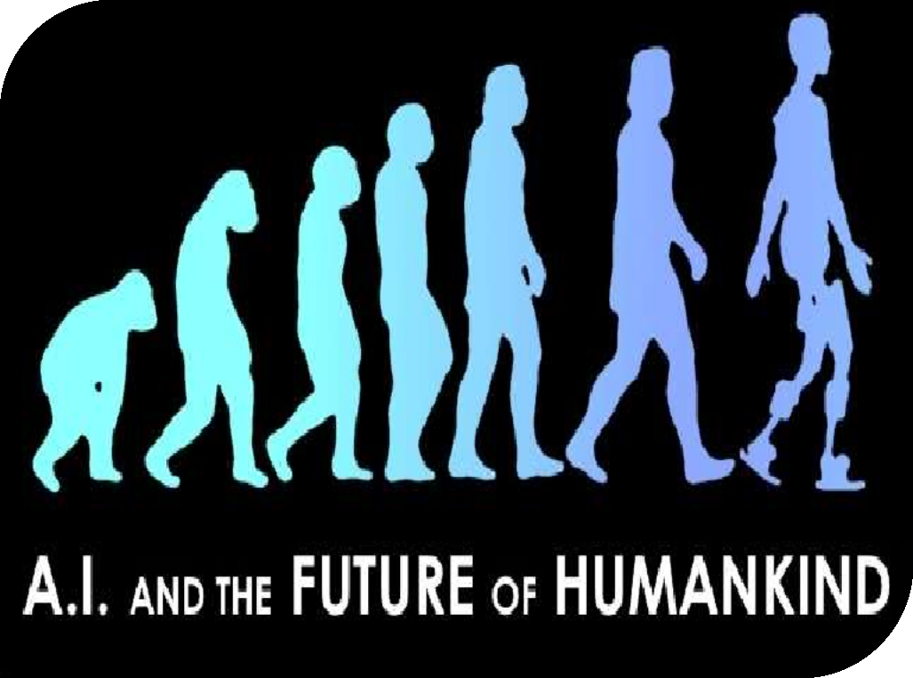
FUTURE OF AI
Beyond negotiation, Moore says CMU is betting several other AI areas are going to be hugely important in the near future.
Self Driving Cars.
Improved Medical Care & Treatment.
Open up doors to future explorations.
Etc.

Slide 9
Advantages & Disadvantages
Precision and Accuracy ▪ Cost incurred in the maintenance and repair
Space exploration ▪ Not able to act any different
Used for mining process ▪ Lack the human touch
Can do laborious tasks ▪ Lack a creative mind
Fraud detection, manage records. ▪ Lack common sense
Lacking the emotional side ▪ Unemployment
Can do repetitive and time-consuming tasks ▪ Abilities of humans may diminish
Robotic pets, Robotic radiosurgery. ▪ Robots superseding humans
Function without stopping, Risk Reducing. ▪ Humans may became dependent on machines.
Diagnosis and Treatment ▪ Wrong hands causes destruction

Slide 10

CONCLUSION
Finally we can say that the Artificial Intelligence (AI) is the intelligence of machines and the branch of Computer Science that aims to create it.AI textbooks define the field as “ The Study and Design of Intelligent Agents” where an intelligent agent is a system that perceives it’s environment and takes actions that maximize the chances of it’s success. John McCarthy ,who coined the term in
1955, defines it as “The Science and Engineering of making intelligent Machines”

Slide 11


