Slide 1


PRESENTATION ON CLOUD COMPUTING
KIET Group of Institutions, Delhi-NCR, Ghaziabad
Department of Computer Applications
(An ISO - 9001: 2015 Certified & ‘A+’ Grade accredited Institution by NAAC)
Submitted By
Uni Roll Num: 1900290140021
Name: Niranjan Darshan
Semester: VI th
Section: A
Date: 05- Feb -2022

Slide 2
1. Introduction…… 3 2. Working Model...4-6 2.1 Service Models ..5 2.2 Deployment Models..6 3. Application area...7 4. conclusion………8
Contents

Slide 3
1. Introduction
Cloud computing is the delivery of different services through the Internet, including data storage, servers, databases, networking, and software.
Cloud-based storage makes it possible to save files to a remote database and retrieve them on demand.

Slide 4
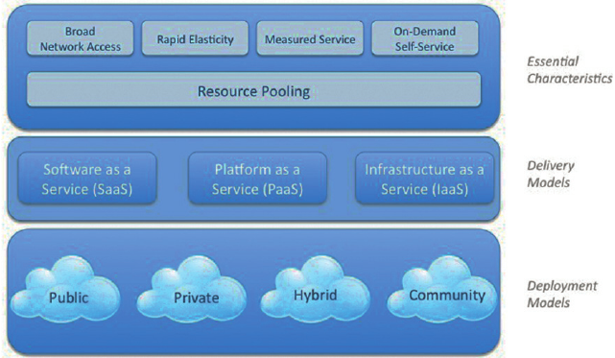
2. Working Models

Slide 5
2.1 Service Models
IaaS is also known as Hardware as a Service (HaaS). It is a computing infrastructure managed over the internet.
PaaS cloud computing platform is created for the programmer to develop, test, run, and manage the applications.
SaaS is also known as "on-demand software". It is a software in which the applications are hosted by a cloud service provider. Users can access these applications with the help of internet connection and web browser.

Slide 6
2.2 Deployment Models
The public cloud allows systems and services to be easily accessible to the general public.
The private cloud allows systems and services to be accessible within an organization. It is more secured because of its private nature.
The community cloud allows systems and services to be accessible by a group of organizations.
The hybrid cloud is a mixture of public and private cloud where critical activities are done in Private cloud and non critical using public cloud.

Slide 7
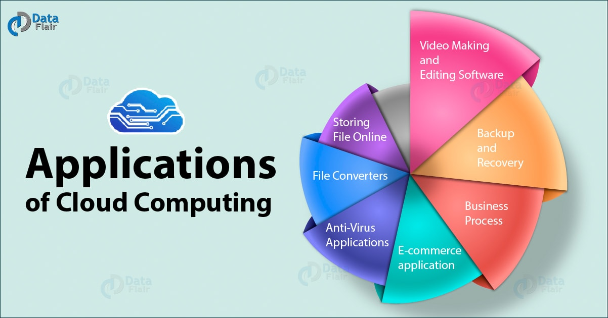
3. Applications

Slide 8
4. Conclusion
Cloud computing is the latest technology that promises immense benefits however there is lot of research which is still required in this area as many of the concerns related to security and privacy issues are not been answered by the experts and remains open.
There are other challenges the cloud computing must overcome. Microsoft, Google, Cisco, IBM in this area and the day is not far when the cloud will widespread adopted and all the security and privacy issues will be handled.

Slide 9
Thank You!

