Slide 1


KIET Group of Institutions, Delhi-NCR, Ghaziabad
Department of Computer Applications
(An ISO - 9001: 2015 Certified & ‘A+’ Grade accredited Institution by NAAC)
PRESENTATION ON
Cloud Computing
Summited by:
Uni roll num:1900290140014 Name:Divyansh Pandey Semester:6th
Section: A
Date : 5-March-2022

Slide 2
INTRODUCTION
Introduction
Working model 3.Application area 4.Conclusion

Slide 3
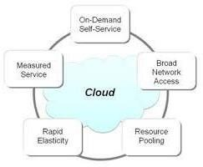
Introduction
Cloud computing is the delivery of different services through the Internet, including data storage, servers, databases, networking, and software.
Cloud-based storage makes it possible to save files to a remote databas and retrieve them on demand.

Slide 4
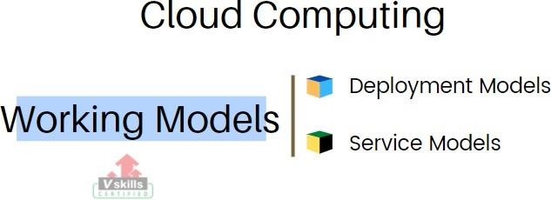
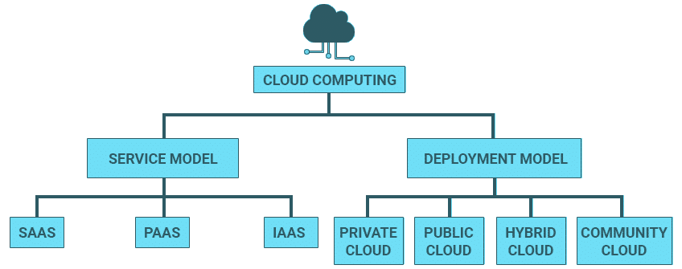
2. Working Models

Slide 5
Service Models
SaaS known as Hardware as a Service (HaaS). It is a computing infrastructure managed over the internet.
PaaS computing platform is created for the programmer to develop, test, run, and manage the applications.
SaaS own as "on-demand software". It is a software in which the applications are hosted by a cloud service provider. Users can access these applications with the help of internet connection and web browser.

Slide 6
Deployment Models
Public cloud allows systems and services to be easily accessible to the general public.
Private cloud allows systems and services to be accessible within an organization. It is more secured because of its private
nature.
Community cloud allows systems and services to be accessible by a group of organizations.

Slide 7
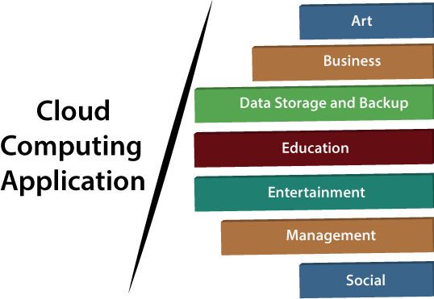
Applications

Slide 8
Conclusion
Cloud computing is recently new technological development that has the potential to have a great impact on the world. It has many benefits that it provides to it users and businesses.
There are other challenges the cloud computing must overcome. People are very skeptical about whether their data is secure and private.
There are other challenges the cloud computing must overcome. People are very skeptical about whether their data is secure and private.

Slide 9


