Slide 1




Colloquium Presentation ON
KIET Group of Institutions, Delhi-NCR, Ghaziabad Department of Computer Applications
(An ISO – 9001: 2015 Certified & ‘A+’ Grade accredited Institution by NAAC)
Java, Postgresql, Gradle
Presented By:
1900290140040
Suruchi Sinha
MCA 6A
Date: 12.03.2022

Slide 2
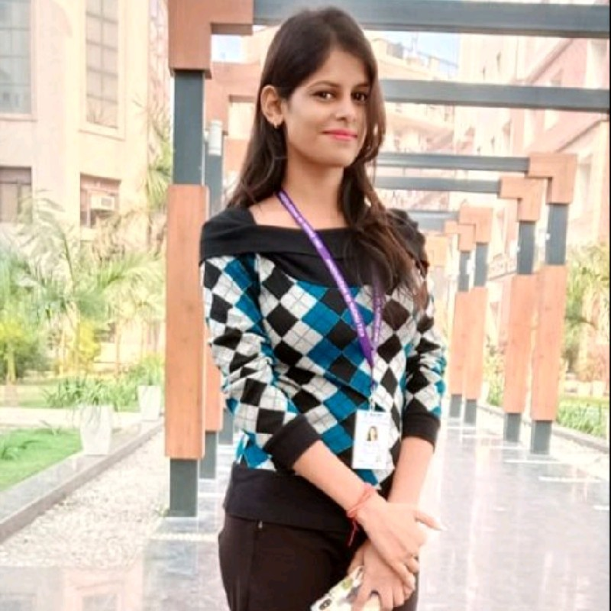


Suruchi Sinha
Trainee at Capgemini
Technology: JEE with DevOps and AWS
Duration: 04.02.2022 to 06.05.2022
Current learnings:
Java
PostgreSQL
Gradle

Slide 3
Java Lambda Expressions
Lambda Expressions were added in Java 8.
A lambda expression is a short block of code which takes in parameters and returns a value. Lambda expressions are similar to methods, but they do not need a name and they can be implemented right in the body of a method.
import java.util.ArrayList;
public class Main {
public static void main(String[] args) {
ArrayList<Integer> numbers = new ArrayList<Integer>();
numbers.add(5);
numbers.add(9);
numbers.add(8);
numbers.add(1);
numbers.forEach( (n) -> { System.out.println(n); } );
}
}

Slide 4
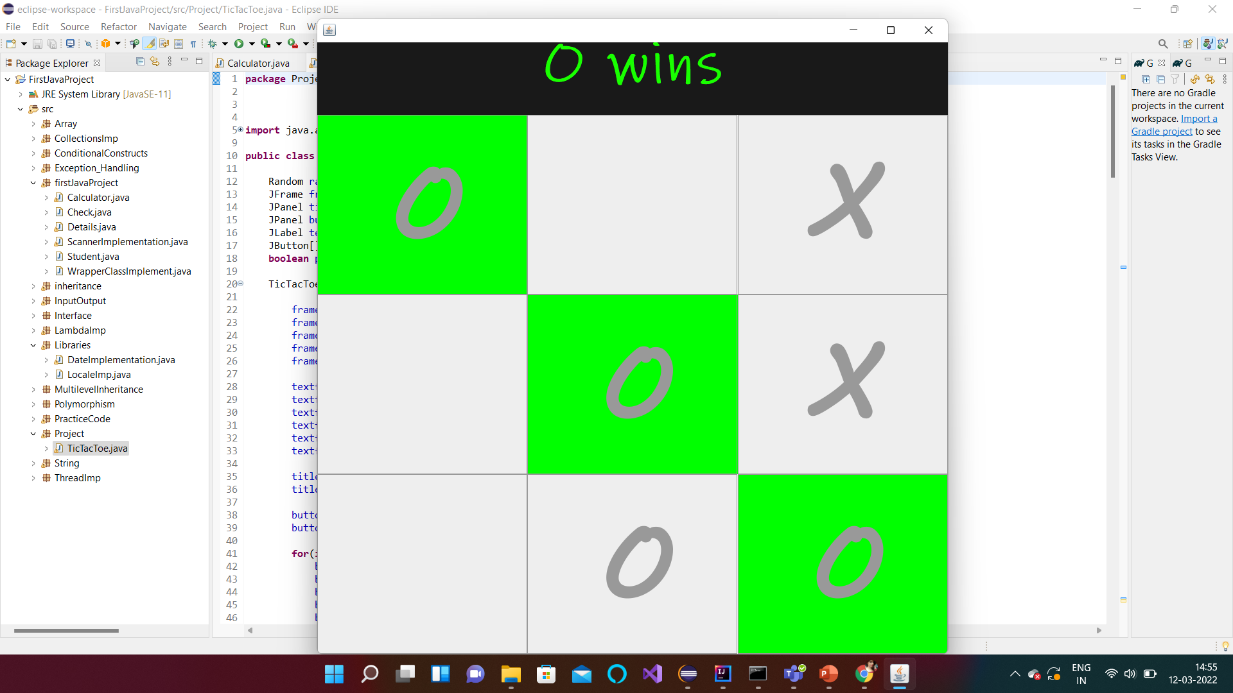
Game Implementation using Java

Slide 5
POSTGRESQL
PostgreSQL, also known as Postgres, is a free and open-source relational database management system emphasizing extensibility and SQL compliance. It was originally named POSTGRES.
Queries tried:
select salary from employees order by salary DESC limit 1 OFFSET 1;
select first_name, department_id, salary from employees e where salary = (select max(salary)
from employees where department_id = e.department_id);
select l.city, count(employee_id) from employees e, departments d, locations l where
e.department_id = d.department_id and d.location_id = l.location_id group by city;
select to_char(hire_date, 'yyyy'), count(employee_id) from employees group by
to_char(hire_date, 'yyyy’); etc

Slide 6
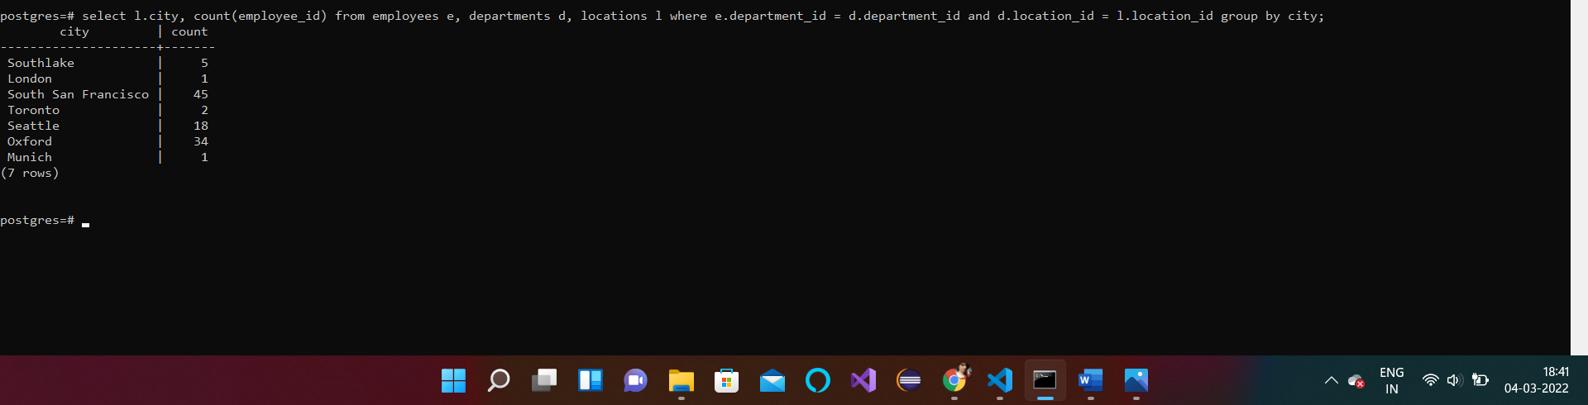
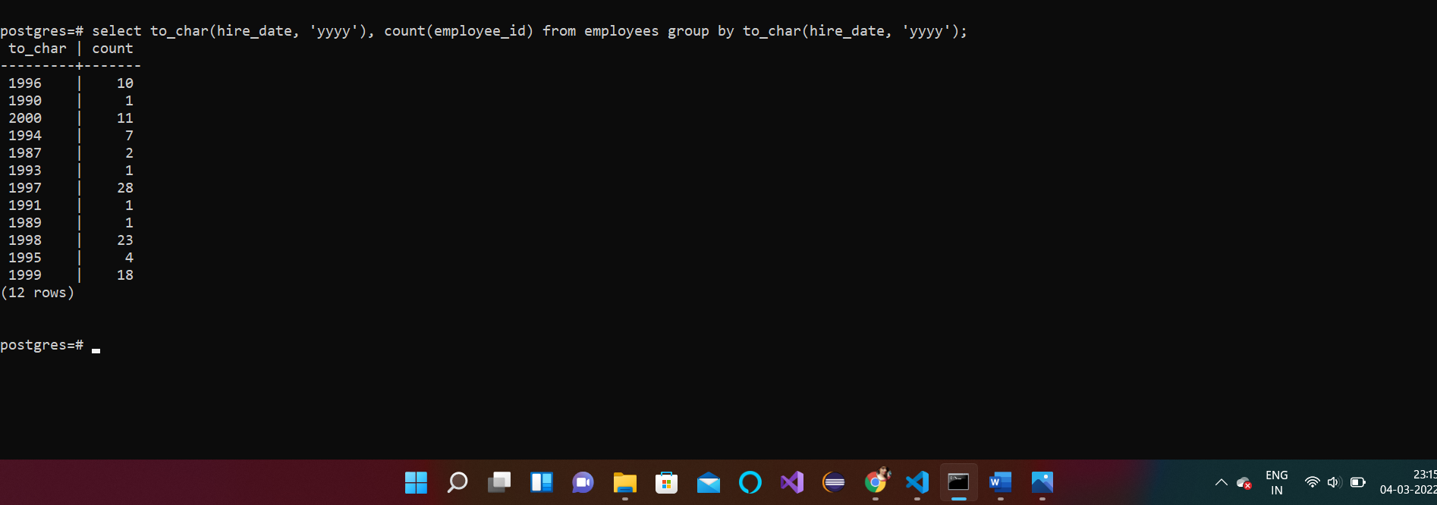

Slide 7
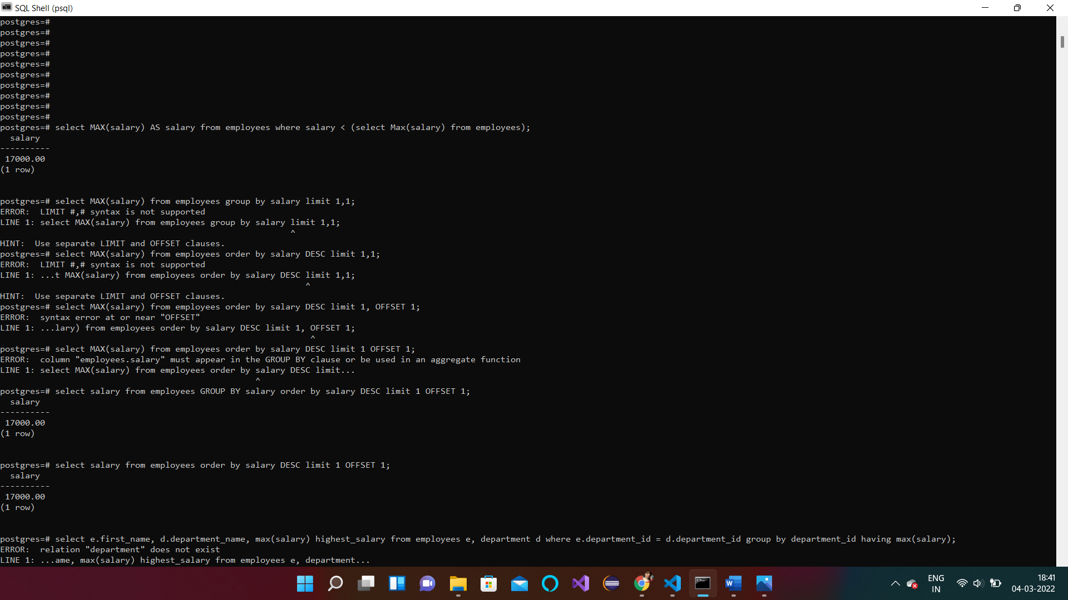

Slide 8
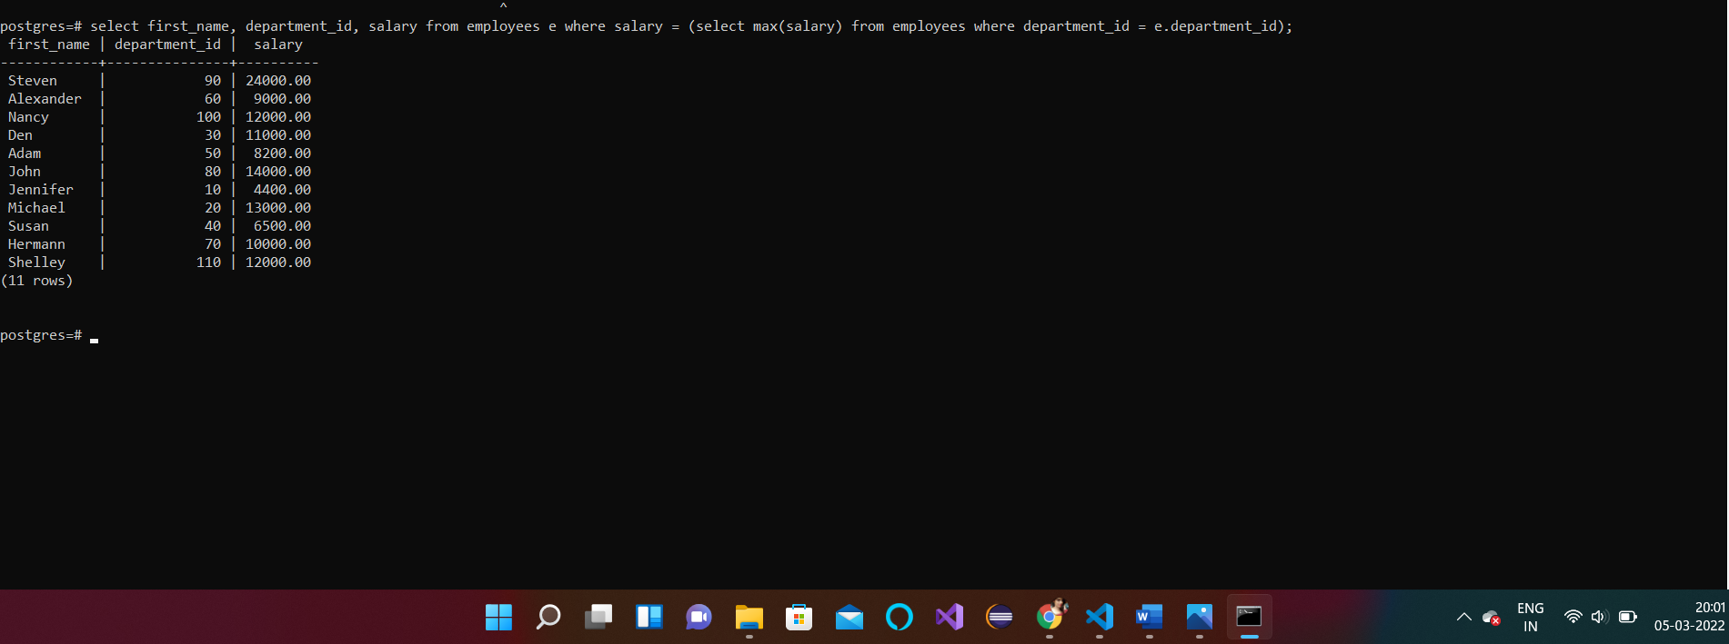

Slide 9
GRADLE
Gradle is a build automation tool for multi-language software development. It controls the development process in the tasks of compilation and packaging to testing, deployment, and publishing.
Supported languages include:
Java, C/C++, and JavaScript.

Slide 10
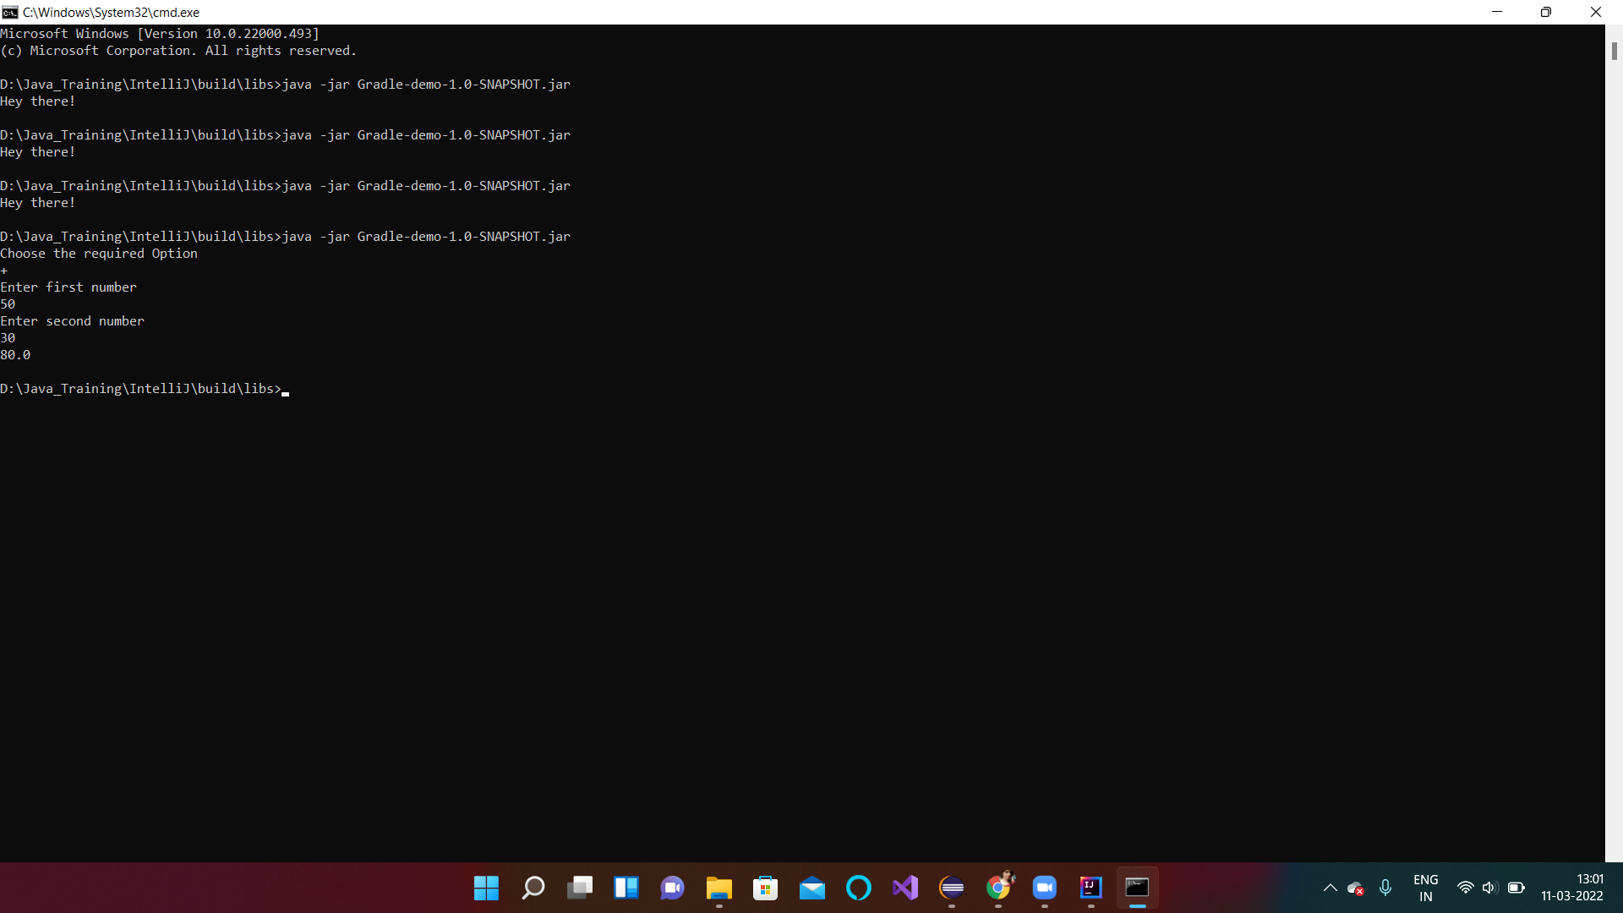

Slide 11
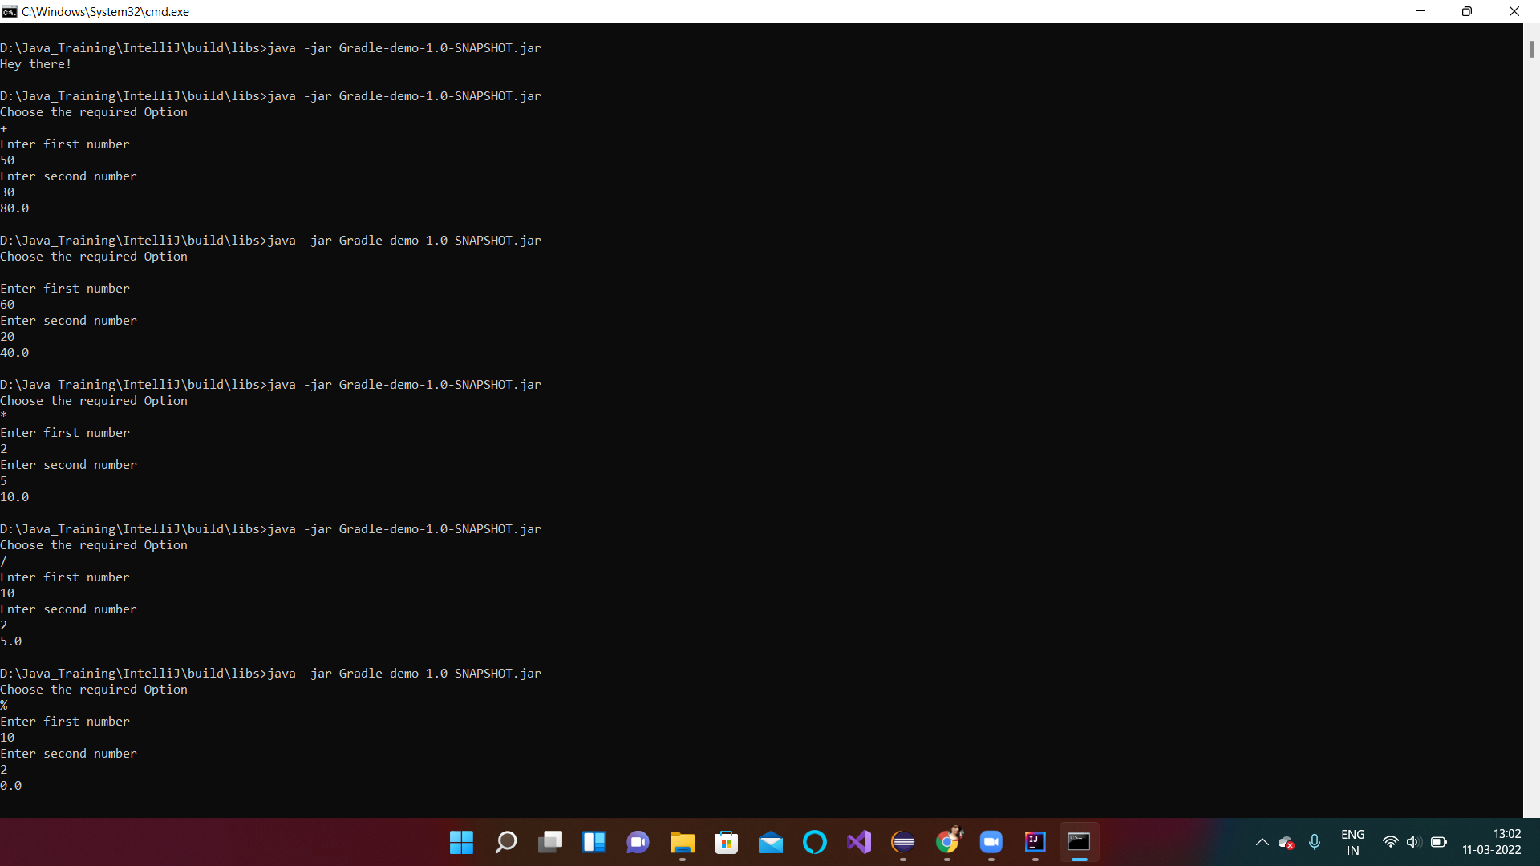

Slide 12


