Slide 1

Presentation On
E-Commerce Cosmetic
Submitted by: Neelam ma’am
University Roll No.: 1900290140009
Name:Archana varshney
Semester:6th
Date:-30/4/2022

Slide 2
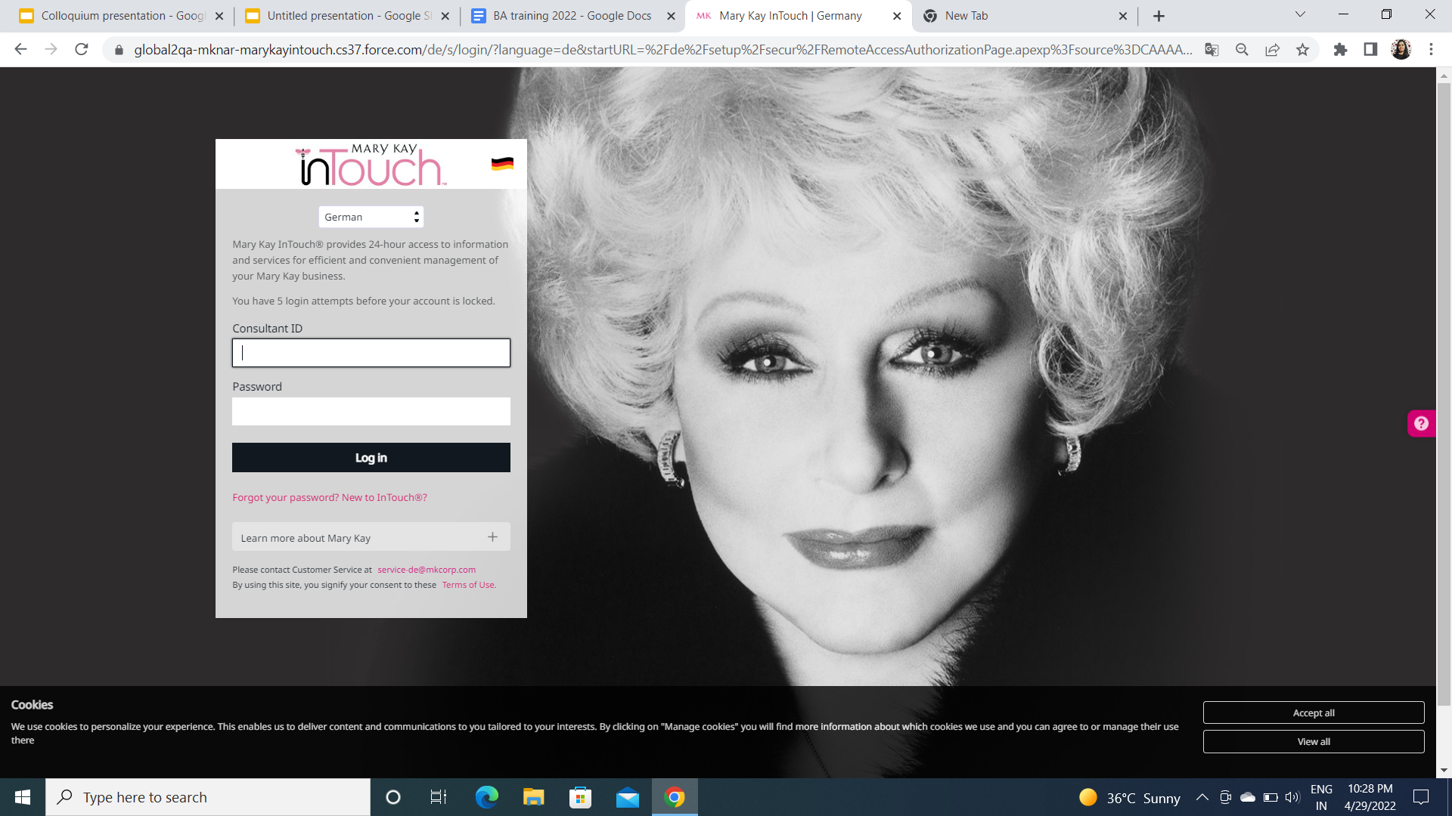
Mary Kay
Mary Kay page(sells beauty product(U.S Based company)
promote women )
1963 is an American Privately owned MLM (multi level marketing company) which sells cosmetics products.
Company founded by Mary Kay Ash.
The project name is project one and the motive of this project is women's empowerment.
Project using almost all the clouds of salesforce like service cloud. Community cloud, commerce cloud, analytics cloud

Slide 3
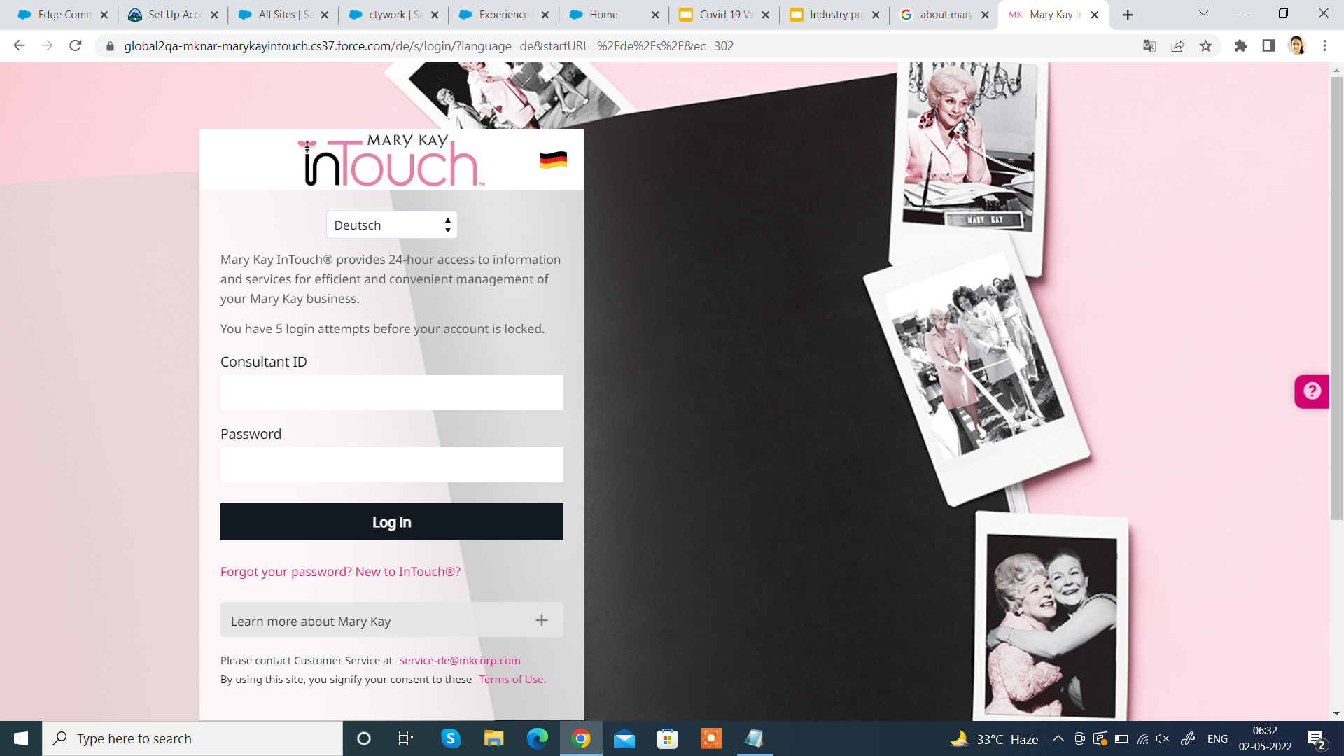
E-commerce Cosmetics
It was Starting in 1963 is an American Privately owned MLM (multi level marketing company) which sells cosmetics products.Company founded by Mary Kay Ash.The project name is project one and the motive of this project is women's empowerment.Project using almost all the clouds of salesforce like service cloud. Community cloud, commerce cloud, analytics cloud
Project is live in 30 markets of 4 regions
1-EUR(European Region)
2-APR(Asia Pacific Region)
3-LAR(Latin America Region)
4-NAR(North America Region)

Slide 4
Introduction
Technologies used :
Agile Methodology
Salesforce Builder
Salesforce Community Cloud
Functionality:
Whenever anyone wants to join MK , then he should have a valid Recruiter number with him , with the help of that recruiter number new recruit will signup on agreement form and then he has to complete that form which consists of multiple sections with multiple fields.
If any recruit complete its purchasing from commerce then can see his details and have some permission sets.

Slide 5
⦁ Project Roles and Responsibilities
The major tasks assigned to me during my internship at Cloud Analogy was:
• To perform Manual Testing for various Salesforce UI
• To perform Automation Testing we need to use a tool Name Tricentis Tosca.
• To perform Manual and Automation Testing for Leads Connection CRM
Sprint tickets and file bugs corresponding to them in JIRA .

Slide 6
Methodology & Modules
Atlassian JIRA:
Jira was designed as a bug and issue tracker.Jira has evolved for all kinds of use cases,
from requirements and test case management to agile software development.Jira has
evolved for all kinds of use cases, from requirements and test case management to agile
software development
Workspace and Builder Experience:
Create Workspace and manage dashboard , administration , Builder , CMS and set the layout of site and other functionality . Salesforce Builder can be used to customize the Community based on our business needs, without doing any custom development, we can customize the Community branding very easily and quickly.
3. Community Cloud:
Community Cloud provides Salesforce customers the ability to create online web properties for external collaboration, customer service, channel sales, and other custom portals in their instance of Salesforce. Tightly integrated to Sales Cloud, Service Cloud, and App Cloud, Community Cloud can be quickly customized to provide a wide variety of web properties.

Slide 7
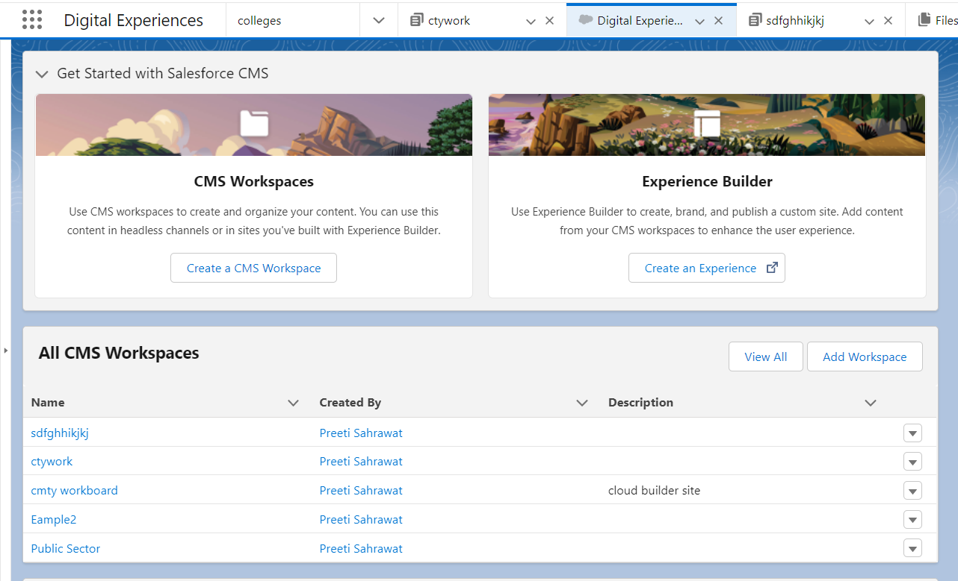

Slide 8
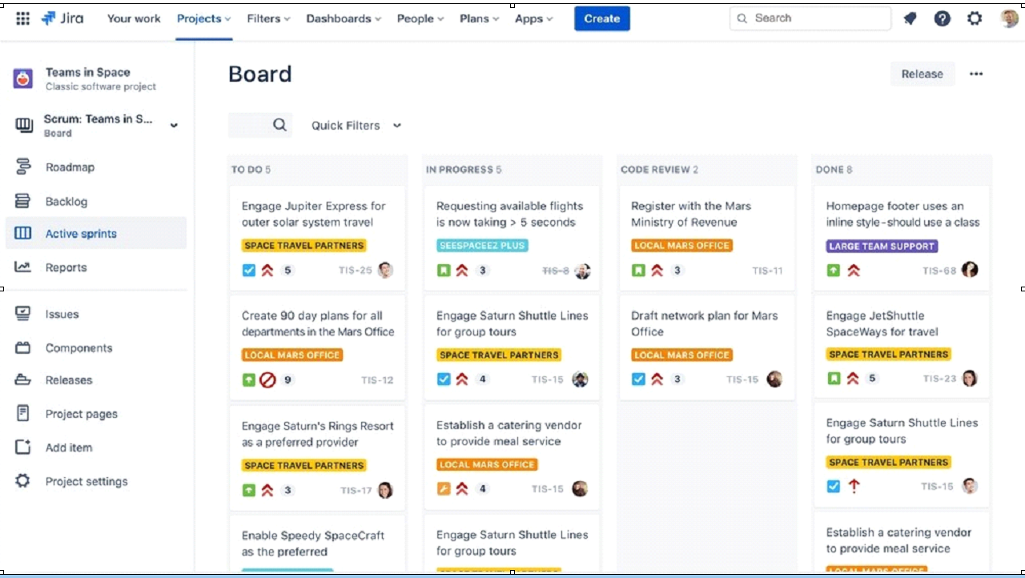

Slide 9
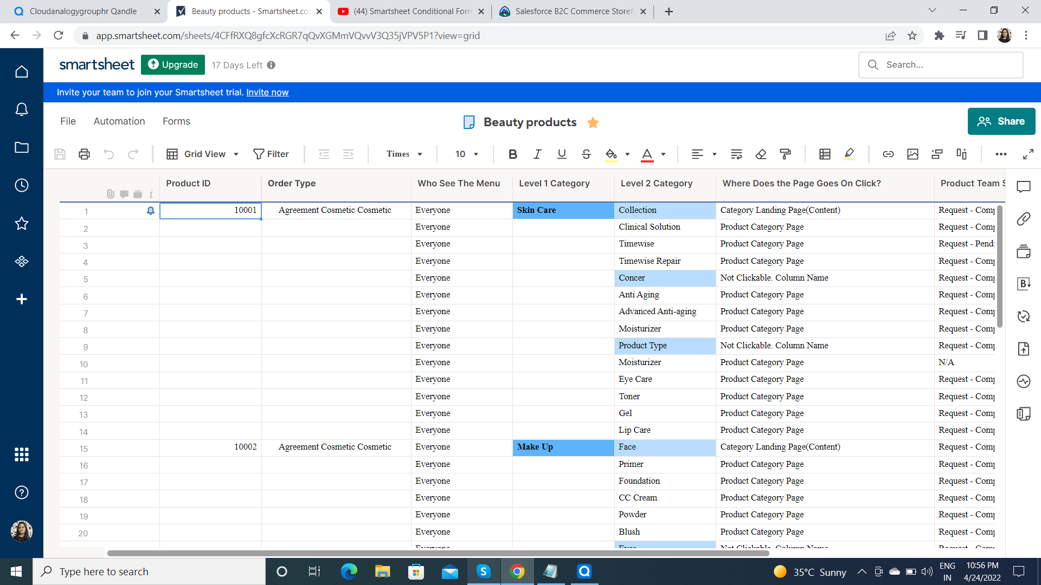
Smartsheet

Slide 10

The types of testing performed
⦁ Smoke Testing
⦁ Sanity Testing
⦁ Functional testing
⦁ Regression Testing
⦁ End-to-end testing

Slide 11
Thank You

