Slide 1


JavaScript
Submitted by:
University roll no:-1900290140024
Name:-Pranjul Panday
Semester-6th
Section:- A
Date:-22/02/2022

Slide 2
Introduction
JavaScript is a lightweight, cross-platform, and interpreted scripting language.
It is well-known for the development of web pages, many non-browser environments also use it.
JavaScript can be used for Client-side developments as well as Server-side developments.
JavaScript contains a standard library of objects, like Array, Date, and Math, and a core set of language elements like operators, control structures, and statements.

Slide 3
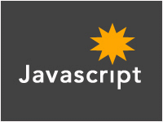
What is Javascript ?
Insert dynamic text into HTML (ex: user name)
react to events (ex: page load user click)
Get information about a user's computer (ex: browser type)
Used to make web pages interactive
Perform calculations on user's computer (ex: form validation)

Slide 4
JavaScript Features :
Object-Centered Script Language.
Client edge Technology.
Validation of User's Input.
Else and If Statement.
Interpreter Centered.
Ability to perform In Built Function.
Case Sensitive format.
Light Weight and delicate.

Slide 5
Advantages of JavaScript :
Speed. Client-side JavaScript is very fast because it can be run immediately within the client-side browser. Unless outside resources are required, JavaScript is unhindered by network calls to a backend server.
Simplicity. JavaScript is relatively simple to learn and implement.
Popularity. JavaScript is used everywhere on the web.
Interoperability. JavaScript plays nicely with other languages and can be used in a huge variety of applications.
Server Load. Being client-side reduces the demand on the website server.
Gives the ability to create rich interfaces.

Slide 6
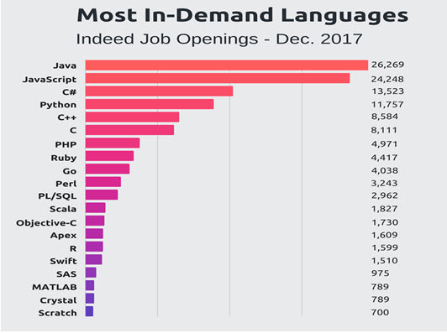
Demand of JavaScript :

Slide 7
Future of JavaScript :
JavaScript is the main powerhouse behind the rapidly evolving Internet.
It is the present and will be the future.
The rampant development of the high-level programming language asserts to the fact of JavaScript is the future
Excellent Choice of Frameworks:AngularJS, Ember.js Metero.js, ReactJS

Slide 8

Why should I use JavaScript ?
JavaScript is commonly used for creating web pages. It allows us to add dynamic behavior to the webpage and add special effects to the webpage.
On websites, it is mainly used for validation purposes.
JavaScript helps us to execute complex actions and also enables the interaction of websites with visitors.
JavaScript is a text-based programming language used both on the client-side and server-side that allows you to make web pages interactive.

Slide 9

Example:
<!DOCTYPE HTML>
<html>
<body>
<p>Before the script...</p>
<script>
alert( 'Hello, world! Welcome to JavaScript' );
</script>
<p>...After the script.</p>
</body>
</html>

Slide 10
Output:
Hello, world! Welcome to JavaScript

Slide 11
Conclusion:
JavaScript is a wonderful technology to use on the web
It is not that hard to learn and it is very versatile.
It plays nicely with other web technologies — such as HTML and CSS — and can even interact with plugins such as Flash.
JavaScript is a dynamic computer programming language

Slide 12


