Slide 1

Colloquium presentation topic React ( type script ) Name : Shivam Nerwal Roll No : 1900290140033

Slide 2
Type Script : Released in 2012 by Microsoft. It is an enhanced version of java script Really helpful in enterprise level application and large scale projects

Slide 3
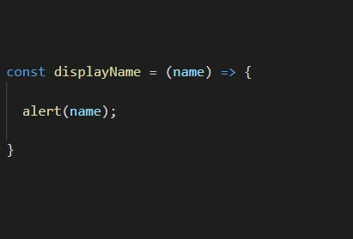
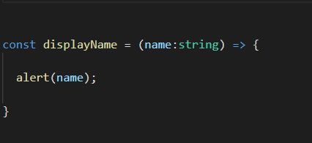
Type script adds static typing feature to java script

Slide 4
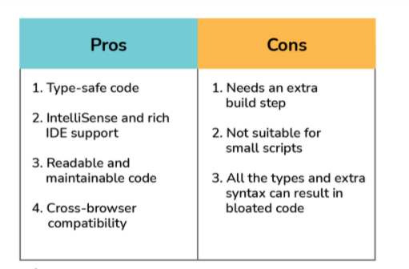
Merits and Demerits of TS

Slide 5
Merits of React Easy to learn and use Component Oriented SEO friendly Power of reusability of components we can develop single page applications

Slide 6
Companies using React Meta Netflix Airbnb Uber Yahoo

Slide 7
Thanking You

