Slide 1

PRESENTATION ON
SALESFORCE
SUBMITTED BY
UNIVERSITY ROLL NO :- 1900290140004
NAME :- Akhil Verma SEMESTER :- 6th SECTION - A
DATE - 24/04/22

Slide 2

What Is Salesforce?
Salesforce CRM provides a complete solution for that includes feature-rich solutions for
marketing, sales, services, partner management and community management.
CRM is originally software for managing customer interaction, such as scheduling tasks,
emailing, texting, and many more.
Salesforce grew into a cloud software solution and acquired several other companies for
Paas(Platform as a Service) and Saas (Software as a Service).

Slide 3
History & Founder
Salesforce is the world’s first and most popular CRM system .
The headquarter of Salesforce is situated in San Francisco.
More than 82,000 companies and many customers used this dynamic, web-based,
low-cost CRM platform.
It was founded in March 1999 by former Oracle executive Marc Benioff
Salesforce.com has its services translated into 16 different languages and currently has 82,400 regular customers and over 2,100,000 subscribers.

Slide 4


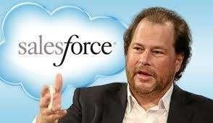




Founder Marc Benioff (1964)
Net worth :4.2 Billion (2015)

Slide 5
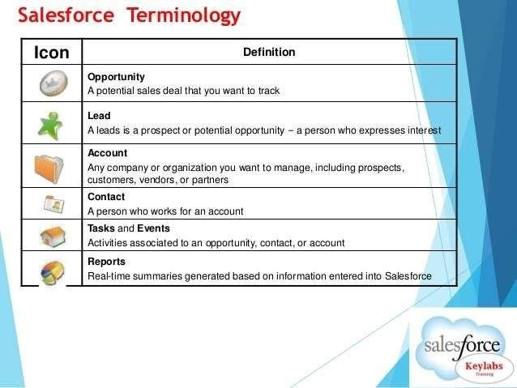
Points To Remember

Slide 6
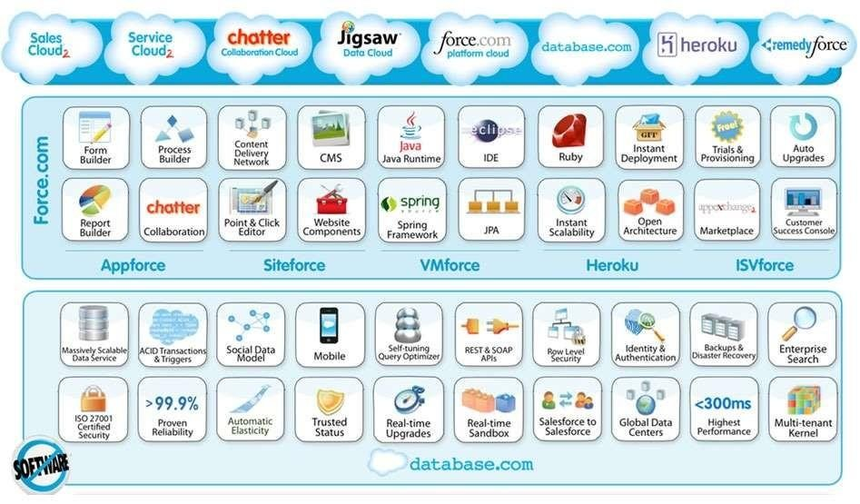
Clouds and Platforms

Slide 7
Different sets of Clouds in Salesforce
Salesforce is divided into different sets of tools referred as “clouds”:
Sales Cloud
Service Cloud
Marketing Cloud
Community Cloud
Wave Analytics
Apps and Programs
IOT Cloud

Slide 8
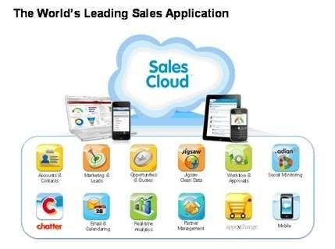
Sales Cloud
Sales Cloud helps to sell products and Services, manage connection with customer, and close more deals. Sales Cloud include Chatter, Social Contact, Marketing and Leads, Data.com, Opportunities and quotes, Approval and Work process, Files and Libraries, Analytics and Forecasting, Partner Management, AppExchange, Email and calendaring

Slide 9
Features of Sales Cloud
Contact Management
Opportunity Management
SalesforceIQ Inbox
Salesforce®Engage
Sales Collaboration
Lead Management
Marketing Automation
Sales Data
Partner Management
Lightning Voice
Mobile App
Workflow and Approvals
Inside Sales Console
Email Integration
Flies Sync and Share
Reports & Dashboards
Sales Forecasting
Territory Management
Sales Wave Analytics

Slide 10
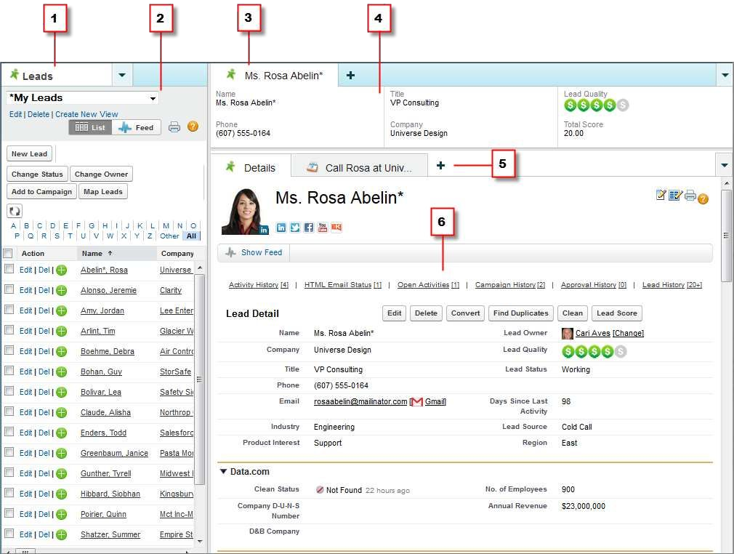

Slide 11

Benefits Using Salesforce Sales Console:
Easily spot important fields on records.
See records and their related items as tabs on one screen.
Find helpful information through quick access to
sales intelligence.
Quickly jot notes or log interactions for each record.
Manage calls using a SoftPhone without leaving
critical data behind.

Slide 12
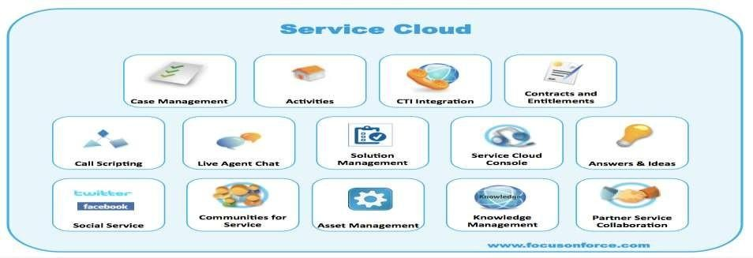
Service Cloud
Service cloud increase agent productivity, reduces service costs, and gain better visibility into Service Organization. It includes Customer Portal, Live Agent, Contract and entitlement

Slide 13
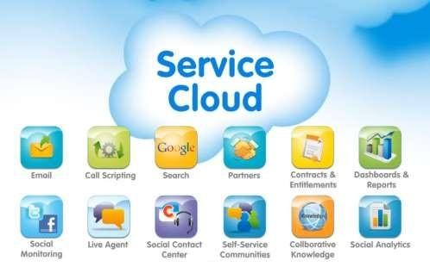
Features of Service Cloud
Lightning Console
Live Agent
Communities
Knowledge
Snap-ins
Service Wave Analytics
Field Service Lightning
Omni Routing
Social Customer Service. etc

Slide 14

SalesforceIQ CRM
SalesforceIQ can be set up in minutes, so you can put Relationship Intelligence technology to work for you and start choosing more deals.
The definition of CRM is customer relationship management. CRM
can help you:
Increase leads
Close more deals, faster
Drive customer loyalty and satisfaction

Slide 15
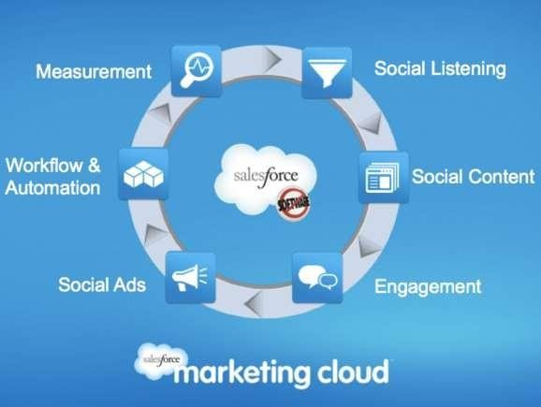
Marketing Cloud
Marketing Cloud is the platform for personalized customer journeys
— on every channel.

Slide 16

Different Studios of Marketing Cloud
Email Studio
Mobile Studio
Social Studio
Web Studio
Advertising Studio

Slide 17
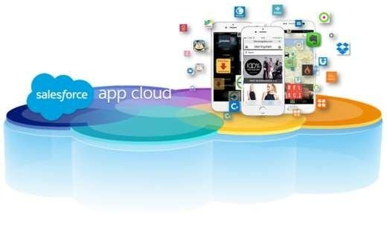
App Cloud

Slide 18
Use of App Cloud
Create richer, deeper customer experiences.
Mobile apps to go.
There's an app for every department.
Connect anything. Integrate everything.

Slide 19



