Slide 1


KIET Group of Institutions, Delhi-NCR,
Ghaziabad Department of Computer Applications
(An ISO - 9001: 2015 Certified & ‘A+’ Grade accredited Institution by NAAC)
PRESENTATION ON <<FIREWALL>>
SUBMITTED BY:
UNIVERSITY ROLL NO.: 1900290140012 NAME : BABLI PANDEY SEMESTER :-6
SECTION :- A
DATE:- 26-02-2022

Slide 2
Content
• Introduction
• Architecture and Types of Firewall
• Applications of Firewall
• Software Firewall vs Hardware Firewall • Conclusion

Slide 3
Introduction
• The Internet has made large amount of information available to the average computer user at home, in business and education.
• A Firewall monitors the incoming and /or outgoing traffic
and decides whether to block a particular packet based on some set of rules
• Therefore, security of network is the main criteria here and firewalls provide this security.

Slide 4
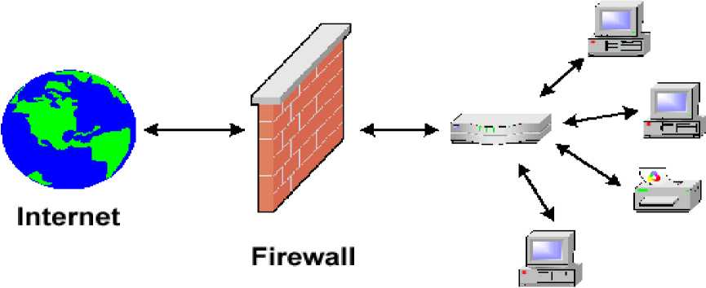
What is a Firewall?
• A Firewall is simply a program or hardware device that filters the information coming through the internet connection into your private network or computer system.
Home or
Business
Network

Slide 5
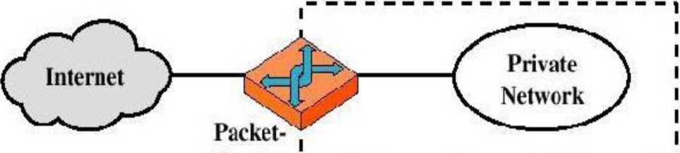
Architecture and Types of firewalls
• Packet-filtering Router
Security Perimeter
filtering *-router

Slide 6
Packet-filtering Router
• Applies a set of rules to each incoming IP packet and then forwards or discards the packet
• Filter packets going in both directions
• The packet filter is typically set up as a list of rules based on matches to fields in the IP or TCP header
• Two default policies (discard or forward)

Slide 7
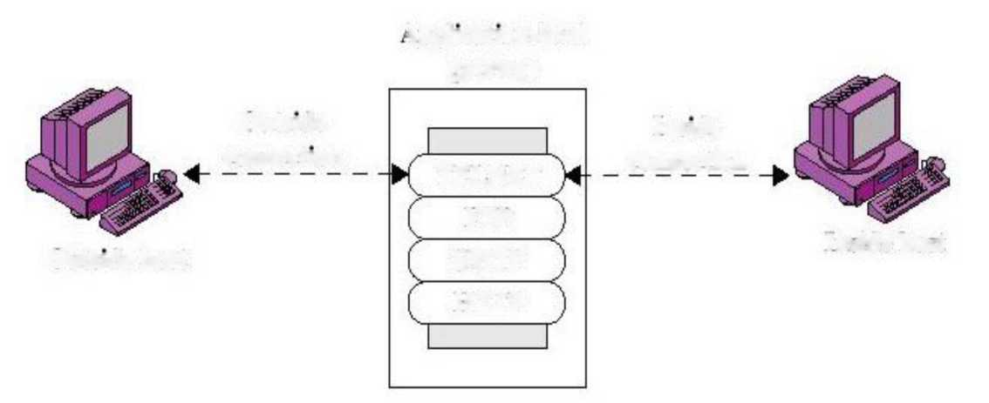
Types of firewalls...
• Application-level Gateway
Vpplication-level
gateway
Outside
Inside
connection
connection
TELNET
FTP
Outside host
SMTP
Inside host
HTTP
Application-level Gateway
• Also called proxy server

Slide 8
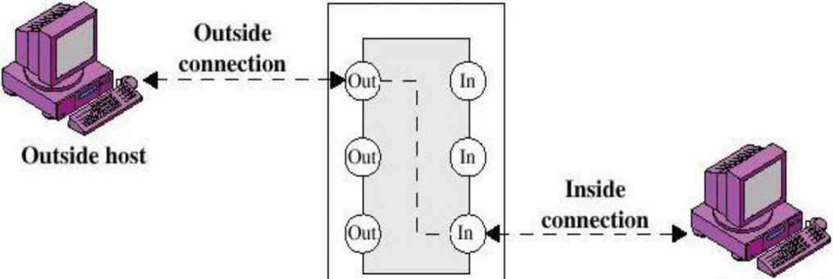
Types of firewalls...
• Circuit-level Gateway
Circuit-level
gateway
Inside host

Slide 9
Circuit-level Gateway
• Stand-alone system or
• Specialized function performed by an Application-level Gateway
• Sets up two TCP connections
• The gateway typically relays TCP segments from one connection to the other without examining the contents
• The security function consists of determining which connections will be allowed

Slide 10
Application of firewall
• It prevents the passage of unwanted content
• The most widely developed application firewall is the web application firewall.
It prevents unauthorized remote access
Helps keep your private information such as online banking credentials or social security number safe

Slide 11
What is the difference between a host-based firewall
and a network-based firewall?
• A host-based firewall is installed on an individual computer to protect it from activity occurring on its network.
• A network-based firewall is implemented at a specified point in the network path and protects all computers on the “internal” side of the firewall from all computers on the “external” side of the firewall.

Slide 12
Hardware firewall vs Software firewall
• Hardware firewalls are integrated into the router that sits between a computer and the Internet.
• Software firewalls are installed on individual servers. They intercept each connection request and then determine whether the request is valid or not.

Slide 13
Conclusion
• One of the best things about a firewall from a security standpoint is that it stops anyone on the outside from logging onto a computer in your private network.
• While this is a big deal for businesses, most home networks will probably not be threatened in this manner. Still, putting a firewall in place provides some peace of mind.

Slide 14
Thanks..!!!

