Slide 1


KIET Group of Institutions, Delhi-NCR, Ghaziabad Department of Computer Applications (An ISO – 9001: 2015 Certified & ‘A+’ Grade accredited Institution by NAAC)
Colloquium Presentation ON
Java framework called
Spring &
SpringBoot
Presented By:
1900290140006
Amit Kumar
MCA 6A
09.04.2022

Slide 2


Amit Kumar
Trainee at Capgemini
Technology: JEE with DevOps and Cloud(GCP)
Duration: 14.02.2022 to 10.05.2022
Current learnings:
Java
JPA
Spring
SpringBoot
PostgreSQL
Gradle

Slide 3
Java
Core java
Oops concept
Encapsulation , polymorphism, abstraction , interface
Collection
ArrayList , LinkedList , HashMap .
Exception handling

Slide 4
JPA(Java Persistance API)
It is a Java specification that gives some functionality and standard to ORM tools. It is used to examine, control, and persist data between Java objects and relational databases
Sql database are not object oriented for that we require an ORM(Object Relational Mapping)
ORM convert object to relational & relational to object
JPA perform CRUD operations

Slide 5
Spring
Spring framework is an open source Java platform that provides comprehensive infrastructure support for developing robust Java applications very easily and very rapidly.
Loosly Coupled
Dependency injection
Set the dependency itself by
@Configuration
@ComponentScan
@EnableAutoConfiguration

Slide 6
SpringBoot
Spring Boot is an open source Java-based framework used to create a micro Service.
Micro Service is an architecture that allows the developers to develop and deploy services independently. Each service running has its own process and this achieves the lightweight model to support business applications
It set the dependency By Itself like spring we have 3 annotations it do that all in one annotation
@Configuration
@SpringBootApplication
@ComponentScan
@EnableAutoConfiguration

Slide 7
POSTGRESQL
PostgreSQL, also known as Postgres, is a free and open-source relational database management system emphasizing extensibility and SQL compliance. It was originally named POSTGRES.
Latest Version –> 14.2

Slide 8
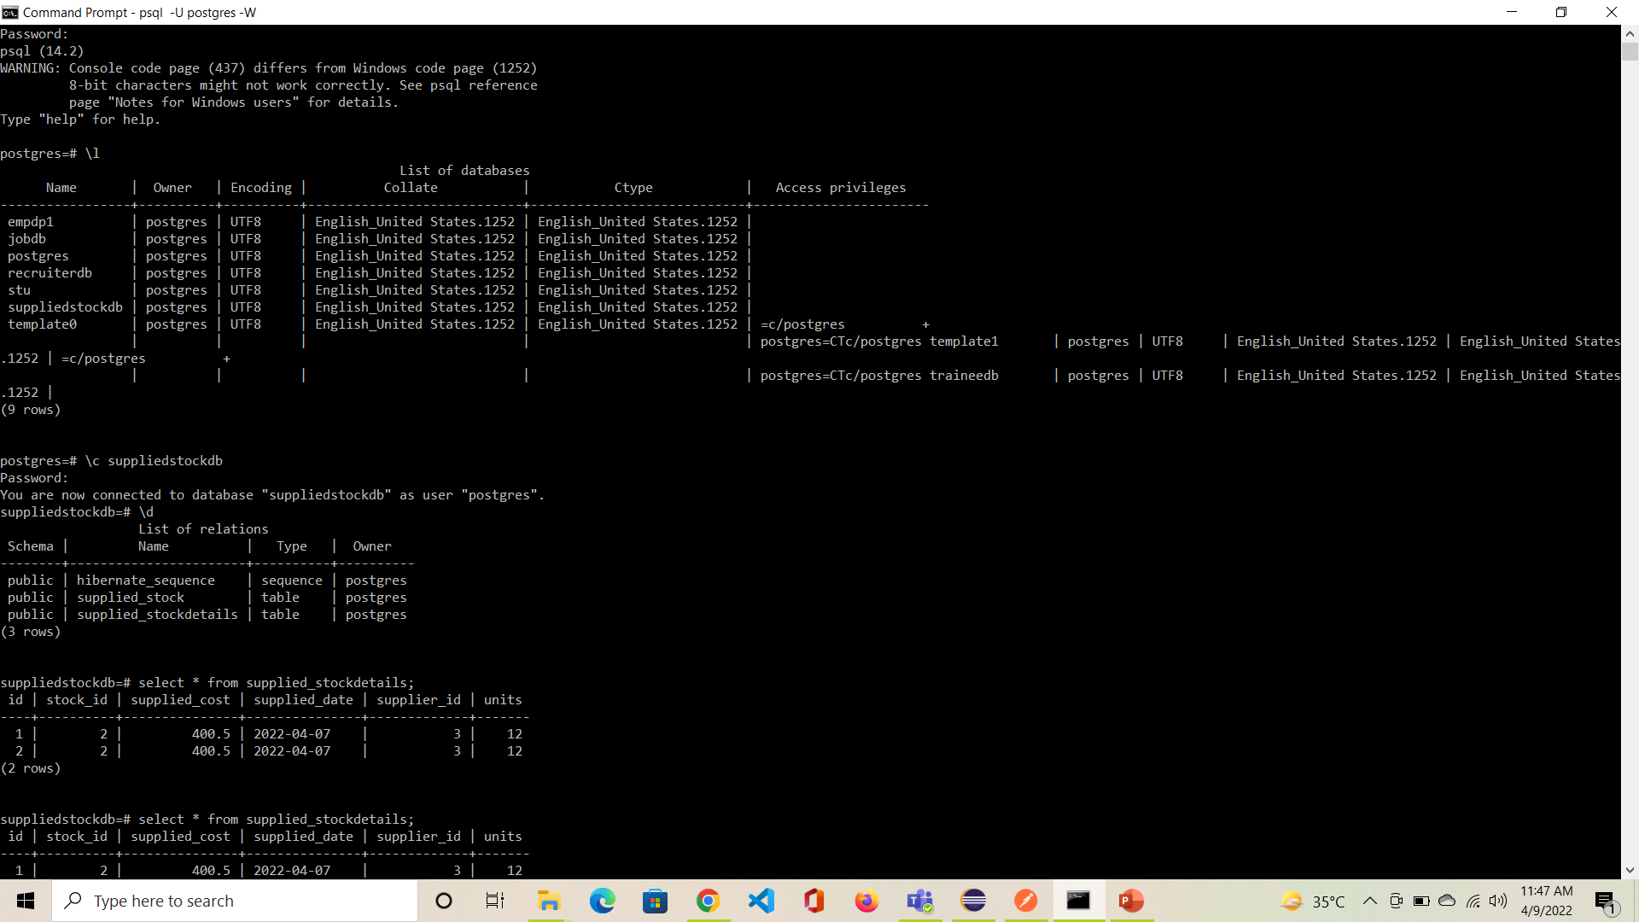

Slide 9
GRADLE
Gradle is a build automation tool for multi-language software development. It controls the development process in the tasks of compilation and packaging to testing, deployment, and publishing.
Supported languages include:
Java, C/C++, and JavaScript.

Slide 10
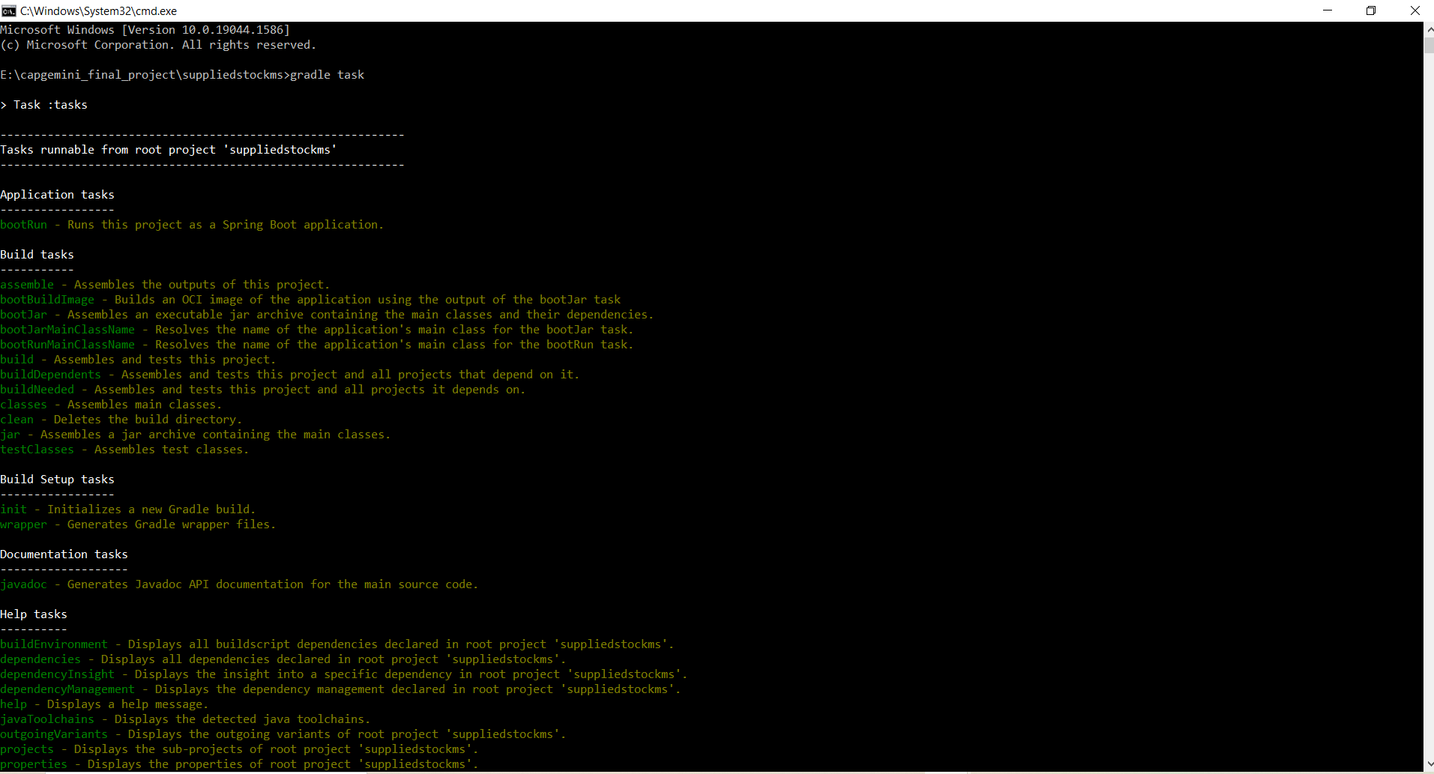

Slide 11
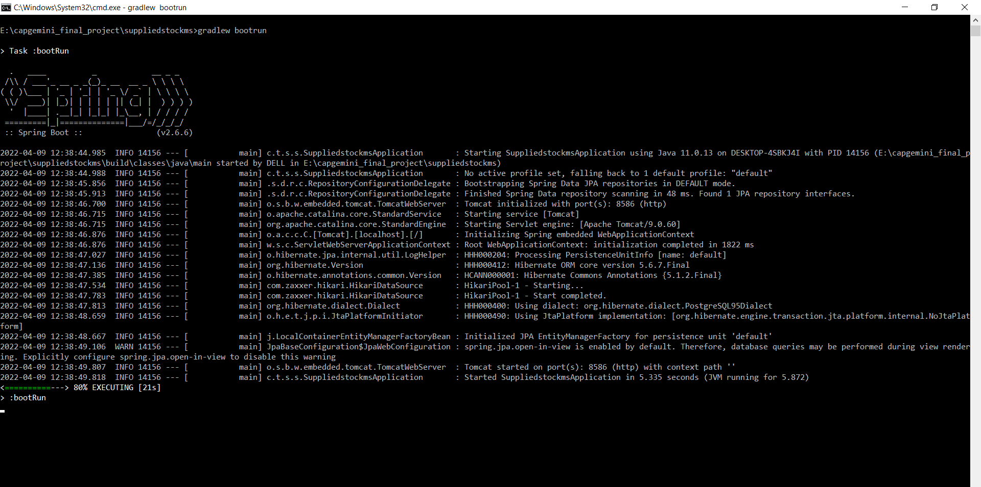

Slide 12
THANK YOU

