Slide 1


SUBMITED TO :- Ms. Vidushi
UNIVERSITY ROLL NO. :- 1900290140025
NAME :-Priyanka Patel
SEMESTER :- 6th
SECTION :- 2021-2022
DATE:- 26/02/2022

Slide 2


Slide 3


Slide 4


Slide 5
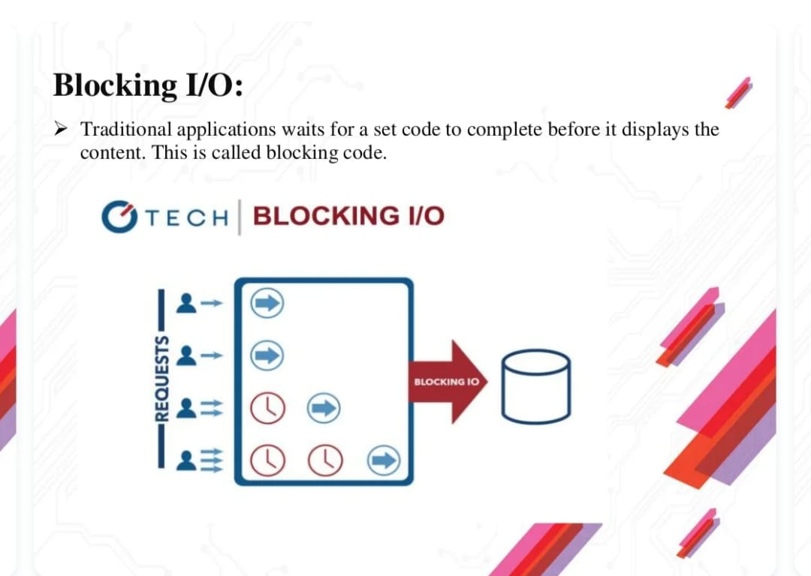

Slide 6
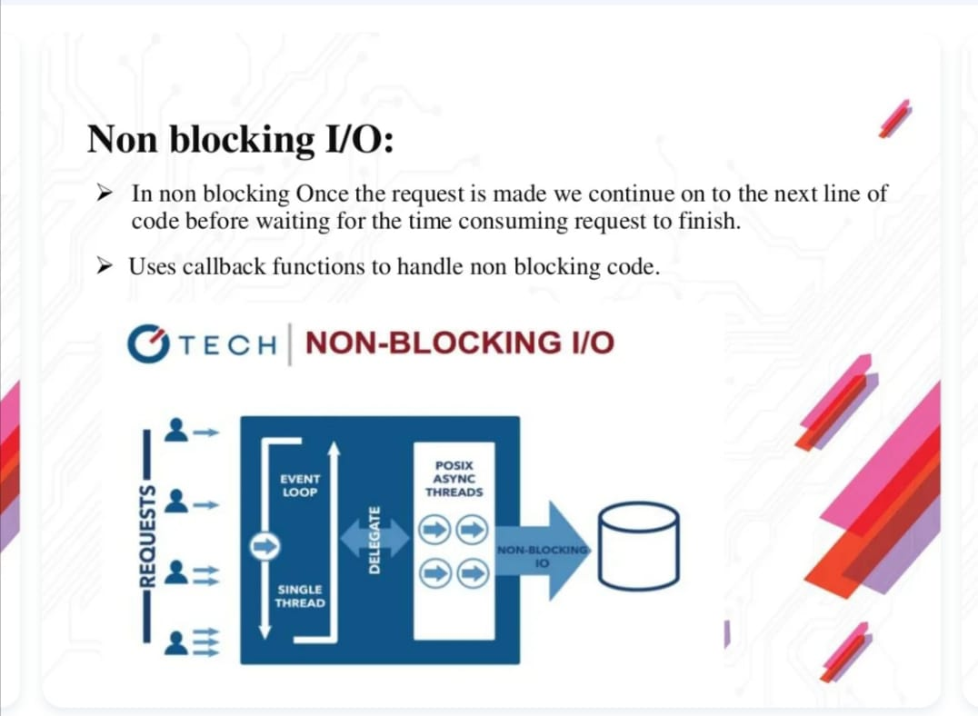

Slide 7
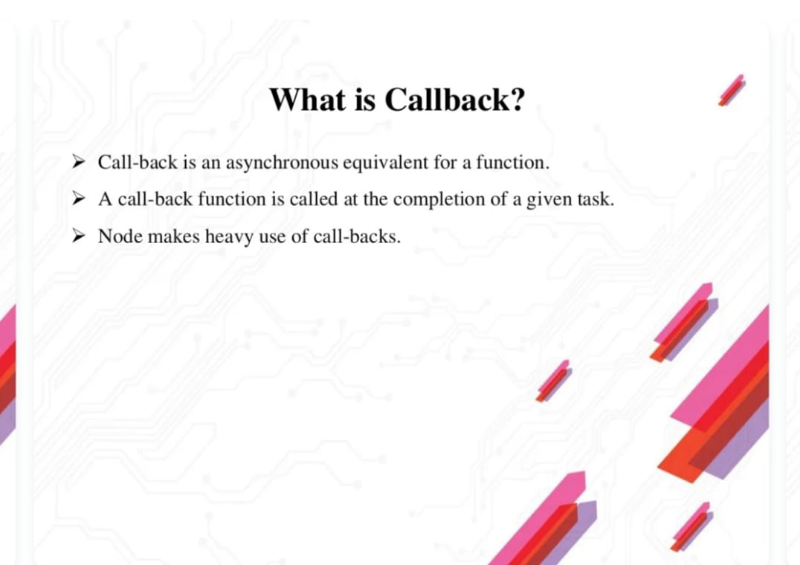

Slide 8
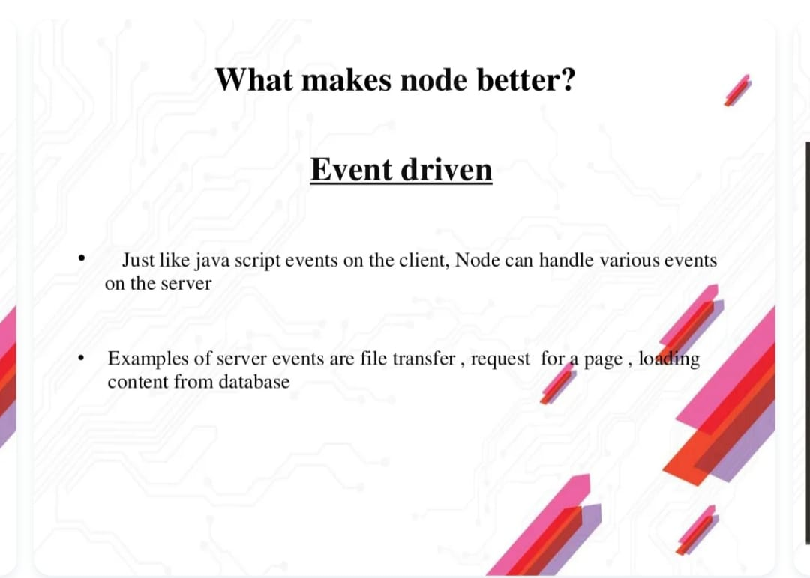

Slide 9
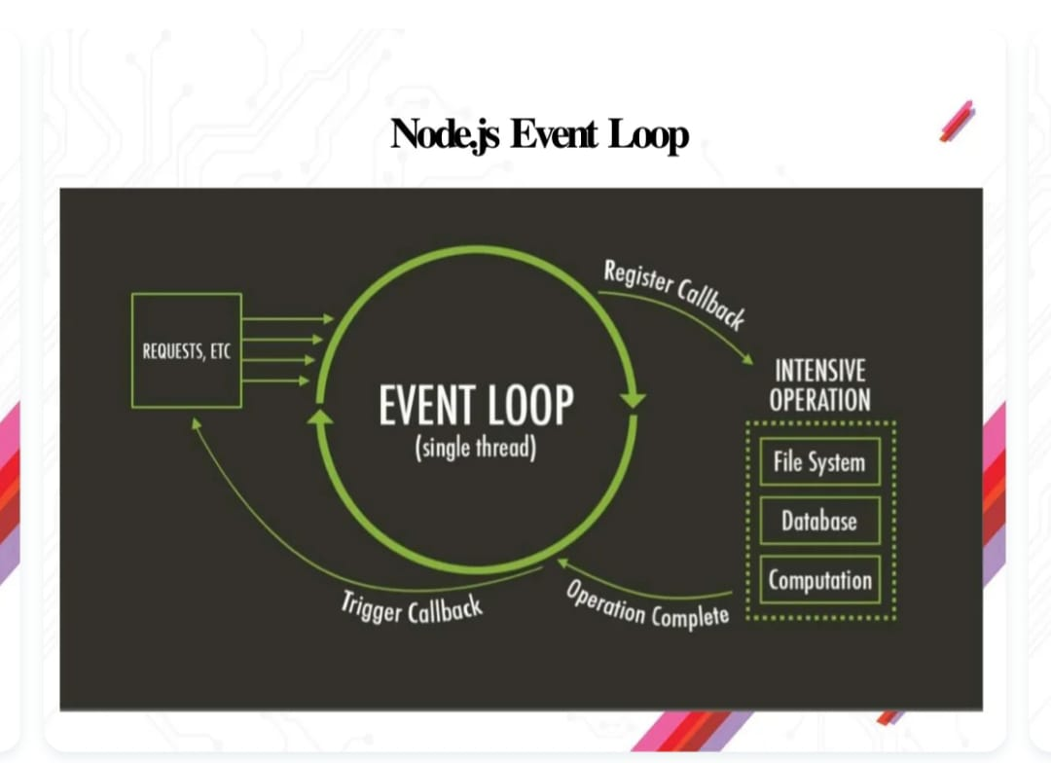

Slide 10


Slide 11
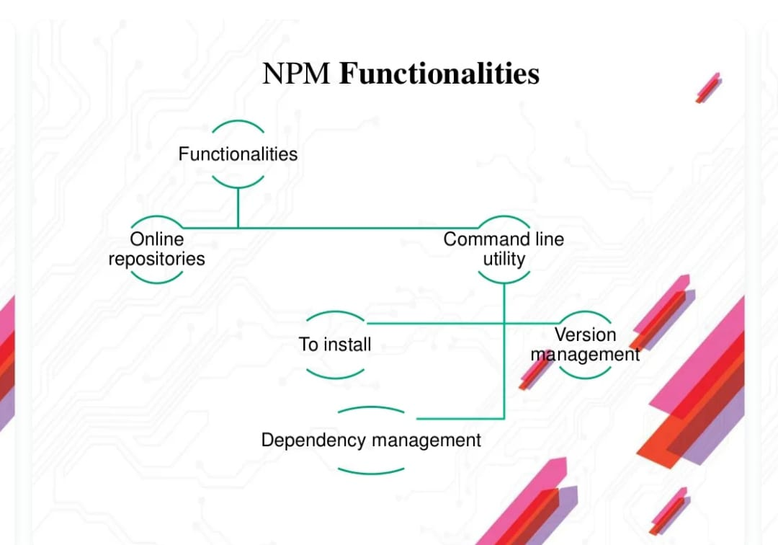

Slide 12
Thank You

