Slide 1
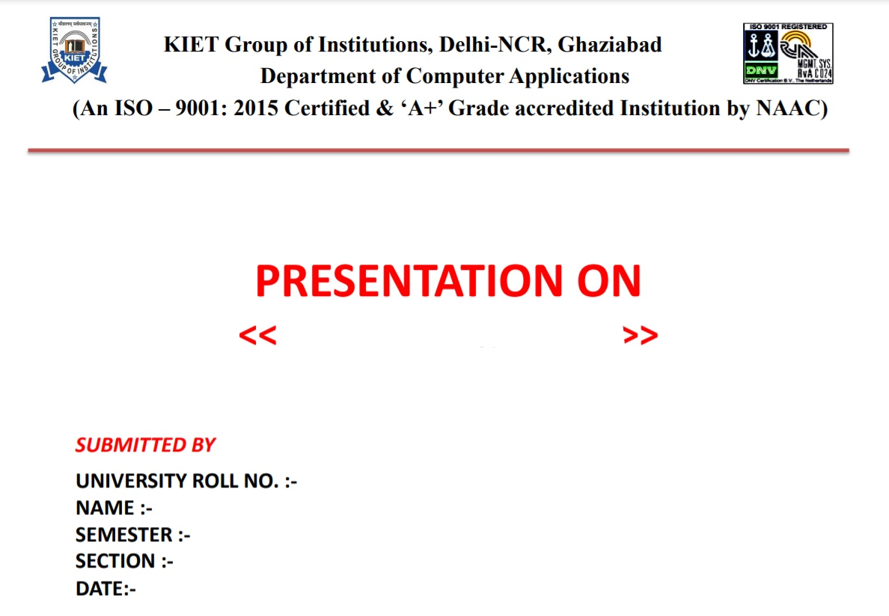
DJANGO FRAMEWORK
1900290140005
AKSHAY GOYAL
6TH
A
23-04-2022

Slide 2
INTRODUCTION TO PYTHON
python is a high level programing language.
Open source and community driven.
Python is designed to be highly readable.
It uses English keywords frequently where as other languages use punctuation.
Dynamic typed.
Source can be compiled or run just in time.
Similer to perl,tcl,ruby.

Slide 3
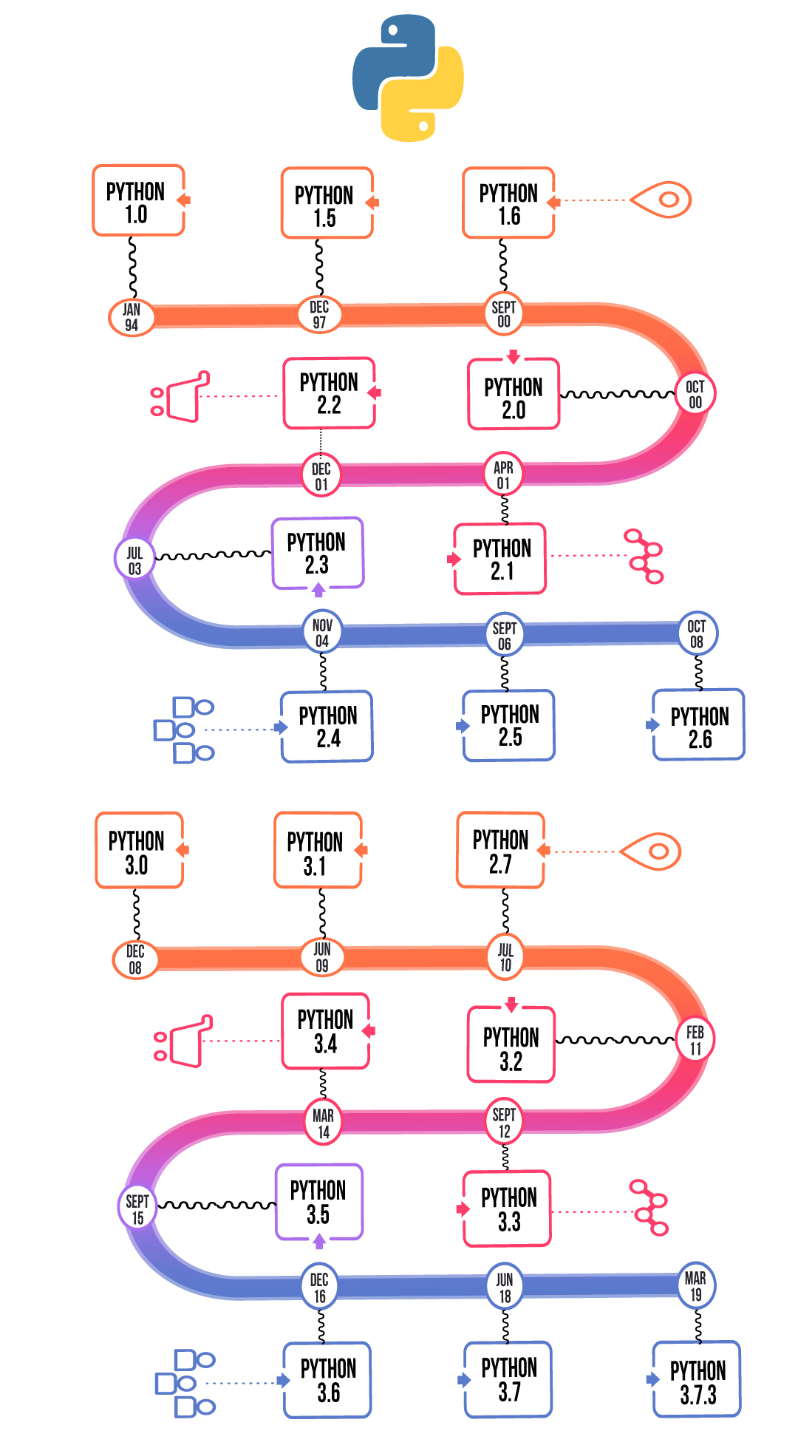
HISTORY
2
Introduction Python is a general-purpose interpreted, interactive, object-oriented, and high-level programming language. It was created by Guido van Rossum during 1985- 1990. Like Perl, Python source code is also available under the GNU General Public License (GPL).
It was mainly developed for emphasis on code readability, and its syntax allows programmers to express concepts in fewer lines of code.

Slide 4
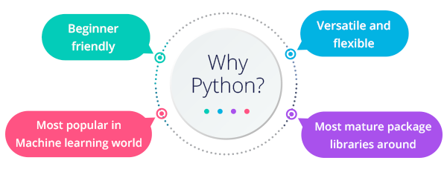
WHY PYTHON ?
Easy-to-learn - Python has few keywords, simple structure, and a clearly defined syntax.
Easy-to-read - Python code is more clearly defined and visible to the eyes.
Easy-to-maintain - Python's source code is fairly easy-to-maintain. A broad standard library - Python's bulk of the library is very portable and cross-platform compatible on UNIX, Windows, and Macintosh.
Interactive Mode - Python has support for an interactive mode which allows interactive testing and debugging of snippets of code.
Portable - Python can run on a wide variety of hardware platforms and has the same interface on all platforms.

Slide 5
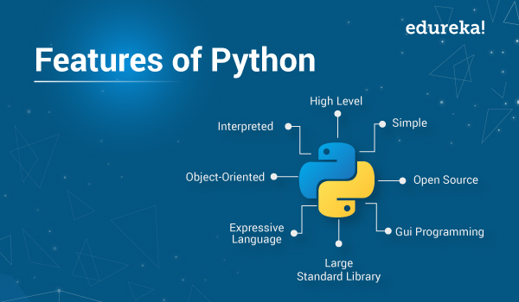
FEATURES OF PYTHON
Python is a dynamic, high level, free open source and interpreted programming language. It supports object-oriented programming as well as procedural oriented programming. In Python, we don’t need to declare the type of variable because it is a dynamically typed language. For example, x = 10 Here, x can be anything such as String, int, etc.
Python is Handy for Web Development Purposes
Python can be used in ML tool
The Language is Extensively used in Data Science

Slide 6
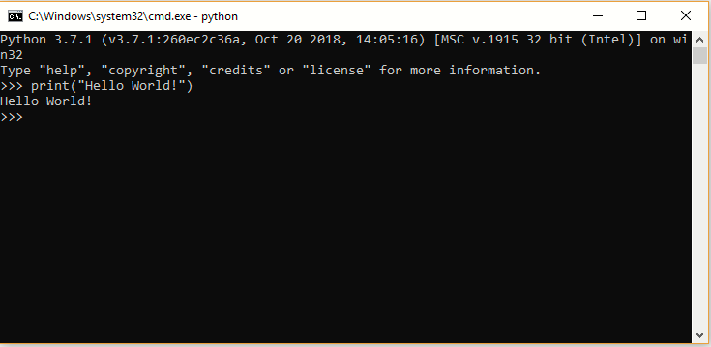
PYTHON - BASIC SYNTAX
Python - Basic Syntax The Python language has many similarities to Perl, C, and Java. However, there are some definite differences between the languages.
First Python Program
Let us execute programs in different modes of programming.
Interactive Mode Programming
Invoking the interpreter without passing a script file as a parameter brings up the following prompt –
Type the following text at the Python prompt and press the Enter –
>>> print("hello world")
And Enter
Output: hello world

Slide 7
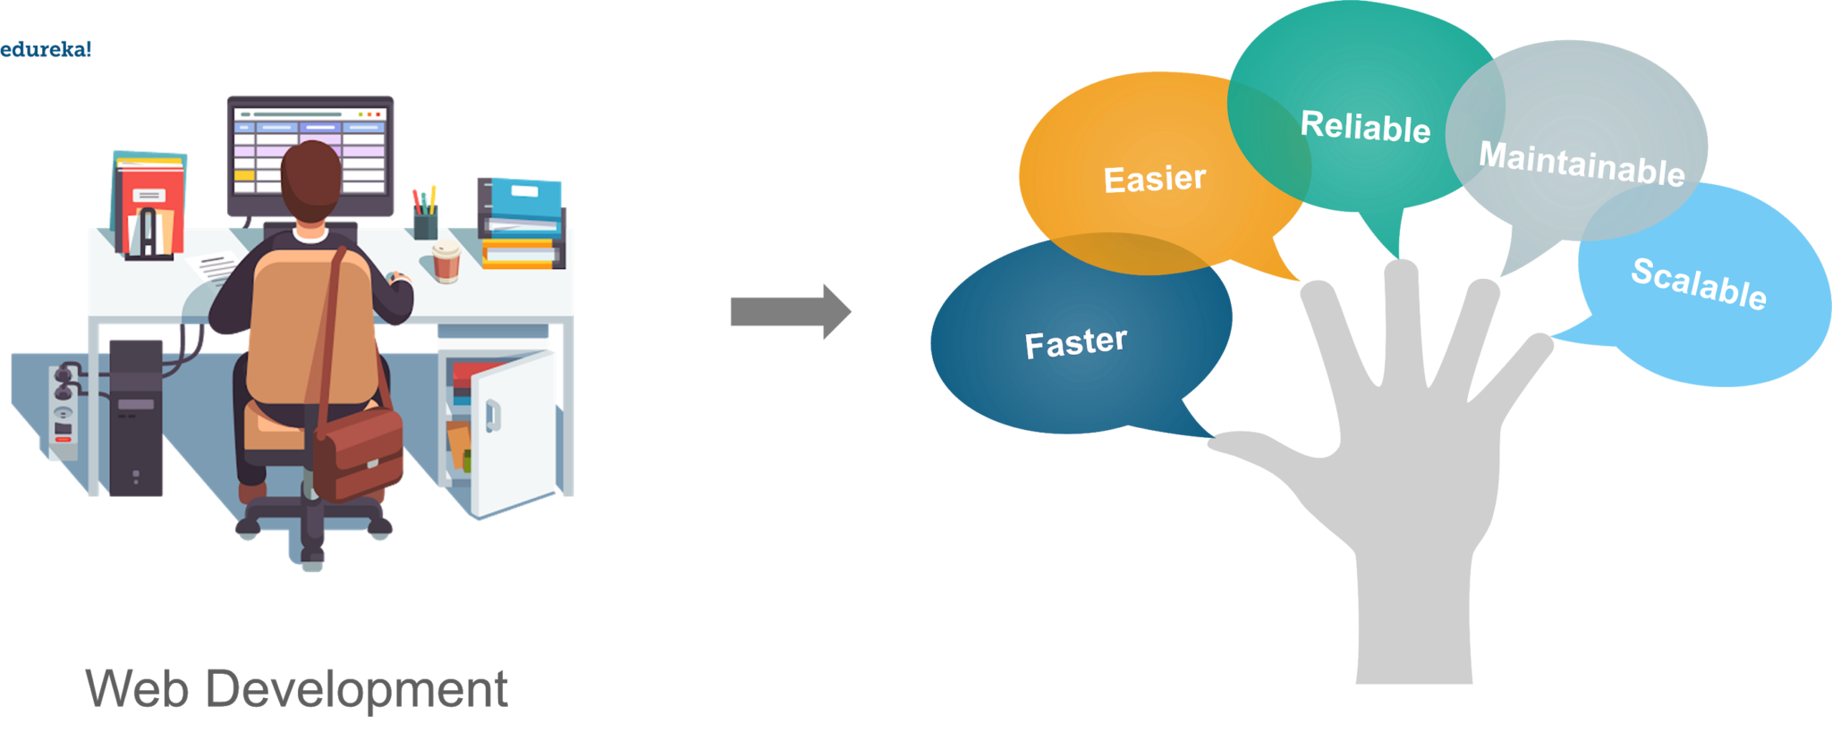
WHAT ARE FRAMEWORKS IN PYTHON ?
A framework is a collection of modules or packages which helps in writing web applications. While working on frameworks in python we don’t have to worry about the low level details such as protocols, sockets or thread management

Slide 8
TOP 5 FRAMEWORKS IN PYTHON ARE :
Depending upon the sort of functionalities and key features they provide to the user, these are top 5 frameworks in python, both micro-frameworks and full-stack frameworks.
Django
Web2Py
Flask
Bottle
Cherry Py

Slide 9
Django framework Introduction:
Django is a high-level Python web framework that enables rapid development of secure and maintainable websites. Built by experienced developers, Django takes care of much of the hassle of web development, so you can focus on writing your app without needing to reinvent the wheel. It is free and open source, has a thriving and active community, great documentation, and many options for free and paid-for support.
Some key features are :
High-level Python Web Framework
Develop fast
Automate the repetitive stuff
Follow best practices

Slide 10
Where did it come from?
Django was initially developed between 2003 and 2005 by a web team who were responsible for creating and maintaining newspaper websites. After creating a number of sites, the team began to factor out and reuse lots of common code and design patterns. This common code evolved into a generic web development framework, which was open-sourced as the "Django" project in July 2005.
Django has continued to grow and improve, from its first milestone release (1.0) in September 2008 through to the recently-released version 4.0 (2022). Each release has added new functionality and bug fixes, ranging from support for new types of databases, template engines, and caching, through to the addition of "generic" view functions and classes (which reduce the amount of code that developers have to write for a number of programming tasks).

Slide 11
Django helps you write software that is
Complete:
Django follows the "Batteries included" philosophy and provides almost everything developers might want to do "out of the box". Because everything you need is part of the one "product", it all works seamlessly together, follows consistent design principles.
Versatile:
Django can be (and has been) used to build almost any type of website — from content management systems and wikis, through to social networks and news sites. It can work with any client-side framework, and can deliver content in almost any format (including HTML, RSS feeds, JSON, XML, etc).

Slide 12
Continue:
Secure:
Django helps developers avoid many common security mistakes by providing a framework that has been engineered to "do the right things" to protect the website automatically. For example, Django provides a secure way to manage user accounts and passwords, avoiding common mistakes like putting session information in cookies where it is vulnerable (instead cookies just contain a key, and the actual data is stored in the database) or directly storing passwords rather than a password hash.
A password hash is a fixed-length value created by sending the password through a cryptographic hash function.
Maintainable:
Django code is written using design principles and patterns that encourage the creation of maintainable and reusable code. In particular, it makes use of the Don't Repeat Yourself (DRY) principle so there is no unnecessary duplication, reducing the amount of code. Django also promotes the grouping of related functionality into reusable "applications“.

Slide 13
What does Django code looks like:
In a traditional data-driven website, a web application waits for HTTP requests from the web browser (or other client). When a request is received the application works out what is needed based on the URL and possibly information in post data or get data.
Depending on what is required it may then read or write information from a database or perform other tasks required to satisfy the request. The application will then return a response to the web browser, often dynamically creating an HTML page for the browser to display by inserting the retrieved data into placeholders in an HTML template.

Slide 14
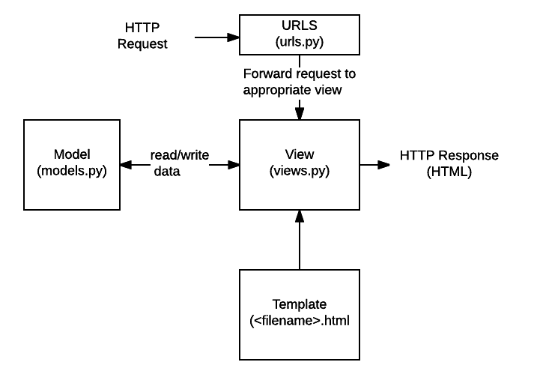
Diagram:

Slide 15
continue:
URLs: While it is possible to process requests from every single URL via a single function, it is much more maintainable to write a separate view function to handle each resource. A URL mapper is used to redirect HTTP requests to the appropriate view based on the request URL. The URL mapper can also match particular patterns of strings or digits that appear in a URL and pass these to a view function as data.
View: A view is a request handler function, which receives HTTP requests and returns HTTP responses. Views access the data needed to satisfy requests via models, and delegate the formatting of the response to templates.
Models: Models are Python objects that define the structure of an application's data, and provide mechanisms to manage (add, modify, delete) and query records in the database.
Templates: A template is a text file defining the structure or layout of a file (such as an HTML page), with placeholders used to represent actual content. A view can dynamically create an HTML page using an HTML template, populating it with data from a model. A template can be used to define the structure of any type of file; it doesn't have to be HTML!

Slide 16
urls:
The urlpattern object is a list of path(). The first argument to both methods is a route (pattern) that will be matched. Path() method uses angle brackets to define parts of a URL that will be captured and passed through to the view function as named arguments.
urlpatterns = [
path('admin/', admin.site.urls),
path('book/<int:id>/', views.book_detail, name='book_detail'),
path('catalog/', include('catalog.urls')),
re_path(r'^([0-9]+)/$', views.best),
]

Slide 17
Handling the request (views.py)
Views are the heart of the web application, receiving HTTP requests from web clients and returning HTTP responses. The example below shows a minimal view function. Index() function which could have been called by our URL mapper in the previous section. Like all view functions it receives httprequest object as a parameter(request).
Views are usually stored in a file called views.py.# filename: views.py (Django view functions)
from django.http import HttpResponse
def index(request):
# Get an HttpRequest - the request parameter
# perform operations using information from the request.
# Return HttpResponse
return HttpResponse('Hello from Django!')

Slide 18
Defining data models (models.py)
Django web applications manage and query data through Python objects referred to as models. Models define the structure of stored data, including the field types and possibly also their maximum size, default values, selection list options, help text for documentation, label text for forms, etc.
The code snippet below shows a very simple Django model for a team object. The team class models.model. It defines the team name and team level as character fields and specifies a maximum number of characters to be stored for each record. It stored in models.py file
# filename: models.py
from django.db import models
class Team(models.Model):
team_name = models.CharField(max_length=40)
TEAM_LEVELS = (
('U09', 'Under 09s'),
('U10', 'Under 10s'),
('U11', 'Under 11s'),
... #list other team levels
)
team_level = models.CharField(max_length=3, choices=TEAM_LEVELS, default='U11')

Slide 19
Querying data (views.py)
The Django model provides a simple query API for searching the associated database. This can match against a number of fields at a time using different criteria (e.g. exact, case-insensitive, greater than, etc. The code snippet shows a view function (resource handler) for displaying all of our U09 teams. list_teams = Team.objects.filter(team_level__exact="U09"). line shows how we can use the model query API to filter for all records where the team_level.
## filename: views.py
from django.shortcuts import render
from .models import Team
def index(request):
list_teams = Team.objects.filter(team_level__exact="U09")
context = {'youngest_teams': list_teams}
return render(request, '/best/index.html', context)

Slide 20
HTML templates:
Template systems allow you to specify the structure of an output document, using placeholders for data that will be filled in when a page is generated. Templates are often used to create HTML, but can also create other types of document. The code snippet shows what the HTML template called by the render() function.
## filename: best/templates/best/index.html
<!DOCTYPE html>
<html lang="en">
<head>
<meta charset="utf-8">
<title>Home page</title>
</head>
<body>
{% if youngest_teams %}
<ul>
{% for team in youngest_teams %}
<li>{{ team.team_name }}</li>
{% endfor %}
</ul>
{% else %}
<p>No teams are available.</p>
{% endif %}
</body>
</html>

Slide 21
Conclusion:
This is all about Django framework. We learned to create structured and functional documentation of Django framework.
Thankyou

