Slide 1


PRESENTATION ON
NestJS
SUBMITTED BY
UNIVERSITY ROLL NO :- 1900290140028
NAME :- ROHIT
SEMESTER :- 6th
SECTION - A
DATE - 19/02/22

Slide 2
Introduction
Nest (NestJS) is a framework for building efficient, scalable Node.js server-side applications. It uses progressive JavaScript, is built with and fully supports TypeScript (yet still enables developers to code in pure JavaScript) and combines elements of OOP (Object Oriented Programming), FP (Functional Programming), and FRP (Functional Reactive Programming).
Under the hood, Nest makes use of robust HTTP Server frameworks like Express (the default) and optionally can be configured to use Fastify as well!

Slide 3
Introduction
Nest provides a level of abstraction above these common Node.js frameworks (Express/Fastify), but also exposes their APIs directly to the developer. This gives developers the freedom to use the myriad of third-party modules which are available for the underlying platform.

Slide 4
Philosophy
In recent years, thanks to Node.js, JavaScript has become the “lingua franca” of the web for both front and backend applications. This has given rise to awesome projects like Angular, React and Vue, which improve developer productivity and enable the creation of fast, testable, and extensible frontend applications. However, while plenty of superb libraries, helpers, and tools exist for Node (and server-side JavaScript), none of them effectively solve the main problem of - Architecture.
Nest provides an out-of-the-box application architecture which allows developers and teams to create highly testable, scalable, loosely coupled, and easily maintainable applications. The architecture is heavily inspired by Angular.

Slide 5

Founder Of NestJS
Kamil Mysliwiec is a software architect truly passionate about web technologies. Creator of NestJS, Co-Founder of Trilon.io, Google Developer Expert in Web Technologies and Angular, international speaker, trainer, consultant, and open source contributor.

Slide 6
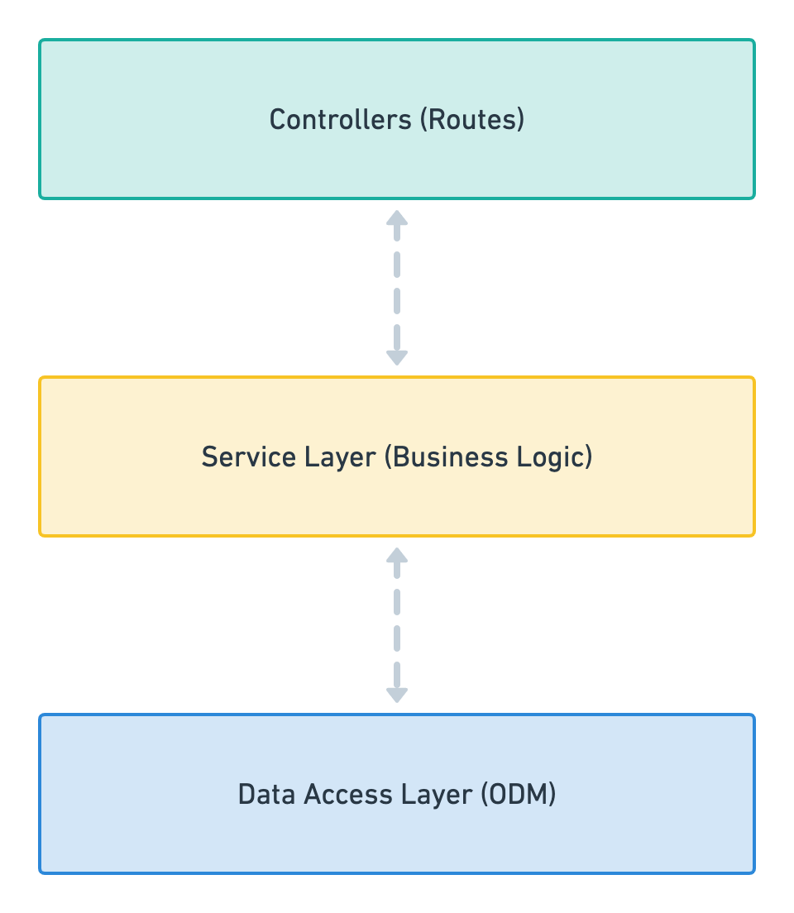
Nest.js — Architectural Pattern
It’s based on three tier architecture
1. Controllers: A controller’s sole purpose is to receive requests for the application and deal with routes.
2. Service Layer: This part of the block should only include business logic. For example, all the CRUD operations and methods to determine how data can be created, stored and updated.
3. Data Access Layer: This layer takes care and provides logic to access data stored in persistent storage of some kind. For example an ODM like Mongoose.

Slide 7
Why NestJS Awesome
NestJS Boilerplate - Boilerplate with available authentication, typeorm, env configuration and swagger. Everything you need to start making great things. Awesome Nest Boilerplate - Typescript, Postgresql, TypeORM, Swagger for Api documentation, Role based access control, and best application architecture.

Slide 8
Workspaces
Nest has two modes for organizing code:
Standard mode: useful for building individual project-focused applications that have their own dependencies and settings, and don't need to optimize for sharing modules, or optimizing complex builds. This is the default mode.
Monorepo mode: this mode treats code artifacts as part of a lightweight monorepo, and may be more appropriate for teams of developers and/or multi-project environments. It automates parts of the build process to make it easy to create and compose modular components, promotes code reuse, makes integration testing easier, makes it easy to share project-wide artifacts like eslint rules and other configuration policies, and is easier to use than alternatives like github submodules.

Slide 9
Performance
Performance#
Using request-scoped providers will have an impact on application performance. While Nest tries to cache as much metadata as possible, it will still have to create an instance of your class on each request. Hence, it will slow down your average response time and overall benchmarking result. Unless a provider must be request-scoped, it is strongly recommended that you use the default singleton scope.

Slide 10
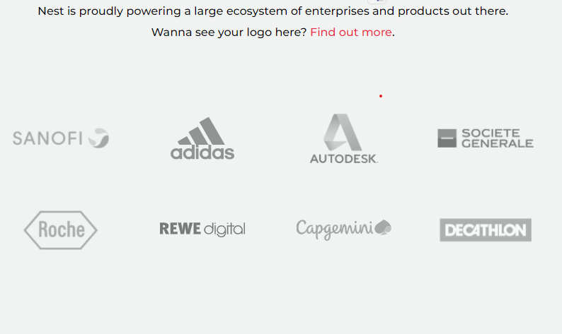
Who is using Nest?

Slide 11
Thank You!!

