Slide 1

PRESENTATION ON
ReactJS(A JavaScript Libraray)
SUBMITTED BY
UNIVERSITY ROLL NO :- 1900290140032
NAME :- SHASHANK MISHRA
SEMESTER :- 6th
SECTION - A
DATE - 26/02/22

Slide 2
Introduction
ReactJS is a declarative, efficient, and flexible JavaScript library for building reusable UI components. It is an open-source, component-based front end library which is responsible only for the view layer of the application.
Developed by Facebook.
React is a view layer library, not a framework like backbone, Angular etc.
You can not use React to build a fully-functional web app

Slide 3

Why was React developed ?
Complexity of two-way data binding
Bad UX from using "cascading updates" of DOM tree
A lot of data on a page changing over time
Complexity of Facebook's UI architecture
Shift from MVC mentality

Slide 4
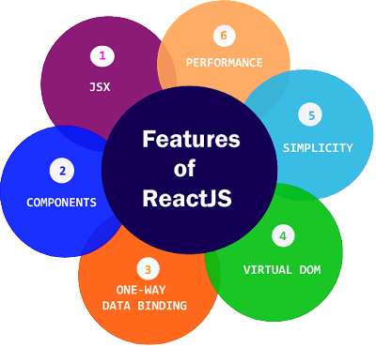
React Features
JSX
Component
One-way Data Binding
Virtual DOM
Simplicity
Performance

Slide 5
Advantages of ReactJs
The HTML-like syntax for which allows templating, and highly detailed documentation.
Developers can spend more time writing modern JavaScript, and less time worrying about the framework-specific code.
Enhance support for server-side rendering, making it a robust framework for content-focused applications.
Migrating between versions is in React.
Facebook offers “codemod” feature to automate much of the process.
Skills learned in React can be applied to Native development.

Slide 6




Who uses React?

Slide 7
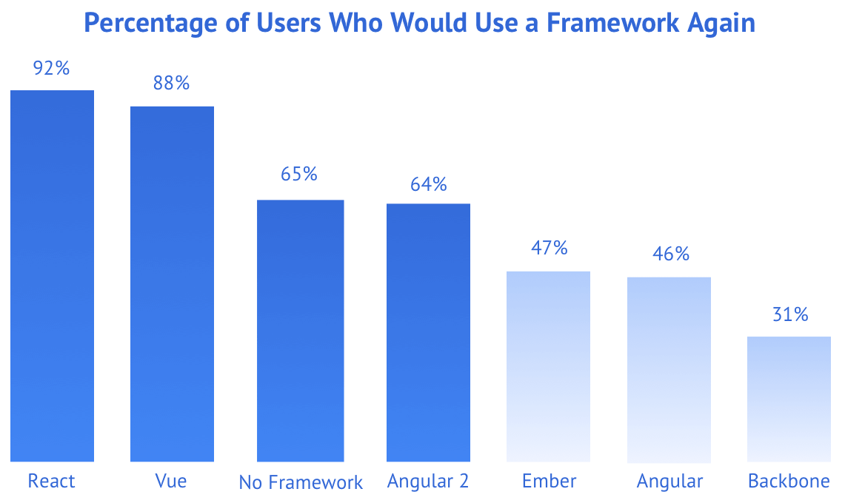
Comparison of ReactJS to others

Slide 8
Why should I use React ?
Easy to read and understand views
Concept of components is the future of web development
If your page uses a lot of fast updating data or real time data - React is the way to go
Once you and your team is over the React's learning curve, developing your app will become a lot faster

Slide 9
Example
import React,{ Component } from 'react';
class App extends Component {
render() {
return (
<div>
<h1>Hello, Learner. Welcome to ReactJs World.</h1>
</div>

Slide 10
Example
);
}
}
export default App;
Output:
Hello, Learner. Welcome to ReactJs World.

Slide 11
Conclusion
React JS allows complete flexibility to the developer. You can use it for creating SPAs, mobile or hybrid apps, even a TV application. You can add as many external libraries and tools as required and build a massive, complicated web application. ReactJS will ensure your app performance is optimized.

Slide 12
Thank You!!

