Slide 1
Presentation on
BLOCKCHAIN
Submitted by
Name: Devendra Rai
University Roll No.: 1900290140013
Semester: 6th
Section: A
Date: 02-April-2022

Slide 2
INTRODUCTION
Blockchain is a decentralized ledger of all transactions across a peer-to-peer network. Using this technology , participants can perform transactions without the need for a central certifying authority.
Potential applications include fund transfers, settling trades, voting and many more.
Business networks benefit from connectivity- Connected customers, suppliers, banks, partners.

Slide 3
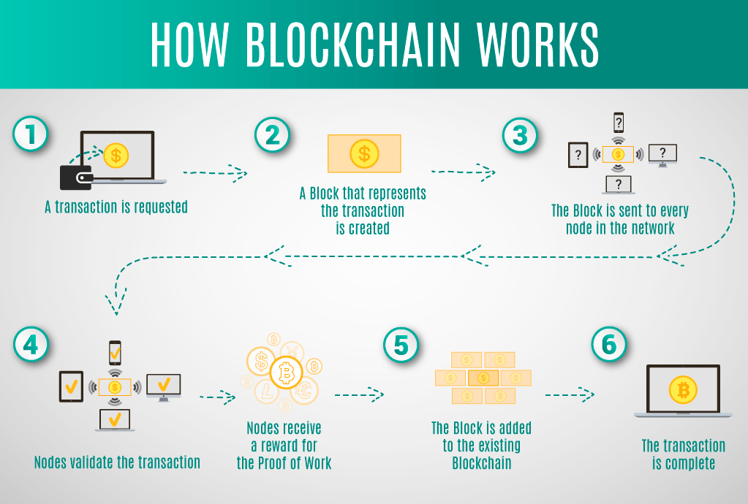

Slide 4
BLOCKCHAIN UNDERPINS BITCOIN
Is unregulated, censorship-resistant shadow currency.
Blockchain ensures Cash Like coin passing
- Unique
- Immutable
- Final
Bitcoin is the first blockchain application.

Slide 5
USES OF BLOCKCHAIN
BitPesa
It is a digital foreign exchange and payment platform for frontier markets.
Storj
It is a crypto currency and digital payment system and is also a blockchain based digital storage and
data retrieval method.
Riot Blockchain
Formerly a biotech company called Bioptix, the company rebranded and is now listed on the
NASDAQ exchange under ticker symbol RIOT, making it the first purely Blockchain focused
public US stock.

Slide 6
Golem
Golem is a global, open source, decentralized supercomputer that anyone can access. It is made up
of the combined power of user’s machines, from PCs to entire data centers.
Open Bazaar
It is one of the first marketplace that accepts cryptocurrency for transactions.
Chronicled
The coolest features allow for better supply chain control and management and anti-fraud
opportunities to protect brand integrity around the world.

Slide 7
ADVANTAGES
Transparency
Users or developers have the opportunity to modify it as they see fit. This makes blockchain a
particularly secure technology.
Reduced transaction costs
Blockchain allows peer-to-peer and business-to-business transactions to be completed without the need
for a third party. It means they can actually reduce costs to the user or business over time.
User controlled networks
Rather than having a third party run the show, users and developers are the ones who get to call the
shots.

Slide 8
Continue…
Faster transaction settlements
Blockchain technology is working 24 hours, meaning blockchain based transactions process
considerably more quickly.
Decentralization
Blockchain actually allows individual transactions to have their own proof of validity and the
authorization to enforce those constraints.

Slide 9
APPLICATIONS
Smart contracts
The projects is a decentralized platform that runs smart contracts applications that run exactly as
programmed without any possibility of downtime, censorship, fraud or third party interferences.
Cloud storage
Simply using excess hard drive space, users could store the traditional cloud 300 times over.
Paying Employees
Payments made via Bitcoin can save both money and time for employers and employees.
Electronic voting
Delegated proof of stake (DPOS) is the fastest most efficient most decentralized and most
flexible consensus model available.

Slide 10
CONCLUSION
Blockchain is a shared, replicated ledger.
IBM supports an open standards, open source, open governance Blockchain.
Blockchain can open up business networks by taking out cost, improving efficiencies and increase
accessibility.
Blockchain addresses an exciting and topical set of business challenges, which cross every industry.

Slide 11
THANK YOU

